Slide 1
Figures / Key points
Fig 1/KP1 - ubiquitous super-linear scaling of metabolism across conus
Fig 2/KP2 - while theory predicts a single allometric relationship, in reality the allometry is bi-phasic, the two phases have x relationship with each other, and the breakpoint is potentially related to x/y/z
Fig 3/KP3 - scaling slopes from both phases vary through time/space, potentially related to x/y/z

Slide 2
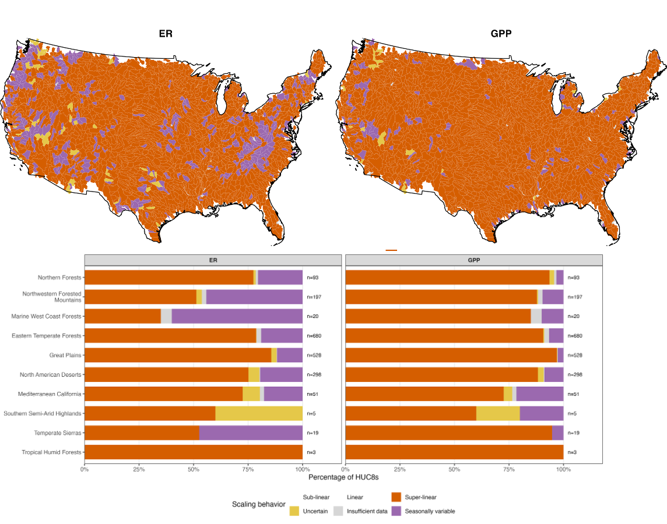
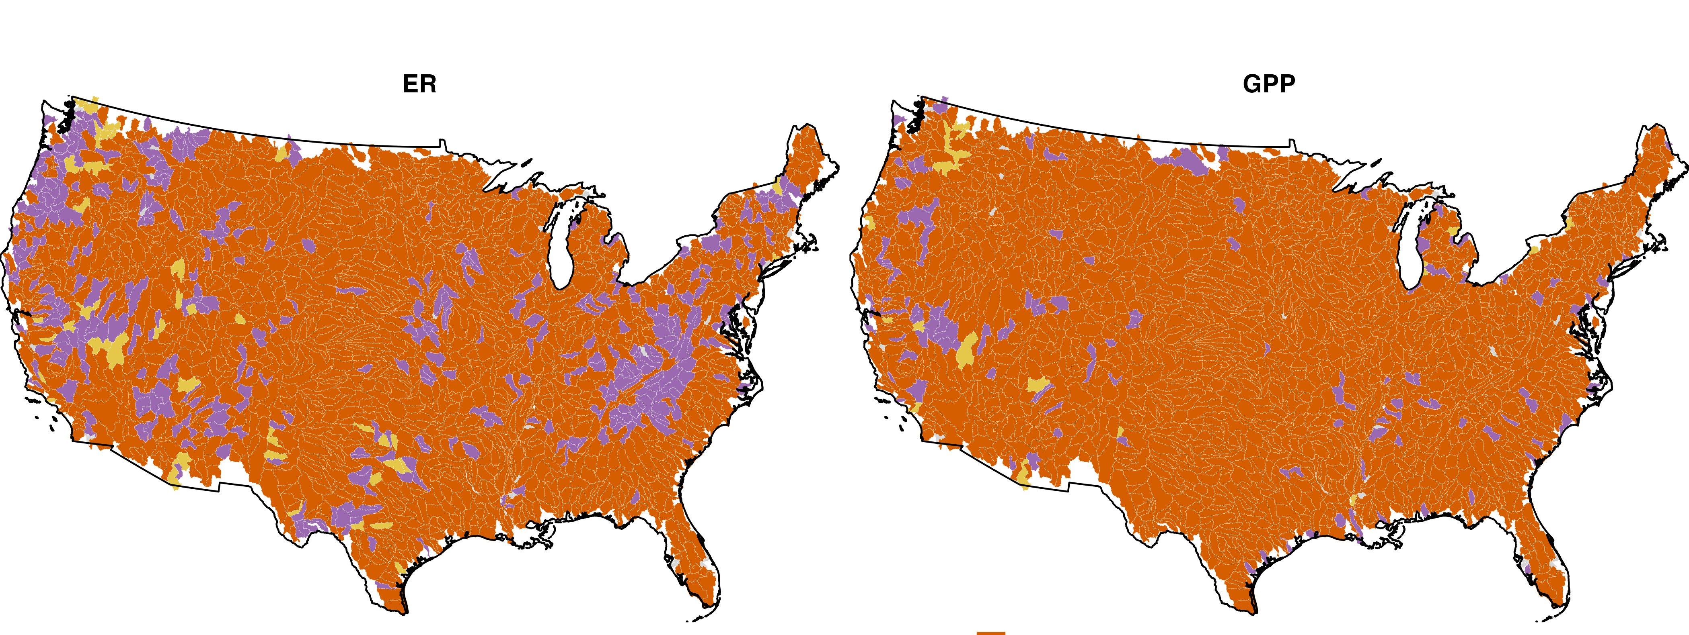
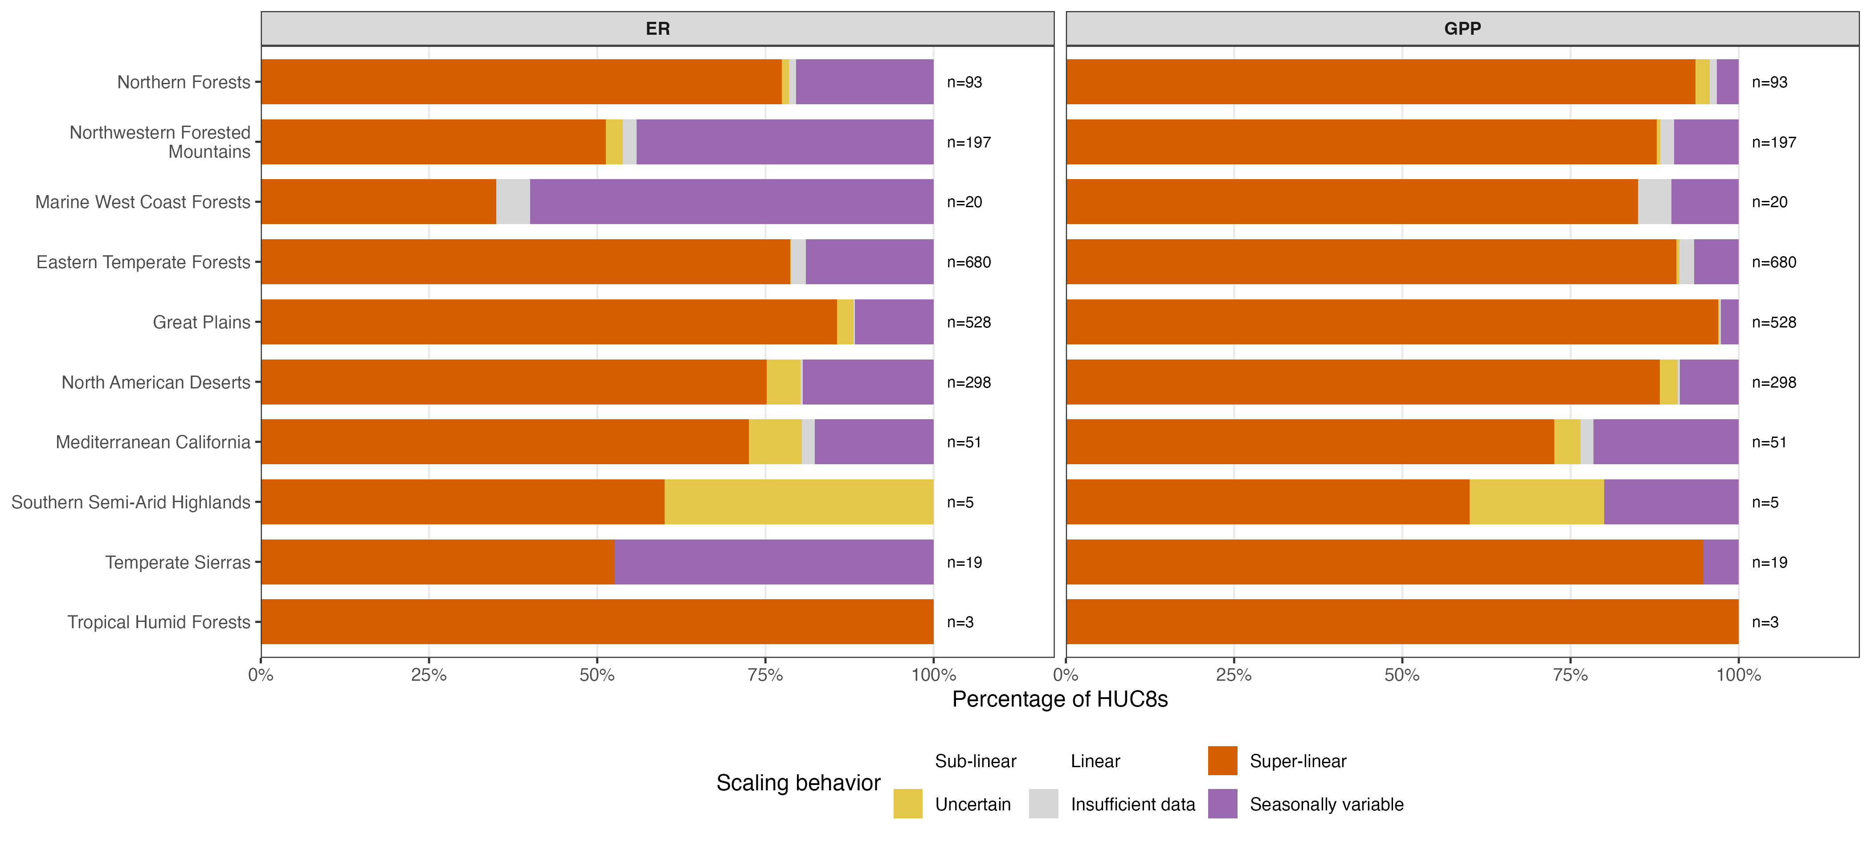
Fig 1

Slide 3
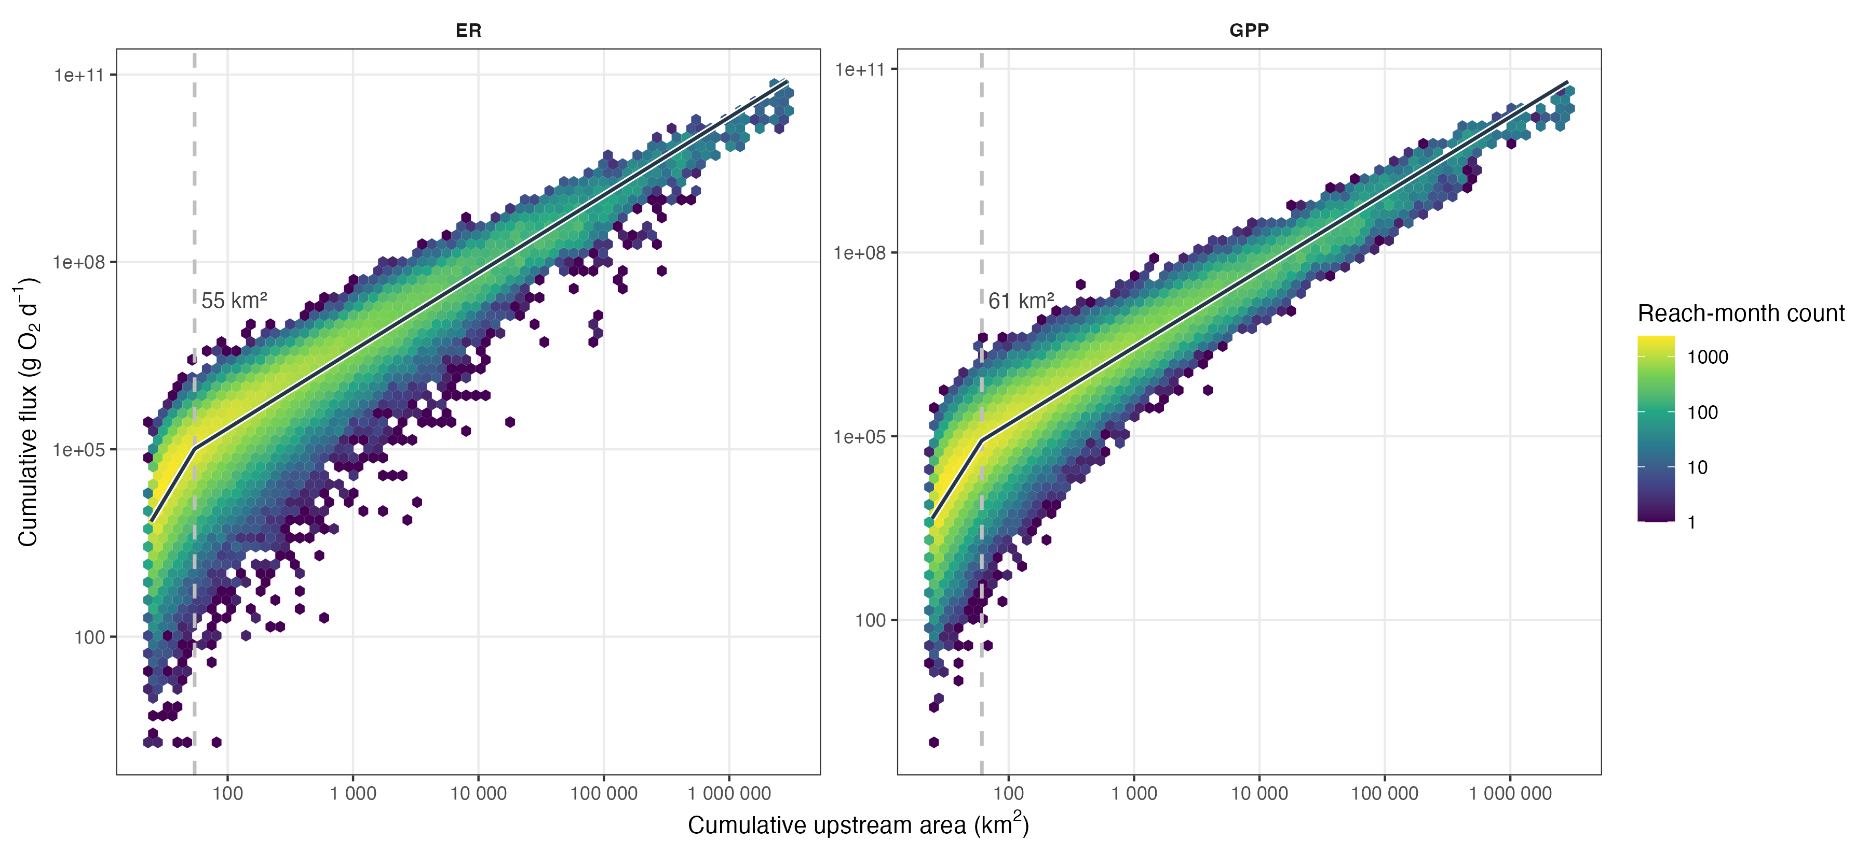
Fig 2

Slide 4
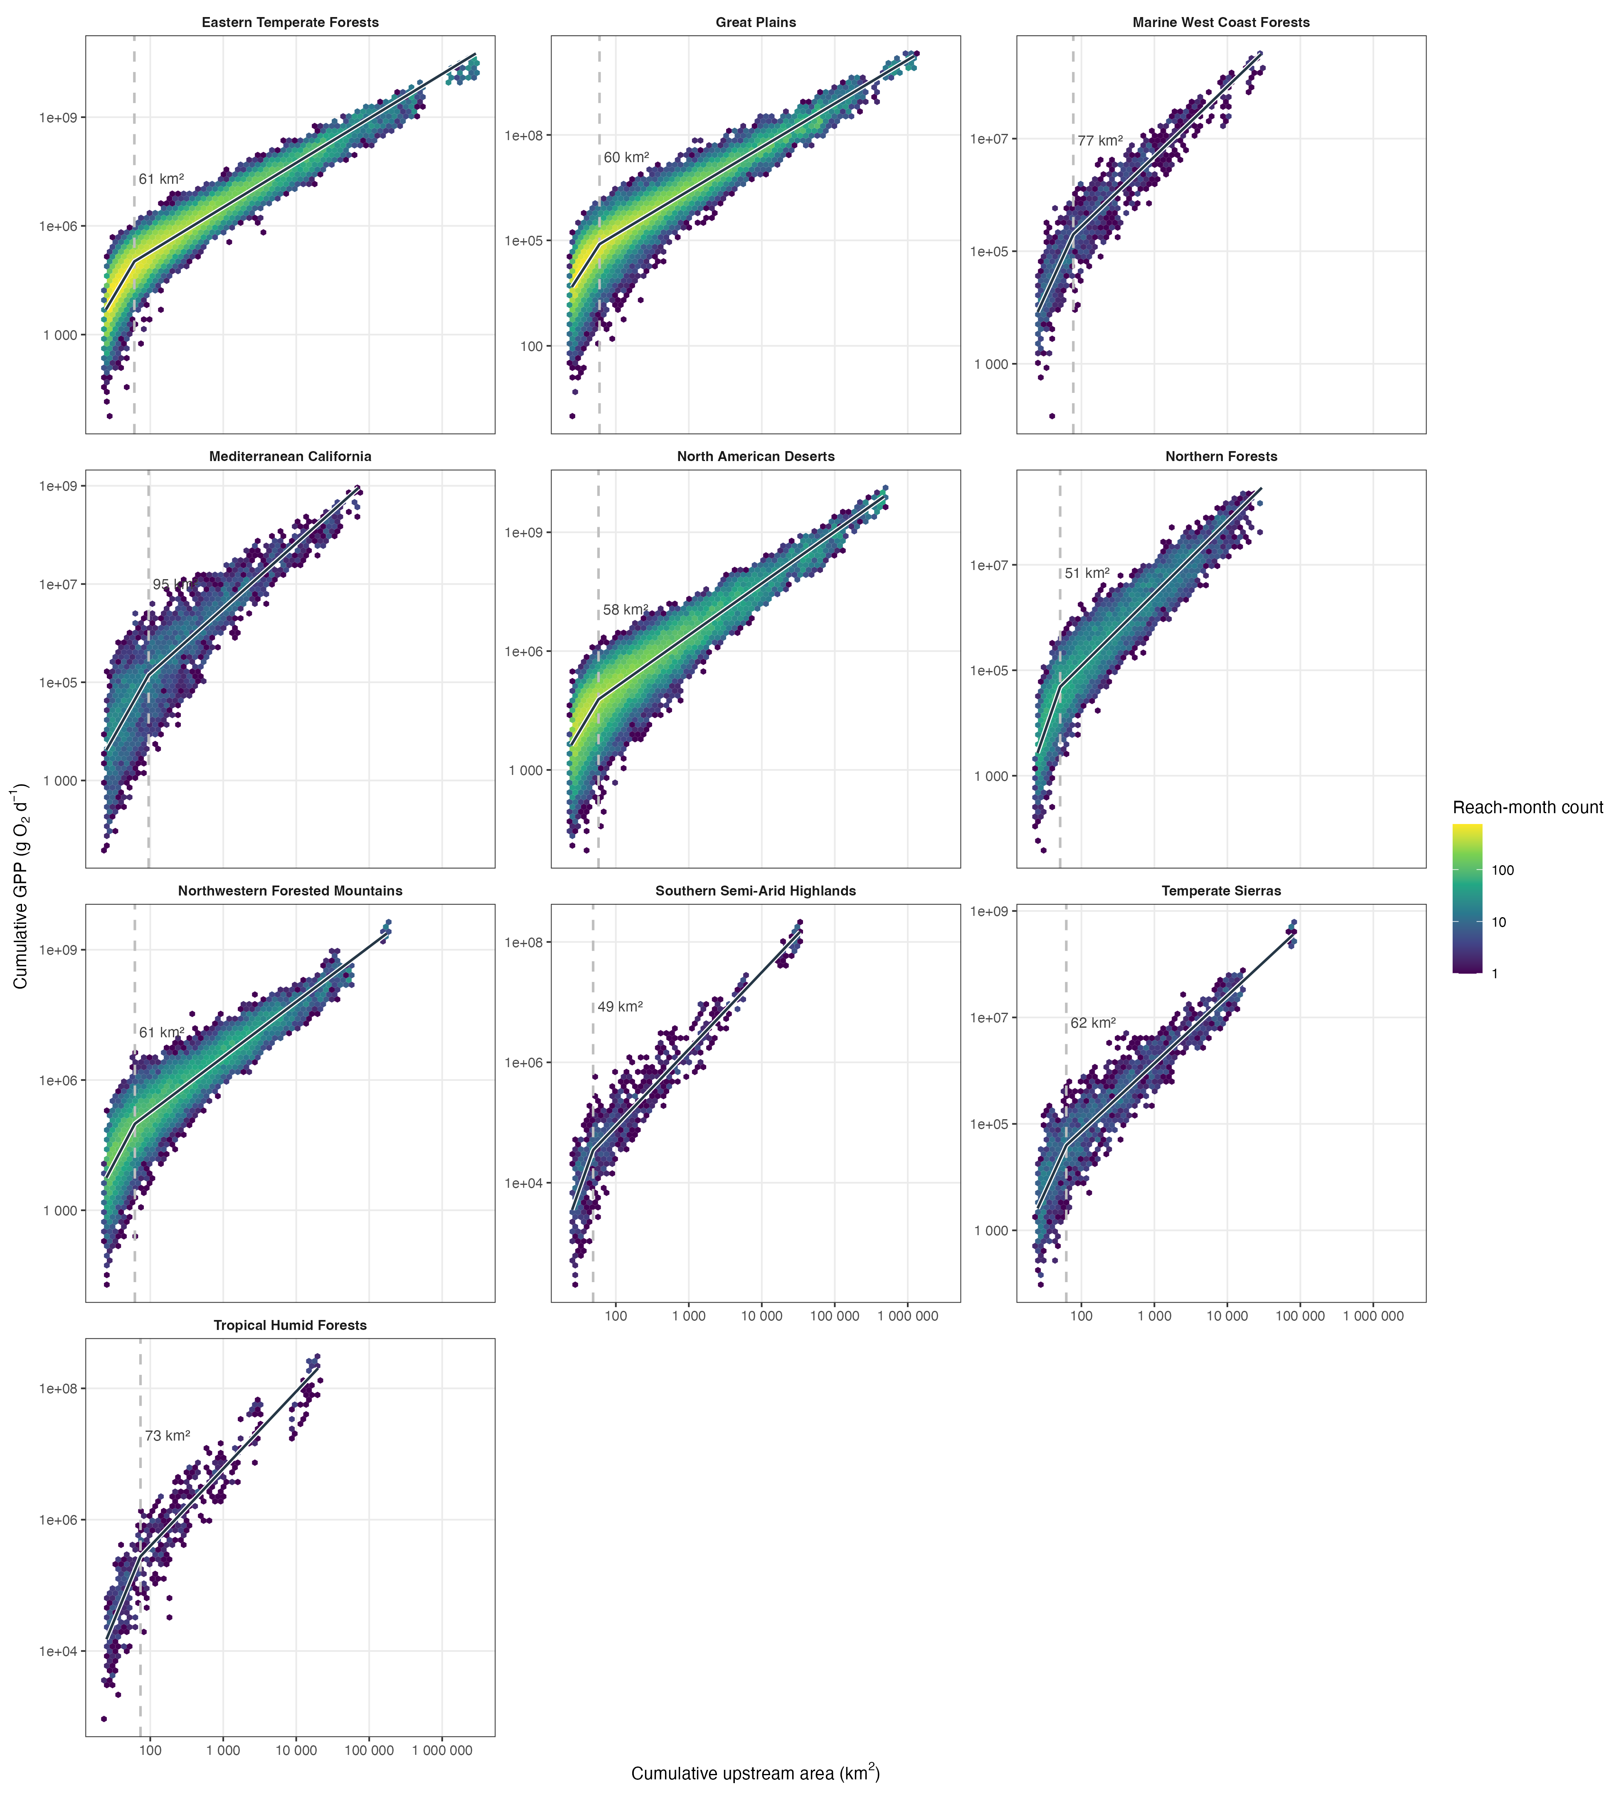
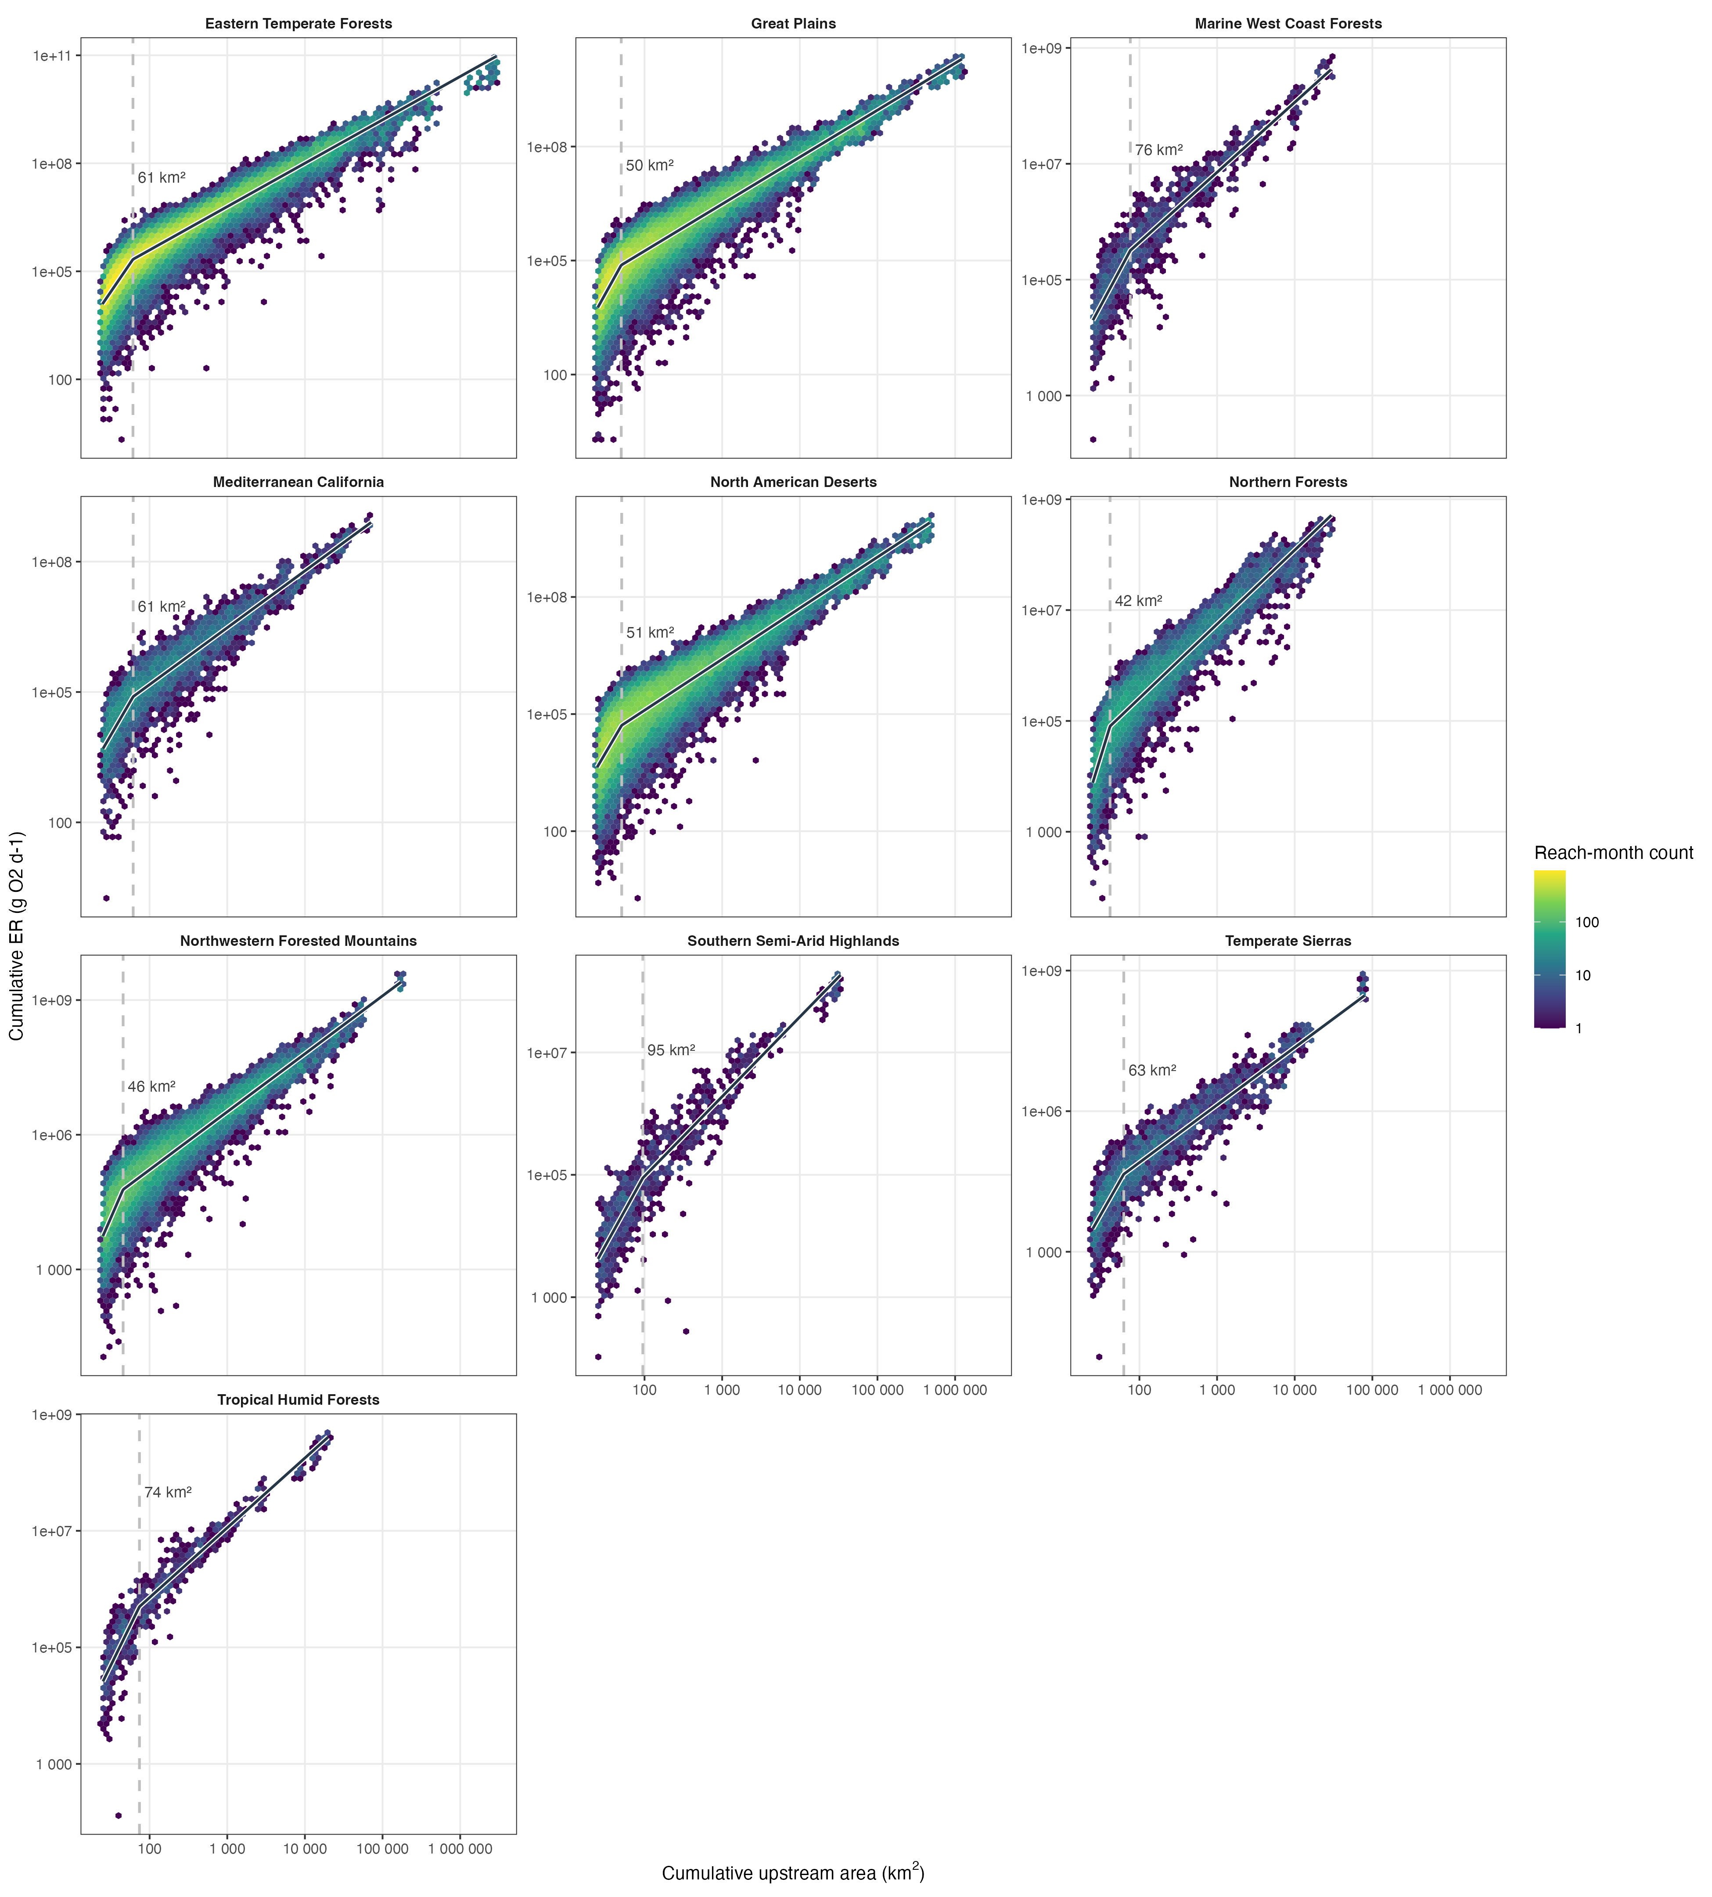

Slide 5
