Slide 1
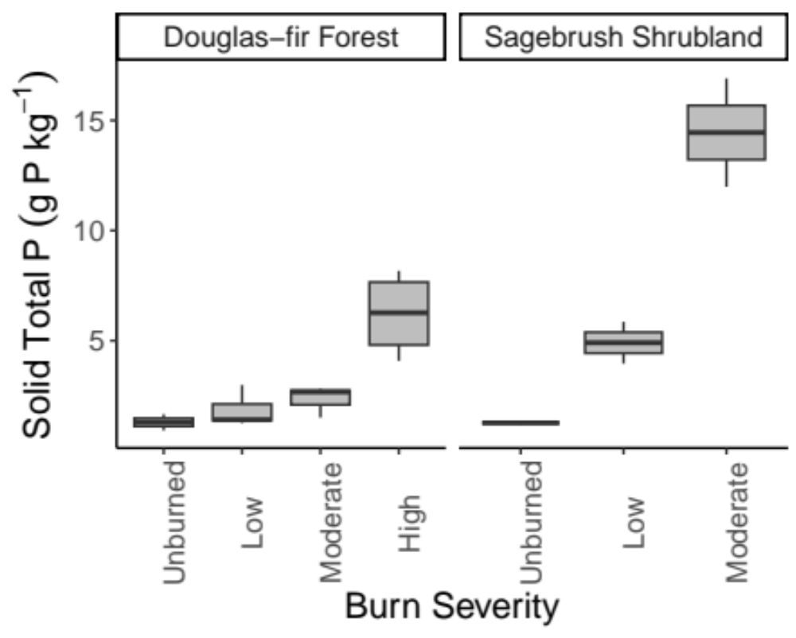
Unburned
(25)
Low
(295-627)
Moderate
(589-757)
High
(589-757)
Unburned
(25)
Low
(308-502)
Moderate
(512-547)

Slide 2
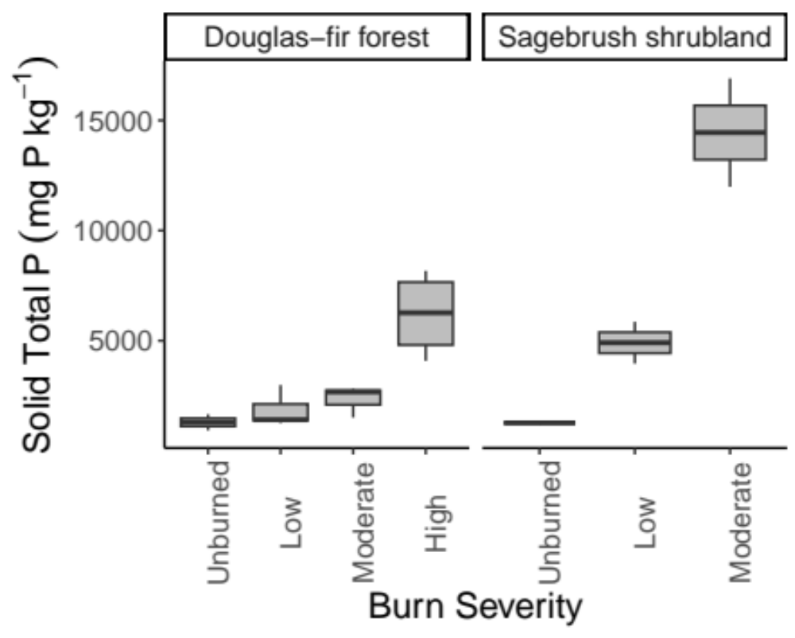
Unburned
(25)
Low
(295-627)
Moderate
(589-757)
High
(589-757)
Unburned
(25)
Low
(308-502)
Moderate
(512-547)

