Slide 1
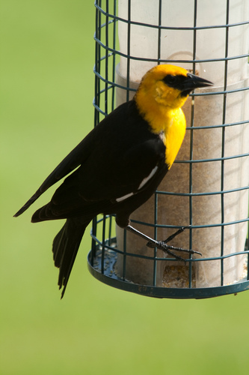
Bag-of-words model for Wikipedia
brazil
wings
red
nests
raven
toes
bird
Bag-of-attributes model for Freebase
CNN
MLP
MLP
Blue crown
Small size
Black forehead
Dot Product
LSTM for the summary sentence
Score for Class K
Raven
is
.…
black
passerine

Slide 2
2321
<EOL>
test
test
test
test
test
LSTM

