Slide 1
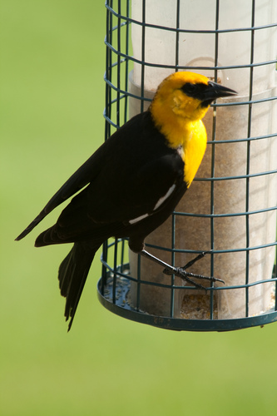
Class k
Bag-of-words of Wikipedia
raven
wings
toes
bird
red
brazil
genus
nests
Bag of Attributes
CNN
MLP
MLP
blue crown
small size
black forehead
solid wings
Dot Product
LSTM for the summary sentence
Score for Class k
Raven
is
…
black
passerine

