Slide 1
PSDS 4900 Capstone
JD Davis
11 Aug 2021
Notes:
Name
Where you work
Background/Current role

Slide 2
Goal
Determine if any one, or a combination of several, weather data sources can accurately predict the wind speed at my personal weather station in my backyard.
Notes:
I’m on the Architecture Review Committee

Slide 3
Importance
Currently, the Homeowners Association where I live does not have any architectural standards for personal wind-electric generation equipment.
I hope to produce a model to retroactively predict an approximation of wind speed in my backyard.
I intend to then use the prediction to estimate roughly how much electricity I might have produced in a given past time range.
Eventually I hope to develop and propose architectural guidelines for wind-electric generation equipment for our community using my findings.

Slide 4
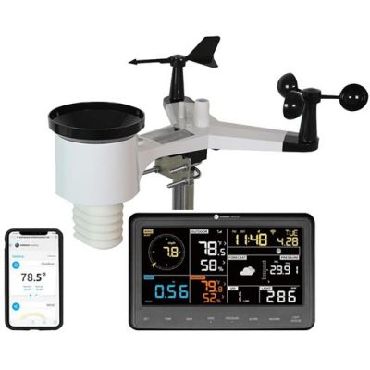
Data Sources: My Sensor
Ambient Weather WS-2902C
solarRadiation: Float
uv: Float
winddir: Integer
humidity: Float
temp: Float
windSpeed: Float
pressure: Float
precipRate: Float
Data exported in Ambient format and/or
Weather Underground format
Notes:
anemometer

Slide 5
Data Sources: Weather Underground
Robust API
Ability to query for historic data
Weather station attributes available (lat/lon, station identifiers, etc)
Data format identical for all stations (including mine)
Notes:
Data Sources Evaluated and Discounted:
Openweather Map - OWM measurements at same times/locations for Weather Underground data is vastly different from Weather Underground data. Further, the values provided are not well correlated with my weather station
Ambient Weather - no ability to access data from weather stations other than my own
Weather Cloud - No API and no ability to access data from weather stations other than my own
Data Sources Not Evaluated
Citizen Weather Observer Program (CWOP/APRSWXNET) via Meteorological Assimilation Data Ingest System (MADIS) at NOAA - API access is via Fortran or helper utilities that one must download/install and the time demands of the project did not allow investigation of this dataset

Slide 6
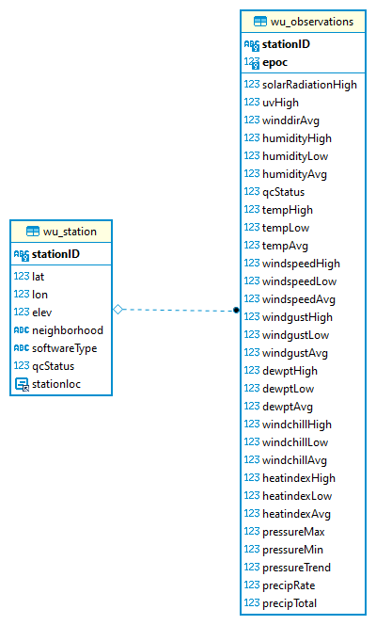
Local DB For Storage
Local storage was necessary due to Weather Underground API limitations
Raspberry Pi-based MariaDB
16 March - 3 July 2021
114 Stations
> 246,000 Observations

Slide 7
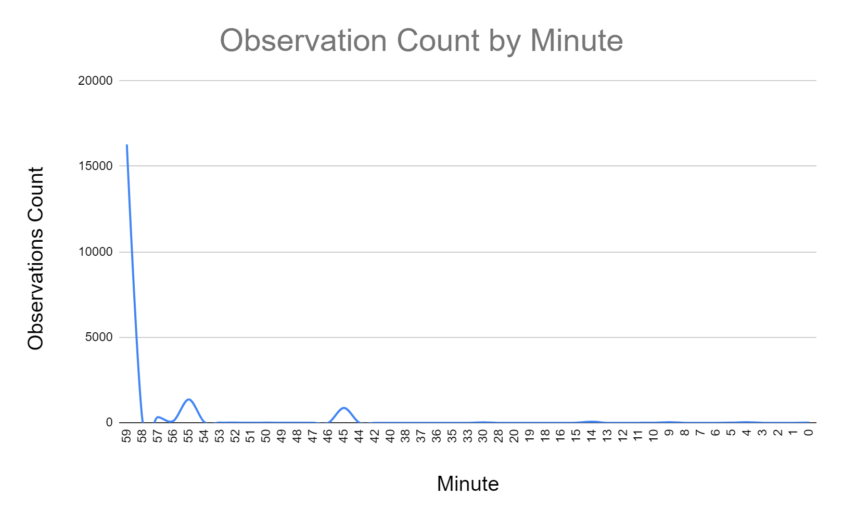
Data Alignment
Stations self-report measurements on their own schedule
Majority of stations report at the bottom of the hour, but not all
For use in prediction models, data must be aligned by time

Slide 8
Maximizing Target Station Representation
 | 5min | 10min | 15min | 20min | 30min | 45min | 60min
My Station Present | 266 | 265 | 265 | 264 | 263 | 263 | 263
Total Groups | 880 | 590 | 577 | 540 | 314 | 351 | 263
Percent Groups Containing My Station | 30.23% | 44.92% | 45.93% | 48.89% | 83.76% | 74.93% | 100.00%

Slide 9
Deduplication of Data
Alignment introduced/compounded the problem of stations reporting multiple observations within one grouping
Multi-step process to remove duplicates
Keep target station observation closest to the bottom of the hour
Compute the time delta between every observation in the group and target
Keep the observation with the smallest absolute value of delta

Slide 10
Choosing Model Input - Step 1
Create correlation matrix of data from my weather station
Include all variables correlated to windspeedAvg at > 0.8
Use most highly correlated stations for those variables
windspeedAvg | 1
windgustAvg | 0.995071
windspeedHigh | 0.852027
windgustHigh | 0.838374
windgustLow | 0.523414
windspeedLow | 0.459209
solarRadiationHigh | 0.370677
uvHigh | 0.364316
tempHigh | 0.286263
windchillHigh | 0.28625
Notes:
Tried just taking the top N highest correlated stations only using windspeedAvg but that model did not do very well at at all

Slide 11
Choosing Model Input - Step 2
Create correlation matrices for all stations compared to my station
Choose stations with highest correlation for each of the variables from Step 1
stationID | windspeedAvg_corr | windgustAvg_corr | windspeedHigh_corr | windgustHigh_corr
KCOCASTL148 | 0.448414 | 0.547012 | 0.675833 | 0.730436
KCOCASTL161 | 0.765005 | 0.744230 | 0.788360 | 0.801225
KCOCASTL167 | 0.708132 | 0.727253 | 0.750650 | 0.758954
KCOCASTL195 | 0.638610 | 0.673448 | 0.747853 | 0.765771
KCOCASTL200 | 0.678979 | 0.721673 | 0.761377 | 0.782530
KCOCASTL204 | 0.716807 | 0.731671 | 0.749011 | 0.759554
KCOCASTL205 | 0.648407 | 0.692907 | 0.756221 | 0.777309
KCOCASTL208 | 0.746687 | 0.745058 | 0.758229 | 0.763326
Notes:
There may be overlap between stations most highly correlated for two or more of the variables

Slide 12
Choosing Model Input - Step 3
Identify N most highly correlated stations for each of the variables from Step 1 using correlation matrix from Step 2
Pull observations of variables (Step 1) for N number of stations
Perform Linear Regression using N stations and score
Store number of stations with best score
Use N stations for training and testing other models

Slide 13
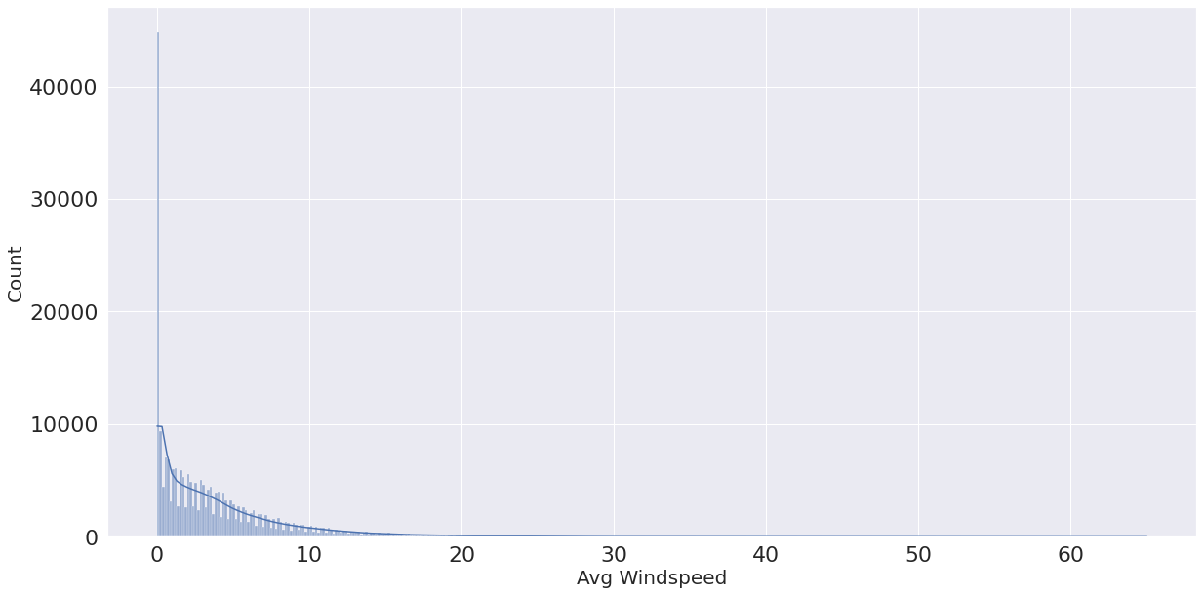
Data Distribution

Slide 14
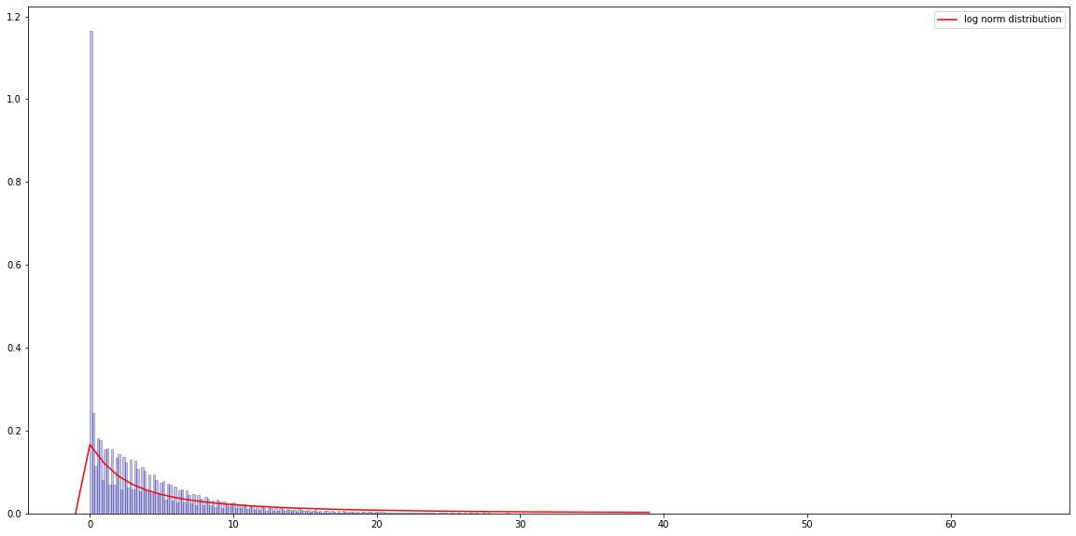
Data Distribution: PDF With Log Norm Overlay
Notes:
Red line denotes lognorm pdf using the mean and standard deviation of windspeedAvg
From Gustavsson University of Gothenburg:Tweedie and Poisson Generalized Linear Models “Our results show that when the association is linear and the sample size is large (> 100 observations), MLLN provides basically unbiased point estimates and has accurate coverage for both confidence and predictor intervals”

Slide 15
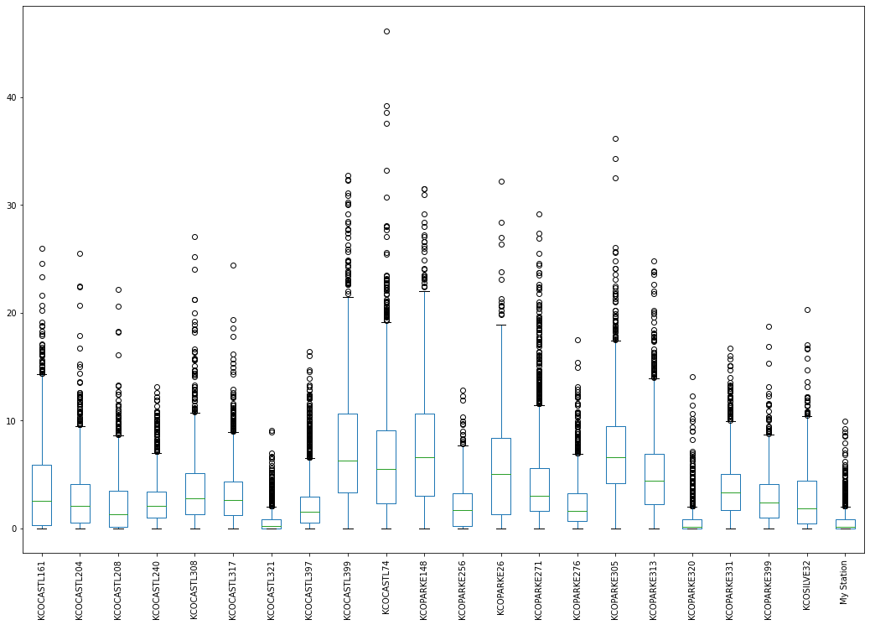
windspeedAvg For Most Correlated Stations
Notes:
Looking at the spread of windspeedAvg across the N most correlated stations, we can see the significant presence of outliers.This led me to experiment with how removing the outliers could improve my models

Slide 16
Impact of Removing Outliers
 | Entire Dataset | Outliers Removed via Isolation Forest | Outliers Removed via LocalOutlierFactor
Rows Dropped | 0 | 159 (13.27%) | 31 (2.59%)
Linear Regression Accuracy | 0.873127 | 0.638218 (-27%) | 0.680896 (-22%)
Ridge Regression Accuracy | 0.766903 | 0.620214 (-19%) | 0.739091 (-4%)
Lasso Regression Accuracy | 0.768726 | 0.610656 (-20%) | 0.70588 (-8%)
SVR (Poly degree 2) Accuracy | 0.766903 | 0.697551 (-9%) | 0.746221 (-3%)

Slide 17
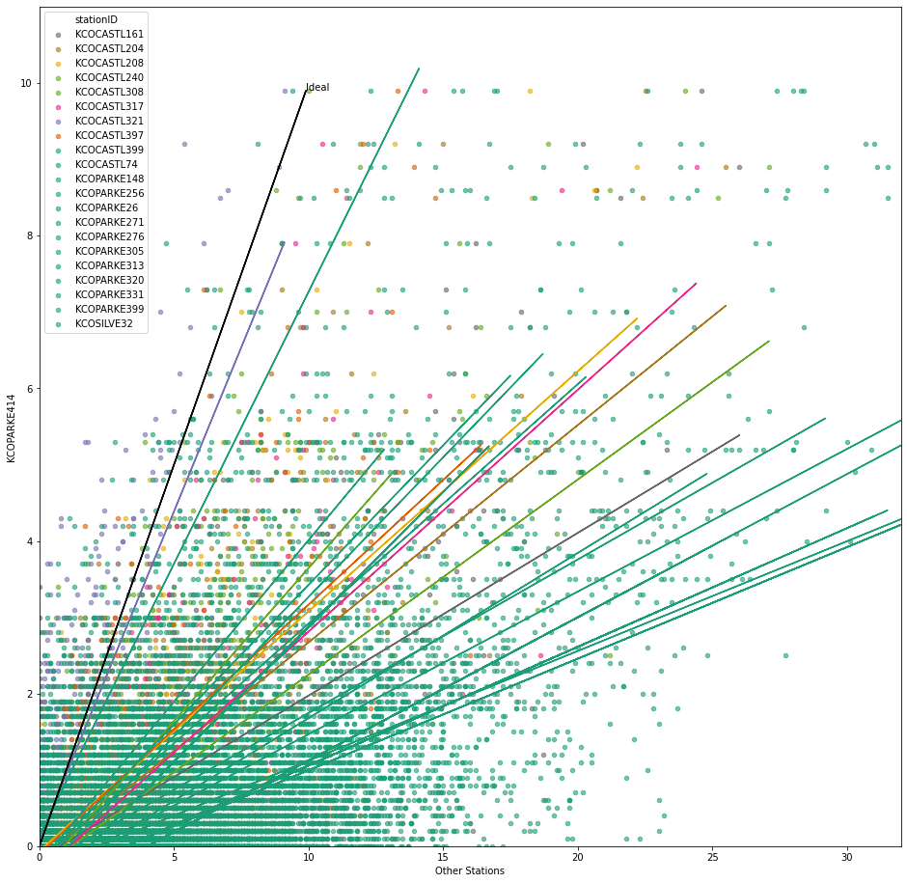
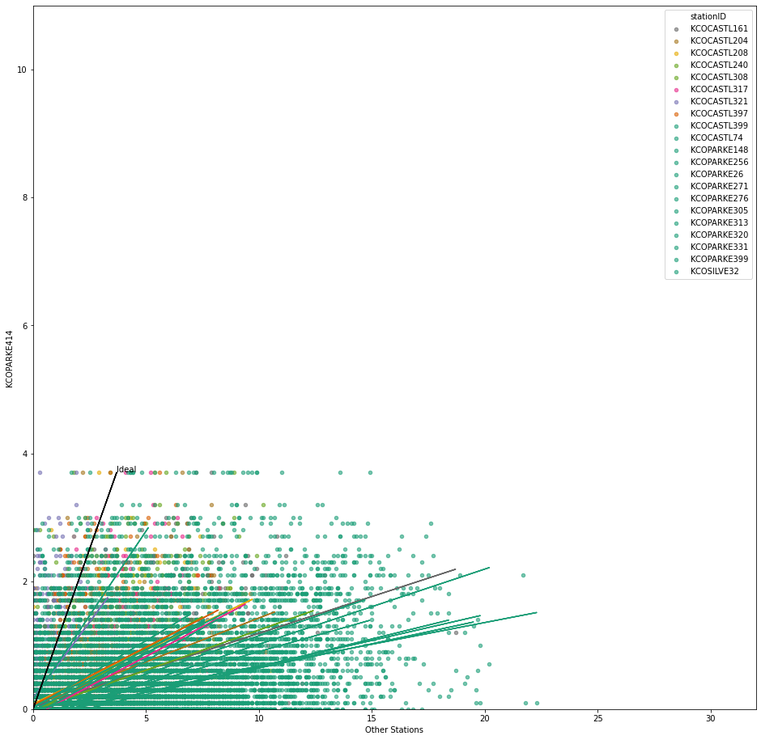
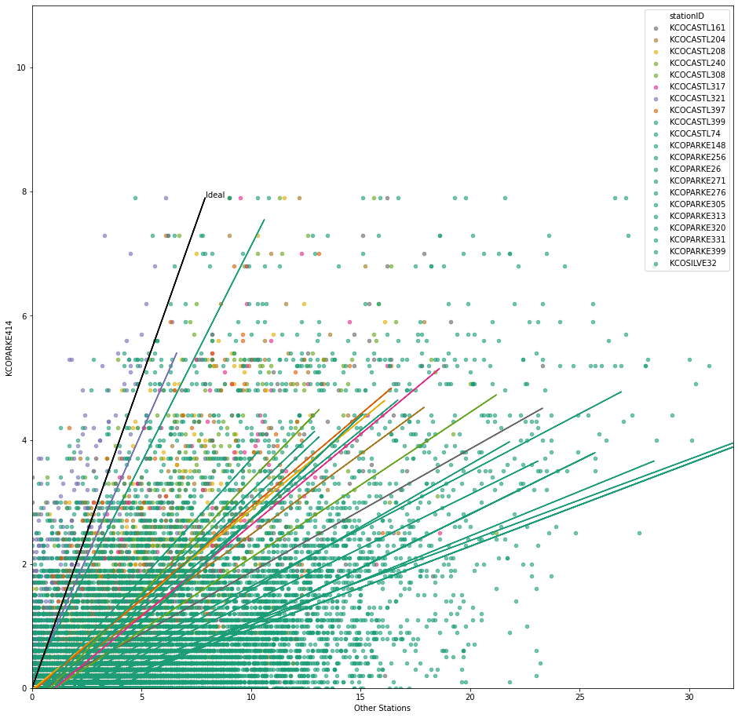
Impact of Removing Outliers
Entire Dataset | Outliers Removed via Isolation Forest | Outliers Removed via LocalOutlierFactor
Notes:
The obvious importance of outliers led me to explore Generalized Least Squares models. Specifically, I experimented with a Huber Regression model to try and compensate for the apparent heteroscedasticity of the data.

Slide 18
Model Selection, Tuning and Training
Experimented with
10 different regression methods
Two different methods for outlier elimination
With and without input scaling
Hyperparameter Tuning via Pipeline/GridSearchCV
85/15 Train Test Split
1198 observations of
61 variables from
27 different stations
Scoring is mean of 5-fold cross validation scores

Slide 19
Regressors, Best Parameters and Accuracy Scores
Model | Best Hyperparameters | Best Avg Accuracy
LinearRegression | N/A | 0.873127
ElasticNet | 'alpha': 0.01, 'l1_ratio': 1.0, 'max_iter': 2000, 'normalize': False | 0.83345688
HuberRegressor with StandardScaler | 'epsilon': 2.3, 'max_iter':201 | 0.803334
Lasso | 'alpha': 0.01 | 0.768726
SVR poly kernel degree 2 | N/A | 0.766903
Ridge | 'alpha': 0.01, 'normalize': True | 0.765682
SVR poly kernel 2 localoutlierfactor removed | N/A | 0.746221
Notes:
Elastic Net - possibly of value as it is effective when we have multiple values correlated to one another. In theory, the windspeedAvg of stations highly correlated with mine should be highly correlated to one another.
Huber Linear (General Linear Model) regression model that is robust to outliers.
Lasso so small an alpha says that it really wants to be OLS

Slide 20
Regressors, Best Parameters and Accuracy Scores
Model | Best Model Parameters | Best Avg Accuracy
HuberRegressor | 'epsilon': 2.1, 'max_iter': 151 | 0.741381
Ridge localoutlierfactor removed | 'alpha': 0.02, ‘normalize': True | 0.739091
LinearRegression with StandardScaler | N/A | 0.738264
BayesianRidge | 'alpha_1': 0.09, 'alpha_2': 0.01, 'normalize': True | 0.706051
Lasso localoutlierfactor removed | 'alpha': 0.02 | 0.70588
SVR poly kernel 2 iso outliers removed | N/A | 0.697551
Linear Regression localoutlierfactor removed | N/A | 0.680896

Slide 21
Regressors, Best Parameters and Accuracy Scores
Model | Best Model Parameters | Best Avg Accuracy
Poisson | 'alpha': 1.8 | 0.654925
Linear Regression iso outliers removed | N/A | 0.638218
Ridge iso outliers removed | 'alpha': 0.02, 'normalize': True | 0.620214
Lasso iso outliers removed | 'alpha': 0.01 | 0.610656
RandomForestRegressor | 'max_depth': 100, 'max_features':'auto', 'n_estimators': 50 | 0.582931
Poisson localoutlierfactor removed | ‘alpha': 1.8 | 0.476733
Poisson with StandardScaler | ‘alpha': 0.2 | 0.438463
Tweedie | ‘alpha': 1.9 ‘power’': 1 | 0.390051
Notes:
According to Gustavsson, Generalized Linear Models should have done really well if the distribution is log norm. That was not the case. Tweedie and Poisson are Generalized Linear Models and neither preformed well.

Slide 22
Predicting January
Best Model: LinearRegression
Average accuracy steady around 0.87
Best Stations: 15 Most Correlated
Retrieved Weather Underground data for target month: January 2021
After cleaning and grooming observations: 580 hour groups
Assess Model Performance
Hourly average wind speed prediction: 0.439 mph
Expected hourly average wind speed between 0.5 and 0.38 (+/- .13)

Slide 23
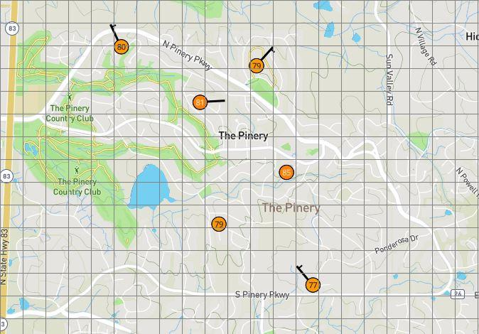
Next Steps
Use other personal weather stations to build new models
Assess wind speed estimations for areas that do not have direct measurements
Architectural Standards recommendations
Notes:
6 stations in The Pinery

Slide 24
Classified Applications & Discussion

Slide 25
Resources
GitHub: https://github.com/riverdogcabin/PSDS4900
Gustavsson, Sara. Sahlgrenska Academy at University of Gothenburg, “Evaluation of Regression Methods for Log-Normal Data Linear Models for Environmental Exposure and Biomarker Outcomes,” Occupational and Environmental Medicine Institute of Medicine, ISBN (e-publ.) 978-91-628-9295-1, 2015. [Online]. Available: https://gupea.ub.gu.se/bitstream/2077/37537/4/gupea_2077_37537_4.pdf. [Last Accessed: Jul. 28, 2021].

