Slide 1



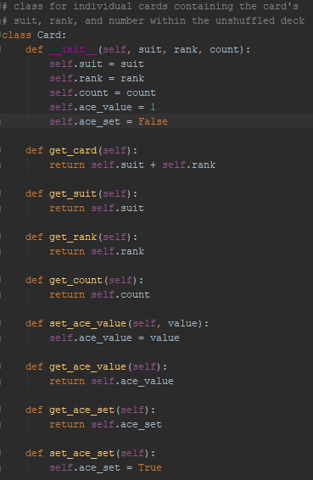

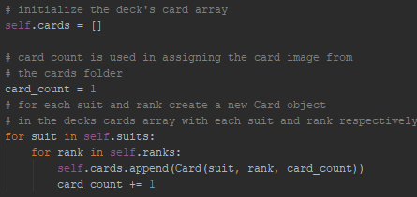
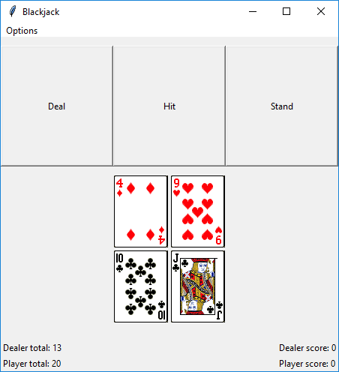
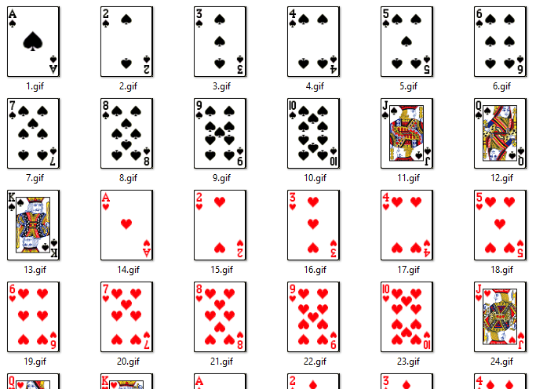
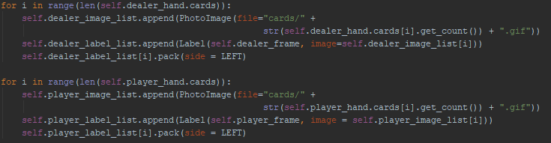
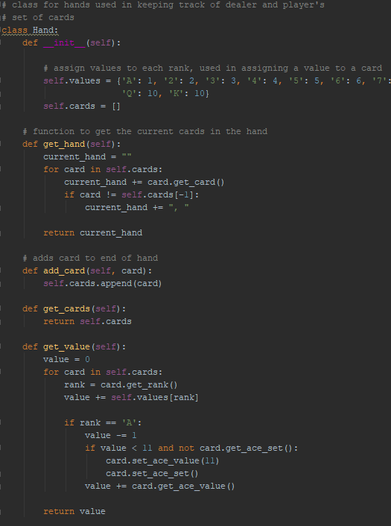
blackjack.py
River Hill
MAIN CLASSES RUNNING THE GAME
PROBLEMS WE RAN INTO
The main classes that make this game are the Card, Hand, and Deck classes.
The Blackjack class keeps track of all the functions used in making the game possible. It begins by creating a new Deck class which consists of 52 Card class objects which keep track of their own assigned suit and rank.
This was accomplished with two arrays in the Deck class which held each suit and rank.
An empty array is created to hold the new Cards and two nested loops go through each suit and rank and assigns it to the newly created Card. The card_count array is used in keeping track of what number a given card is within the deck and is used in finding the appropriate card image to display on screen.
Using the card images provided within the python book examples, we found that they are in the order of Spades, Hearts, Diamonds and Clubs. Knowing this, we arranged my self.suit rank to reflect that which allows the card_count variable represent the card’s image number
The Blackjack class then deals two cards
from the Deck class to two new Hand
classes for the dealer and player.
To find the value of a hand which is
used in presenting the dealer and players
hand value at the end of a turn we use the
get_value function. This will go through
each card, find it’s rank, and compare it
with the values array which keeps track of
each ranks value,
A problem we faced right away was with the get_value function and aces. Currently we get the value of the player at the end of every turn and display it. By default if the player or dealer’s total score is under 10 then we count aces as 11 otherwise we add 1. But since the get_values function is called at the end of every turn, it would change previous aces which were counted as 11 to 1 if the player’s score got above 10. To fix this we had to add separate function in the card class which kept track if the Card had already had it’s ace counted and the value it held.
To compare this image with the last image in the left panel, the
get_value function checks to see if the card it’s analyzing is an ace.
If it is, it will check if the card has been set before and if the hand
value is below 11, if not it will run the cards functions which will
set it as checked and set the cards ace value to 11 which is added
to the hands total.
Another problem faced was figuring out how to display the dealer and player’s cards on the screen. Using the example from the python book which showed how to display cards and shuffle them we modified it to show a single card using the Cards count variable.
We used a loop to go through the cards in a hand and
create an image list which uses the Cards count variable
to find the numbered image representing the card. Then
we add the image to a label list which consists of the
Tkinter label images for the cards which are then drawn
to the screen.
The image below shows how images were displayed
for the dealer’s hand
Icons made by Freepik from www.flaticon.com

