Slide 1


Springboard Lichess Capstone
Extracting Data Insights from Chess Games

Slide 2
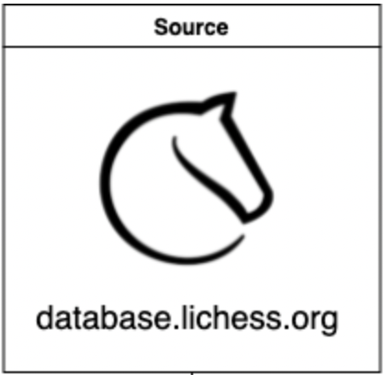
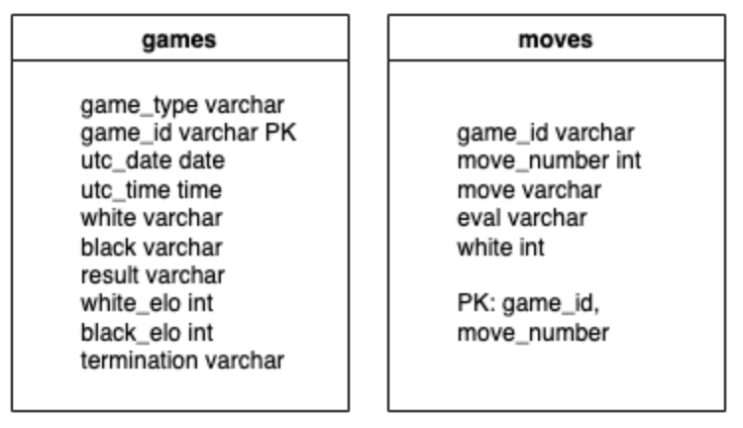
Data Exploration
Questions to resolve:
Percent of checkmate in 1 that are found
Percent of checkmate in 1 that are found by elo
Games where a player lost after checkmate in one
Highest elo example of the question above
Game with player with the highest elo who missed a checkmate in 1
My percent of checkmates in 1 that are found
Players with the most games and a perfect checkmate in 1 pct

Slide 3
Prototype the Data Pipeline
Create a logger
Download monthly data from database.lichess.org using requests library
Unzip file using a read and write context manager
Locate games with evaluations – other games will be discarded
Create a games file. Use the chess.pgn library to parse the file.
Create a moves file
Upload them to the database

Slide 4


Scale the Prototype
Converted my scripts to Spark using Databricks
I saw performance decreases at a sample of 1 GB of data, and my pure python code is scaling linearly (O(n)) so far, so I will use pure python.

Slide 5
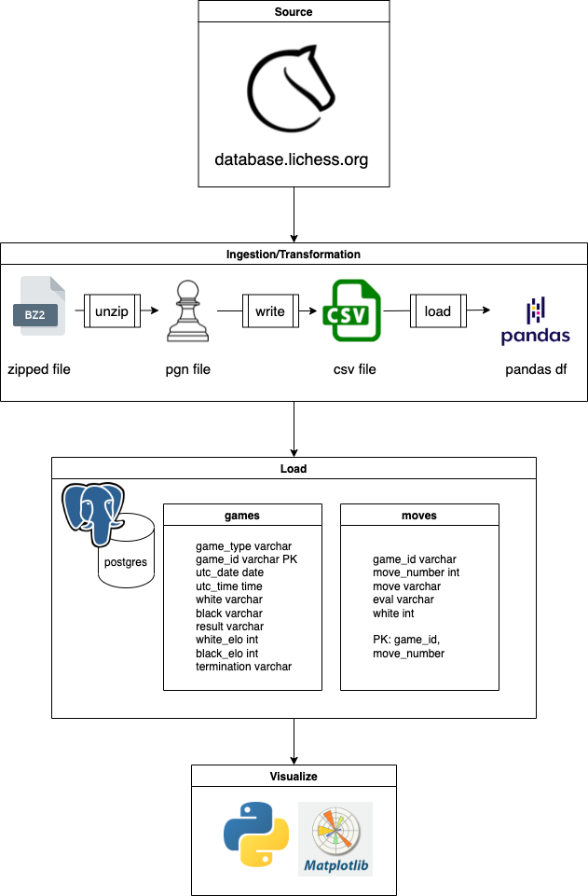
Deployment Architecture
I have chosen to run my full pipeline locally using postgres because I see significant performance increases when running my scripts locally and inserting to a local database.
Because I will be working with approximately 1 billion moves, volume and velocity of data are my primary concerns with this project.

Slide 6
Deploy Code for Testing
Used Unittest and mock
93% coverage

Slide 7
Deploy Production Code & Process Dataset
Replaced Global variables with self class variables for cleaner code
Used tqdm to visualize progress bar for loading data to the database
Created visualization script using Matplotlib
Original script processed 100+ million games of chess
Final dataset has approximately 1 billion moves
Inserting data into the database grew at O(n²). This may have been alleviated if I used Spark.

Slide 8
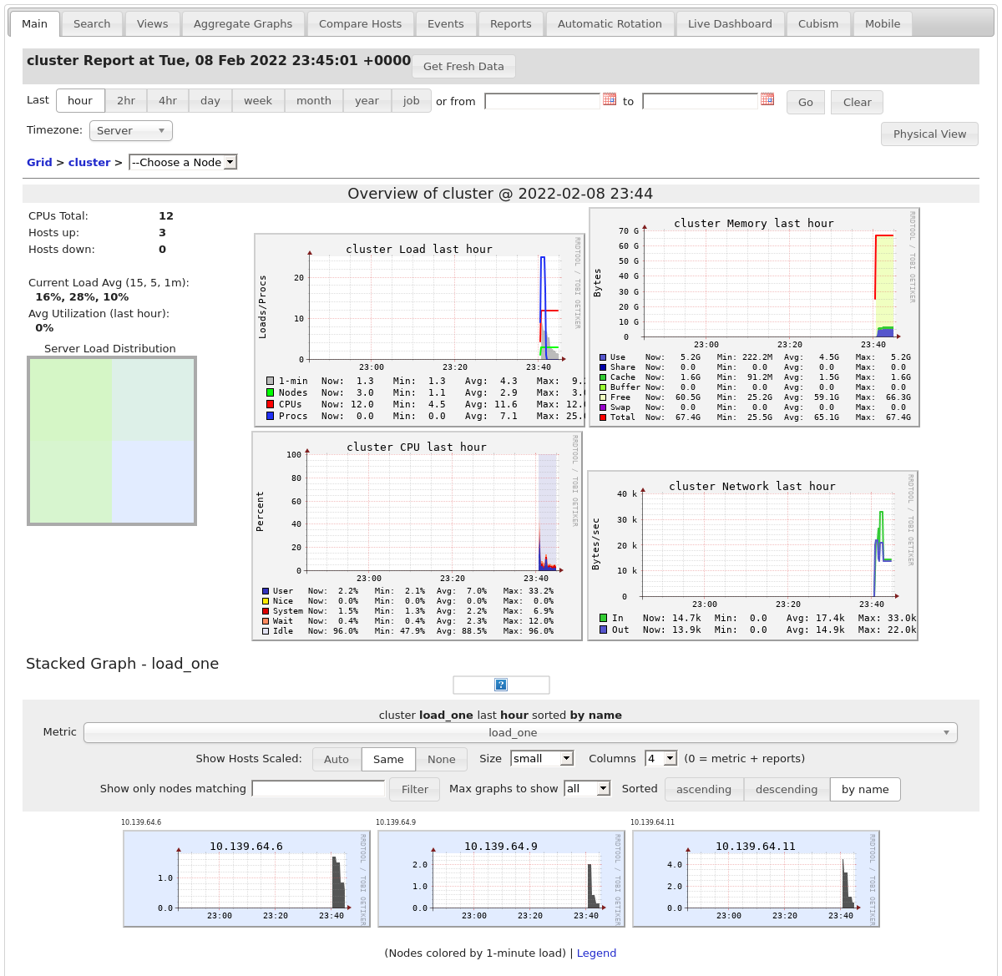
Monitoring Dashboard
I used gangalia in order to view aggregated log metrics of my databricks cluster, which I used to run part of my pipeline using Apache Spark.

