Slide 1
Bash shell scripting
Riverina Developer Meetup – 27/05/2017

Slide 2

Background
First released in 1989
Successor to the Bourne Shell
Default shell on Linux and macOS, also available on BSDs
Now available on Windows 10 through WSL

Slide 3
When to use Shell Scripts
When it’s a simple problem (or simpler than using another language)
When you’ll be working with external binaries
When you simply want to

Slide 4
When NOT to use Shell Scripts
When it’s a non trivial problem to solve
When all the processing will be internal
When you’re looking for more performance
When you don’t want to be hassled by “gotchas”

Slide 5
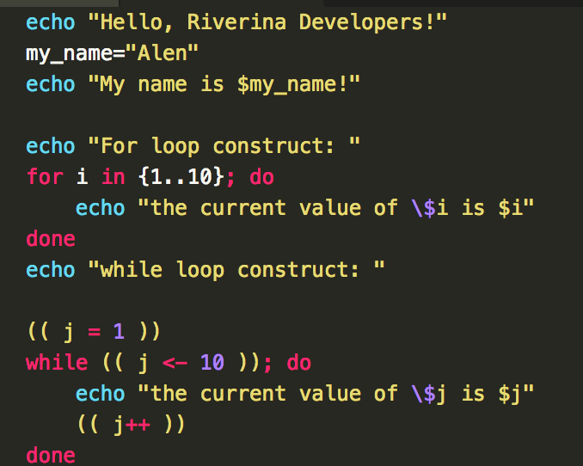
Let’s look at code!

Slide 6
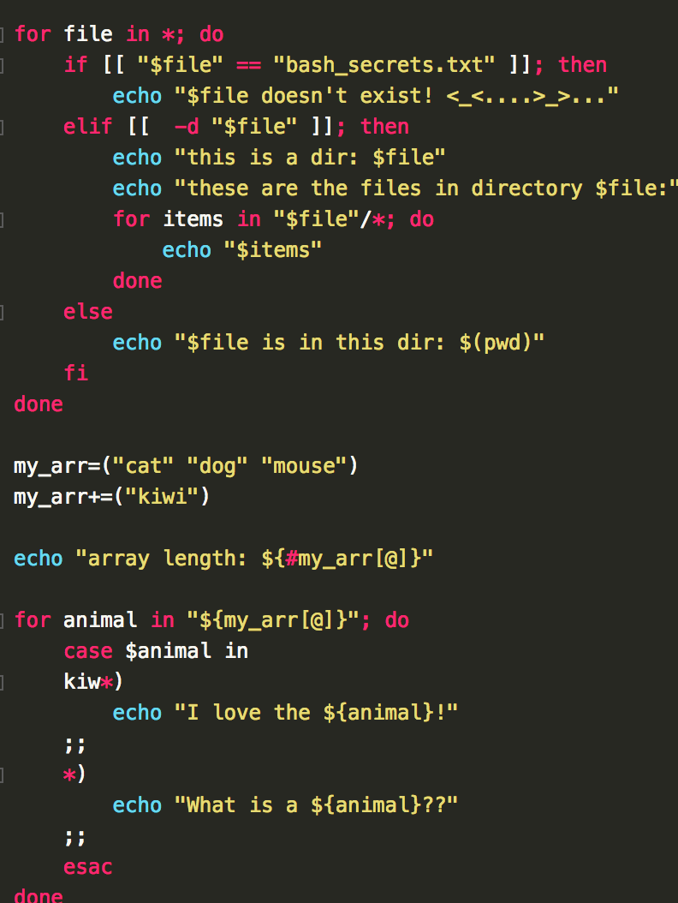
Let’s look at code!

Slide 7
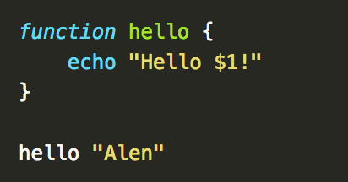
Let’s look at code!

Slide 8
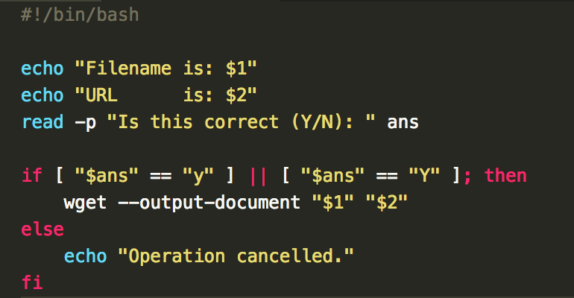
Examples: wget helper

Slide 9
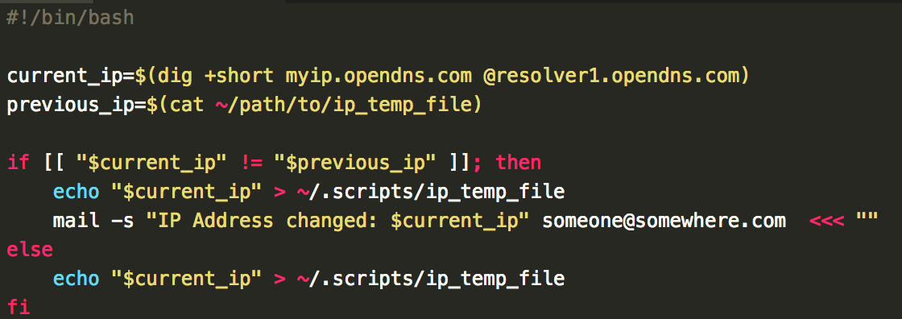
Examples: email IP changes

Slide 10
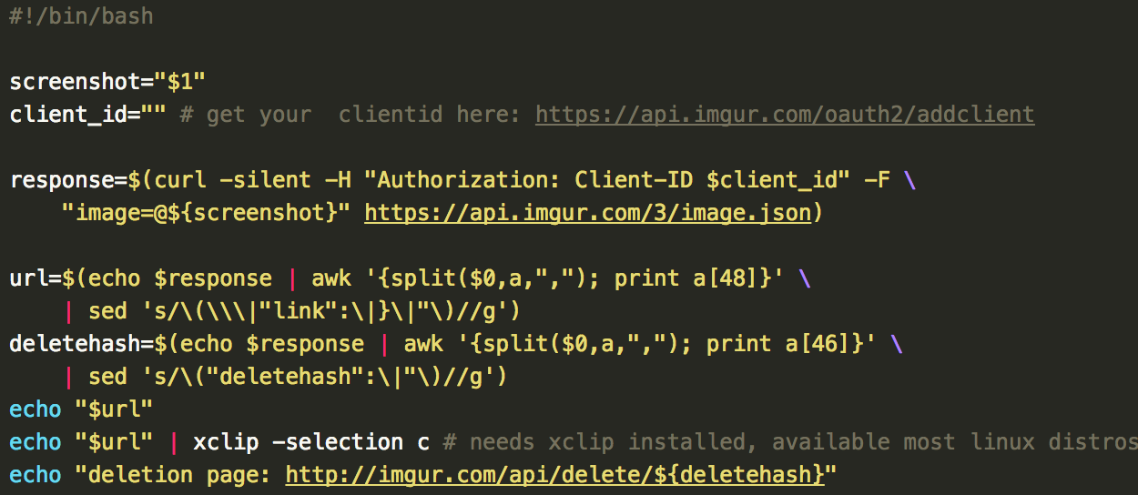
Examples: imgur upload

Slide 11
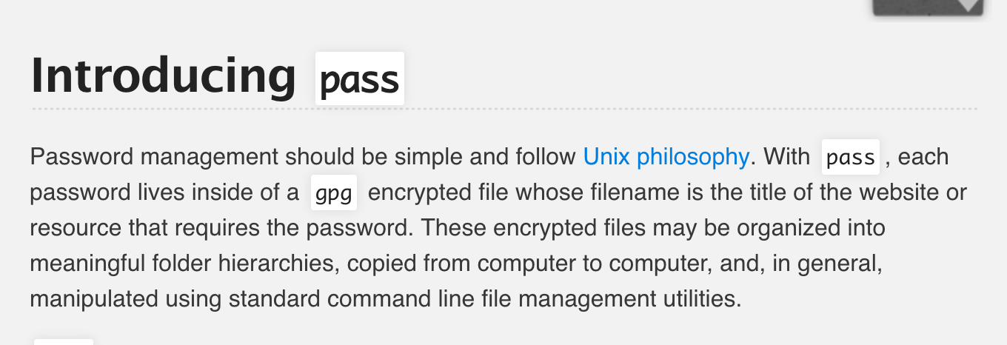
Examples: password manager
https://www.passwordstore.org/

Slide 12
Ideas?
Cron + shell script = lazy automation
Tail –f + make = lazy CI
Obscure command + shell script = training wheels
Loads more!

Slide 13
That’s All Folks!
GitHub Repo
https://github.com/riverina-developer-meetup/bash-scripting-introduction

