Slide 1
Pump it Up: Data Mining the Water Table
Project of CSX433.3 and CSX433.7
Jiang Li

Slide 2

Introduction
Goal:
Using data from Taarifa and the Tanzanian Ministry of Water, can you predict which pumps are functional, which need some repairs, and which don't work at all?
Data Source:
https://www.drivendata.org/competitions/7/pump-it-up-data-mining-the-water-table/
Notes:
The Taarifa Platform is an open source web API, designed to close citizen feedback loops.
We are currently working on an Innovation Project in Tanzania, with various partners.

Slide 3

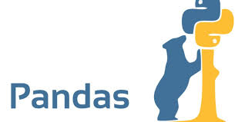
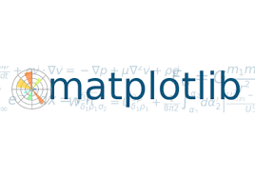
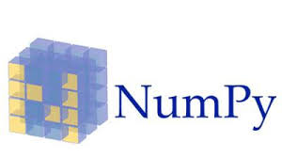

Outline
Exploratory data analysis
Data cleaning and transformation
ML Analysis through Tensorflow
Simple softmax regression
Random Forest
Deep Neural Network
Exploratory data analysis
Data cleaning and transformation
ML Analysis through Tensorflow
Simple softmax regression
Random Forest
Deep Neural Network

Slide 4
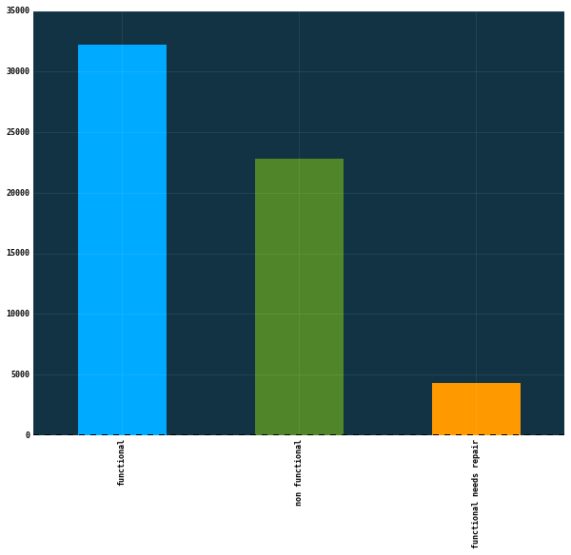
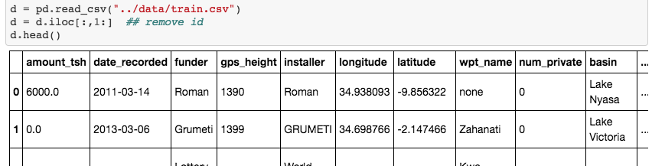
Exploratory data analysis - overview
Training dataset contains 59,400 observations with 39 features.
There are 3 classes:
functional
functional needs repair
non functional

Slide 5
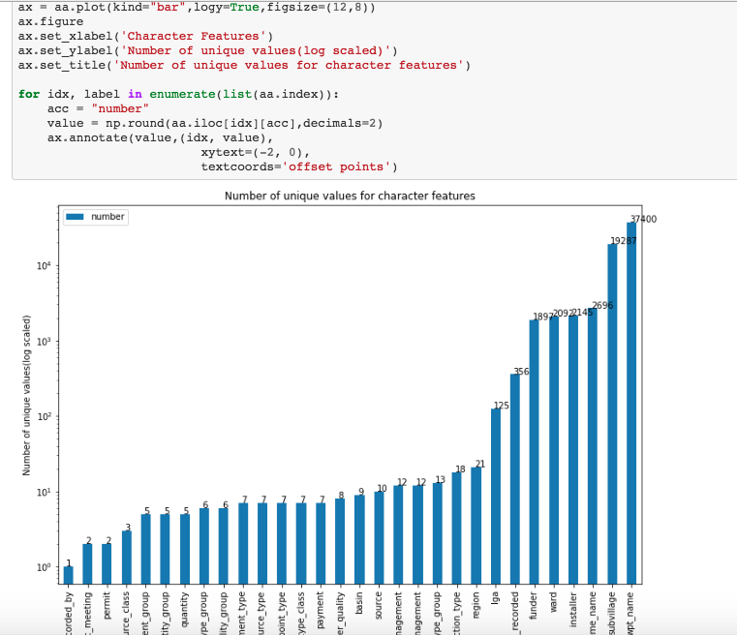
Non-numeric features
For each of non-numeric features, look at the number of unique values

Slide 6
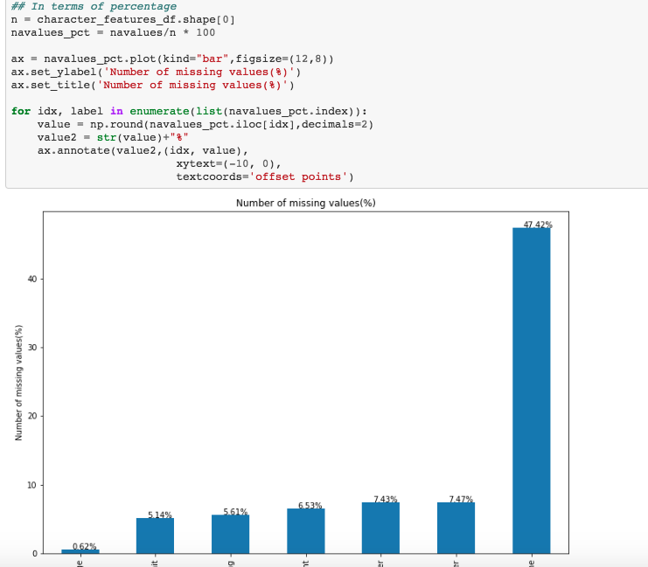
Missing values

Slide 7
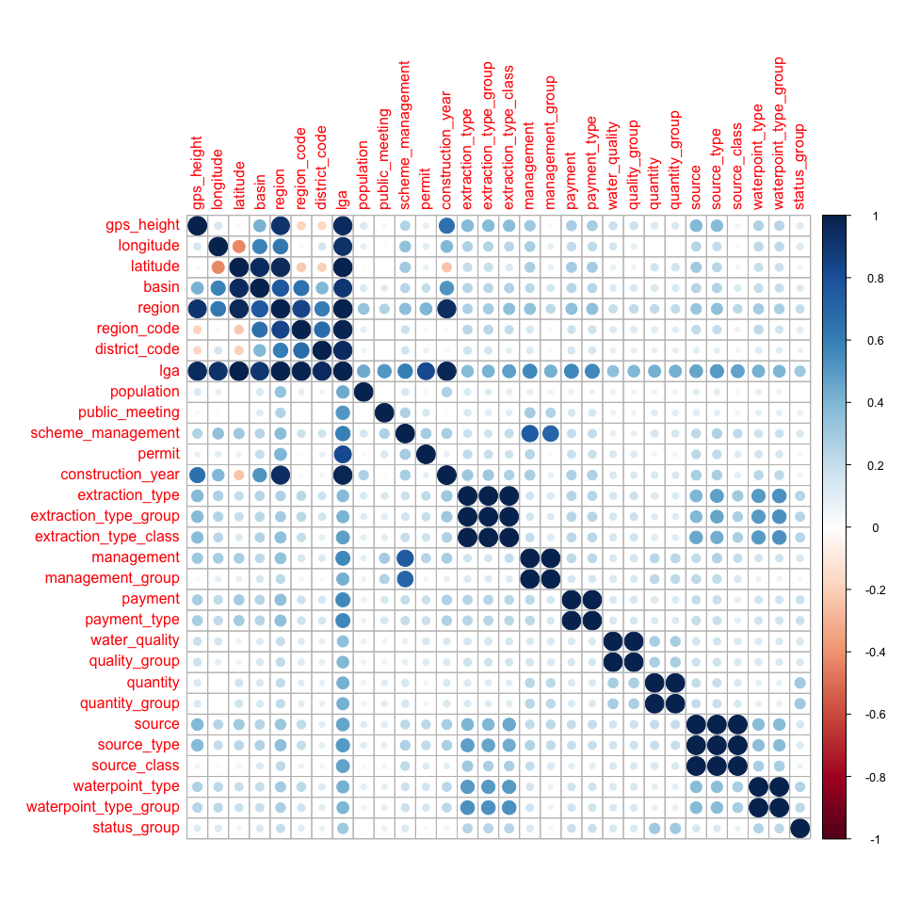
Feature correlation
"lga","region","basin" ,correlated other region information
"extraction_type_group","extraction_type_class", correlated with 'extraction_type'
"management_group", correlated with 'management'
"payment_type", correlated with 'payment'
"quality_group", correlated with 'quality'
"quantity_group", correlated with 'quantity'
"source_type","source_class", correlated with 'source'
"waterpoint_type_group", correlated with 'waterpoint_type'

Slide 8
Outline
Exploratory data analysis
Data cleaning and transformation
ML Analysis through Tensorflow
Simple softmax regression
Random Forest
Deep Neural Network

Slide 9
Data cleaning and transformation
Remove features
More than 40% missing values
Unique to all the observations (recorded_by)
highly correlated with other features
For non-numeric features with >30 categories, reduce it to 30 categories
Create dummy variables for the non-numeric features and transform input as numpy matrix (float32)
Reduce 39 features to 25
Extend 25 features to 188 ‘features’

Slide 10
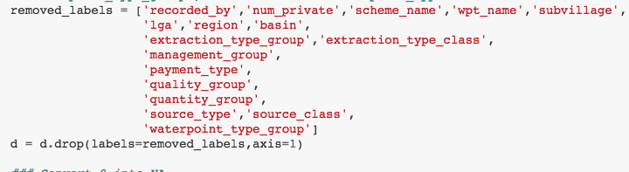
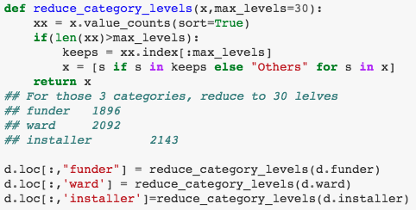
fd
Remove features
Reduce categories
https://github.com/riverlee/Certificate-Program-in-Data-Science/blob/master/CSX433.7/Project/code/Clean_data.ipynb

Slide 11
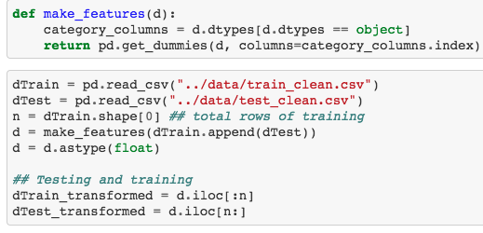
Create dummy variables
https://github.com/riverlee/Certificate-Program-in-Data-Science/blob/master/CSX433.7/Project/code/prepare_data.ipynb

Slide 12
Outline
Exploratory data analysis
Data cleaning and transformation
ML Analysis through Tensorflow
Simple softmax regression
Random Forest
Deep Neural Network
Notes:
Deep Neural Network

Slide 13
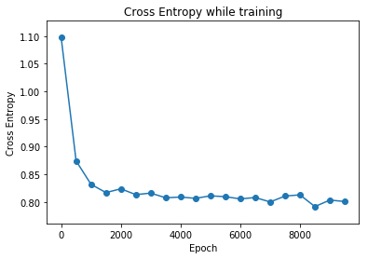
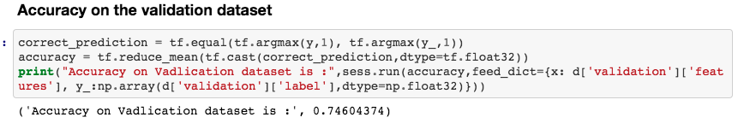
Simple softmax regression
Low level API
Split ‘training’ into 80/20 training and validation
Testing data was evaluated through DRIVENDATA
https://github.com/riverlee/Certificate-Program-in-Data-Science/blob/master/CSX433.7/Project/code/Tensorflow-Softmax-regression.ipynb
Notes:
Simple softmax regression

Slide 14
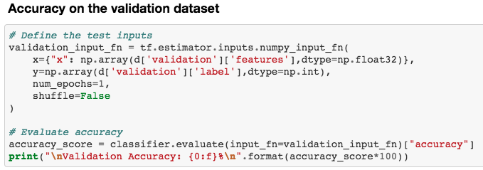
Random Forest
High Level API
tf.contrib.tensor_forest.client.random_forest.TensorForestEstimator
https://github.com/riverlee/Certificate-Program-in-Data-Science/blob/master/CSX433.7/Project/code/Tensorflow_RF.ipynb

Slide 15
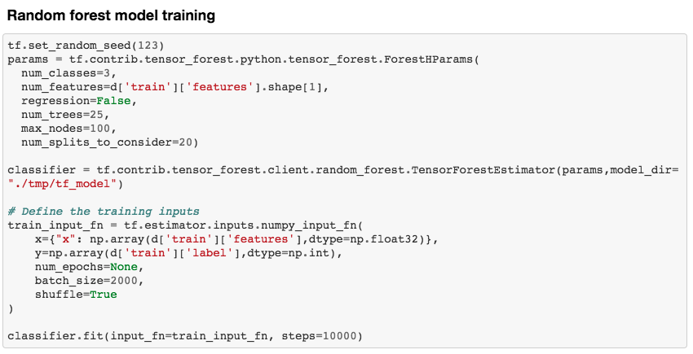
https://github.com/riverlee/Certificate-Program-in-Data-Science/blob/master/CSX433.7/Project/code/Tensorflow_RF.ipynb

Slide 16
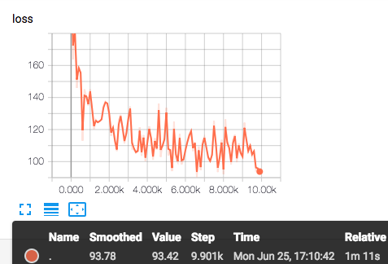
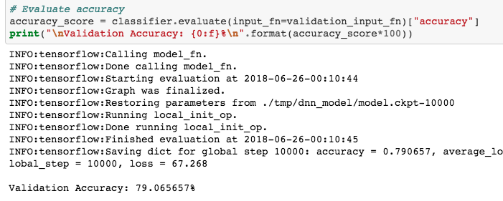
Deep Neural Network
High Level API
tf.estimator.DNNClassifier
https://github.com/riverlee/Certificate-Program-in-Data-Science/blob/master/CSX433.7/Project/code/DNNClassifier.ipynb
Notes:
Simple softmax regression

Slide 17
Model performance comparison

Slide 18
Questions

