Slide 1
Signal

Slide 2
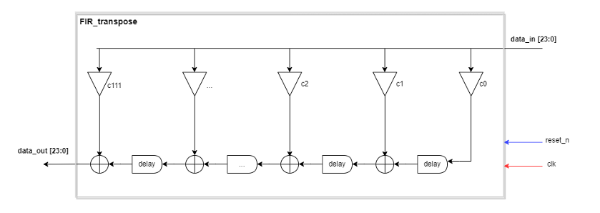
FIR Design

Slide 3
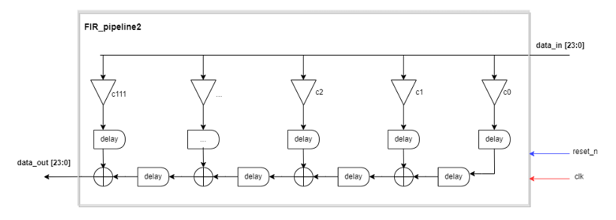
FIR Design

Slide 4


Simulation

Slide 5

Simulation
output_audio_new.wav - Google Drive

Slide 6
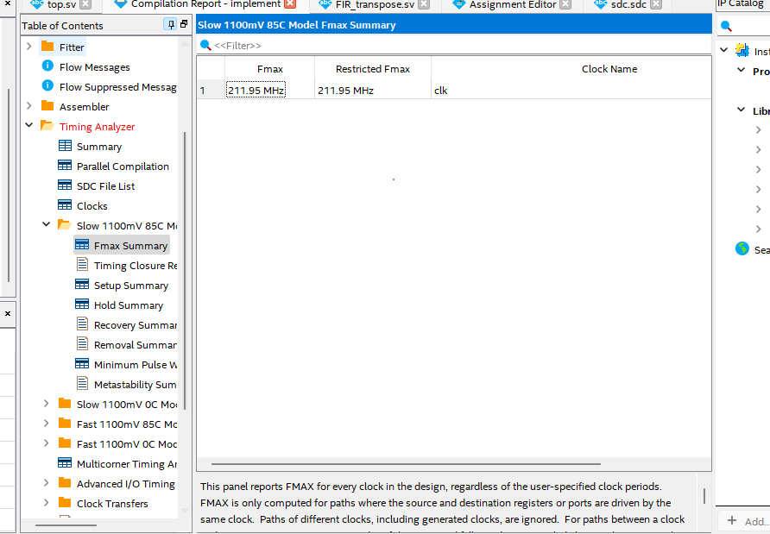
Feq max FIR
30 order transpose

Slide 7
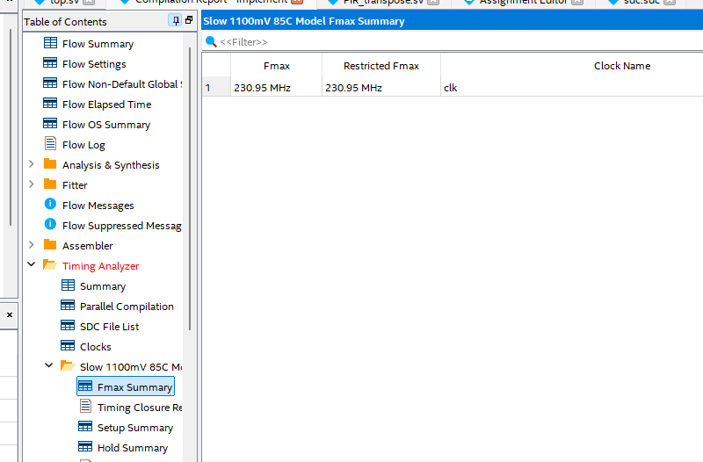
Feq max FIR
30 order pipeline 2

Slide 8
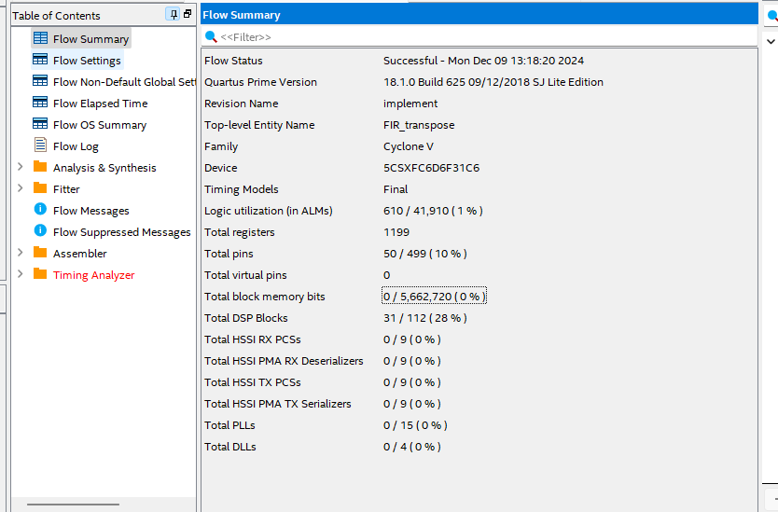
Resource
30 order transpose

Slide 9
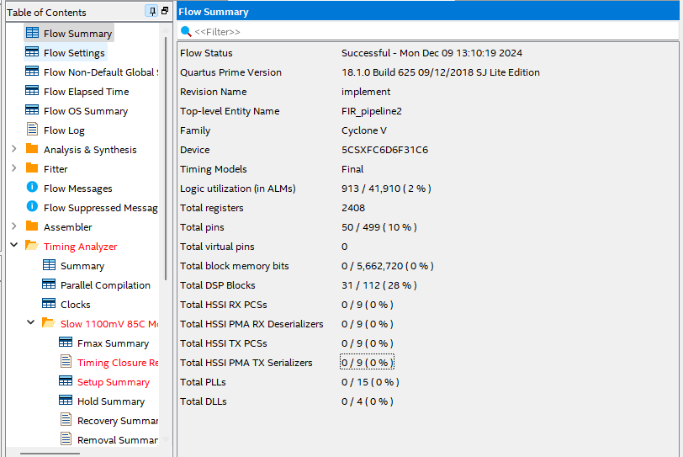
Resource
30 order pipeline 2

Slide 10
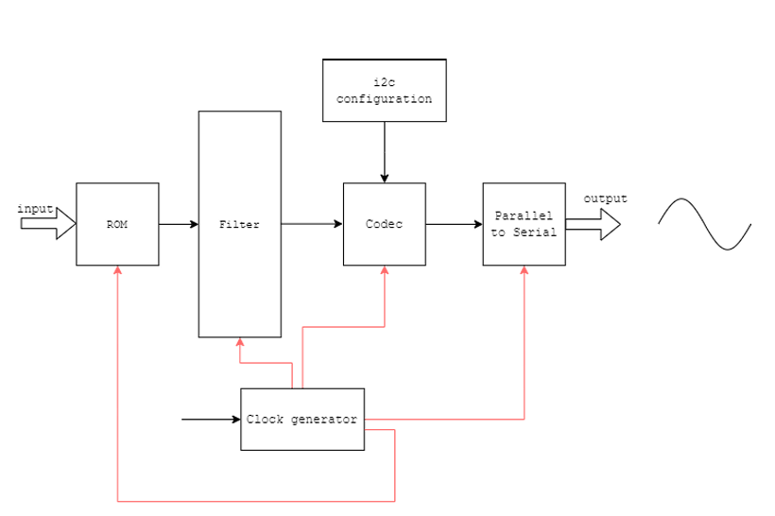
Overall Design

Slide 11


Backup i2c protocol

Slide 12
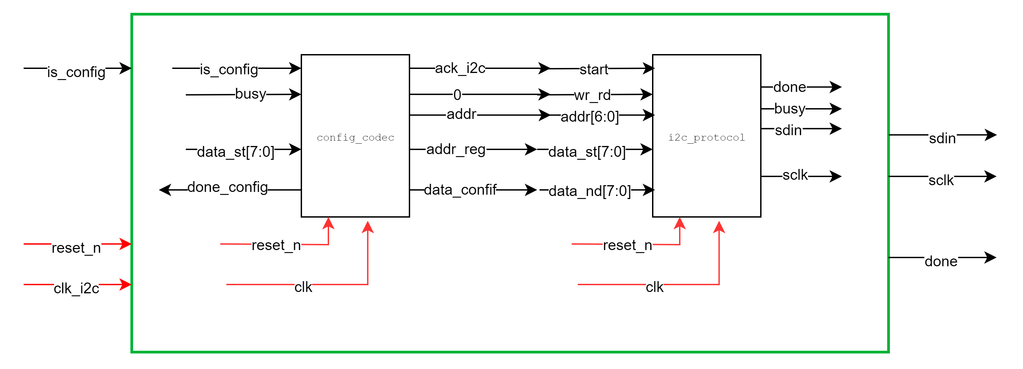

Backup codec config

Slide 13
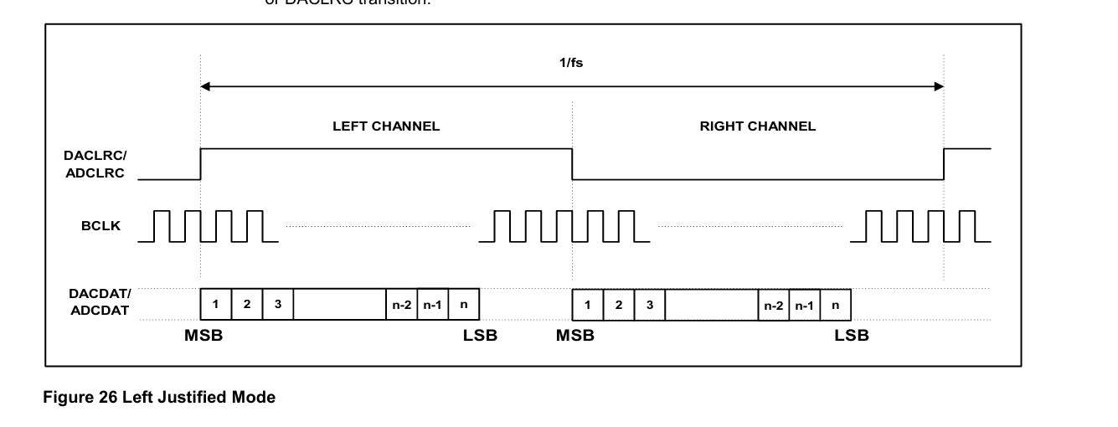

Backup digital to analog

