Slide 2
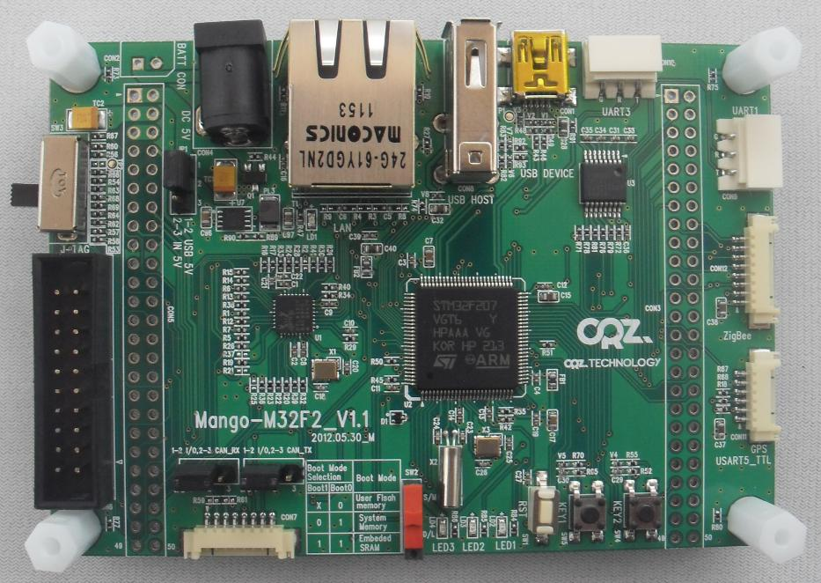
USB Host
Battery Connector
DC 5V Adapter
RJ-45 Connector
USB Device
RS232 Port3
Power Select Switch
RS232 Port1(Debug)
Power ON/OFF
SP3232 Level Shift
Zigbee 8P Connector
50P Expansion A
Power LED
STM32F207VGT CPU
JTAG 20P
UART5(GPS etc)
RTL8201CP 10/100Mbs Ethernet
50P Expansion B
CAN/IO Select Switch1
LED 1,2,3
KEY1
KEY2
CAN/IO Select Switch1
I2C/CAN
(Sensor Connector)
Boot Switch
Reset

