Slide 2

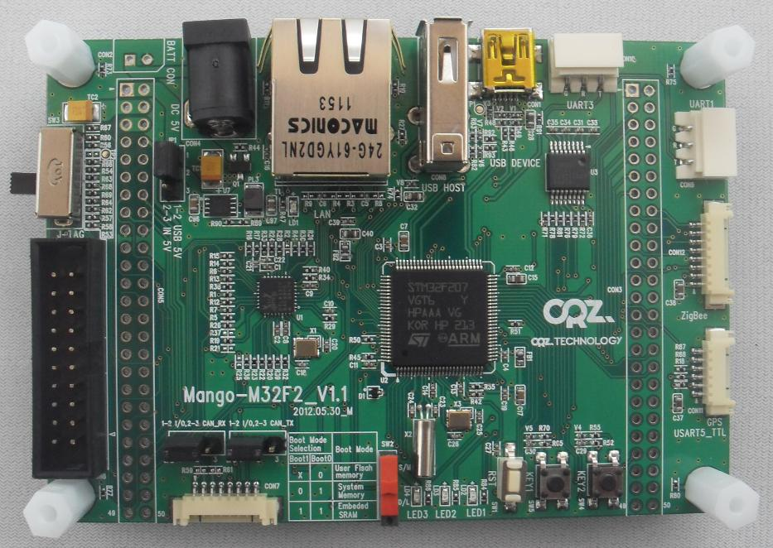

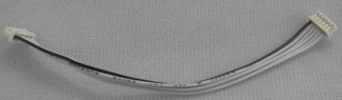

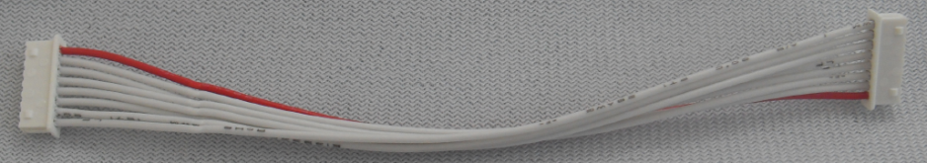






Zigbee
8P cable
GPS
6P Cable
8P cable
Pressure sensor
Light sensor
3-Axis sensor
Remocon sensor
Gyro sensor
CAN Tranceiver

