Slide 1
Different ways to pass data between Windows Forms
Prepared by Team 13 [Excalibur]
21st March 2010

Slide 2
Agenda
Using Constructors
Using Objects
Using Properties
Using Delegates

Slide 3
The Scenario
AddTaskForm: Form that contains task name, source and target directories to be displayed
DisplayTaskForm: Form that takes in task name, source and target directories for display

Slide 4
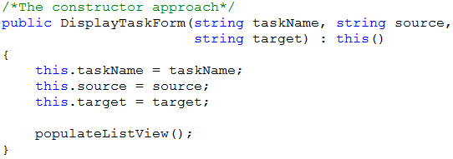
The Constructor Approach
Simplest approach
Overload the constructor of DisplayTaskForm to receive task info from AddTaskForm
Notes:
Simplest approach, just provide another constructor in DisplayTaskForm with parameters to take in the data from AddTaskForm.

Slide 5
The Object Approach
Change the access modifier of the controls that contain the task info to public in AddTaskForm
Create a variable to store the instance of AddTaskForm in DisplayTaskForm
Notes:
The object approach, not recommended as it will increase the coupling of your design.

Slide 6

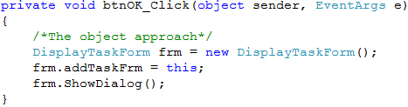
The Object Approach
AddTaskForm Sample Code

Slide 7
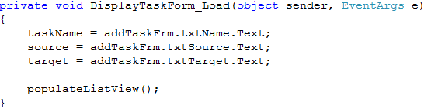
The Object Approach
DisplayTaskForm Sample Code

Slide 8
The Properties Approach
Declare property in AddTaskForm to retrieve task info
Declare property in DisplayTaskForm to set the task info to some data members
Notes:
This approach is like our get and set assessors that we commonly used to retrieve data members in classes.

Slide 9
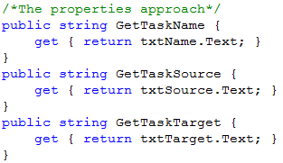
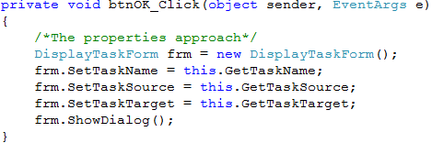
The Properties Approach
AddTaskForm Sample Code

Slide 10
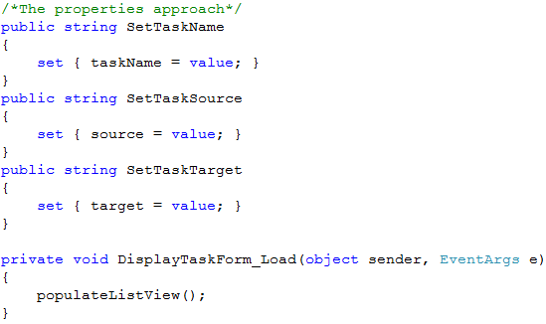
The Properties Approach
DisplayTaskForm Sample Code

Slide 11
The Delegates Approach
Declare a delegate in AddTaskForm
Declare a function in DisplayTaskForm that takes in task info and assign it to some data members
Function declare must match the signature and return type of the delegate
Notes:
The delegate approach. What is delegate? Delegates in cSharp are similar to function pointers in C/C++, basically it encapsulates a method with a specific signature and return type. Functions/methods with the same signatures and return types can be assigned to a common delegate, and when the delegate is called, the corresponding function that is assigned to it will be executed. This is like polymorphism in object-oriented programming.

Slide 12
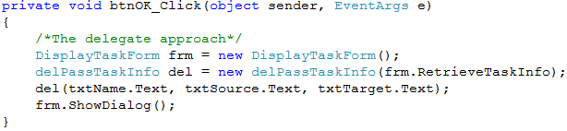
The Delegates Approach
AddTaskForm Sample Code

Slide 13
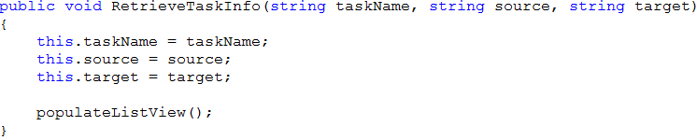
The Delegates Approach
DisplayTaskForm Sample Code

Slide 14
Conclusion
Object approach increases coupling of your design.
Our team recommends to use the other 3 approaches or combination of the 3 when passing data between forms

Slide 15
References
http://www.codeproject.com/KB/cs/pass_data_between_forms.aspx

Slide 16
Questions?

