Slide 1
The ISTP Framework
A Systematic Blueprint for Building High-Potential New Businesses and Brands
mGanik.com

Slide 2

Business creation is often guided by intuition. Repeatable Consistent Success Requires a System
Key Challenges
Unclear Market Focus
Weak differentiation
Wasted resources
Risk for failure
The Solution: The ISTP Framework
A repeatable engine for creating new ventures with precision
While de-risking the path to market and reducing adjustments and inefficiencies.

Slide 3

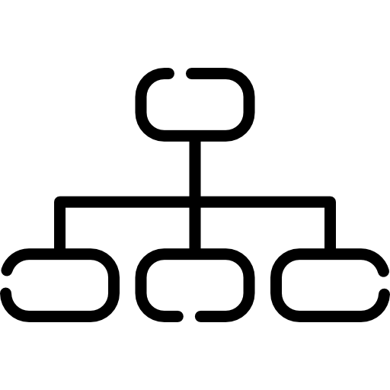

A Four-Phase Framework from Broad Idea to a Winning Company
Phase I:
Industry Insights
Phase III: Targeting
Phase IV: Positioning
Phase II:
Segmentation
Find the right continent.
Choose the best island.
Build your fortress
Map the Regions.

Slide 4
Phase I: First, Validate the Viability of the Industry
Is this an industry worth our investment for the next decade?
Purpose: To define the market, evaluate long-term sustainability, and assess mid-term attractiveness before committing significant resources.
Output: A clear ‘Proceed’ or ‘Stop’ Decision

Slide 5



We analyse the market at three levels of altitude.
Define the Market
2. Assess Sustainability (10+ Years)
3. Assess Attractiveness (3-5 years)
Start with a precise definition.
Evaluate broad structural trends that support long-term growth.
Quantify the immediate opportunity.
Healthcare
Diabetes Management Solutions
Demographic Trends
Regulatory Changes
Tech Adoption
Customer Values
Market Size (total value)
Market Growth Rate (CAGR)
Include: Customer Groups, Channels, and Categories/Solutions

Slide 6
Phase II: Deconstruct the Industry through Segmentation
Where are all the possible markets we could enter?
Mapping out all the islands.
Purpose: To map out all possible customer groups, competitors, and solutions types available within the defined industry.
Output: A comprehensive catalogue of potential market segments.

Slide 7



The Most Actionable Segments are first built around customer solutions
Drug Market
Medication, Insulin
Private Clinical Solutions
Labs, consultations
Diabetes Management
Clinical Nutrition
Meal replacements
Device Solutions
CGM, Glucometers

Slide 8
Phase III: Select the Single Best Segment Objectively
Which specific market gives us the highest probability of winning
Choosing the best island
Purpose: To evaluate each segment objectively and choose the one that best first your strategy, capability, and current business stage.
Output: One winning ‘entry market’

Slide 9
A Consistent Quantitative framework Ensure the Right Choice for the Right Reasons
Demand Power
Market size (TAM, SAM, Revenue)
Market Gorwth Rate (CAGR)
Profitability/Maign (Gross margins, Ebitda, net margins)
2. Market Segments & Structure
Competitive intensity (no. of players, fragmentation)
Entry barriers (regulatory, needs , tech)
Customer segmentation Quality (How profitable are the customer segments
3. Structural Dynamics (Long-Term Power)
Regulatory Environment
Is it supportive, neutral or restritctive
Social, Demographic and Macro Trends
Aging population
Urbanisation
Price sensitivity

Slide 10
However, the framework requires extensive research. A good much more executable framework would be:
Market-insight fit.
Measuring strategic relevance of market with the insights + gaps of opportunity
2. Market Attractiveness.
Barod numbers of market size and growth potential
3. Investment Barriers
The cost of entry. CapEx, time to Market and NPV
4. Capability Feasibility
How hard is it to start operating and winning within the market. Minimum requirements and key success factors.

Slide 11
The “right” choice depends on the current state of the business.
While Each Factor is important, it should be noted that whichever is most important is mostly dependent on the business e.g.
 | Primary Focus | Secondary Focus
For Startups | Market-insight Fit | Growth
For Mid-Sized Companies | Investment Ease | Key Success Factors
For Large Companies | Portfolio Synergy | Market Size

Slide 12
Phase IV: Design Your Strategy to Dominate the Chosen Market
How will we win?
Building the fortress
Purpose: To understand the selected market deeply and build a sustainable competitive advantage
Output: A clear competitive position, product strategy and business structure.

Slide 13
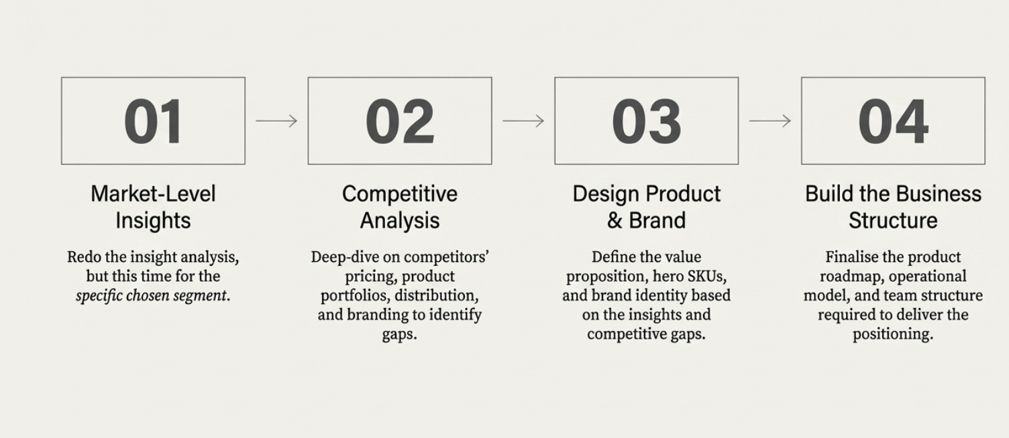
With a target selected, we repear teh process until we gain micro-focus

Slide 14
