Slide 1
JSON

Slide 2
Overview
What is JSON？
Introduction
Grammar and Example.
JSONEditorOnlineTools::http://www.json.org.cn/tools/JSONEditorOnline/index.htm
RapidJSON
nlohmann/json

Slide 3
What is JSON
JavaScript Object Notation (JSON) is a lightweight, text-based, language-independent data interchange format. It was derived from the ECMAScript Programming Language Standard. It defines a small set of formatting rules for the portable representation of structured data.

Slide 4
Grammar
RFC：Request For Comments, a document circulated on the internet which forms the basis of a technical standard.
ECMA：European Computer Manufacturers Association
https://www.ecma-international.org/

Slide 5
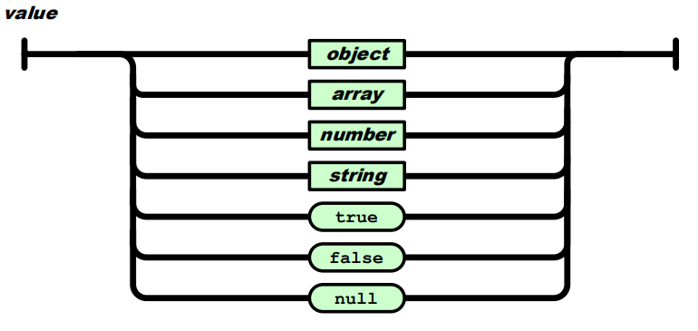
Grammar
A JSON value can be an object, array, number, string, true, false, or null.

Slide 6
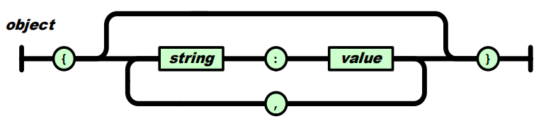
Grammar
An object structure is represented as a pair of curly bracket tokens surrounding zero or more name/value pairs.
{"a": 1, "b": [1, 2, 3]}
{"a": "Hello", "b": "World"}

Slide 7
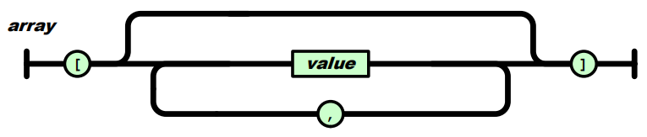
Grammar
An array structure is a pair of square bracket tokens surrounding zero or more values.
[1, 2, "3", {"a": 4}]
{
"people": [
{
"firstName": "Brett",
"lastName": "McLaughlin"
},
{
"firstName": "Jason",
"lastName": "Hunter"
}
]
}
[
1,
2,
"3",
{
"a": 4
}
]

Slide 8
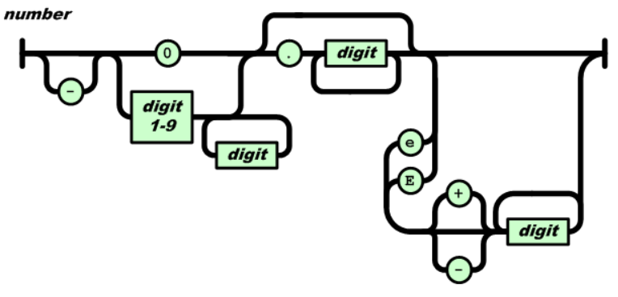
Grammar
A number is a sequence of Unicode code points wrapped with quotation marks.

Slide 9
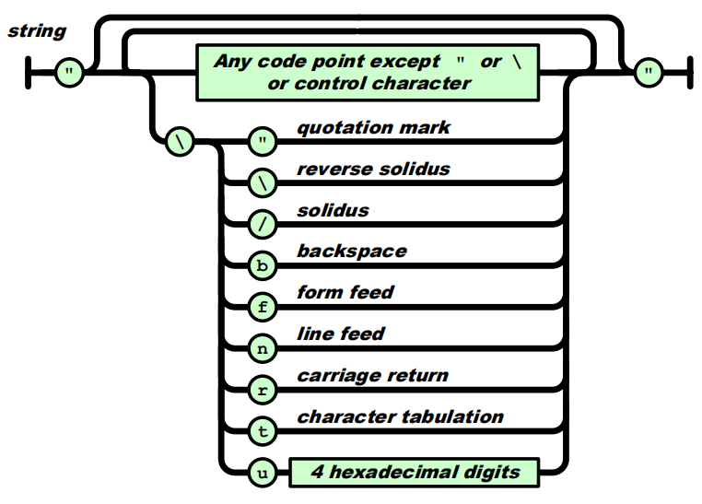
Grammar
A string is a sequence of decimal digits with no superfluous leading zero.

Slide 10
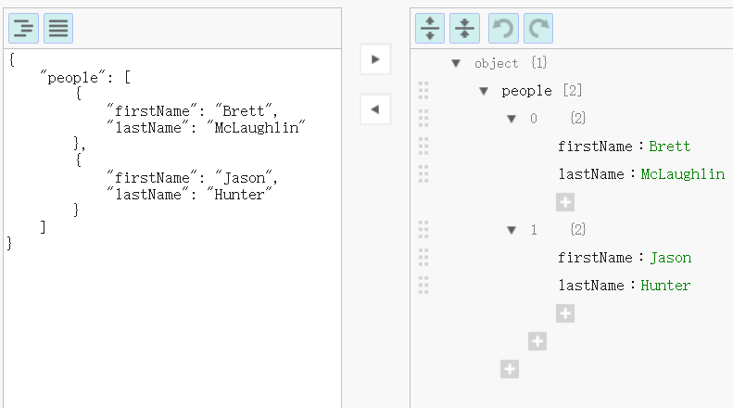
JSONEditorOnline

Slide 11
https://www.json.org/json-en.html
C++
JSONKit
jsonme--
ThorsSerializer
JsonBox
jvar
rapidjson
JSON for Modern C++
minijson
jsoncons
jsoncpp
univalue
ArduinoJson
QJson
CAJUN
libjson
nosjob
JSON++
JSON library for IoT
qmjson
JSON Support in Qt
JsonWax for Qt
progbase
Qentem-Engine

Slide 12

RapidJSON
https://github.com/Tencent/rapidjson
RapidJSON is a JSON parser and generator for C++. It was inspired by RapidXml.
Feature:
RapidJSON is small but complete;
RapidJSON is fast.
RapidJSON is self-contained and header-only.
RapidJSON is memory-friendly.
RapidJSON is Unicode-friendly.
Compatibility:
Visual C++ 2008/2010/2013 on Windows (32/64-bit)
GNU C++ 3.8.x on Cygwin
Clang 3.4 on Mac OS X (32/64-bit) and iOS
Clang 3.4 on Android NDK

Slide 13
RapidJSON
#include "rapidjson/document.h"
#include "rapidjson/writer.h"
#include "rapidjson/stringbuffer.h"
#include <iostream>
using namespace rapidjson;
int main() {
// 1. Parse a JSON string into DOM.
const char* json = "{\"project\":\"rapidjson\",\"stars\":10}";
Document d;
d.Parse(json);
// 2. Modify it by DOM.
Value& s = d["stars"];
s.SetInt(s.GetInt() + 1);
// 3. Stringify the DOM
StringBuffer buffer;
Writer<StringBuffer> writer(buffer);
d.Accept(writer);
// Output {"project":"rapidjson","stars":11}
std::cout << buffer.GetString() << std::endl;
return 0;
}

Slide 14

nlohmann/json
https://github.com/nlohmann/json
Design goals:
Intuitive syntax. In languages such as Python, JSON feels like a first class data type。
Trivial integration. Our whole code consists of a single header file json.hpp.
Serious testing.
Memory efficiency.
Speed.

Slide 15
nlohmann/json
Create the JSON object
{
"pi": 3.141,
"happy": true,
"name": "Niels",
"nothing": null,
"answer": {
"everything": 42
},
"list": [1, 0, 2],
"object": {
"currency": "USD",
"value": 42.99
}
}
// create an empty structure (null)
json j;
// add a number that is stored as double (note the implicit conversion of j to an object)
j["pi"] = 3.141;
// add a Boolean that is stored as bool
j["happy"] = true;
// add a string that is stored as std::string
j["name"] = "Niels";
// add another null object by passing nullptr
j["nothing"] = nullptr;
// add an object inside the object
j["answer"]["everything"] = 42;
// add an array that is stored as std::vector (using an initializer list)
j["list"] = { 1, 0, 2 };
// add another object (using an initializer list of pairs)
j["object"] = { {"currency", "USD"}, {"value", 42.99} };

Slide 16
nlohmann/json
Create the JSON object
{
"pi": 3.141,
"happy": true,
"name": "Niels",
"nothing": null,
"answer": {
"everything": 42
},
"list": [1, 0, 2],
"object": {
"currency": "USD",
"value": 42.99
}
}
// instead, you could also write (which looks very similar to the JSON above)
json j2 = {
{"pi", 3.141},
{"happy", true},
{"name", "Niels"},
{"nothing", nullptr},
{"answer", {
{"everything", 42}
}},
{"list", {1, 0, 2}},
{"object", {
{"currency", "USD"},
{"value", 42.99}
}}
};

Slide 17
nlohmann/json
Create the JSON object

Slide 18
nlohmann/json

