Slide 1
JSON

Slide 2
Overview
What is JSON？
Grammar and Example.
JSON Editor Online Tools
  http://www.json.org.cn/tools/JSONEditorOnline/index.htm
RapidJSON

Slide 3
What is JSON
JavaScript Object Notation (JSON)：
  It is a lightweight, text-based, language-independent data interchange format.
  It was derived from the ECMAScript Programming Language Standard.
  It defines a small set of formatting rules for the portable representation of structured data.

Slide 4
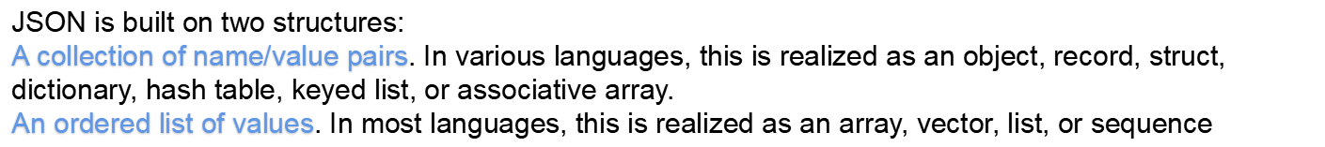
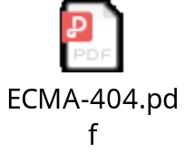
Grammar
ECMA：European Computer Manufacturers Association
  https://www.ecma-international.org/
  http://www.ecma-international.org/publications/files/ECMA-ST/ECMA-404.pdf

Slide 5
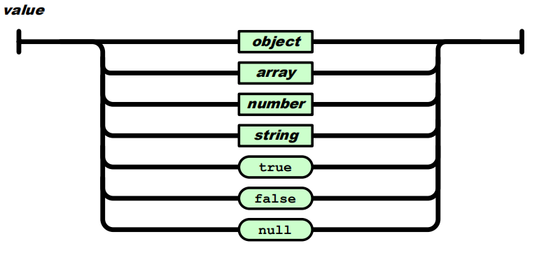
Grammar
A JSON value can be an object, array, number, string, true, false, or null.

Slide 6
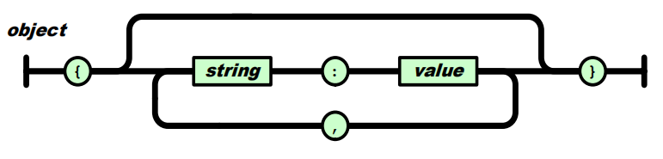
Grammar
An object structure is represented as a pair of curly bracket tokens surrounding zero or more name/value pairs.
{"a": 1, "b": [1, 2, 3]}
{"a": "Hello", "b": "World"}

Slide 7
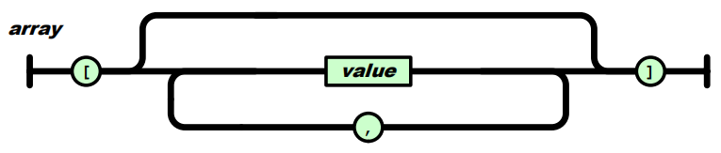
Grammar
An array structure is a pair of square bracket tokens surrounding zero or more values.
[1, 2, "3", {"a": 4}]
{
"people": [
{
"firstName": "Brett",
"lastName": "McLaughlin"
},
{
"firstName": "Jason",
"lastName": "Hunter"
}
]
}
[
1,
2,
"3",
{
"a": 4
}
]

Slide 8
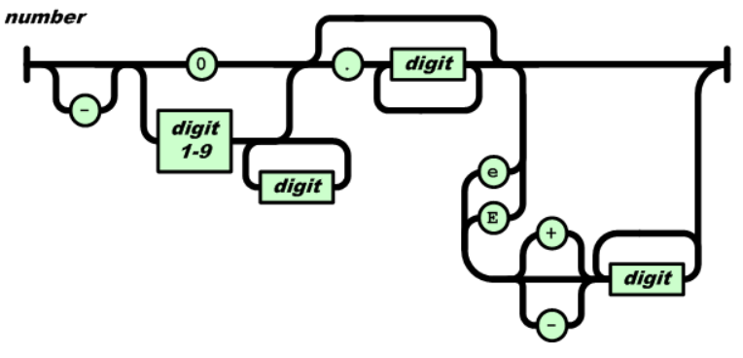
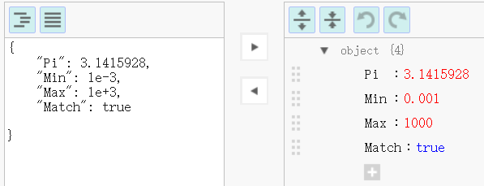
Grammar
A number is a sequence of Unicode code points wrapped with quotation marks.

Slide 9
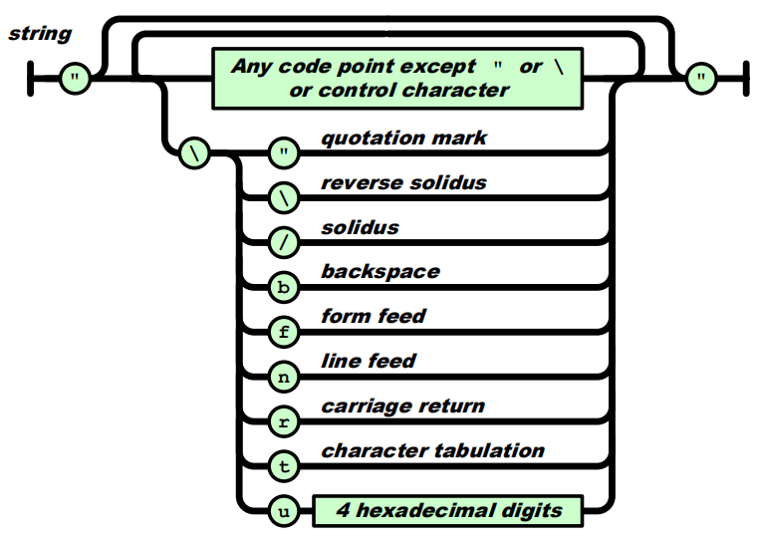
Grammar
A string is a sequence of decimal digits with no superfluous leading zero.

Slide 10
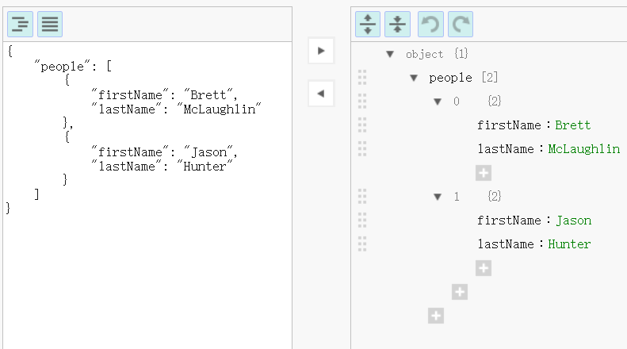
JSONEditorOnline
  http://www.json.org.cn/tools/JSONEditorOnline/index.htm

Slide 11
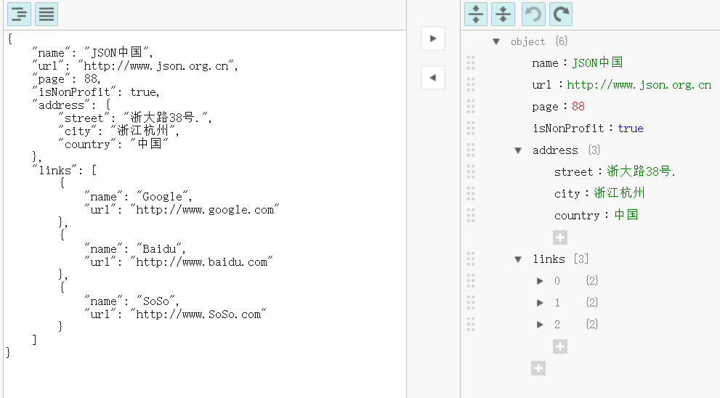
JSONEditorOnline
  http://www.json.org.cn/tools/JSONEditorOnline/index.htm

Slide 12
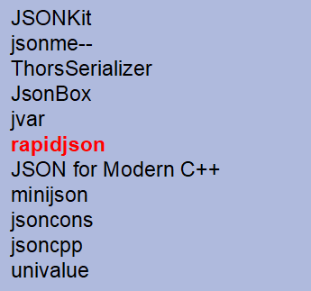
https://www.json.org/json-en.html
C++ libary for JSON
ArduinoJson
QJson
CAJUN
libjson
nosjob
JSON++
JSON library for IoT
qmjson
JSON Support in Qt
JsonWax for Qt
progbase
Qentem-Engine

Slide 13

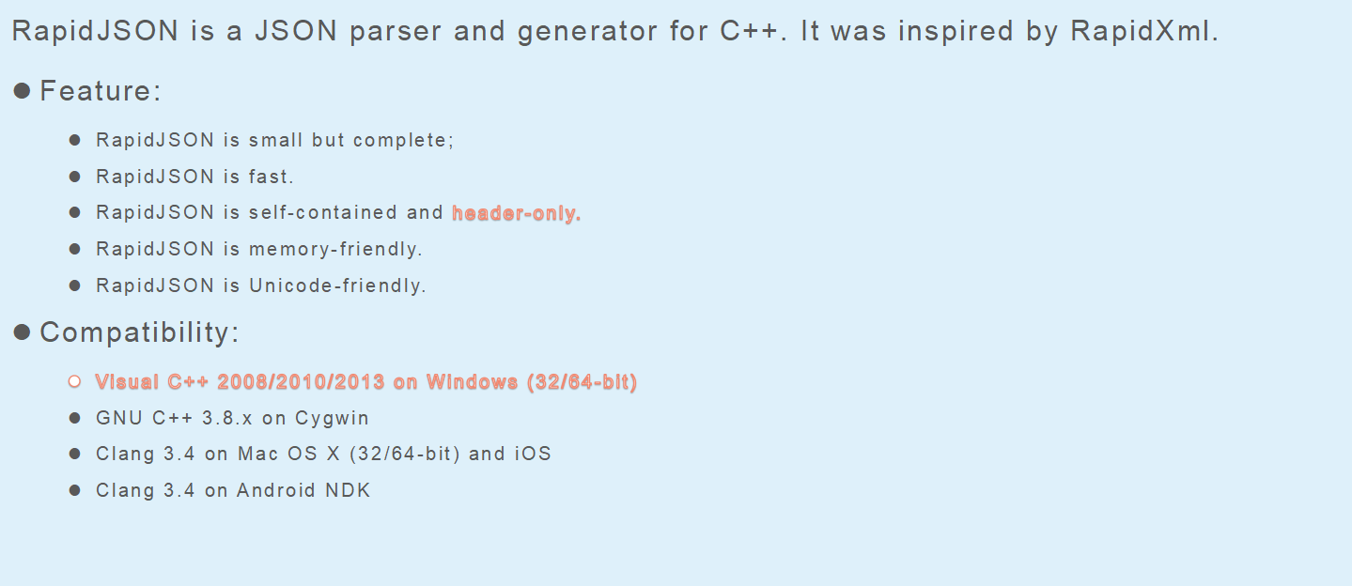
RapidJSON
https://github.com/Tencent/rapidjson

Slide 14
RapidJSON
Examples are available:
DOM API
  tutorial: Basic usage of DOM API.
SAX API
  simplereader: Dumps all SAX events while parsing a JSON by Reader.
  condense: A command line tool to rewrite a JSON, with all whitespaces removed.
  pretty: A command line tool to rewrite a JSON with indents and newlines by PrettyWriter.
  capitalize: A command line tool to capitalize strings in JSON.
  messagereader: Parse a JSON message with SAX API.
  serialize: Serialize a C++ object into JSON with SAX API.
  jsonx: Implements a JsonxWriter which stringify SAX events into JSONx (a kind of XML) format. The example is a command line tool which converts input JSON into JSONx format.
Schema
  schemavalidator : A command line tool to validate a JSON with a JSON schema.
Advanced
  prettyauto: A modified version of pretty to automatically handle JSON with any UTF encodings.
  parsebyparts: Implements an AsyncDocumentParser which can parse JSON in parts, using C++11 thread.
  filterkey: A command line tool to remove all values with user-specified key.
  filterkeydom: Same tool as above, but it demonstrates how to use a generator to populate a Document.

Slide 15
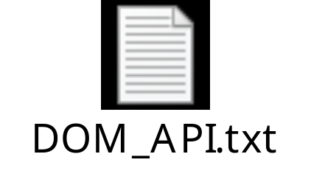
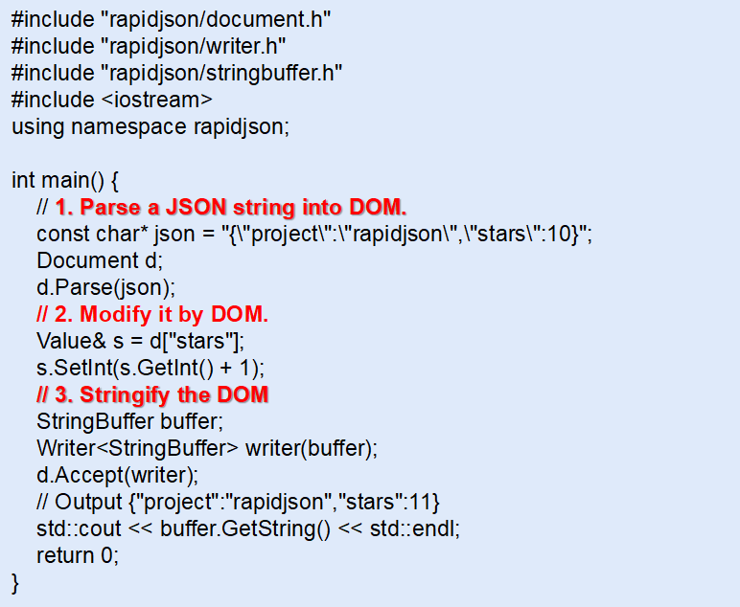
RapidJSON
DOM_API Example

Slide 16

RapidJSON
SAX API Example

