Slide 1
JSON

Slide 2
Overview
What is JSON？
Grammar and Example.
JSON Editor Online Tools
http://www.json.org.cn/tools/JSONEditorOnline/index.htm
RapidJSON

Slide 3
What is JSON
JavaScript Object Notation (JSON)：
It is a lightweight, text-based, language-independent data interchange format.
It was derived from the ECMAScript Programming Language Standard.
It defines a small set of formatting rules for the portable representation of structured data.

Slide 4
Grammar
JSON is built on two structures:
A collection of name/value pairs. In various languages, this is realized as an object, record, struct, dictionary, hash table, keyed list, or associative array.
An ordered list of values. In most languages, this is realized as an array, vector, list, or sequence
ECMA：European Computer Manufacturers Association
https://www.ecma-international.org/
http://www.ecma-international.org/publications/files/ECMA-ST/ECMA-404.pdf

Slide 5
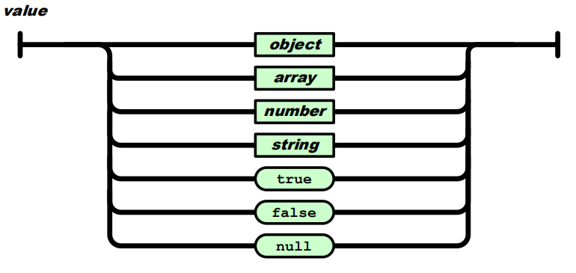
Grammar
A JSON value can be an object, array, number, string, true, false, or null.

Slide 6
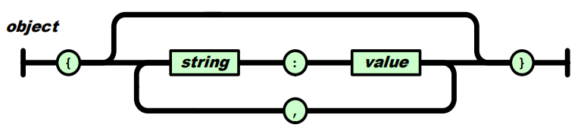
Grammar
An object structure is represented as a pair of curly bracket tokens surrounding zero or more name/value pairs.
{"a": 1, "b": [1, 2, 3]}
{"a": "Hello", "b": "World"}

Slide 7
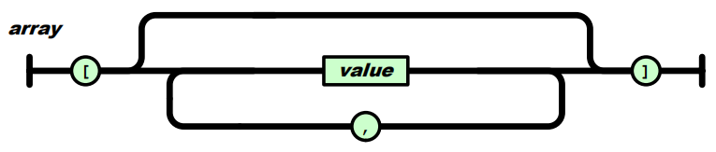
Grammar
An array structure is a pair of square bracket tokens surrounding zero or more values.
[1, 2, "3", {"a": 4}]
{
"people": [
{
"firstName": "Brett",
"lastName": "McLaughlin"
},
{
"firstName": "Jason",
"lastName": "Hunter"
}
]
}
[
1,
2,
"3",
{
"a": 4
}
]

Slide 8
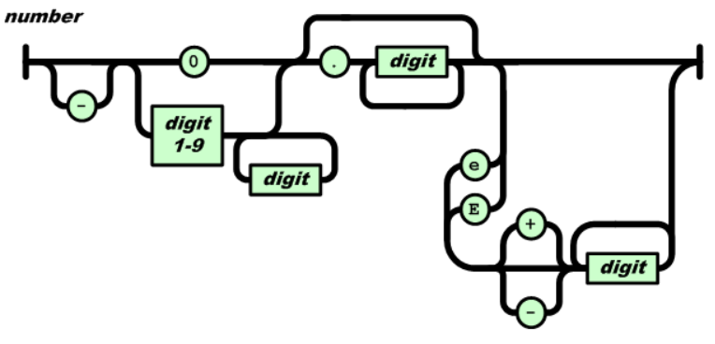
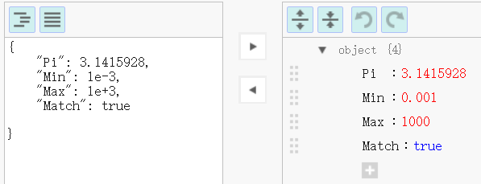
Grammar
A number is a sequence of Unicode code points wrapped with quotation marks.

Slide 9
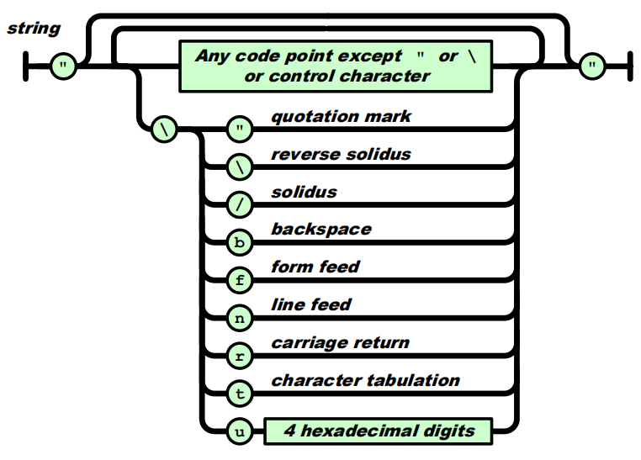
Grammar
A string is a sequence of decimal digits with no superfluous leading zero.

Slide 10
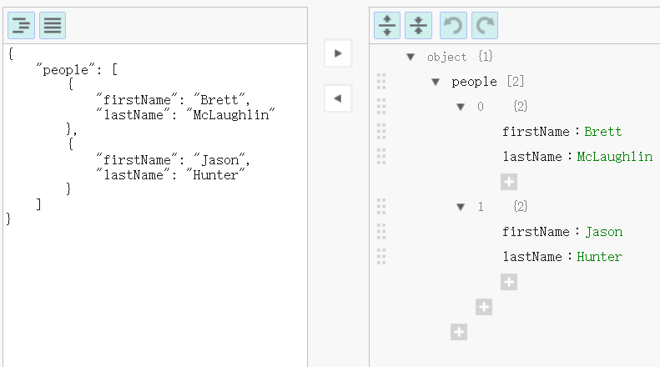
JSONEditorOnline
http://www.json.org.cn/tools/JSONEditorOnline/index.htm

Slide 11
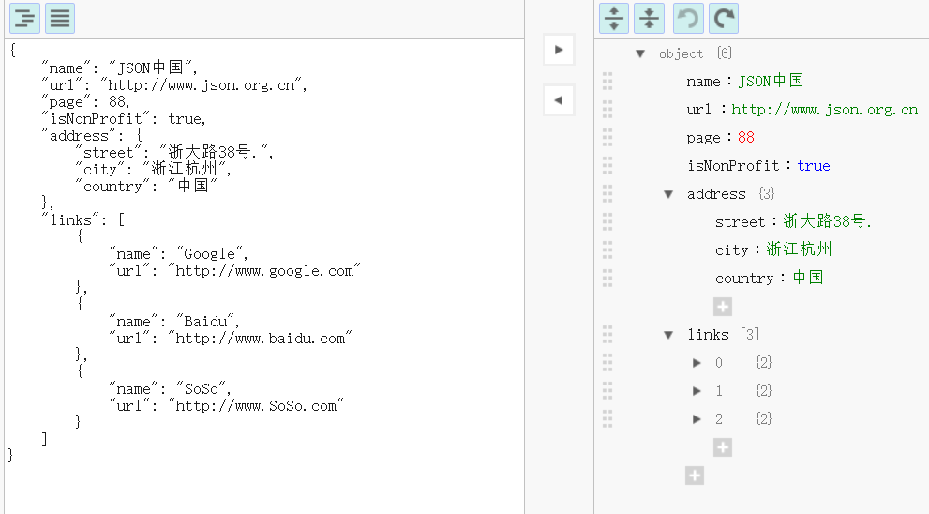
JSONEditorOnline
http://www.json.org.cn/tools/JSONEditorOnline/index.htm

Slide 12
https://www.json.org/json-en.html
C++ libary for JSON
JSONKit
jsonme--
ThorsSerializer
JsonBox
jvar
rapidjson
JSON for Modern C++
minijson
jsoncons
jsoncpp
univalue
ArduinoJson
QJson
CAJUN
libjson
nosjob
JSON++
JSON library for IoT
qmjson
JSON Support in Qt
JsonWax for Qt
progbase
Qentem-Engine

Slide 13

RapidJSON
https://github.com/Tencent/rapidjson
RapidJSON is a JSON parser and generator for C++. It was inspired by RapidXml.
Feature:
RapidJSON is small but complete;
RapidJSON is fast.
RapidJSON is self-contained and header-only.
RapidJSON is memory-friendly.
RapidJSON is Unicode-friendly.
Compatibility:
Visual C++ 2008/2010/2013 on Windows (32/64-bit)
GNU C++ 3.8.x on Cygwin
Clang 3.4 on Mac OS X (32/64-bit) and iOS
Clang 3.4 on Android NDK

Slide 14
RapidJSON
Examples are available:
DOM API
tutorial: Basic usage of DOM API.
SAX API
simplereader: Dumps all SAX events while parsing a JSON by Reader.
condense: A command line tool to rewrite a JSON, with all whitespaces removed.
pretty: A command line tool to rewrite a JSON with indents and newlines by PrettyWriter.
capitalize: A command line tool to capitalize strings in JSON.
messagereader: Parse a JSON message with SAX API.
serialize: Serialize a C++ object into JSON with SAX API.
jsonx: Implements a JsonxWriter which stringify SAX events into JSONx (a kind of XML) format. The example is a command line tool which converts input JSON into JSONx format.
Schema
schemavalidator : A command line tool to validate a JSON with a JSON schema.
Advanced
prettyauto: A modified version of pretty to automatically handle JSON with any UTF encodings.
parsebyparts: Implements an AsyncDocumentParser which can parse JSON in parts, using C++11 thread.
filterkey: A command line tool to remove all values with user-specified key.
filterkeydom: Same tool as above, but it demonstrates how to use a generator to populate a Document.

Slide 15
RapidJSON
DOM_API Example
#include "rapidjson/document.h"
#include "rapidjson/writer.h"
#include "rapidjson/stringbuffer.h"
#include <iostream>
using namespace rapidjson;
int main() {
// 1. Parse a JSON string into DOM.
const char* json = "{\"project\":\"rapidjson\",\"stars\":10}";
Document d;
d.Parse(json);
// 2. Modify it by DOM.
Value& s = d["stars"];
s.SetInt(s.GetInt() + 1);
// 3. Stringify the DOM
StringBuffer buffer;
Writer<StringBuffer> writer(buffer);
d.Accept(writer);
// Output {"project":"rapidjson","stars":11}
std::cout << buffer.GetString() << std::endl;
return 0;
}

Slide 16
RapidJSON
SAX API Example

