Slide 1




CMSC204
Kartchner
V(StateGraph) = {Oregon, Alaska, Texas, Hawaii, Vermont, NewYork, California}
E(StateGraph) = {(Alaska, Oregon), (Hawaii, Alaska), (Hawaii, Texas), (Texas, Hawaii), (Hawaii, California), (Hawaii, New York), (Texas, Vermont), (Vermont, California), (Vermont, Alaska)}
1. Draw the StateGraph
Alaska
Oregon
California
Hawaii
Texas
New York
Vermont
Skipped
No
Yes
Texas

Slide 2
a. Show the adjacency matrix that would describe the edges in the graph. Store the vertices in alphabetical order
States
Alaska California Hawaii New York Oregon Texas Vermont
Alaska
California
Hawaii
New York
Oregon
Texas
Vermont
0 0 0 0 1 0 0
0 0 0 0 0 0 0
1 1 0 1 0 1 0
0 0 0 0 0 0 0
0 0 0 0 0 0 0
0. 0 1 0 0 0 1
1 1 0 0 0 0 0
3. b. Show the adjacency lists
that would describe the edges in the graph
Alaska
California
Hawaii
New York
Oregon
Texas
Vermont
Oregon
Alaska California New York Texas
Hawaii Vermont
Alaska California

Slide 3
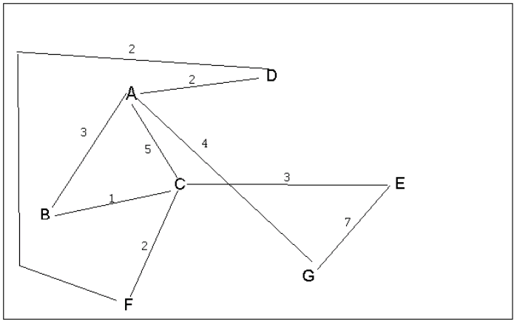
4 a. Which of the following lists the graph nodes in depth first order beginning with E?
A) E, G, F, C, D, B, A
B) G, A, E, C, B, F, D
C) E, G, A, D, F, C, B
D) E, C, F, B, A, D, G
4 b. Which of the following lists the graph nodes in breadth first order beginning at F?
A) F, C, D, A, B, E, G
B) F, D, C, A, B, C, G
C) F, C, D, B, G, A, E
D) a, b, and c are all breadth first traversals

Slide 4
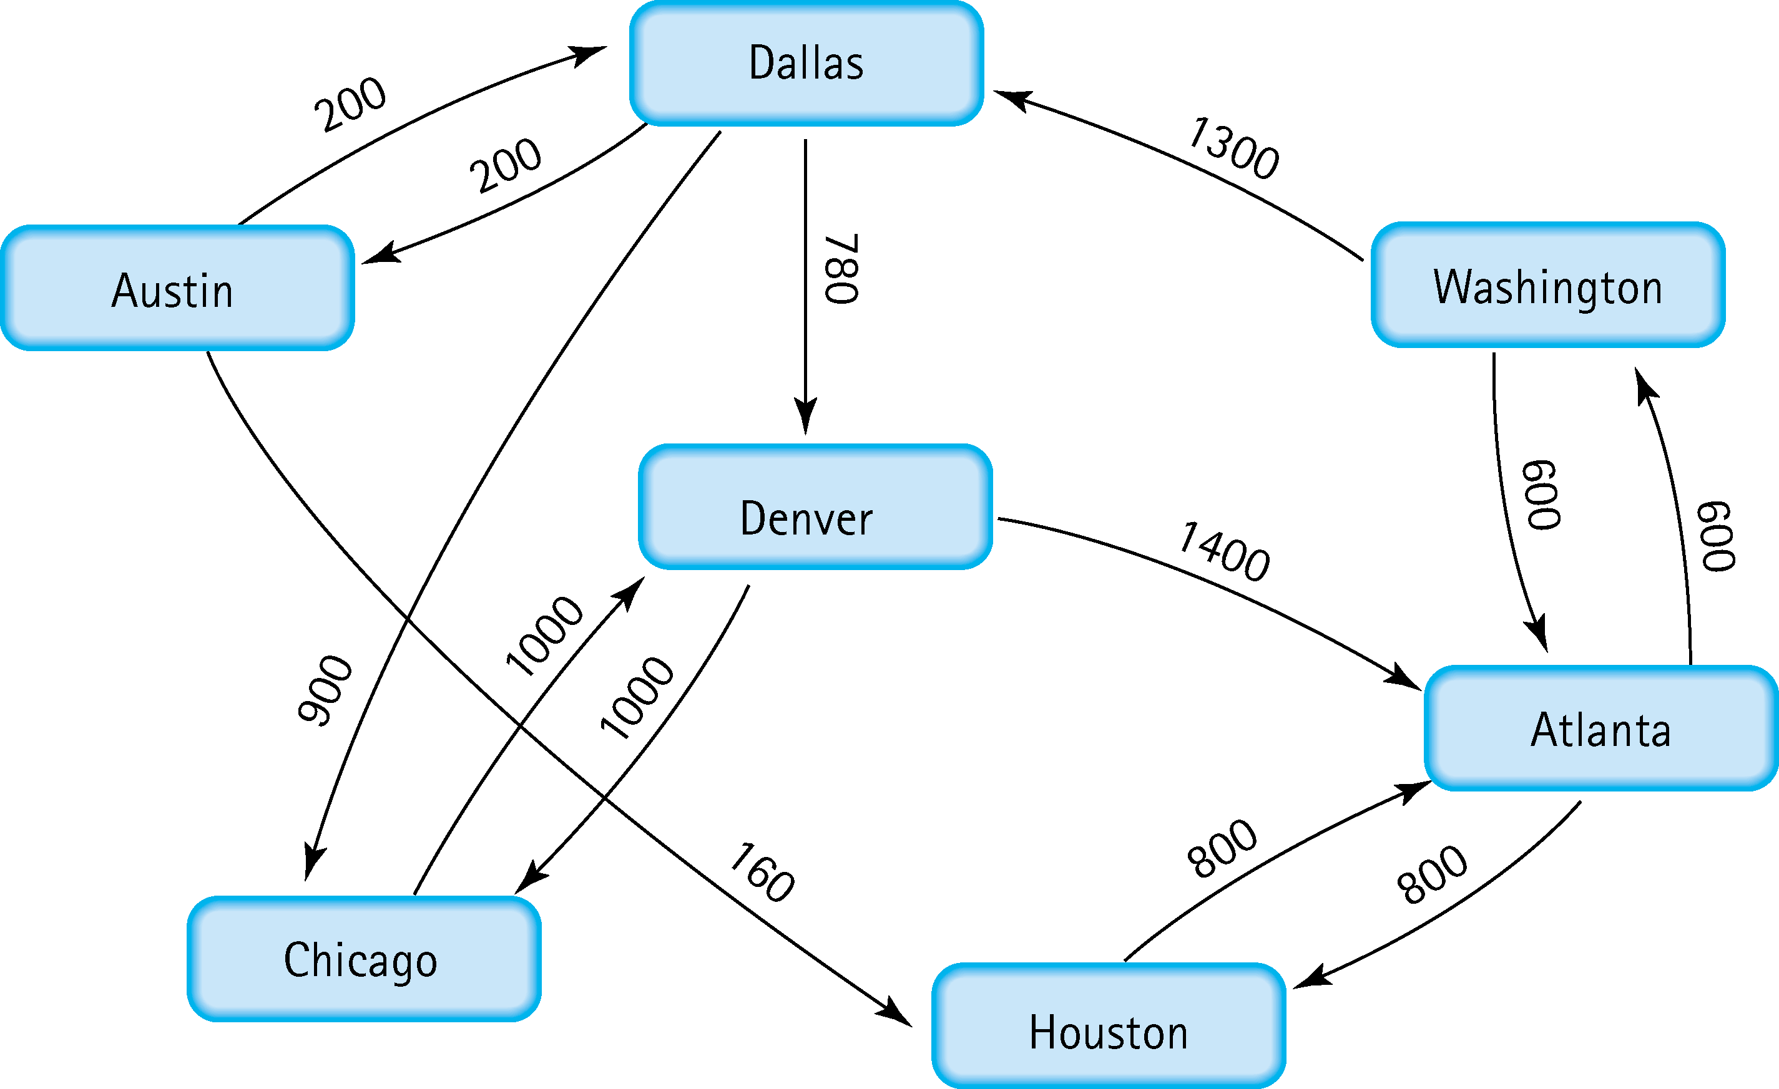
5. Find the shortest distance from Atlanta to every other city
Atlanta Washington 600
Atlanta Houston 800
Atlanta Dallas 1900
Atlanta Denver 2680
Atlanta Chicago 2800
Atlanta Austin 2100

Slide 5
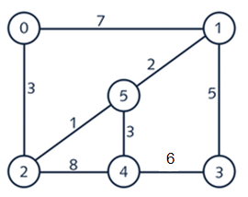








6. Find the minimal spanning tree using Prim’s algorithm. Use
0 as the source vertex . Show the steps.
V = {0} E = O
V= {0,2} E = {(0,2)}
V= {0,2,5} E = {(0,2),(2,5)}
V= {0,2,5,1} E = {(0,2),(2,5),(5,1)}
V = {0,2,5,1,4} E = {(0,2),(2,5),(5,1),(5,4)}
V= {0,2,5,1,4,3} E = {(0,2),(2,5),(5,1),(5,4), (1,3)}
0
1
2
3
5
5
1
3
2
4
3

Slide 6
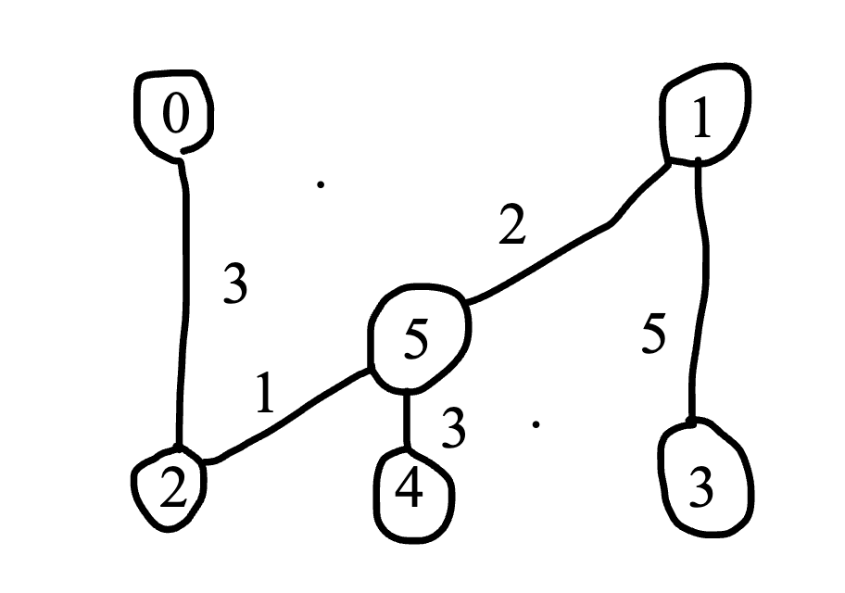
7. Find the minimal spanning tree using Kruskal’s algorithm.
Show the weights in order and the steps.
(2–5) weight 1 (add)
(5–1) weight 2 (add)
(0–2) weight 3 (add)
(5–4) weight 3 (add)
(1–3) weight 5 (add)
(3–4) weight 6
(0–1) weight 7
(2–4) weight 8

Slide 7
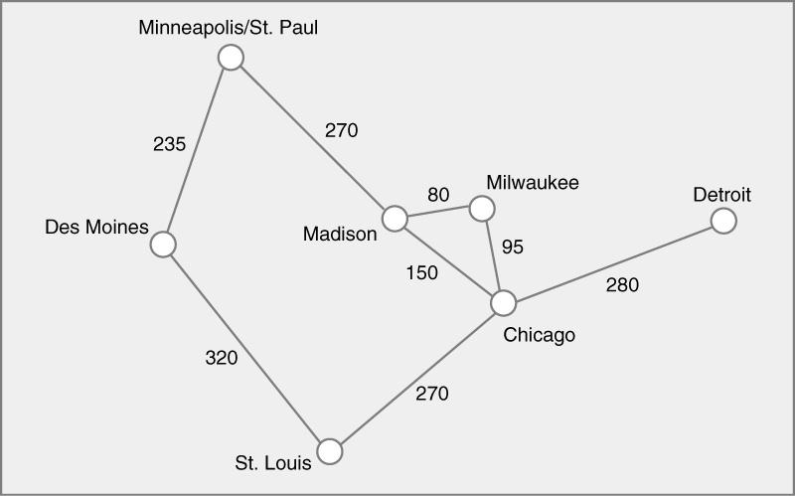
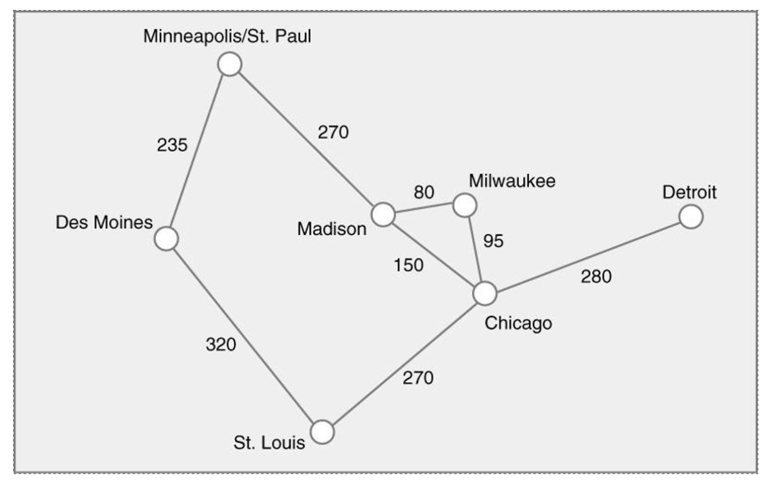

8. Find the minimal spanning tree using the algorithm you prefer. Use
Minneapolis/St. Paul as the source vertex
Madison — Milwaukee : 80 (add)
Milwaukee — Chicago : 95 (add)
Madison — Chicago : 150 (add)
Minneapolis — Des Moines : 235 (add)
Minneapolis — Madison : 270 (add)
St. Louis — Chicago : 270 (add)
Chicago — Detroit : 280 (add)
Des Moines — St. Louis : 320

Slide 8
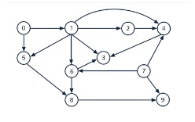
9. List the nodes of the graph in a breadth first topological ordering. Show the
steps using arrays predCount, topologicalOrder and a queue
0, 7, 1, 2, 3, 5, 4, 6, 8, 9

Slide 9

10. List the nodes of the graph in a breadth first topological ordering.
Start, Discrete Math, Programming 1, Programming 2, Computer, Organization, Algorithms, High-Level Languages, Operating Systems, Theory of Computation, Compilers, Senior Seminar, End

