Slide 1
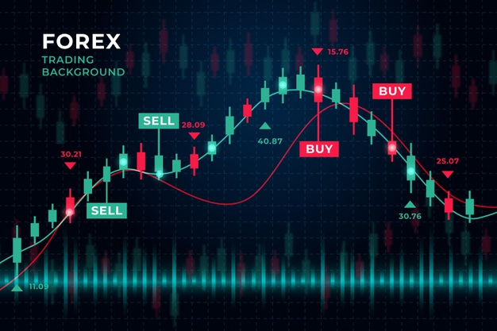
Capstone Project:
Forecasting Time Series with LSTM Recurrent Neural Networks

Slide 2
AGENDA
Introduction
Motivation & Task
Forecasting Time Series with Long Short-term Memory (LSTM) Networks
Work Flow Chart
Results
Conclusions and thoughts

Slide 3
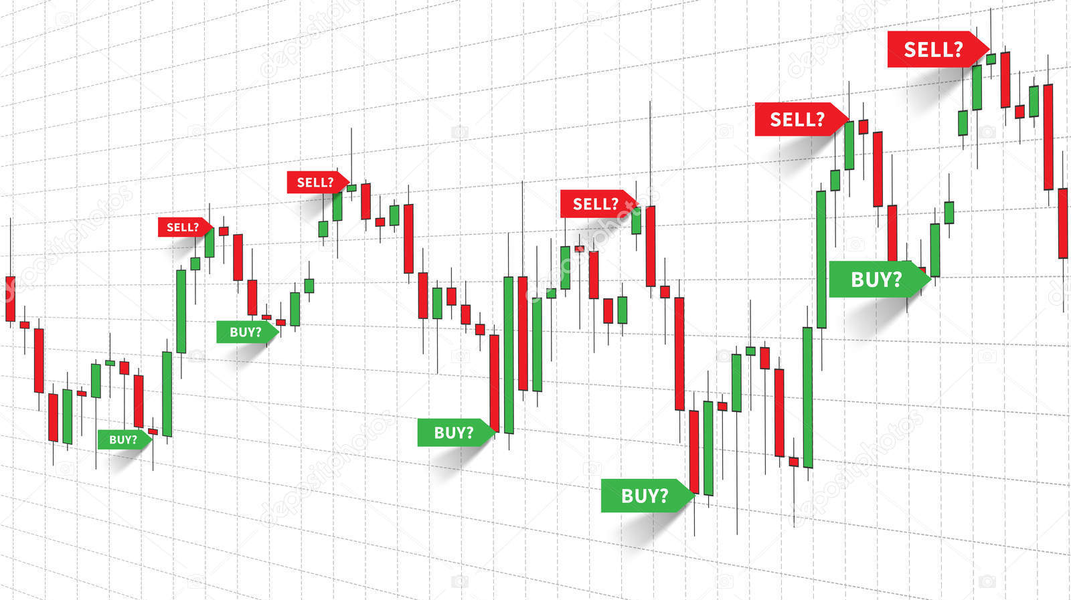
Motivation & Task
WHAT IF !!!
Buy or Sell

Slide 4
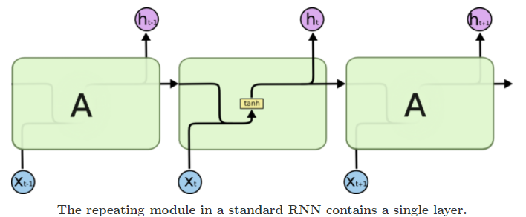
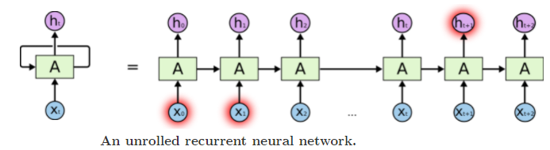
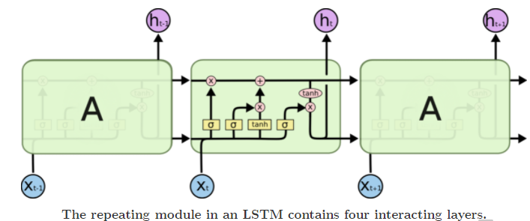
Forecasting Time Series with Long Short-term Memory (LSTM) Networks
RNN
Networks with loops in them, allowing information to persist.
Able to connect previous information to the present task
It’s entirely possible for the gap between the relevant information and the point where it is needed to become very large.
As that gap grows, RNNs become unable to learn to connect the information
LSTMs – are a special kind of RNN, capable of learning long-term dependencies
https://colah.github.io/posts/2015-08-Understanding-LSTMs/

Slide 5
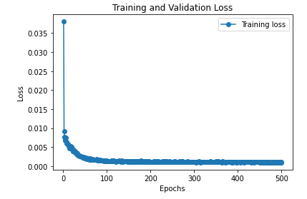
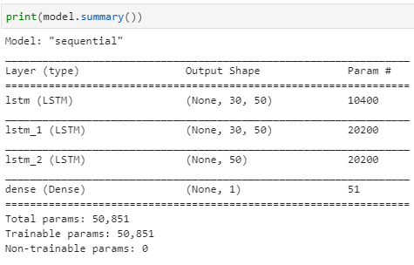
Work Flow Chart
Data Gathering
Yahoo finance API
Data Preparation
Data Split
Data Scale
Data Reshape
LSTM Model
LSTM architecture
Hyper parameter Testing
Forecasting
Result Analysis
Loss Function
RMSE
Display

Slide 6
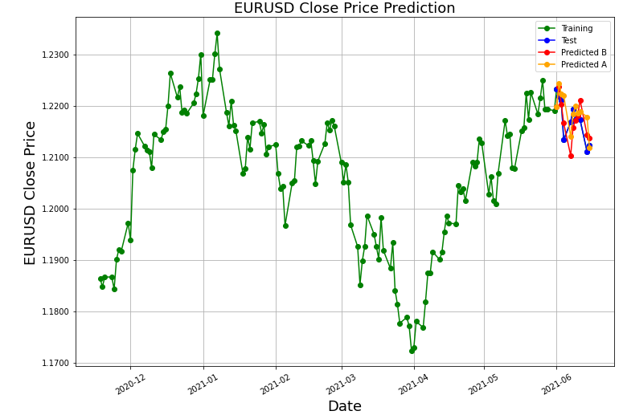
Result Analysis
To predict the price for a specific 1 day, the closing price for the previous 30 days are needed
Version A
Model learnt from the training dataset
Several Closing price forecasted with the same trained model
Version B
Model learnt from a rolling training dataset.
Model updated everyday
Next day Closing price forecasted
Training
Dataset
Test
Dataset

Slide 7
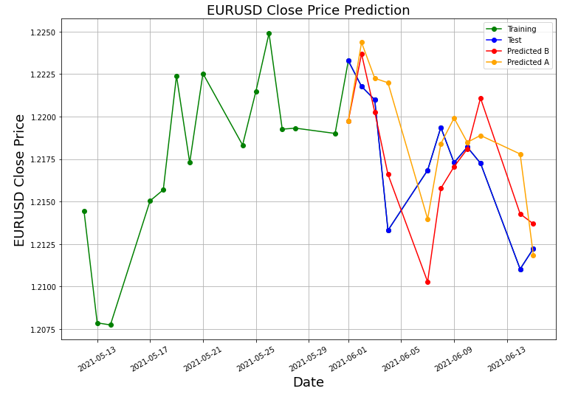
Result Analysis
To predict the price for a specific 1 day, the closing price for the previous 30 days are needed
Version A
Model learnt from the training dataset
Several Closing price forecasted with the same trained model
Version B
Model learnt from a rolling training dataset.
Model updated everyday
Next day Closing price forecasted
Training
Dataset
Test
Dataset
Zoomed display

Slide 8
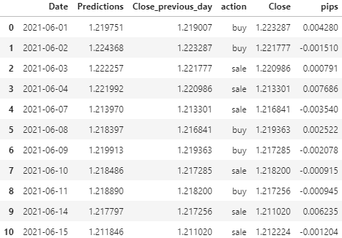
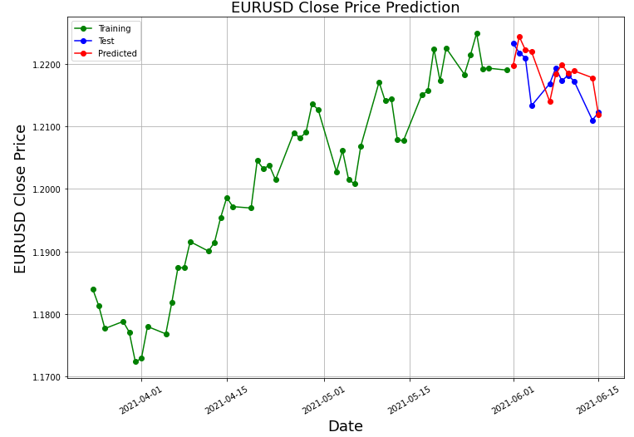
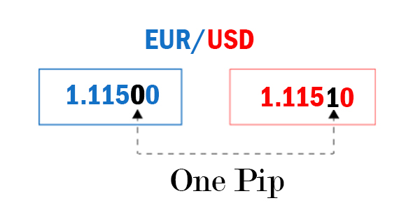
Result Analysis – Version A
B
Get Prediction Price and compare it to Previous Day Close * higher BUY signal,
* lower SELL signal

Slide 9
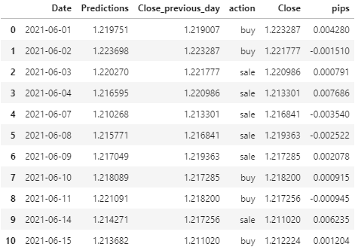
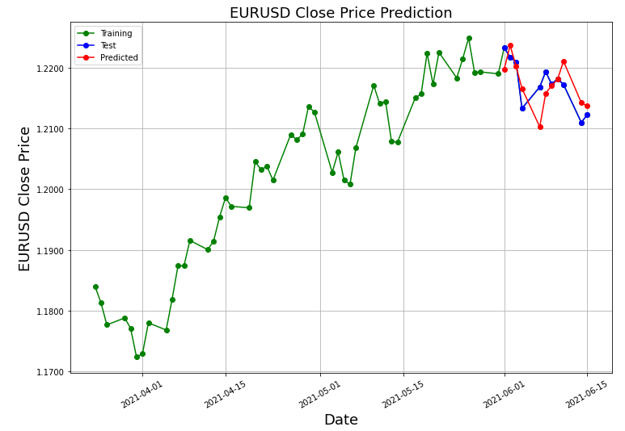
Result Analysis – Version B
B
Get Prediction Price and compare it to Previous Day Close * higher BUY signal,
* lower SELL signal

Slide 10
Conclusions and thoughts
Version | Buy pips | Sale pips | Total pips | Accuracy % | RMSE pips
A | 22.70 | 90.53 | 111.23 | 45.45 | 38.29
B | 39.44 | 107.27 | 146.71 | 63.63 | 31.78
LSTM architecture and hyperparameters highly affect the performance of the model.
The model is basically oriented to technical analysis, no fundamental analysis was taken in consideration when developing the model.
Version B - Updating the model every days seems to provide a better accuracy and total amount of winning pips.
Will you make money with this model? Will depend on several factors that need to be considered. To name a few:
Broker fees for sell/buy
Broker spread between buy/sell price
Fundamental news that can create big price swings..

Slide 11
Thanks to Light House Labs for the learning experience and the opportunity of presenting this capstone project and specially thanks goes to All teachers and support team!!!

