Slide 1
2020 Flight Delays
How to predict flight delays using ML

Slide 2
The problem
Predict Delays
Data Analysis
Create a regression model to predict future flight delays using available data.
Find correlation between independent and dependent variables
Look for meaningful distributions and trends on past data
Utilize historical data for future prediction
Study different delay types and expand domain expertise through available data and information found on the web

Slide 3
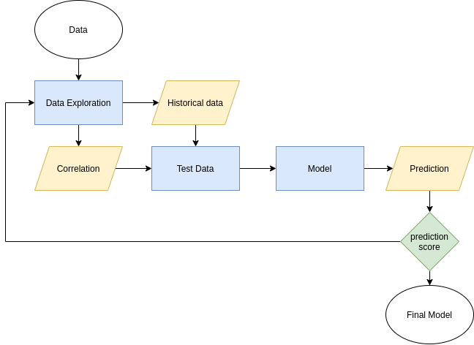
General Project Workflow idea
Create Model and Optimization

Slide 4
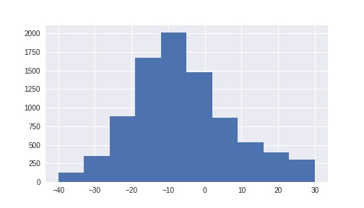
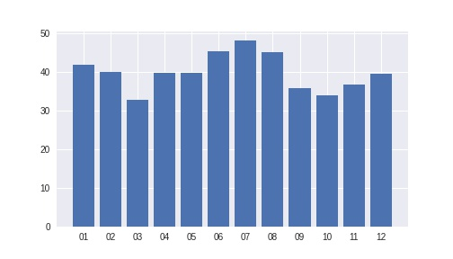
Data Exploration Findings
Delay Distribution
Monthly delay average

Slide 5
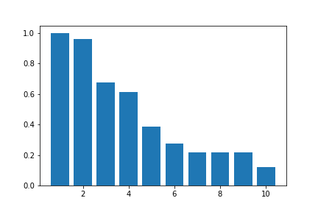
Data Exploration Findings
arr_delay correlation matrix
arr_delay
dep_delay
carrier_delay
late_aircraft_delay
nas_delay
weather_delay
total_add_gtime
taxi_out
longest_add_gtime
dep_time

Slide 6
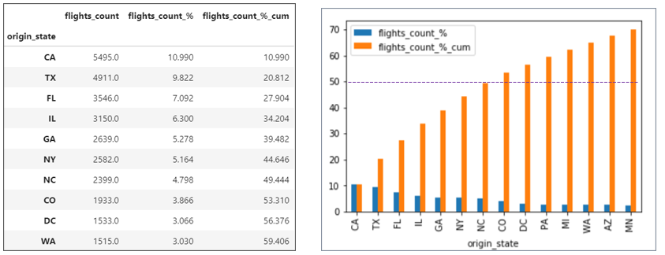
Data Exploration Findings
Flight Traffic by State [%]

Slide 7
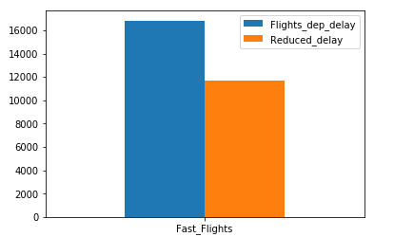
Data Exploration Findings
Do Planes flight faster when a Departure Delay exists? YES
~636 km/h
100%
59%
speed
~652 km/h
Assumptions: If Dep_Delay > 0 Then Delay
If [ Arr_Delay < Dep_Delay ] Then Fast Flight

Slide 8
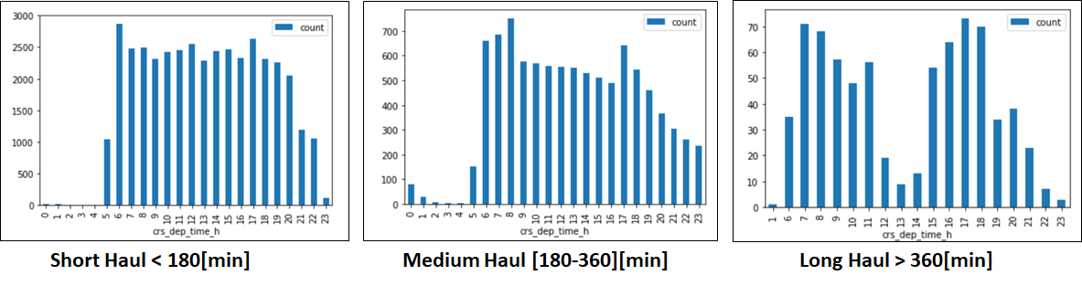
Data Exploration Findings
What hour do most “LONG, SHORT, MEDIUM” haul flights take off ?

Slide 9
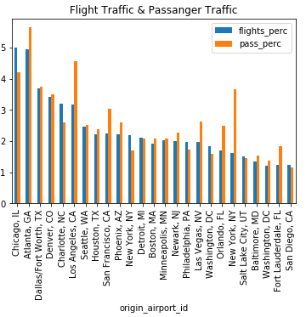
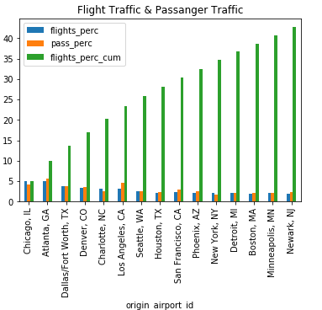
Data Exploration Findings
Does the biggest number of flights mean that the biggest number of passengers went through the particular airport?

Slide 10
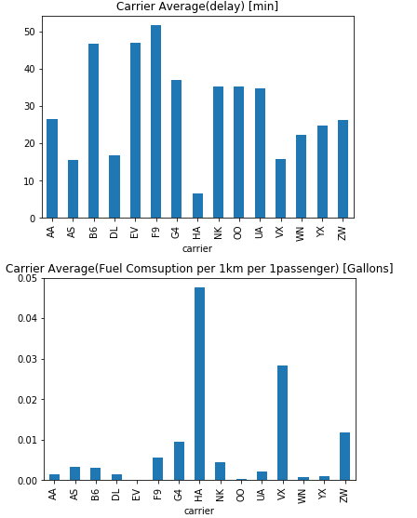
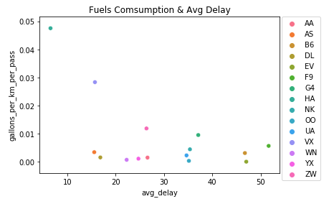
Data Exploration Findings
Average fuel consumption per passenger per km. Is this higher for the airlines with bigger average delays?

Slide 11
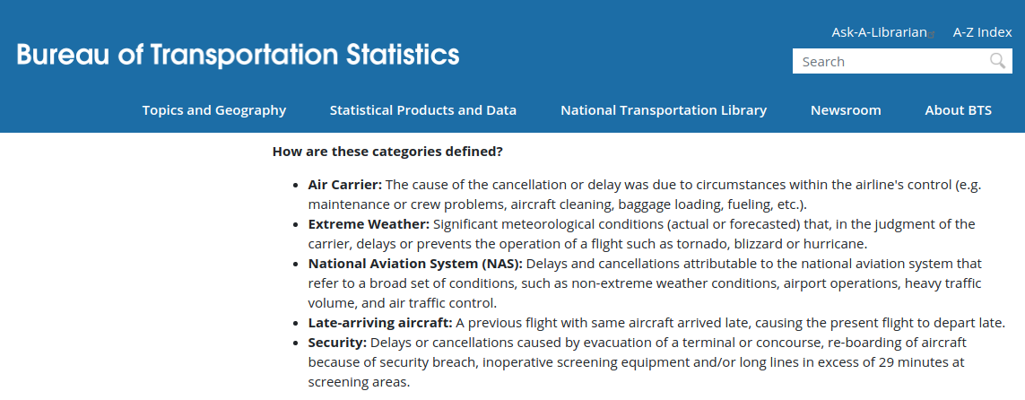
Delays and their meaning
https://www.bts.gov/topics/airlines-and-airports/understanding-reporting-causes-flight-delays-and-cancellations

Slide 12
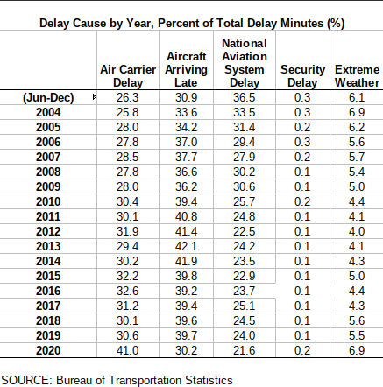
Delay Percentage
Primary contributors of delay:
Air Carrier
Aircraft Arriving Late
National Aviation System
Extreme Weather
Security

Slide 13

Solution
Find the right features with enough correlation to target
Time of the year
Time of the day
Distance
Elapsed flight time
Airport IDs
Use historical data and trends to compliment test data
NAS delay
Carrier delay
Find the right model that would fit the pattern of our test data
Optimize features and hyperparameters for best solution

Slide 14



Tweaks and Optimization
Multiple models and hyperparameters used to find better results:
Xgboost
Adaboost
RandomForestRegressor
ElasticNet
Various variations of Linear Regression models
Data Preprocessing to find better training set:
PolynomialFeatures
PCA
Scaling

Slide 15
Results and Conclusions
We achieved the highest score with LinearRegression model
R-square of 1.7 and MAE of 23.97
Different models, hyperparameters and preprocessing yields similar score with minor difference with the final score (differences of .001 - .002)
Utilized historical data to find the chances or frequency of delay based on specific carrier, airport ID, month of year, time of day, distance and flight total time
Not a lot of correlation with available data to accurately predict the delays
Delays are diverse and only affects between 25-35% of the flights

Slide 16
Barriers and Stretch ideas
Not enough API weather service access to create features for all observation
Explore more combinations of features and models to find the best result
Model training and hyperparameter tweaking takes a long time
Do more research on flights and airport data to expand Domain Knowledge
Lack of best practice knowledge and feature optimization

