Slide 1
COG Segmentation Engine

Slide 2
What is Segmentation
In marketing, market segmentation is the process of dividing a broad consumer or business market, normally consisting of existing and potential customers, into sub-groups of consumers based on some type of shared characteristics. In addition, we can segment the items and find the best items and market them. It is also possible to identify seasonal items.
More on external: https://www.knime.com/blog/how-to-build-a-data-app-for-customer-segmentation

Slide 3
Major Benefits
Improves Campaign Performance
Informs Product Development
Reveals Areas to Expand
Improves Business Focus
Informs Other Business Decisions
Identify seasonal items
Identify merchant performance and their contribution

Slide 4
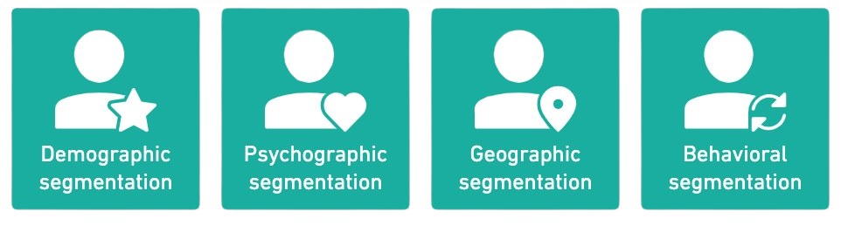
Segmentation Features
Demographic, psychographic, behavioral and geographic segmentation are considered the four main types of market segmentation, but there are also many other strategies you can use, including numerous variations on the four main types.
Psychographic
LifeStyle
Activity (wish List, Order History)
Attitudes
Demographic
Age
Gender
Income
Behavioral
Purchase Time
Purchase Amount
Order Status
Geographic
Customer Location
City / Country
Urban Or Rural
More on Features: https://drive.google.com/file/d/1-Rq2AplsWZRNHMIY3SCAbM_GuVnlKz7w/view?usp=sharing

Slide 5
Technologies
And Tools

Slide 6
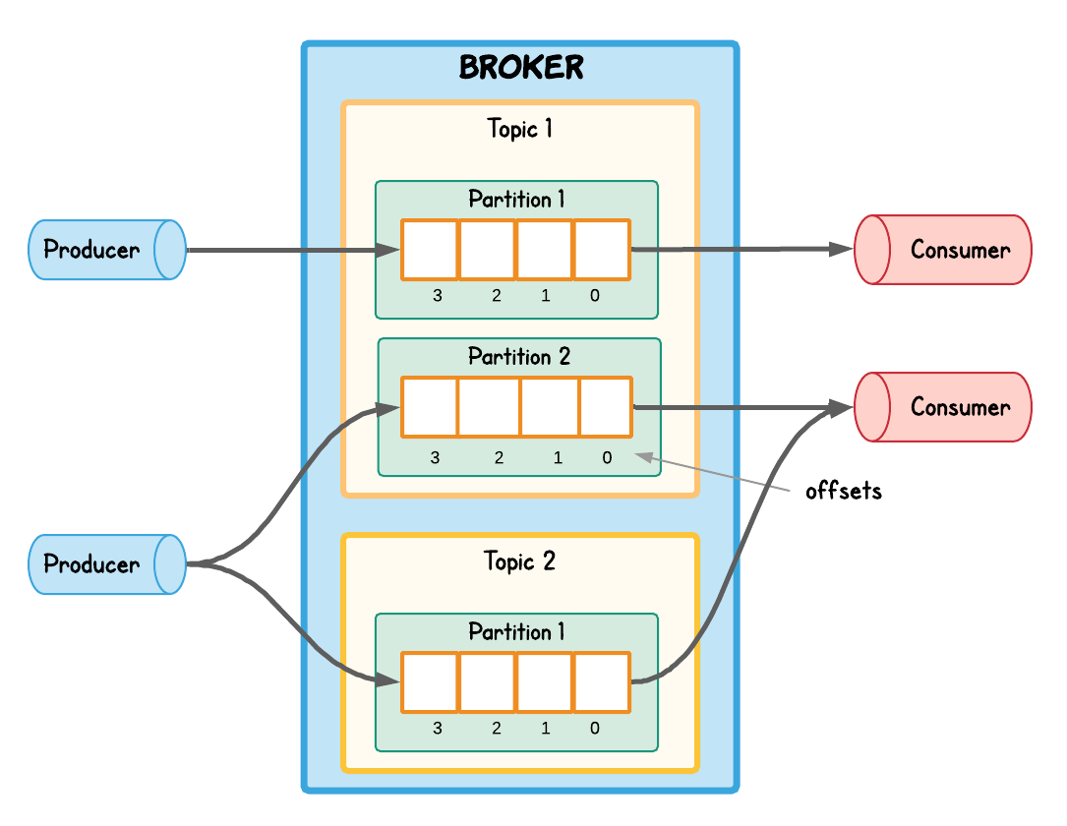
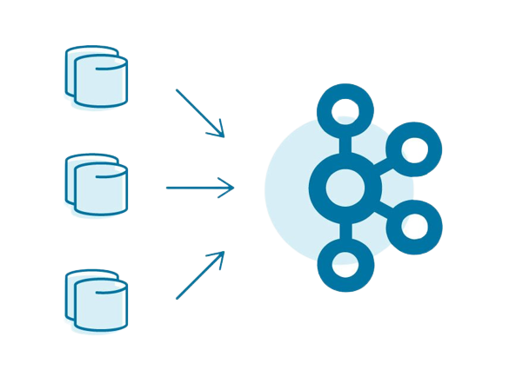
Apache Kafka
Apache Kafka is a distributed event store and stream-processing platform. In this project we can use Kafka to to build real-time streaming data pipelines and real-time streaming applications.
More On Kafka and Spark: https://docs.google.com/document/d/1jYHiqPc6p_la2imJpUWKgW_N7Qeu3_eed7Ep30i7dRo/edit?usp=sharing
https://docs.google.com/document/d/1008B3ZedM3yh1avWqSBmERqgZPrnHNbhwHf9UQ8FmT4/edit

Slide 7
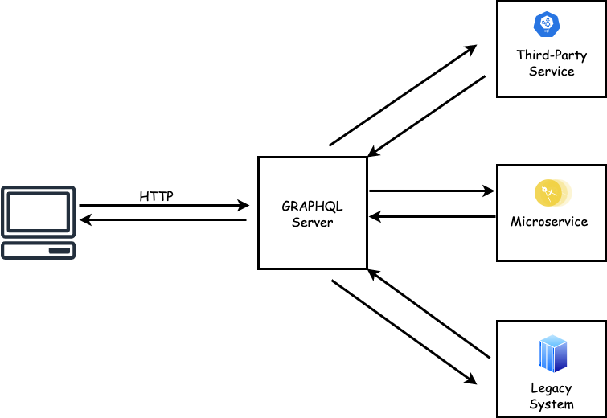
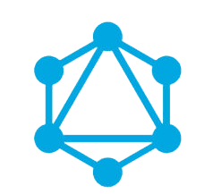
GraphQL
GraphQL is a query language for APIs and a runtime for fulfilling those queries with your existing data. GraphQL provides a complete and understandable description of the data in your API, gives clients the power to ask for exactly what they need and nothing more, makes it easier to evolve APIs over time, and enables powerful developer tools.

Slide 8
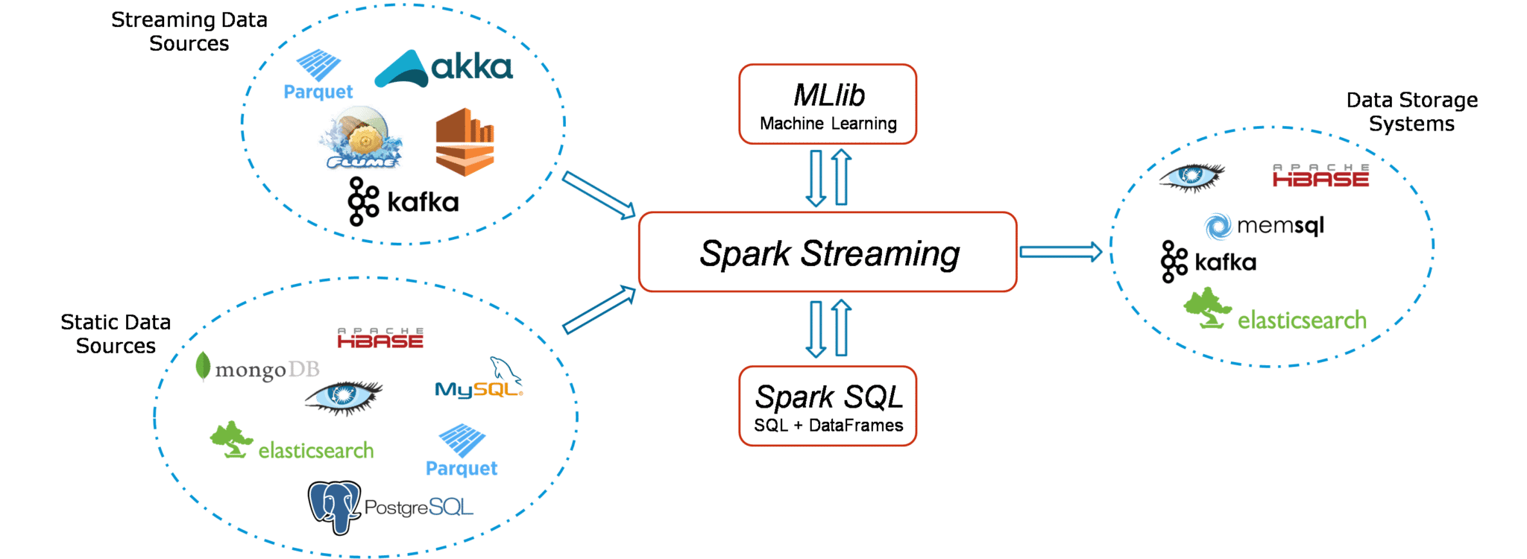
Apache Spark
Apache Spark is an open-source unified analytics engine for large-scale data processing. Spark provides an interface for programming clusters with implicit data parallelism and fault tolerance. It can keep data in memory and quickly add multiple operations and final result store in the disk.
More On Kafka and Spark: https://docs.google.com/document/d/1jYHiqPc6p_la2imJpUWKgW_N7Qeu3_eed7Ep30i7dRo/edit?usp=sharing

Slide 9
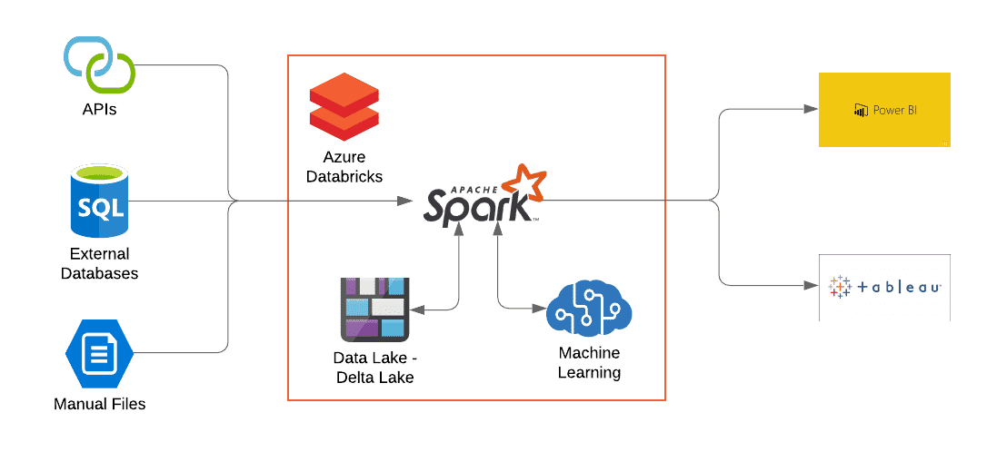
Databricks
Databricks is a data Lakehouse platform that that provides combinations of features in data warehouses and data lakes. It is built on the top of Spark which is used for distributed data processing. Databrick provides cluster and infrastructure management for Spark. Also in Databricks, Spark is heavily optimized and so we can use it more efficiently.

Slide 10

Databricks vs EMR
Simply Databrick is like all in one platform which is easy to use without many configurations, easy to manage clusters and Spark runs in Databricks in more optimized way. And it is something expensive. With EMR we can do what we want but its not user friendly as Databricks and has lot more configurations. Anyway it is not expensive like Databricks as overall.
More On Databricks: https://docs.google.com/document/d/1I_nit4hVgdZRW1sx6m7P-OIZW2KJstEm9jGeX3L01rQ/edit

Slide 11
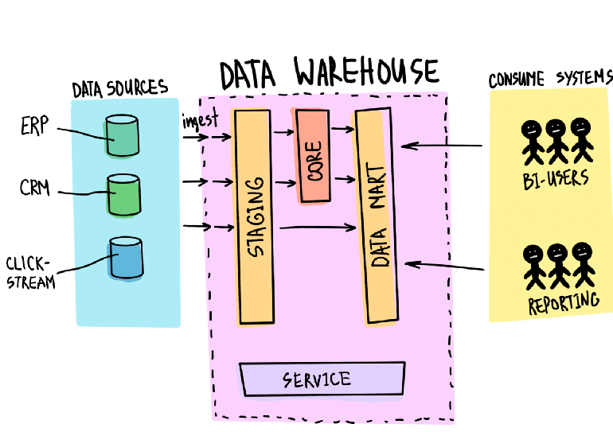
Data Warehouses
Data warehouses store structured and processed data in specific format and for specific purpose. This data is generally used by business users who use prepared data in analytic tools. Data warehouses normally includes data management features like data cleansing and ETL.

Slide 12
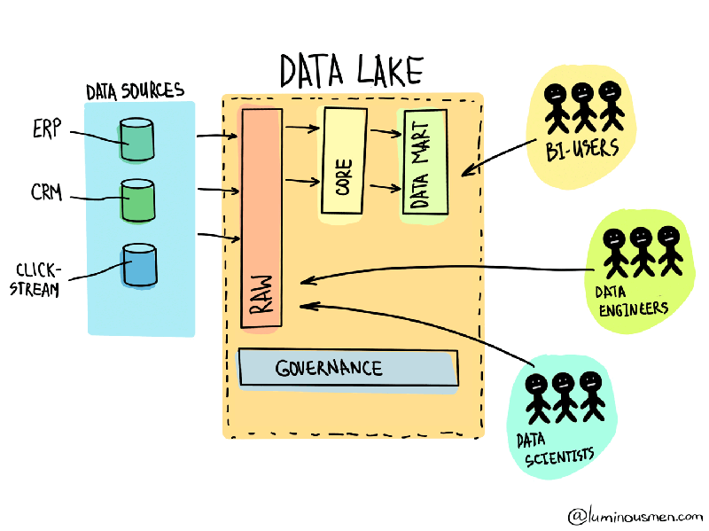
Data Lakes
Data Lakes are low-cost storage repositories that store unstructured raw data from various sources. This data is generally used by data scientists. Often used for staging prior to loading into data warehouses.

Slide 13
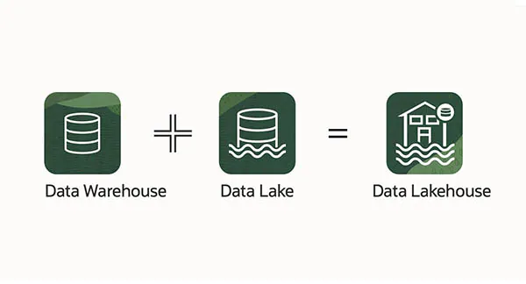
Data Lakehouse
A new architecture that combine a data warehouse with a data lake. So data Lakehouse work as a low-cost storage for raw data and the same some possible to use data management features by implementing metadata layer. This make it possible different teams like data science, machine learning, and business intelligence to use single system to access all of the enterprise data.

Slide 14
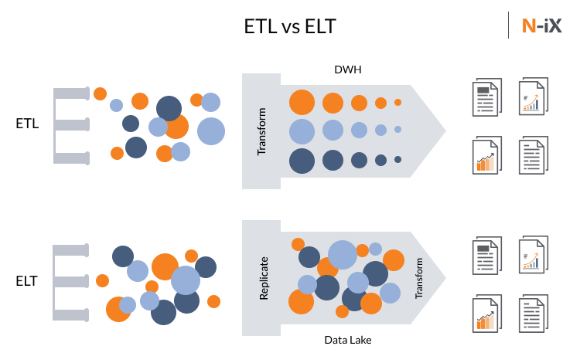
ETL and ELT
In ETL, data is extracted from different sources, process(transform) them like applying calculations and finally load the processed data into the destination like data warehouse. So in ELT there is a staging area to perform a process. In ELT, data is extracted from different sources, load them into destination and the processing is done by the destination. So ELT don't has any intermediate staging area and process is done by the destination.

Slide 15
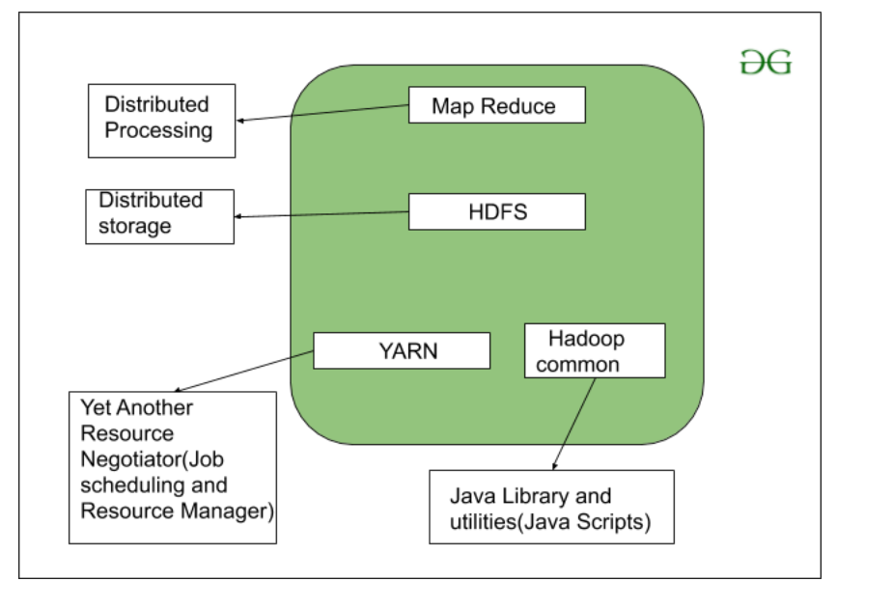
Hadoop
Like Spark, Hadoop is also a distributed processing system that use MapReduce for processing, HDFS as distributed file system and YARN as the resource manager. So it is possible to use HDFS for Spark as its distributed file system.

Slide 16
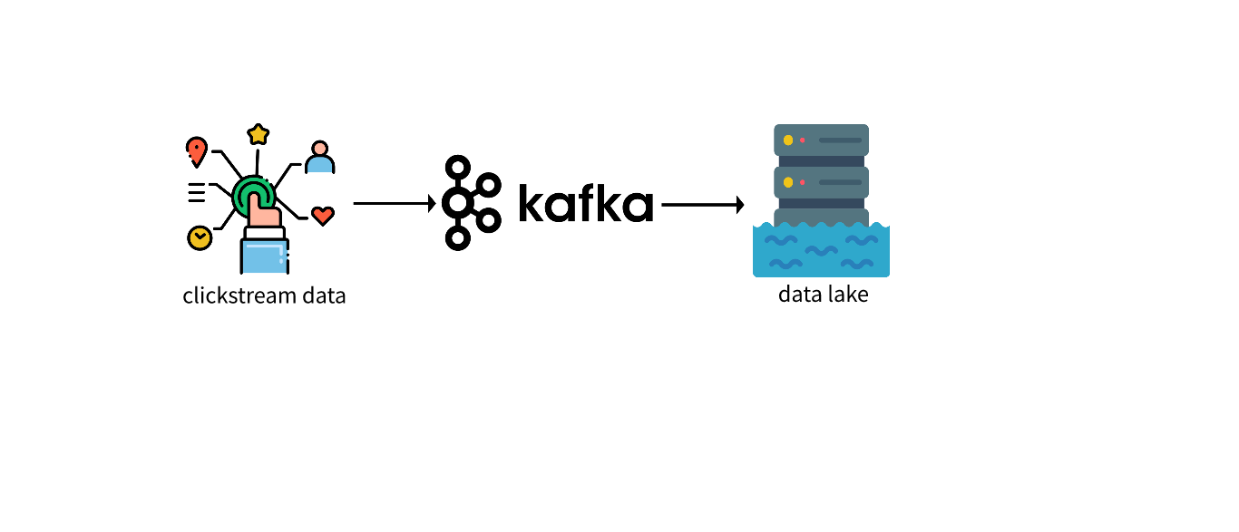
ClickStream Data
ClickStream data is about the user activities when he/she browse through a web page. We can store these clickstream data in our data warehouses/lakes for segmentation or any other analytics.

Slide 17
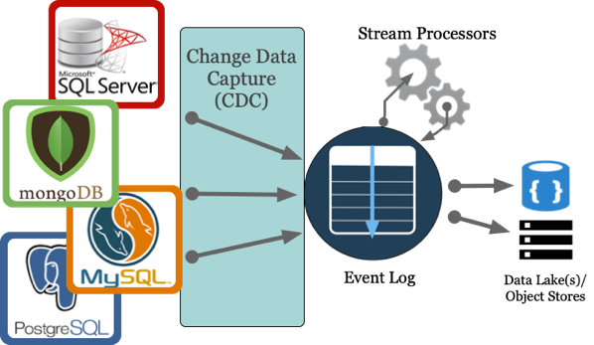
Change Data Capture(CDC)
With CDC we can detect changes in our databases. So with that it is possible to replicate those changes from our operational database to data warehouse or data lake through our Kafka broker.

Slide 18
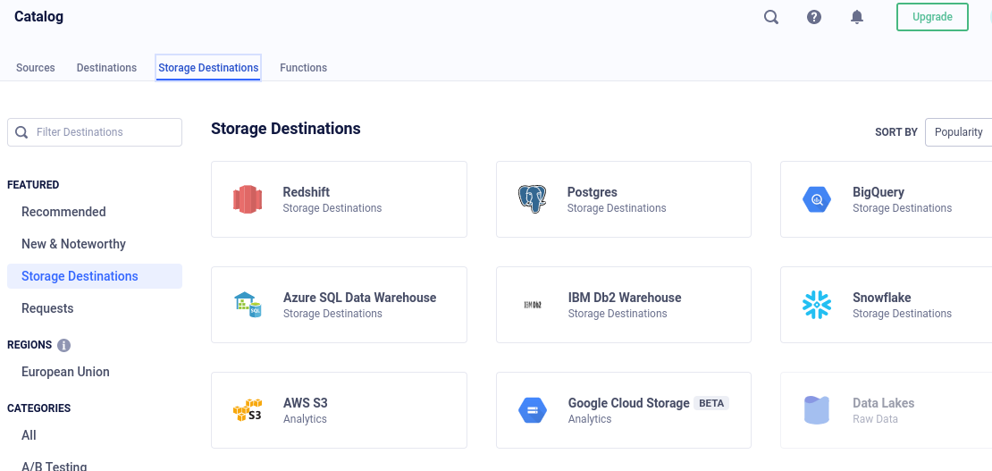

Slide 19
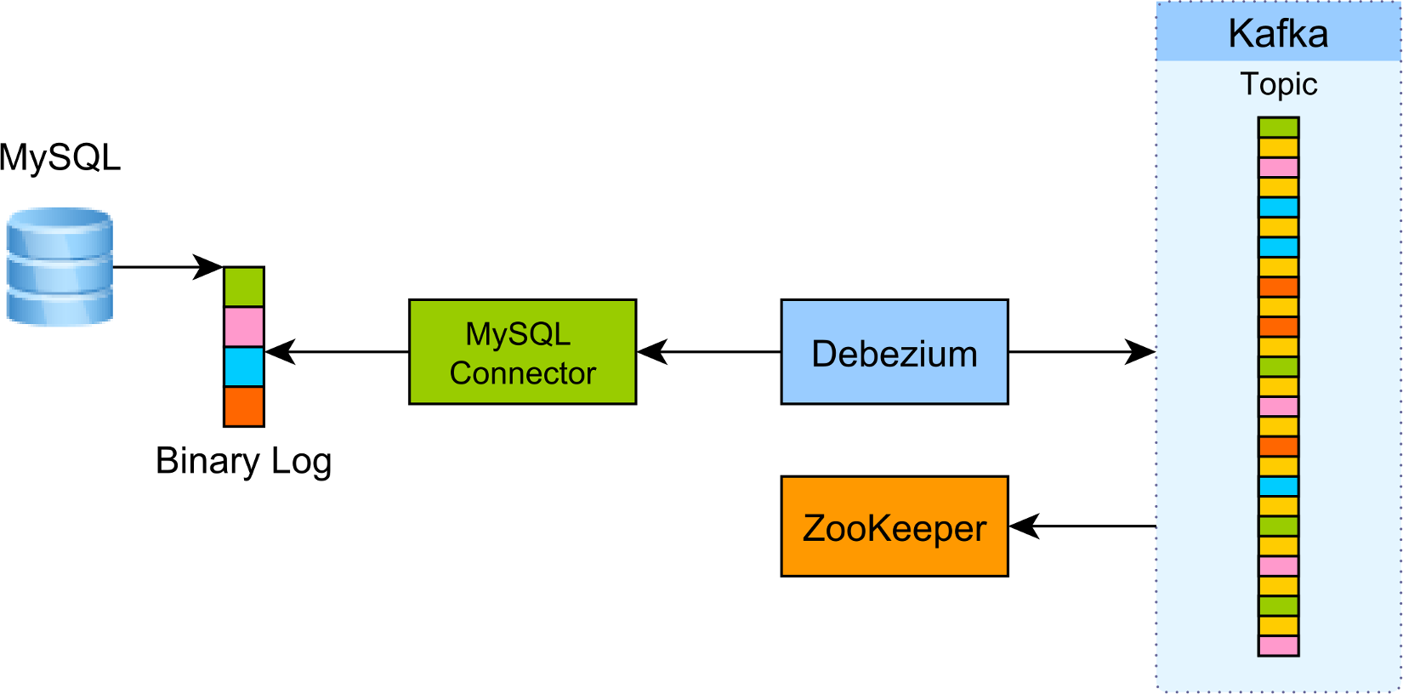
Debezium
Debezium is a CDC tool that can stream database changes. This works by reading transaction log of the database. In our case, mysql bin log is used to detect the changes and we can set the Kafka broker as a consumer to consume these changes.

Slide 20
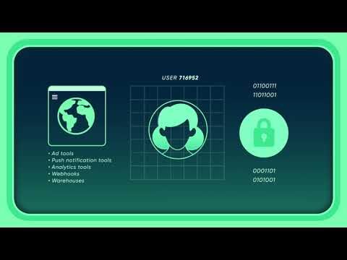
Twilio Segment
Twilio Segment Researched Documentation ( segment.com ) : https://docs.google.com/document/d/1uDuinEma4oijaQXjXCGrDcajl_jSxW-QLfWqfERLF10/edit?usp=sharing

Slide 21






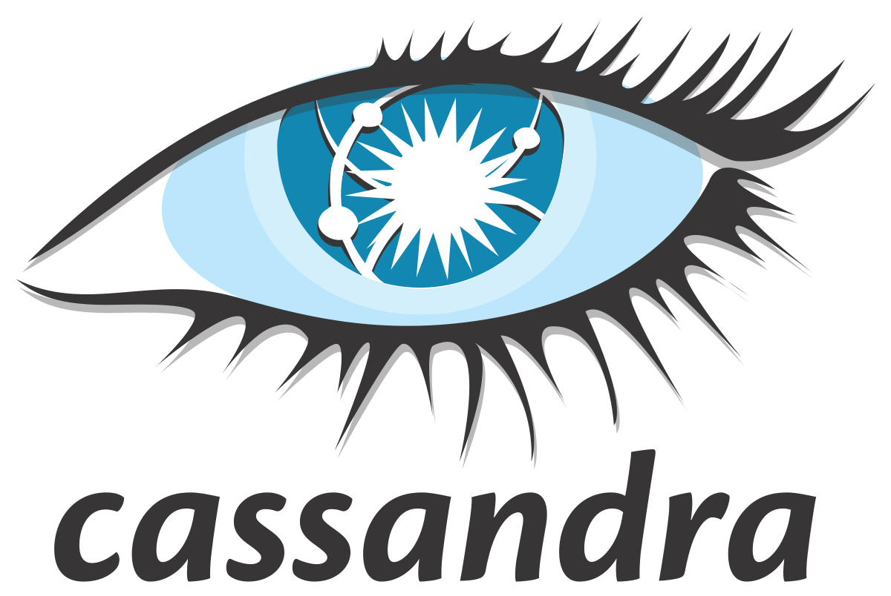



Architecture
Message,
Event Collector
Data Integration / Data Processing / Storage / Analytics
Source Data
(Producer/s)
Data Integration
Data Processing
Write to Sink
processed
data
Raw Data
Kafka
Distributed
Streaming
Platform
Data
Dashboard
E-commerce
sales data
Producer
Implementation Producer : https://github.com/rivinduchamath/Real-Time-PYSpark-Project-Part-01
Implementation Consumer : https://github.com/rivinduchamath/RealTimeSparkWorking-2

Slide 22
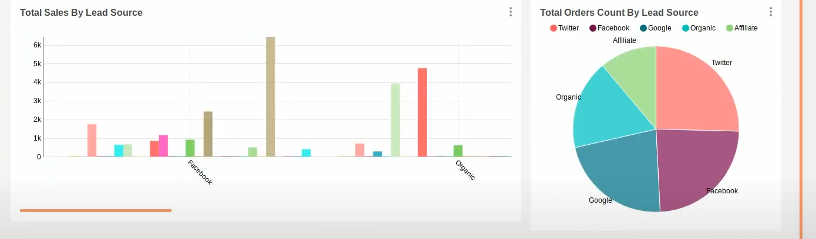
Test Project Screenshots
We Developed a Sample Basic Project according to above architecture by using technologies we learned. Here the Screenshots of Apache Superset real time dashboard.
Example: Here it shows Total Orders Received From Lead Sources. According to this we can identify most of orders are coming from Twitter. So, We can Focus on Twitter Marketing.
Documentation : https://docs.google.com/document/d/1jYHiqPc6p_la2imJpUWKgW_N7Qeu3_eed7Ep30i7dRo/edit?usp=sharing

Slide 23
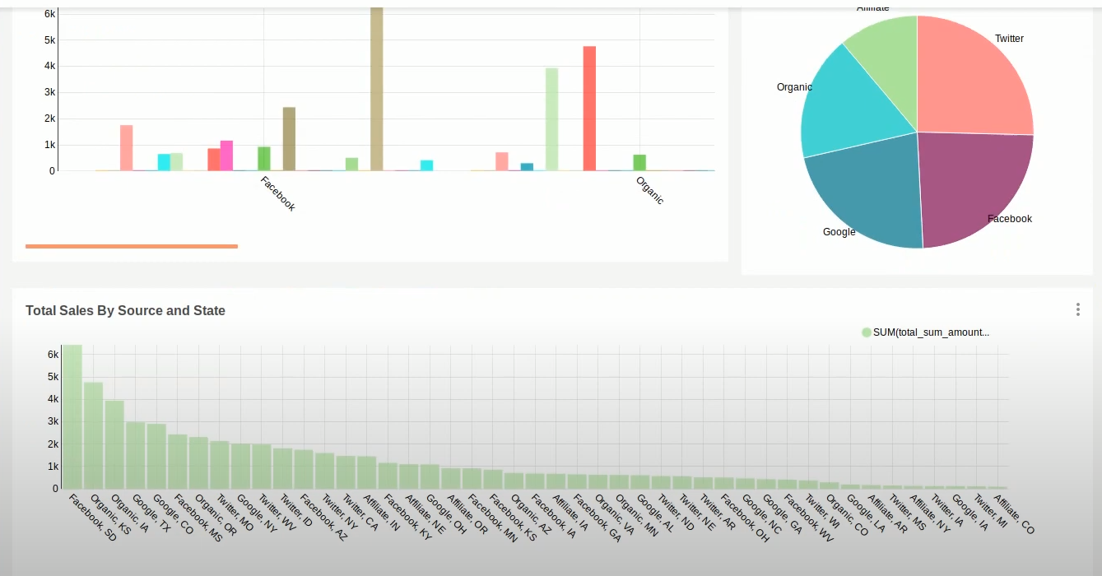
Test Project Screenshots
Example: Here we can see the total Sales by Source and States In USA. According to this Most sales are came from Facebook Source in South Dakota (SD) State In USA.
In Next Use Machine Learning, By Using proceed data specially for Predictions.
Example: How much customer will spend in the next month?
Where the customers would like to travel in the next month?
( also possible to find Seasonal Items )
Also We can Use Clustering (k-means) to cluster data.
Example (order Item Cluster) : https://github.com/rivinduchamath/Segmentation/blob/master/Untitled.ipynb

Slide 24
References
Big Data Streaming : https://towardsdatascience.com/hands-on-big-data-streaming-apache-spark-at-scale-fd89c15fa6b0
Kafka : https://kafka.apache.org/documentation/
Twilio Segment : https://segment.com/docs/connections/spec/
Kafka : https://www.tutorialspoint.com/apache_kafka/apache_kafka_introduction.htm
Kafka : https://www.youtube.com/watch?v=ZpoBYFsMPSI&t=146s
Spark : https://www.analyticsvidhya.com/blog/2021/06/real-time-data-streaming-using-apache-spark/
Twilio Segment : https://www.youtube.com/watch?v=Hkk2f9GwyNg
GraphQL : https://graphql.org/learn/
Databricks vs EMR: https://medium.com/insiderengineering/benchmarking-amazon-emr-vs-databricks-4c2f7d209d3d#:~:text=In%20order%20to%20run%20the,underlying%20EC2%20costs%20on%20AWS.
https://courses.cs.washington.edu/courses/csed516/20au/projects/p08.pdf

Slide 25
Demo Applications
Clustering : https://github.com/rivinduchamath/Segmentation/blob/master/Untitled.ipynb
Kafka : https://github.com/vdsperera/kafka_demo_applications
PySpark : https://github.com/vdsperera/pyspark_basics
Kafka with PySpark: https://github.com/vdsperera/kafka_pyspark_mysql
: https://github.com/rivinduchamath/Real-Time-PYSpark-Project-Part-01
: https://github.com/rivinduchamath/RealTimeSparkWorking-2

Slide 26


