Slide 1


RIVR
A social network for local life.
Rivr makes the capacity of a place visible enough to act on
— so more of what we need can be found, shared,
coordinated, exchanged, and created together.
REGENERATIVE · INTERCONNECTED · VIBRANT · REGIONS
Flow local. Connect global. A Rivr made of many rivers.
Seed Round 2026 · rivr.social · app.rivr.social
Notes:
SAY: This is Rivr — a social network for local life.
Every place already holds most of what the people in it need: skills, tools, food, spaces, knowledge, money, care. What's missing is not resources. What's missing is visibility and coordination.
[pause]
Rivr makes the capacity of a place visible enough to act on.
BRIDGE: Let me start with what's already in every community.

Slide 2













THE PROBLEM · LATENT CAPACITY
Every place is already
full of what it needs.
skills
things to give
unused tools
ideas
food
organizations
A PLACE
spaces
labor
knowledge
care
projects
money
The problem is not that these things don't exist — it is finding them, trusting them, and coordinating around them.
A need and a resource can exist blocks apart without ever meeting.
Rivr · Seed Round 2026
01
Notes:
SAY: Look at what any place already contains. People with skills. People looking for work. Tools sitting unused. Food being grown. Spaces, knowledge, projects, money, care, ideas — things people would give away, and things people are actively searching for.
[pause]
None of this is missing. It exists, right now, within a few miles of every person in this room.
The problem is not that these things don't exist. The problem is finding them, trusting them, and coordinating around them.
[pause]
A need and a resource can sit three blocks apart and never meet.
BRIDGE: And even when they do meet, the work is only beginning.

Slide 3

THE PROBLEM · COORDINATION
Finding each other is only
the beginning.
THE FULL ARC OF WORKING TOGETHER
DISCOVER
TRUST
AGREE
ORGANIZE
find each other
enough context
terms + roles
schedule + assign
ACT
VERIFY
ACCOUNT
COMPENSATE
do the work
confirm it happened
record it
value moves
WHAT PEOPLE ASSEMBLE BY HAND, EVERY TIME
? Who is doing what?
? What was agreed to?
? What resources are needed?
? How does someone participate?
? Who contributed?
? What is owed?
Coordination overhead prevents useful activity from happening. Rivr lowers the friction between wanting to do something together and doing it.
Rivr · Seed Round 2026
02
Notes:
SAY: Say you do find each other. You still have to answer: who is doing what, what did we agree to, what resources are needed, how does someone join, who contributed, what happened, and what is owed.
[pause]
Real coordination is this whole chain — discover, trust, agree, organize, act, verify, account, compensate. Today people assemble that chain by hand, out of a dozen disconnected tools, every single time.
[pause]
That overhead is why so much possible activity never happens. It isn't a lack of will. It's friction.
BRIDGE: And the tools we use to fight that friction are themselves scattered.

Slide 4

THE PROBLEM · DIGITAL FRAGMENTATION
Our digital lives are split across
too many places.
events
projects
markets
payments
messages
documents
scheduling
governance
payouts
identity
We spend too much time coordinating the tools meant to help us coordinate.
Social media evolved toward coordination — under extractive incentives.
The problem was never that social networks expanded into groups, events, marketplaces, and business tools.
The problem was the incentive structure underneath them.
Rivr · Seed Round 2026
03
Notes:
SAY: Meanwhile our digital lives are split across a dozen products. Events over here. Payments over there. Projects, messages, markets, documents, scheduling, governance — each in its own silo, none of them aware of the others.
[pause]
We spend a remarkable amount of time coordinating the tools that are supposed to help us coordinate.
[pause]
And notice what actually happened over the last fifteen years: social media did evolve toward coordination. It grew groups, events, marketplaces, business tools. The expansion wasn't the problem. The incentive structure underneath it was.
BRIDGE: So what would it look like if a community could actually see itself?

Slide 5
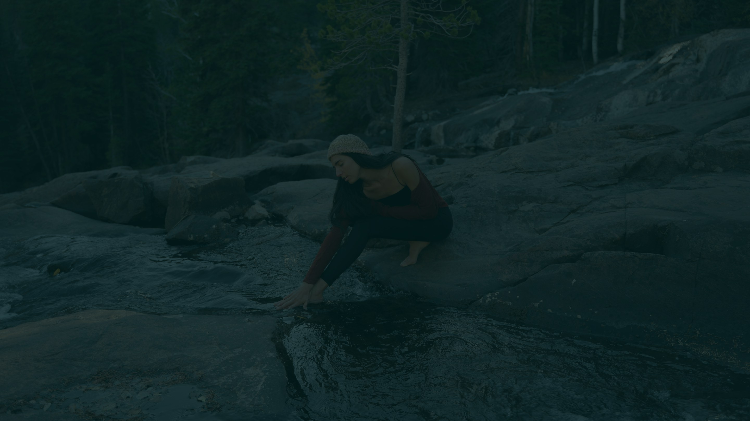
THE POSSIBILITY
see itself?
What happens when a community can
TODAY — LATENT, UNCONNECTED
WITH RIVR — VISIBLE, COORDINATED
The resources don't always need to be created — sometimes they simply need to be connected.
Rivr · Seed Round 2026
04
Notes:
SAY: So picture the alternative. What happens when a community can actually see itself?
[pause]
Needs find resources. Skills find opportunities. People find each other. Ideas find collaborators. Local businesses find local customers. Projects find the people who can make them happen.
[pause]
Notice what that requires. In most cases the resources don't need to be created. They simply need to be connected.
BRIDGE: And connection has a shape — it happens somewhere. Place matters.

Slide 6

PLACE MATTERS
We can search the whole planet —
and miss the thing
down the street.
Someone buys from across the country what a neighbor already has.
A business struggles to find customers while nearby residents
search elsewhere for exactly what it offers.
Organizations duplicate work because they cannot see one another.
RIVR BRINGS PLACE BACK
Not as a wall around a community.
As context.
Local when possible.
Wider network when needed.
YOUR PLACE
value leaving the place
Rivr · Seed Round 2026
05
Notes:
SAY: We can search the entire planet and still miss the thing three blocks away.
[pause]
Someone orders from across the country what a neighbor already has on a shelf. A business struggles to find customers while nearby residents search elsewhere for exactly what it sells. Two organizations duplicate the same work because they cannot see each other.
[pause]
Rivr brings place back — not as a wall around a community, but as context. Local when possible, wider network when needed.
BRIDGE: Though 'local' turns out to mean more than one thing.

Slide 7

PLACE IS LAYERED
Not geographic lock-in —
layered belonging.
WIDER NETWORK
Place itself can be nested — and people can belong
to several places and communities at once.
The right people, information, resources, and
activity appear at the scope where they matter.
WATERSHED · BIOREGION
TOWN · ORGANIZATION
NEIGHBORHOOD
HOUSEHOLD
Rivr · Seed Round 2026
06
Notes:
SAY: Place is not one fixed boundary. It's nested. A household sits inside a neighborhood, inside a town or an organization, inside a watershed or bioregion, inside the wider network.
[pause]
And people belong to several of these at once. This is not geographic lock-in — it's layered belonging.
[pause]
What that buys you is scope. The right people, information, resources, and activity appear at the level where they actually matter.
BRIDGE: The largest of those scopes is ecological — and that's not decoration.

Slide 8

PLACE + ECOLOGY
where we live.
A river basin tells a different story about
culture
care
habitat
economy
energy
transport
water
food
The question is not simply what kind of social media comes next — it is what kind of technology
helps humans live more intelligently within the places and ecosystems that sustain us.
Rivr · Seed Round 2026
07
Notes:
SAY: A river basin tells a different story about where we live than a city boundary does.
[pause]
Water, food, energy, transport, habitat, economy, and culture all move through actual places, and they don't stop at the county line. They follow the shape of the land.
[pause]
So the question is not simply what kind of social media comes next. It's what kind of technology helps humans live more intelligently inside the places and ecosystems that sustain us.
BRIDGE: Here is what we built to do that.

Slide 9







THE SOLUTION
visible to itself.
Rivr makes the resources of a place
A PLACE-BASED SOCIAL AND ECONOMIC NETWORK
find what's nearby
discover + create events
offer + ask
find work · hire well
create groups
build projects together
create roles + tasks
exchange value
coordinate action
Less searching through disconnected platforms. More actually doing things together.
Rivr · Seed Round 2026
08
Notes:
SAY: Rivr is a place-based social and economic network. One connected environment where a community can see and use what it has.
[pause]
Find what's nearby. Discover and create events. Offer and ask. Find work, hire well. Create groups. Build projects together. Create roles and tasks. Exchange value. Coordinate action.
[pause]
Less searching through disconnected platforms. More actually doing things together.
BRIDGE: On the surface, it looks like something you already know how to use.

Slide 10

FAMILIAR ON THE SURFACE
The social network is the
familiar doorway.
WHAT YOU SEE — FAMILIAR
profiles
posts
feeds
events
groups
messages
offers
businesses
products
services
jobs
local discovery
WHAT IT RUNS ON — COORDINATION INFRASTRUCTURE
agreements · roles · tasks · scheduling · shared records · treasury · governance · payments · attestation
Rivr should still feel alive and social. Economic relationships often begin as human relationships.
Rivr · Seed Round 2026
09
Notes:
SAY: The surface is deliberately familiar. Profiles, posts, feeds, events, groups, messages, offers, businesses, products, services, jobs, local discovery.
[pause]
That's on purpose. Rivr should still feel alive and social — expression, personality, interests, and relationships all matter. Economic relationships usually begin as human ones.
[pause]
But underneath that familiar surface is real coordination infrastructure. That's the part nobody else has built.
BRIDGE: Start with discovery — because discovery is where it all begins.

Slide 11

USEFUL DISCOVERY
Useful
serendipity.
USEFUL TO ME
a service tonight
a project to join
a venue
a nearby collaborator
a person with the skill
an opportunity
paid placement
WHAT I KNOW I NEED → WHAT I DIDN'T KNOW EXISTED
Not random noise. Not whoever paid to be inserted into the feed.
Discovery optimized for the user's world — not advertiser demand.
Rivr · Seed Round 2026
10
Notes:
SAY: Discovery on Rivr has two jobs.
Sometimes you know exactly what you need — a person, a service, a tool, a venue, tonight's event. Show me that.
[pause]
And sometimes you don't know what's possible yet — a project you'd want to join, a skill nearby, an opportunity you didn't know to search for. Show me what I'd be glad to know exists.
[pause]
What it should never be is random noise, or whoever paid to be inserted into the feed. Discovery optimized for the user's world, not advertiser demand.
BRIDGE: And discovery is only worth anything if it leads to participation.

Slide 12

DISCOVERY BECOMES PARTICIPATION
Finding one another is only
the beginning.
04
05
03
06
02
07
organize
act
01
agree
verify
08
trust
account
discover
compensate
A person finds a project. The project creates a role. The role has tasks. Value moves. The organization sees what happened.
The person builds a history of real participation.
Rivr · Seed Round 2026
11
Notes:
SAY: Here's the arc Rivr actually supports. A person finds a project. The project creates a role. The role has tasks. The person fulfills them. The contribution is recorded. Value moves. The organization sees what happened.
[pause]
And the person builds a history of real participation — which becomes the basis for trust the next time.
[pause]
Every other platform stops at the first step.
BRIDGE: That history is a different kind of signal than a follower count.

Slide 13

CONTRIBUTION OVER POPULARITY
Contribution can become more visible
than popularity.
MOST PLATFORMS MEASURE
RIVR CAN MEASURE
followers
projects helped
likes
work completed
views
skills offered
engagement
people supported
A popularity score — tuned to keep people performing for the feed.
Context for trust, qualification, reputation, compensation, and stake.
Trust grows through real participation, not follower counts.
Rivr · Seed Round 2026
12
Notes:
SAY: Most platforms measure followers, likes, views, engagement. That's a popularity score, and it's tuned to keep people performing for the feed.
[pause]
Rivr can measure something else: what have you actually contributed? Helped with projects. Completed work. Offered skills. Shown up. Supported people. Created value.
[pause]
That makes participation legible — and it becomes context for trust, qualification, reputation, compensation, and stake. Trust grows through real participation, not follower counts.
BRIDGE: Which brings us to trust itself.

Slide 14

TRUST
Trust is part of
coordination.
WHAT THE NETWORK ALREADY KNOWS
relationships
history
qualifications
ENOUGH CONTEXT TO ACT
references
verified claims
contribution
Finding the resource is not enough — we also need enough context to act.
Rivr · Seed Round 2026
13
Notes:
SAY: Finding the resource is not enough. Before anyone acts, they ask a second set of questions. Who is this person? Are they part of my community? What have they done? Do they have the relevant skill? Do we share relationships? Have they contributed before?
[pause]
Every one of those is a trust question, and today you answer them by asking around.
[pause]
Rivr can answer them from things the network already knows — relationships, history, qualifications, references, verified claims, group membership, and contribution.
BRIDGE: That's the substrate. Here's what it looks like as a product.

Slide 15

PRODUCT OVERVIEW
Familiar on the surface.
Powerful underneath.
FOR A PERSON
FOR AN ORGANIZATION
FOR A COMMUNITY
A genuinely useful local
social network — feeds,
profiles, groups, events,
markets, jobs, and local
discovery.
Tools for coordinating
people, work, resources,
and exchange — projects,
roles, tasks, scheduling,
payments, documents,
governance, inventory.
A living map of what that
place has, needs, knows,
makes, and can do.
Today these functions live across many disconnected products. Rivr brings them into one connected ecosystem.
Rivr · Seed Round 2026
14
Notes:
SAY: Three audiences, one product.
For a person: a genuinely useful local social network — feeds, profiles, groups, events, markets, jobs, local discovery.
For an organization: the tools to actually operate — projects, roles, tasks, scheduling, payments, documents, governance, inventory.
For a community: a living map of what that place has, needs, knows, makes, and can do.
[pause]
Today those functions live across many disconnected products. Rivr brings them into one connected ecosystem.
BRIDGE: And it isn't only for formal organizations.

Slide 16
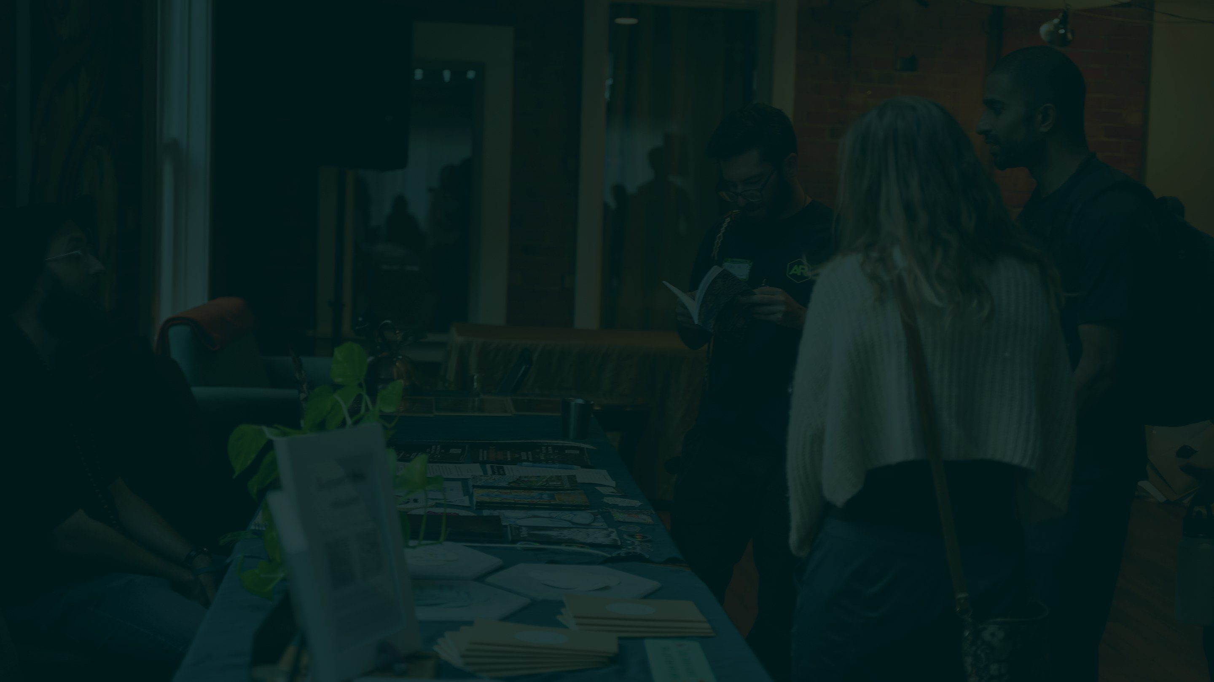
EVERYDAY LIFE
Resilience is built partly through
ordinary life.
extra food
the ladder
childcare
a work party
shared purchases
Rivr is not only for formal organizations.
Rivr · Seed Round 2026
15
Notes:
SAY: And this has to work for ordinary life, not just for institutions.
Neighbors see who has extra food. Someone finds the ladder. Someone finds childcare. A neighborhood organizes a work party. A household tracks shared purchases.
[pause]
Resilience is built partly through ordinary life — the small exchanges that never make it into any formal system.
BRIDGE: But when a group does get formal, it needs much more than a feed.

Slide 17







ORGANIZATIONS NEED MORE THAN A FEED
A place where the organization can
actually operate.
NOT ANOTHER GROUP CHAT ABOUT THE ORGANIZATION —
documents
projects
jobs
tasks
qualifications
roles
contributions
governance
permissions
treasury
payments
membership
events
communications
Today those functions live across many different products. Rivr brings them into one shared relational environment.
Rivr · Seed Round 2026
16
Notes:
SAY: A small business schedules shifts. A cooperative tracks contribution. A nonprofit runs projects, holds documents, makes decisions, moves money.
[pause]
None of that is a group chat about the organization. It's the organization actually operating — documents, projects, jobs, tasks, qualifications, roles, contribution records, governance, permissions, treasury, payments, membership, events, communications.
[pause]
Today those live across a dozen products that don't know about each other. Rivr brings them into one shared relational environment.
BRIDGE: Start with the most mundane part of it — the records.

Slide 18

SHARED RECORDS
less messy.
Shared records make cooperation
COMMITMENT
WHO
STATUS
VERIFIED
VALUE
build the greenhouse beds
M. Rivera
delivered
✓
$240
run Saturday's market stall
K. Osei
in progress
—
shared
repair the shared van
T. Lindqvist
delivered
✓
4 hrs credit
host the tool library
Front Range Commons
ongoing
✓
in-kind
less dependent on memory, chasing people,
repeated coordination, interpersonal conflict
Clear commitments and visible history
make trust easier.
Rivr · Seed Round 2026
17
Notes:
SAY: Most collaborative problems are boring. Who agreed to do this? Did it happen? Who contributed? Who approved it? What did we agree to? How much does somebody get paid?
[pause]
When those answers live in someone's memory or a chat thread, cooperation depends on chasing people. When they live in a shared record, it doesn't.
[pause]
Clear commitments and visible history make trust easier. The ledger is social infrastructure as much as financial infrastructure.
BRIDGE: And once the patterns are recorded, they can be reused.

Slide 19

ORGANIZATIONAL KNOW-HOW
every time.
Nobody should have to reinvent cooperation
PICKED UP ON DAY ONE
a food co-op
a repair collective
ONE TEMPLATE
roles · workflows · approvals
a housing group
a farmers market
Easier organization → more projects → more businesses → more organizations →
more economic activity → more local capacity.
Rivr · Seed Round 2026
18
Notes:
SAY: Every new project reinvents the same structures — roles, workflows, approvals, governance patterns, resource flows.
[pause]
Capture those once as templates, and any group can pick them up on day one. Starting something new stops requiring an operations expert before it requires anything else.
[pause]
That matters economically: easier organization means more projects, more businesses, more organizations — more economic activity, and more local capacity.
BRIDGE: Capacity that doesn't only move in dollars.

Slide 20

PLURAL EXCHANGE
with money.
Not every exchange begins and ends
WHAT PEOPLE HAVE
HOW IT CAN MOVE
sold
rented
traded
lent
shared
gifted
mutual credit
time
skills
tools
food
space
knowledge
A community contains far more value than the dollars currently circulating through it. The aim is useful resource flow.
Rivr · Seed Round 2026
19
Notes:
SAY: Not every useful exchange begins and ends with money.
People have time, skills, tools, food, space, knowledge. They have dollars and bitcoin and vouchers and professional services. They have things to lend and things they no longer need.
[pause]
And a resource can move in many ways: sold, rented, traded, lent, shared, gifted, contributed, on mutual credit, part cash plus part service.
[pause]
A community contains far more value than the dollars currently circulating through it. The aim is useful resource flow.
BRIDGE: Which reframes what it means to lack money.

Slide 21


ECONOMIC SOVEREIGNTY
A lack of cash should not mean
a lack of capacity.
CASH-ONLY — ONE DOOR
PLURAL — MANY DOORS
no dollars → no participation
dollars
time
skill
labor
knowledge
Economic sovereignty does not mean abandoning existing money.
It means having more than one way to participate.
If someone lacks dollars but has time, skill, knowledge, or labor — useful activity does not have to stop.
A community becomes more resilient when useful exchange can continue
through multiple mutually agreed forms.
Rivr · Seed Round 2026
20
Notes:
SAY: A lack of cash should not automatically mean a lack of capacity.
[pause]
Economic sovereignty does not mean abandoning existing money. It means having more than one way to participate. If someone lacks dollars but has time, skill, knowledge, or labor — useful activity does not have to stop.
[pause]
A community becomes more resilient when useful exchange can continue through multiple mutually agreed forms.
BRIDGE: And when exchange keeps moving, something compounds.

Slide 22




LOCAL CAPACITY LOOP
Better resource flow creates
new productive capacity.
visibility
resilience
coordination
THE LOOP
capacity
exchange
demand
relationships
intelligence
The goal is not simply to circulate what already exists.
Rivr · Seed Round 2026
21
Notes:
SAY: This is the loop that makes the whole thing compound.
Greater visibility creates more coordination. More coordination creates more exchange. More exchange creates more relationships. More activity creates better information about what a place actually needs — and visible demand makes new local businesses, services, production, care networks, and infrastructure viable. Which creates more capacity, and more resilience, and more to be visible about.
[pause]
The goal is not simply to circulate what already exists. Better resource flow creates new productive capacity.
BRIDGE: And the information coming off that loop is itself valuable.

Slide 23

LOCAL ECONOMIC INTELLIGENCE
learn.
Better visibility helps a place
QUESTIONS A PLACE CAN FINALLY ASK ABOUT ITSELF
72%
41%
57%
84%
unmet requests
idle resources
sourced elsewhere
repeat searches
shortages
sitting unused
leaving the place
latent demand
A feedback system for developing local capacity — not merely a marketplace for what already exists.
Rivr · Seed Round 2026
22
Notes:
SAY: Once activity is visible, a place can finally ask questions about itself.
Where are the shortages? What sits unused? What are people repeatedly trying to find? What do we constantly source from elsewhere? What new business could become viable? What could people build together?
[pause]
That's a feedback system for developing local capacity — not merely a marketplace for what already exists.
BRIDGE: And it reveals partners, not just counterparties.

Slide 24

COLLABORATION, NOT ONLY TRANSACTION
Coalitions
— not only transactions.
THE FAMILIAR PATTERN
NEED
PROVIDER
DEAL
Two organizations may be working separately on
the same problem — and never see each other.
THE LARGER PATTERN
a food co-op
COLLECTIVE CAPACITY
A mission too large for one organization
becomes possible through a coalition.
a land trust
SHARED
MISSION
a repair collective
Rivr · Seed Round 2026
23
Notes:
SAY: The familiar pattern online is need, provider, transaction. Done.
[pause]
But there's a larger pattern: visibility, coordination, coalition, collective capacity.
Two organizations may be working separately on the same problem. Several projects may hold complementary resources and never know it.
[pause]
A mission too large for any one organization becomes possible through a coalition.
BRIDGE: Which is really a statement about interdependence.

Slide 25
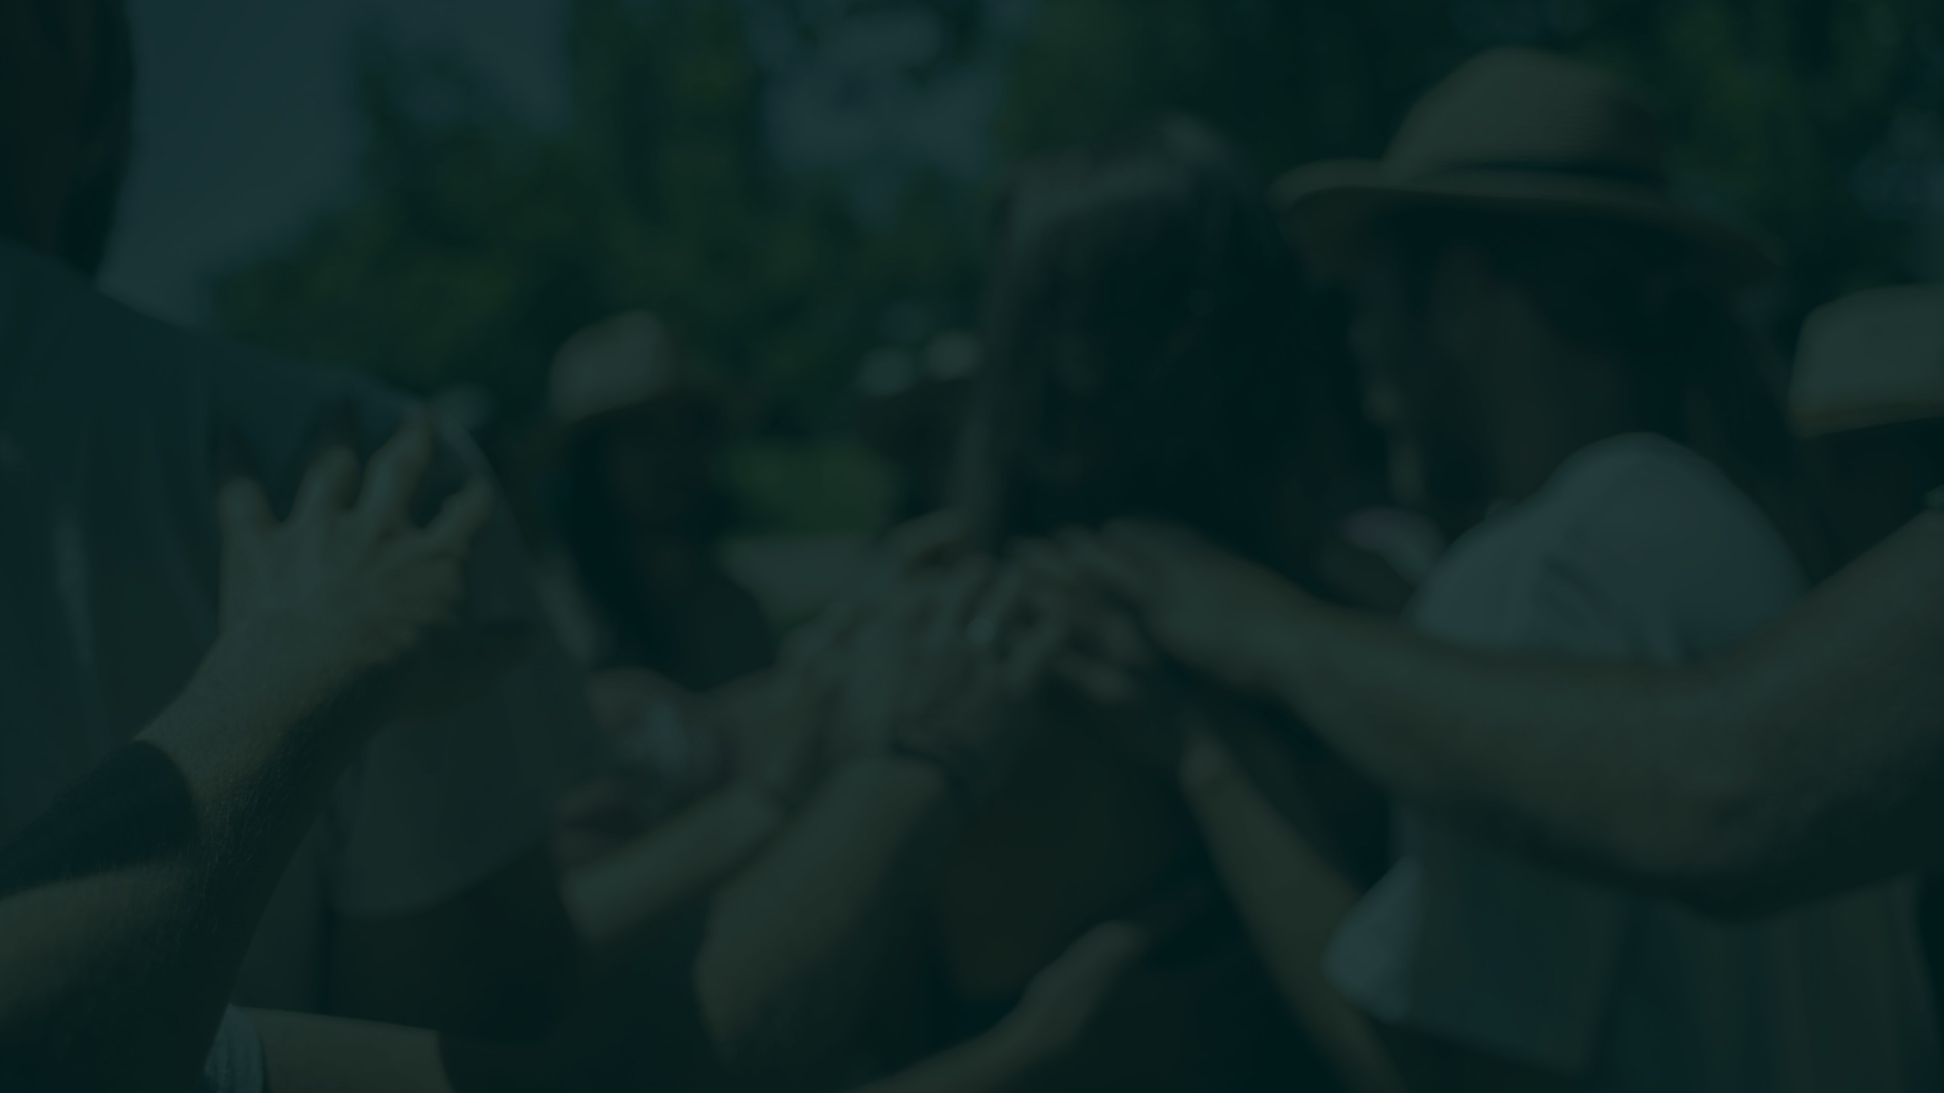
FUNCTIONAL INTERDEPENDENCE
Strong individuals
inside strong networks.
Healthy communities are not made of people who can each do everything themselves —
they are made of people with different abilities who can find, trust, and cooperate.
The goal is greater autonomy, supported by stronger interdependence.
Rivr · Seed Round 2026
24
Notes:
SAY: Healthy communities are not made of people who can each do everything themselves. They're made of people with different abilities who can find, trust, and cooperate with one another.
[pause]
The goal is greater autonomy, supported by stronger interdependence. Those aren't opposites — one produces the other.
BRIDGE: To support that, the software underneath has to be a different shape.

Slide 26



INFRASTRUCTURE
The social network is the doorway —
coordination infrastructure is the
larger opportunity.
communication
commerce
projects
ONE RELATIONAL SYSTEM
events
payments
scheduling
Different parts of the same relationships
between people, organizations, resources,
needs, agreements, and actions.
governance
documents
AI
Instead of stitching disconnected platforms together, these functions share an underlying relational system.
Rivr · Seed Round 2026
25
Notes:
SAY: Step back and look at the architecture.
Communication, commerce, projects, events, payments, scheduling, governance, documents, AI — today each of these is a separate platform you stitch together.
[pause]
But they are all different views of the same relationships: between people, organizations, resources, needs, agreements, and actions.
[pause]
The social network is the doorway. Coordination infrastructure is the larger opportunity.
BRIDGE: With one rule — the complexity stays underneath.

Slide 27

COMPLEX UNDERNEATH, HUMAN ON TOP
The complexity belongs
underneath.
WHAT NOBODY SHOULD NEED TO UNDERSTAND
federation · REA data models · mutual credit · cooperative law · containers · distributed computing · interoperability protocols
WHAT PEOPLE ACTUALLY DO
find a bike
join an event
find a babysitter
take a job
start a project
Complex infrastructure. Simple participation.
Rivr · Seed Round 2026
26
Notes:
SAY: There's a design rule underneath all of this.
Nobody should need to understand federation, REA data models, mutual credit, cooperative law, containers, distributed computing, or interoperability protocols.
[pause]
What people should experience is: find a bike. Join an event. Find a babysitter. Take a job. Start a project.
[pause]
Complex infrastructure. Simple participation.
BRIDGE: So what is that infrastructure, concretely?

Slide 28


THE REA ACTIVITY MODEL
Model the real activity
underneath the feed.
acts on
performed by
RESOURCE
EVENT
AGENT
tools · food · space · money
skills · work products
an exchange · a contribution
a decision · a delivery
people and groups who act
individuals · organizations
The basic unit is not “someone posted something.”
It is people and organizations doing things with resources.
Rivr · Seed Round 2026
27
Notes:
SAY: Underneath, Rivr models the world the way accountants and economists actually do — resources, events, and agents.
A resource is anything that can change hands or change state: tools, food, space, money, skills, work products. An event is something happening: an exchange, a contribution, a decision, a delivery. An agent is a person or a group who acts.
[pause]
The basic unit is not 'someone posted something.' It is people and organizations doing things with resources.
BRIDGE: And because it's a shared model, other tools can plug into it.

Slide 29

INTEROPERABILITY
Build the connective tissue —
not every organ.
a course platform
your app here
a health tool
RIVR
a specialized co-op tool
a farm-management system
an astrology app
Rivr becomes the connective environment they share. Ecosystem coherence, not total software ownership.
Rivr · Seed Round 2026
28
Notes:
SAY: Rivr does not have to build every application. It has to be the connective tissue between them.
[pause]
A course platform, a health tool, a farm-management system, an astrology app, a specialized co-op tool — any of them can plug into the same relational environment and reach the same people, resources, and agreements.
[pause]
The goal is ecosystem coherence, not total software ownership.
BRIDGE: But somebody still has to build the thing people actually use.

Slide 30

BUILD THE CAR
we need the car.
We don't just need an engine spec —
PROTOCOLS ALONE
SOMEBODY STILL HAS TO
Shared schemas matter.
Open-source infrastructure matters.
Interoperability matters.
But specifications alone do not produce
an ecosystem people can actually use.
Integrate it. Design it. Maintain it.
Support people. Market it.
Make product decisions, keep listening,
and respond to changing needs.
Somebody still has to build the ecosystem people can actually use.
Rivr · Seed Round 2026
29
Notes:
SAY: A fair question: why not just publish protocols and let a thousand apps bloom?
[pause]
Shared schemas matter. Open-source infrastructure matters. Interoperability matters. But specifications alone do not produce an ecosystem people can actually use.
[pause]
Somebody still has to integrate it, design it, maintain it, support people, market it, make product decisions, and keep responding to changing needs.
We don't just need an engine spec. We need the car.
BRIDGE: And you learn the right standards by driving it.

Slide 31

BUILD, USE, LEARN, STANDARDIZE
by driving.
Maybe we learn the standards
build
01
Build the thing real communities need
02
Use it — real coordination, exchange, governance
standardize
use
03
Learn what actually needs to work together
04
Refine — practice informs architecture
05
Standardize what works, then federate
refine
learn
Purely theoretical protocols optimize for imagined needs. Real implementations reveal actual needs.
Rivr · Seed Round 2026
30
Notes:
SAY: So our approach to standards is empirical.
Build the thing real communities need. Use it — real coordination, real exchange, real governance. Learn what actually needs to work together. Refine, because practice informs architecture. Then standardize what works, and federate.
[pause]
Purely theoretical protocols optimize for imagined needs. Real implementations reveal actual interoperability needs.
BRIDGE: Now, the harder questions — starting with data.

Slide 32

DATA SOVEREIGNTY
surrendered.
Connected does not have to mean
A PERSON
A GROUP
A COMMUNITY
Controls where their information lives —
and what, if anything, moves outward.
Can operate its own instance, with its
own rules, memory, and data.
Can share local infrastructure — still
connected to the wider network.
only what people choose or permit moves outward
Participating in the network does not mean surrendering ownership of your data to the network.
Rivr · Seed Round 2026
31
Notes:
SAY: Connected does not have to mean surrendered.
A person controls where their information lives, and what — if anything — moves outward. A group can operate its own instance, with its own rules, memory, and data. A community can share local infrastructure and still be connected to the wider network.
[pause]
Those systems still talk to the network. But only what people choose or permit moves outward. Participating in the network does not mean surrendering ownership of your data to the network.
BRIDGE: Privacy works the same way — contextually.

Slide 33

CONTEXTUAL PRIVACY
Connection shouldn't require
total exposure.
WHO IS ASKING
WHAT THEY SEE
name
skills
location
contact
history
a neighbor
my group
an employer
the wider network
Prove without revealing — qualified? in the area? eligible? The system can confirm yes or no without exposing what's underneath.
The goal is not secrecy. It's appropriate visibility.
Rivr · Seed Round 2026
32
Notes:
SAY: Privacy is not simply public or private. Different people see different things, for different purposes, under different conditions.
[pause]
You can be findable for a job without publishing everything. An organization can show one face to members and another to neighbors. And often the system can simply confirm yes or no — qualified, in the area, eligible — without exposing what's underneath.
[pause]
The goal is not secrecy. It's appropriate visibility.
BRIDGE: The same principle applies to your attention.

Slide 34

ATTENTION SOVEREIGNTY
Sovereignty over your
attention, too.
SELECTIVE DISCLOSURE — OUTWARD
SELECTIVE ATTENTION — INWARD
You decide what the world can see of you,
and in which contexts.
You decide what gets to enter your field
of view. What reaches me? Why?
RELEVANCE SHAPED BY
place
relationships
interests
urgency
communities
chosen context
Useful relevance instead of attention capture.
Rivr · Seed Round 2026
33
Notes:
SAY: Sovereignty over your attention, too.
Outward: you decide what the world can see of you, and in which contexts. Inward: you decide what gets to enter your field of view. What reaches me? Why? According to whose priorities?
[pause]
Relevance shaped by place, relationships, interests, urgency, communities, time, and chosen context — useful relevance instead of attention capture.
BRIDGE: Which becomes far more urgent once AI is in the loop.

Slide 35

AI SOVEREIGNTY
AI makes all of this
more important.
AI COULD BECOME
OR IT COULD HELP COMMUNITIES
Another centralized layer.
Another source of dependence.
Another surveillance infrastructure.
Already capable of searching, scheduling,
purchasing, organizing — acting.
Find resources. Coordinate work.
Understand needs. Surface unused capacity.
Care for place — and steward the
ecological systems that sustain it.
Does AI make us more dependent on distant infrastructure — or more capable where we are?
Rivr · Seed Round 2026
34
Notes:
SAY: AI makes all of this more important, not less.
AI could become another centralized layer, another source of dependence, another surveillance infrastructure. It is already capable of searching, scheduling, purchasing, organizing — acting.
[pause]
Or it could help communities find resources, coordinate work, understand needs, surface unused capacity, and care for the ecological systems that sustain them.
[pause]
The question is whether AI makes us more dependent on distant infrastructure, or more capable where we are.
BRIDGE: That outcome is decided by ownership.

Slide 36

OWNERSHIP
Ownership changes
the incentives.
MOST PLATFORMS — VALUE CONCENTRATES UPWARD
RIVR'S LOOP — VALUE RETURNS TO PARTICIPANTS
attention
PLATFORM
members
data
transactions
stake
use
The people using the network create its value —
so they participate in its success.
patronage
revenue
Serving the community is how Rivr succeeds — not something added after it succeeds.
Rivr · Seed Round 2026
35
Notes:
SAY: Ownership changes the incentives.
Most platforms capture attention, capture data, capture transactions — and network value concentrates upward.
[pause]
In Rivr's loop, the people using the network create its value, so they participate in its success. Revenue supports operations, patrons, workers, stewards, reserves, and continued development.
[pause]
Serving the community is how Rivr succeeds — not something added after it succeeds.
BRIDGE: And the cooperative isn't a claim on a page. It's in the product.

Slide 37

USE RIVR TO RUN RIVR
The co-op lives
inside the product.
VISIBLE RELATIONSHIPS, IN THE SYSTEM ITSELF
membership
stake
participation
contribution
revenue
surplus
patronage
governance
The cooperative is not a statement on the About page.
The institution demonstrates the coordination architecture it is building for others.
Rivr · Seed Round 2026
36
Notes:
SAY: The cooperative is not a statement on the About page. Rivr runs on Rivr.
[pause]
Membership, stake, participation, contribution, revenue, surplus, patronage, and governance are all visible relationships inside the system itself.
[pause]
The institution demonstrates the coordination architecture it is building for others.
BRIDGE: Which raises the obvious worry about any coordinating institution.

Slide 38

COHERENCE WITHOUT CAPTURE
Coordination and control are
not the same thing.
RIVR NEEDS
THAT DOES NOT REQUIRE
One strong brand. A coordinated company.
Capital. A development team. Marketing.
Product leadership. A shared UX.
Common standards.
One company owning everyone's data.
One authority controlling every community.
One governance body over every instance.
One permanent corporate center.
A coherent product can coexist with distributed ownership, local governance,
sovereign data, federation, and interoperability.
Rivr · Seed Round 2026
37
Notes:
SAY: Rivr does need real things. One strong brand. A coordinated company. Capital, a development team, marketing, product leadership, a shared user experience, common standards.
[pause]
But none of that requires one company owning everyone's data, one authority controlling every community, one governance body over every instance, or one permanent corporate center.
[pause]
A coherent product can coexist with distributed ownership, local governance, sovereign data, federation, and interoperability.
BRIDGE: And here's how we make capture structurally hard.

Slide 39


ANTI-CAPTURE
Don't rely on future leaders
staying nice.
COOPERATIVE OWNERSHIP
PUBLIC-BENEFIT PURPOSE
FEDERATION
The users own the institution — capture has no cheap entry point.
The outcomes are in the Articles: obligations, not marketing.
No single switch to seize — many instances, one network.
SOVEREIGN DATA
INTEROPERABILITY
CONTEXTUAL PERMISSIONS
Communities keep their data; leaving is always possible.
Open standards mean no lock-in to defend badly.
Visibility and access stay under member control.
If platforms became extractive because incentives changed, Rivr cannot just say “trust us.”
Build the system so capture is harder even if future incentives change.
Rivr · Seed Round 2026
38
Notes:
SAY: If platforms became extractive because incentives changed, Rivr cannot simply say 'trust us.' The answer has to be structural.
[pause]
Cooperative ownership — the users own the institution, so capture has no cheap entry point. Public-benefit purpose — the outcomes are in the Articles: obligations, not marketing. Federation — no single switch to seize. Sovereign data — communities keep their data, and leaving is always possible. Interoperability — open standards mean no lock-in to defend badly. Contextual permissions — visibility and access stay under member control.
[pause]
Build the system so capture is harder even if future incentives change.
BRIDGE: Now let's talk about the market.

Slide 40

COMPETITIVE LANDSCAPE
The competition is
the fragmented stack.
Facebook
Nextdoor
Meetup
Eventbrite
Asana
Slack
Venmo
Google Workspace
Square
Shopify
Luma
centralized AI
MONTHLY COST FOR ONE SMALL ORGANIZATION
$328.20
$282.14
$46.06
recognizable app stack / month, 5-seat org
Rivr organization / month, one ecosystem
saved each month ≈ $3,546.68 per year
Modeled on a 5-seat organization: Asana, Slack, Google Workspace, Square Payroll + Plus, Shopify, Luma Plus — before hiring fees.
The social network is the doorway. Rivr models real activity, not just content.
Rivr · Seed Round 2026
39
Notes:
SAY: Our competition is not one company. It's the fragmented stack.
Facebook, Nextdoor, Meetup, Eventbrite, Asana, Slack, Venmo, Google Workspace, Square, Shopify, Luma, and now centralized AI.
[pause]
Modeled on a five-seat organization, that recognizable stack runs about three hundred twenty-eight dollars and twenty cents a month, before hiring fees. The equivalent Rivr organization is about forty-six dollars and six cents — one relational ecosystem.
[pause]
That's roughly two hundred eighty-two dollars a month saved. About three thousand five hundred forty-seven dollars a year, for one small organization.
BRIDGE: But price isn't the reason people will switch.

Slide 41

PRODUCT QUALITY
good.
Values aren't enough — Rivr has to be
Rivr cannot succeed simply because people agree with the philosophy. It needs to:
save time
save money
replace fragmented tools
make work easier
make discovery more useful
reduce coordination friction
feel good to use
People should choose Rivr because Rivr works.
The deeper architecture determines who benefits when it works.
Rivr · Seed Round 2026
40
Notes:
SAY: Values are not enough. Rivr cannot succeed simply because people agree with the philosophy.
[pause]
It has to save time, save money, replace fragmented tools, make work easier, make discovery more useful, reduce coordination friction, and feel good to use.
[pause]
People should choose Rivr because Rivr works. The deeper architecture determines who benefits when it does.
BRIDGE: And it already works — this is not a mockup.

Slide 42

MARKET + TRACTION · THIS IS NOT A MOCKUP
The platform is
built and running.
LIVE NETWORK
FULL ECONOMIC LOOP
RIVR PAY LANES
app.rivr.social live — sovereign community instances (person, group, locale) federating into one network.
Marketplace, ticketing, jobs → attestation → payout, memberships, refunds — proven end-to-end on Stripe rails, cent-exact.
Tap-to-pay checkout, connected payouts, withholding, subgroup treasuries + card issuing on Stripe Treasury/Issuing.
REAL GOVERNANCE
SALES TAX, DONE RIGHT
AI-NATIVE
Six ballot styles, eligibility gates, weighted voting, boards — running in production groups today.
Stripe Tax registered computation, venue-sourced ticket tax, 1099-K seller gates.
Org assistant on first-party credentials; an MCP surface of 118 tools; agents act only as the asking member.
Boulder is the first proving ground. This seed round funds go-to-market — not a science project.
Rivr · Seed Round 2026
41
Notes:
SAY: This is not a mockup. The platform is built and running.
app.rivr.social is live — sovereign community instances, person, group, and locale, federating into one network. The full economic loop is proven end to end on Stripe rails, cent-exact: marketplace, ticketing, jobs, attestation, payout, memberships, refunds. Rivr Pay lanes include tap-to-pay checkout, connected payouts, withholding, subgroup treasuries and card issuing on Stripe Treasury and Issuing.
[pause]
Real governance is running in production groups today — six ballot styles, eligibility gates, weighted voting, boards. Sales tax is registered computation with venue-sourced ticket tax and 1099-K seller gates. And it's AI-native: an org assistant on first-party credentials, an MCP surface of 118 tools, where agents act only as the asking member.
[pause]
Boulder is the first proving ground. This seed round funds go-to-market — not a science project.
BRIDGE: Here's how the money actually works.

Slide 43

BUSINESS MODEL
Membership velocity,
not fee inflation.
TIER
% OF USERS
FEE / MO
TRANSACTION FEE
Collaborator
15%
$11
3.3% + $1.49
Seller
10%
$22
unified across all rails · patronage-eligible
Host / Producer
7%
$22
FIVE REVENUE STREAMS
memberships
platform + transaction fees
local advertising
invested reserves
Organizer
10%
$44
Free users (non-members)
58%
—
42% of active users convert to paid membership — calibrated on ONE Boulder.
Rivr · Seed Round 2026
42
Notes:
SAY: The model is membership velocity, not fee inflation.
Collaborators are eleven dollars a month, sellers twenty-two, hosts and producers twenty-two, organizers forty-four. Fifty-eight percent of users are free non-members.
[pause]
Transaction fee is unified across all rails: three point three percent plus a dollar forty-nine — and it's patronage-eligible, which matters in a minute.
[pause]
Five revenue streams: memberships, platform and transaction fees, local advertising from local businesses, and invested reserves.
Forty-two percent of active users converting to paid membership is calibrated on ONE Boulder, where we did this before.
BRIDGE: Now watch where every dollar goes.

Slide 44

REVENUE CASCADE · COOPERATIVE ECONOMICS
Where
every dollar
goes.
FEE SURPLUS
NON-FEE SURPLUS
RETAINED PROFIT
platform + transaction fees
dues · ads · invested reserves
after corporate tax
50% Association
100% Association
33% Stewards
25% Fee-paying member
33% Workers
25% Chapter
33% Reserves
Patronage goes only to the members who generated the fees.
Retained by the Association to fund the mission.
Investors, labor, and the commons share the upside evenly.
Every patronage refund arrives 20% cash + 80% member capital — members build equity with every sale.
Rivr · Seed Round 2026
43
Notes:
SAY: Here is where every dollar goes.
Fee surplus — platform and transaction fees — splits fifty percent to the Association, twenty-five percent to the fee-paying member, twenty-five percent to the chapter. Patronage goes only to the members who generated the fees.
[pause]
Non-fee surplus — dues, ads, invested reserves — is one hundred percent retained by the Association to fund the mission.
[pause]
Retained profit after corporate tax splits three ways: thirty-three percent stewards, thirty-three percent workers, thirty-three percent reserves. Investors, labor, and the commons share the upside evenly.
[pause]
And every patronage refund arrives twenty percent cash plus eighty percent member capital — so members build equity with every sale.
BRIDGE: That's the engine. Now, scale.

Slide 45

SCALE
Market share becomes
coordination capacity.
PARTICIPATION
VISIBILITY
DEMAND
CAPACITY
people join
it becomes legible
it aggregates
it becomes buildable
WHAT AGGREGATED DEMAND CAN DO
· direct attention toward local providers
· coordinate purchasing
· launch campaigns
· reveal missing services
· bootstrap infrastructure
Demand that supports local businesses, services, jobs, cooperative purchasing, and new markets.
Rivr · Seed Round 2026
44
Notes:
SAY: Scale here has a purpose beyond company growth.
Participation creates visibility. Visibility aggregates demand. Aggregated demand creates capacity.
[pause]
A network with meaningful adoption can direct attention toward local providers, coordinate purchasing, launch campaigns, reveal missing services, and bootstrap infrastructure — demand that supports local businesses, services, jobs, cooperative purchasing, and new markets.
BRIDGE: Which is why we have to take real market share.

Slide 46

COOPERATIVE LEAD FIRM
Take
enough of the market
rewards.
to change what the market
The goal is not a tiny alternative for people who already agree.
A values-aligned alternative cannot remain permanently marginal if it wants to change the industry.
change user expectations
influence competitors
raise standards
prove ownership can differ
Play at a high enough level to change the game.
Rivr · Seed Round 2026
45
Notes:
SAY: The goal is not a tiny alternative for people who already agree.
[pause]
A values-aligned alternative cannot remain permanently marginal if it wants to change the industry. Take enough of the market and you change user expectations, influence competitors, raise standards, and prove that ownership can work differently.
[pause]
Play at a high enough level to change the game.
BRIDGE: And you get there one place at a time.

Slide 47

HOW RIVR SCALES
isolated.
Local doesn't mean
LOCALLY SCOPED
SOVEREIGN
INTEROPERABLE
Each place develops around its own
people, culture, ecology, economy,
needs, and resources.
Communities keep their identity,
rules, memory, and authority.
Even their data.
Shared standards let systems work
together — connecting difference,
not erasing it.
↔
↔
Not one centralized global marketplace with dependent users everywhere —
strong local networks ↔ connected to strong local networks.
Rivr · Seed Round 2026
46
Notes:
SAY: Local does not mean isolated.
Each place develops around its own people, culture, ecology, economy, needs, and resources. Communities keep their identity, rules, memory, and authority — even their data. And shared standards let systems work together, connecting difference rather than erasing it.
[pause]
Not one centralized global marketplace with dependent users everywhere — strong local networks connected to strong local networks.
BRIDGE: So how does a new place actually start?

Slide 48

GROWTH MODEL
Grow
one place deep
at a time.
01
SEED
02
ANCHOR
03
DENSITY
04
REPLICATE
a strong local community
events, organizations, creators, trusted members
enough activity that the network becomes useful
aligned places, local stewards, partner networks
PROVEN BEFORE — ONE BOULDER 2020–2023
EXPANSION REGIONS MAPPED
Nearly 4,800 users on one locale's events;
42% of high-activity users converted to paid
membership. The playbook Rivr now ships as software.
Austin · Portland · Boston · Asheville · Nashville
San Diego · Sedona · Taos · Maui — and a variety
of cities in bioregions worldwide.
Starting local, again, in Boulder, Colorado.
Rivr · Seed Round 2026
47
Notes:
SAY: We grow one place deep at a time.
Seed a strong local community. Anchor it with events, organizations, creators, trusted members. Build density — enough activity that the network becomes genuinely useful. Then replicate into aligned places with local stewards and partner networks.
[pause]
We have done this before. ONE Boulder reached nearly forty-eight hundred users on one locale's events between 2020 and 2023, and forty-two percent of high-activity users converted to paid membership. That playbook is what Rivr now ships as software.
[pause]
Expansion regions are already mapped — Austin, Portland, Boston, Asheville, Nashville, San Diego, Sedona, Taos, Maui, and a variety of cities in bioregions worldwide.
Starting local, again, in Boulder, Colorado.
BRIDGE: Here's who's building it.

Slide 49
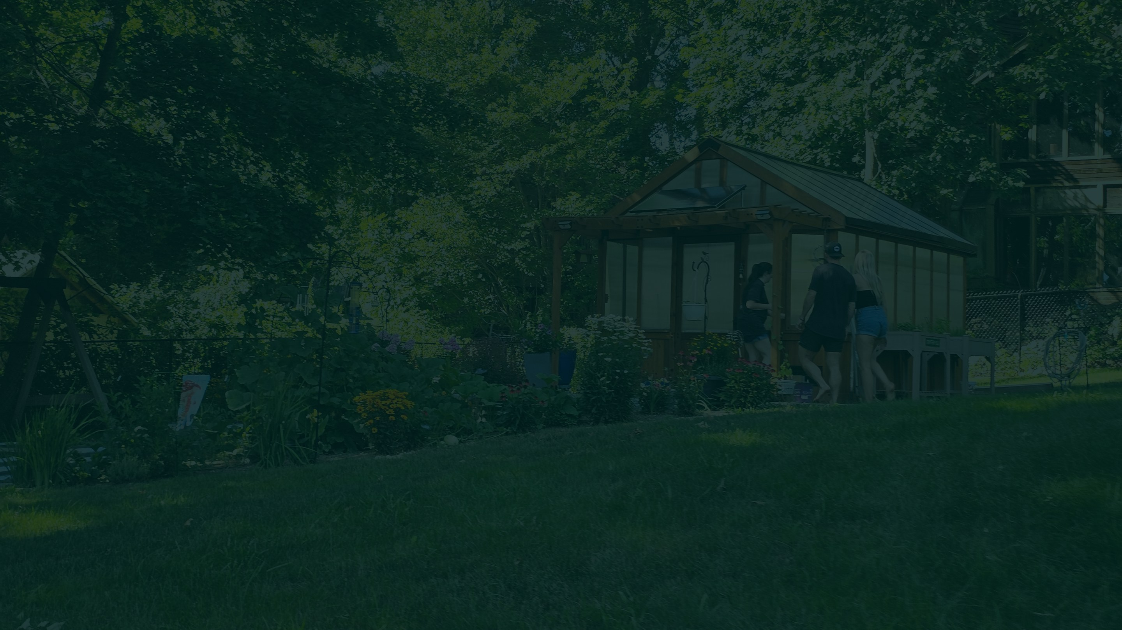
TEAM + TIMELINE
Building the software
and the institution.
Cameron Ely-Murdock
Kathleen Marie Rose
Grig Bilham
Strategy Director & Development
Design & Community Outreach
Operations Management
Q3 2026
2027
END 2027
Beta launch opens in Boulder — members sign up.
Mobile app build-out · bioregional expansion.
~30 bioregions · ~200 organizations · 5,000+ members.
AFFILIATED ORGS
SPIRIT of the Front Range · OpenCivics · The Riverside · regenhub.xyz · CoHere · The Mystery Works · Front Range Commons
Rivr · Seed Round 2026
48
Notes:
SAY: A small team building both the software and the institution.
Cameron Ely-Murdock — strategy direction and development. Kathleen Marie Rose — design and community outreach. Grig Bilham — operations management.
[pause]
Timeline: Q3 2026, beta launch opens in Boulder and members sign up. Through 2027, mobile app build-out and bioregional expansion. By end of 2027, approximately thirty bioregions, about two hundred organizations, and more than five thousand members.
[pause]
We're affiliated with SPIRIT of the Front Range, OpenCivics, The Riverside, regenhub.xyz, CoHere, The Mystery Works, and Front Range Commons.
BRIDGE: Which brings me to what we're raising.

Slide 50

THE ASK · SEED ROUND 2026
$500K
live.
to take the built platform
INSTRUMENT + TERMS
USE OF FUNDS
Cooperative SAFE — $4M cap · 20% discount →
Class D Steward Shares (accredited, 506b).
Colorado residents: direct Class R purchase (147A).
Live-money cutover + payment operations
Core team compensation + engineering
SHARE PRICE
Community growth + chapter onboarding
$0.20 per share.
Legal, compliance + co-op formation
DIVIDEND RIGHT
Infrastructure + AI
Steward Pool = 33% of after-tax retained profit,
pro-rata, from the first profitable year.
Runway into the 2027 Crowd round.
Informational only. Not an offer to sell securities. See governing documents and membership agreements for binding terms.
Rivr · Seed Round 2026
49
Notes:
SAY: We're raising five hundred thousand dollars to take the built platform live.
[pause]
The instrument is a cooperative SAFE at a four million dollar cap with a twenty percent discount, converting to Class D Steward Shares for accredited investors under 506(b). Colorado residents can purchase Class R directly under 147A. Share price is twenty cents.
[pause]
The dividend right: the Steward Pool is thirty-three percent of after-tax retained profit, pro-rata, from the first profitable year.
[pause]
Use of funds: live-money cutover and payment operations, core team compensation and engineering, community growth and chapter onboarding, legal and compliance and co-op formation, and infrastructure and AI. That's runway into the 2027 Crowd round.
BRIDGE: And this is what the money is ultimately for.

Slide 51

VALUES-BASED WORLD OUTCOMES
Public benefits,
codified.
ECONOMIC RESILIENCE
REGENERATIVE IMPACT
CIVIC ENGAGEMENT
Local economic thriving — cooperative commerce, resource sharing, community building.
Environmentally regenerative practice through education, technology, and transparency.
Democratic participation through accessible cooperative ownership.
PERSONAL LIBERTY
LOCAL CULTURE & ECOLOGY
THRIVING BIOREGIONS
Data sovereignty and open tools — an opt-in ecosystem of vibrant social organisms.
The vitality of each place: water, land, food, art, music, business, care.
~30 active bioregions and ~200 living organizations by end of 2027 — and beyond.
The bigger vision is capable places — able to see and care for themselves
without cutting themselves off from the rest of the world.
Rivr · Seed Round 2026
50
Notes:
SAY: As a Public Benefit Corporation, these outcomes are obligations in our Articles — not marketing.
Economic resilience: local economic thriving through cooperative commerce, resource sharing, community building. Regenerative impact through education, technology, and transparency. Civic engagement through accessible cooperative ownership. Personal liberty — data sovereignty and open tools. Local culture and ecology: the vitality of each place. And thriving bioregions — roughly thirty active bioregions and two hundred living organizations by end of 2027.
[pause]
The bigger vision is capable places — able to see and care for themselves without cutting themselves off from the rest of the world.
BRIDGE: One last thought.

Slide 52
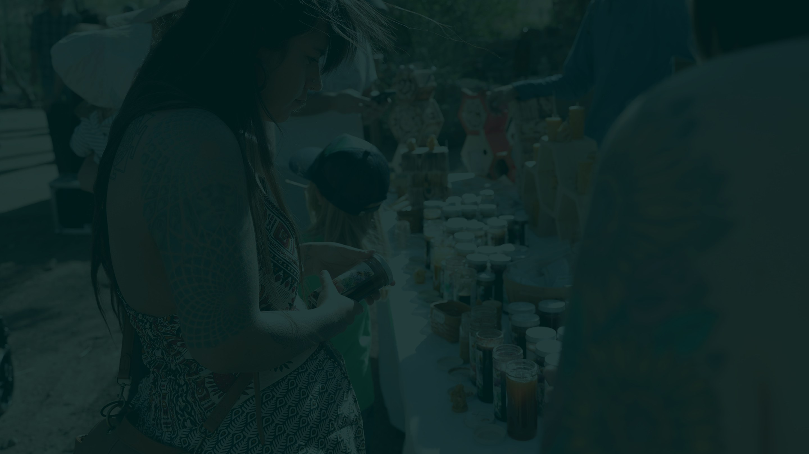
CLOSING · FLOW LOCAL. CONNECT GLOBAL.
The best Rivr interaction may end
with you leaving Rivr.
Find the thing. Find the person. Make the agreement. Join the project.
Go meet them. Go do the work. Put the phone away.
We don't need to abandon modern technology to remember how to live together —
we can build better technology for it.
admin@rivr.social · app.rivr.social · invest.rivr.social
Flow local. Connect global. A Rivr made of many rivers.
Rivr · Seed Round 2026
51
Notes:
SAY: I'll close with the strangest thing about this product.
[pause]
The best Rivr interaction may end with you leaving Rivr. Find the thing. Find the person. Make the agreement. Join the project. Go meet them. Go do the work. Put the phone away.
[pause]
We don't need to abandon modern technology to remember how to live together — we can build better technology for it.
[pause]
Flow local. Connect global. A Rivr made of many rivers.
Thank you. admin@rivr.social, app.rivr.social, invest.rivr.social.

