Slide 1
CS523
Frena Mhretab, Feven Kiflai, Riwaaz B. Sijapati, Ryan Stephens

Slide 2
AGENDA
Introduction
Kafka
Spark Streaming
Spark SQL/Hive
Tableau visualization

Slide 3







overview

Slide 4
Kafka

Slide 5
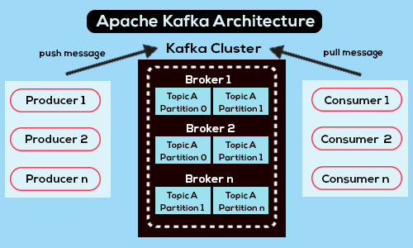

Slide 6

What info IS BEING PUSHED TO KAFKA
Magazine info specifically sending id, title, author, published, date, excerpt, topic, country, authors, opinion

Slide 7
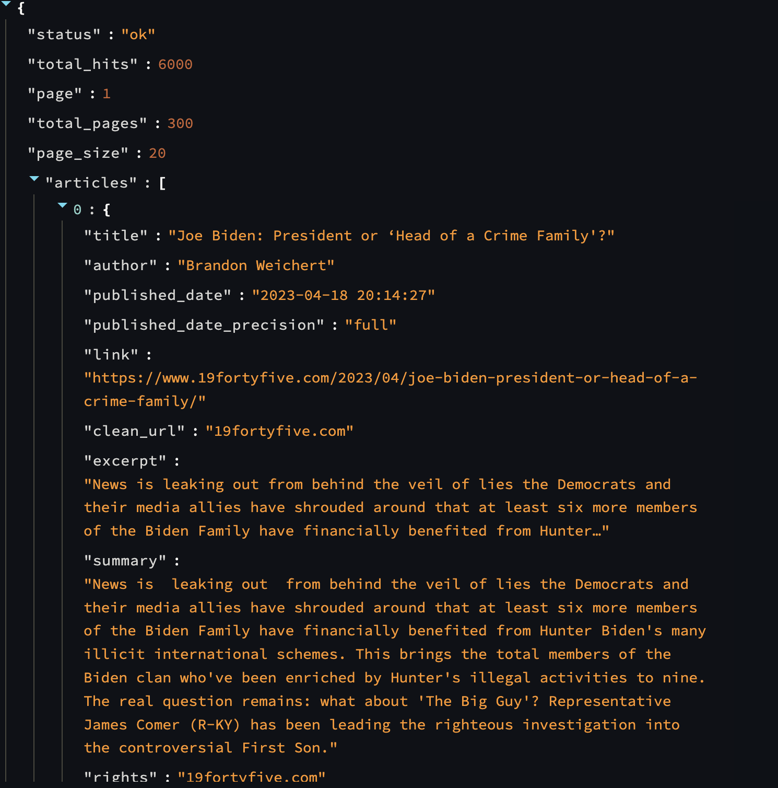
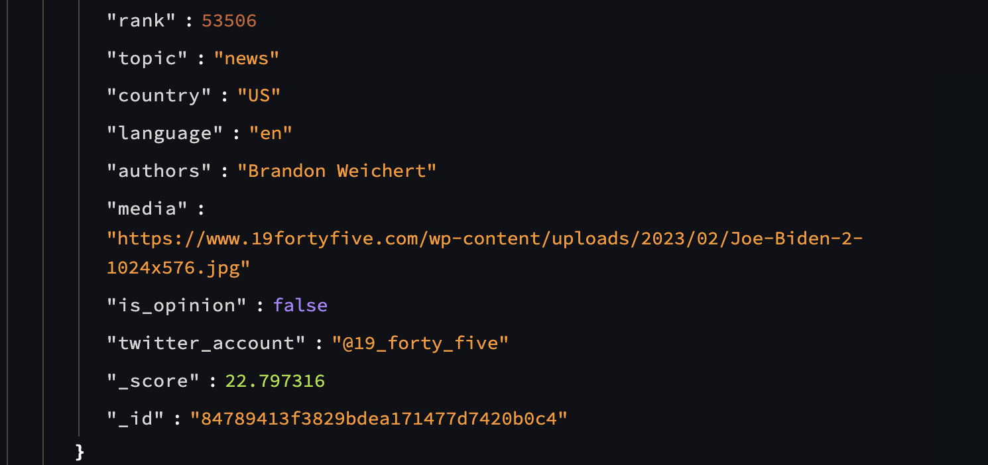

Slide 8
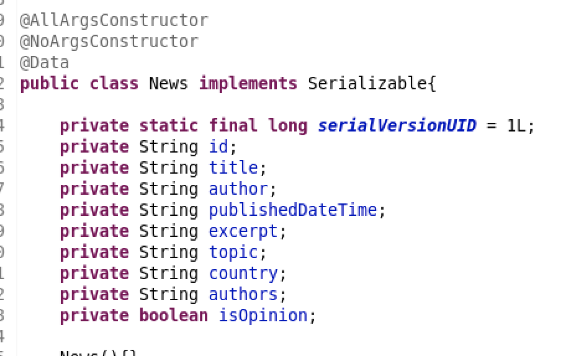

Slide 9
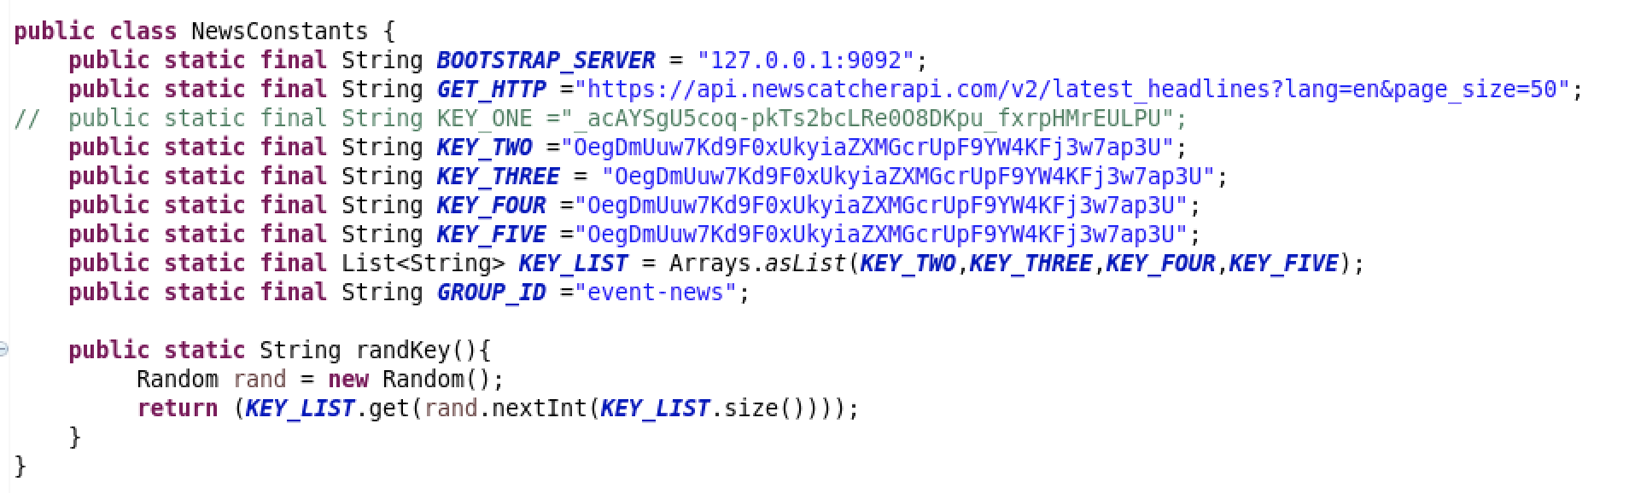

Slide 10
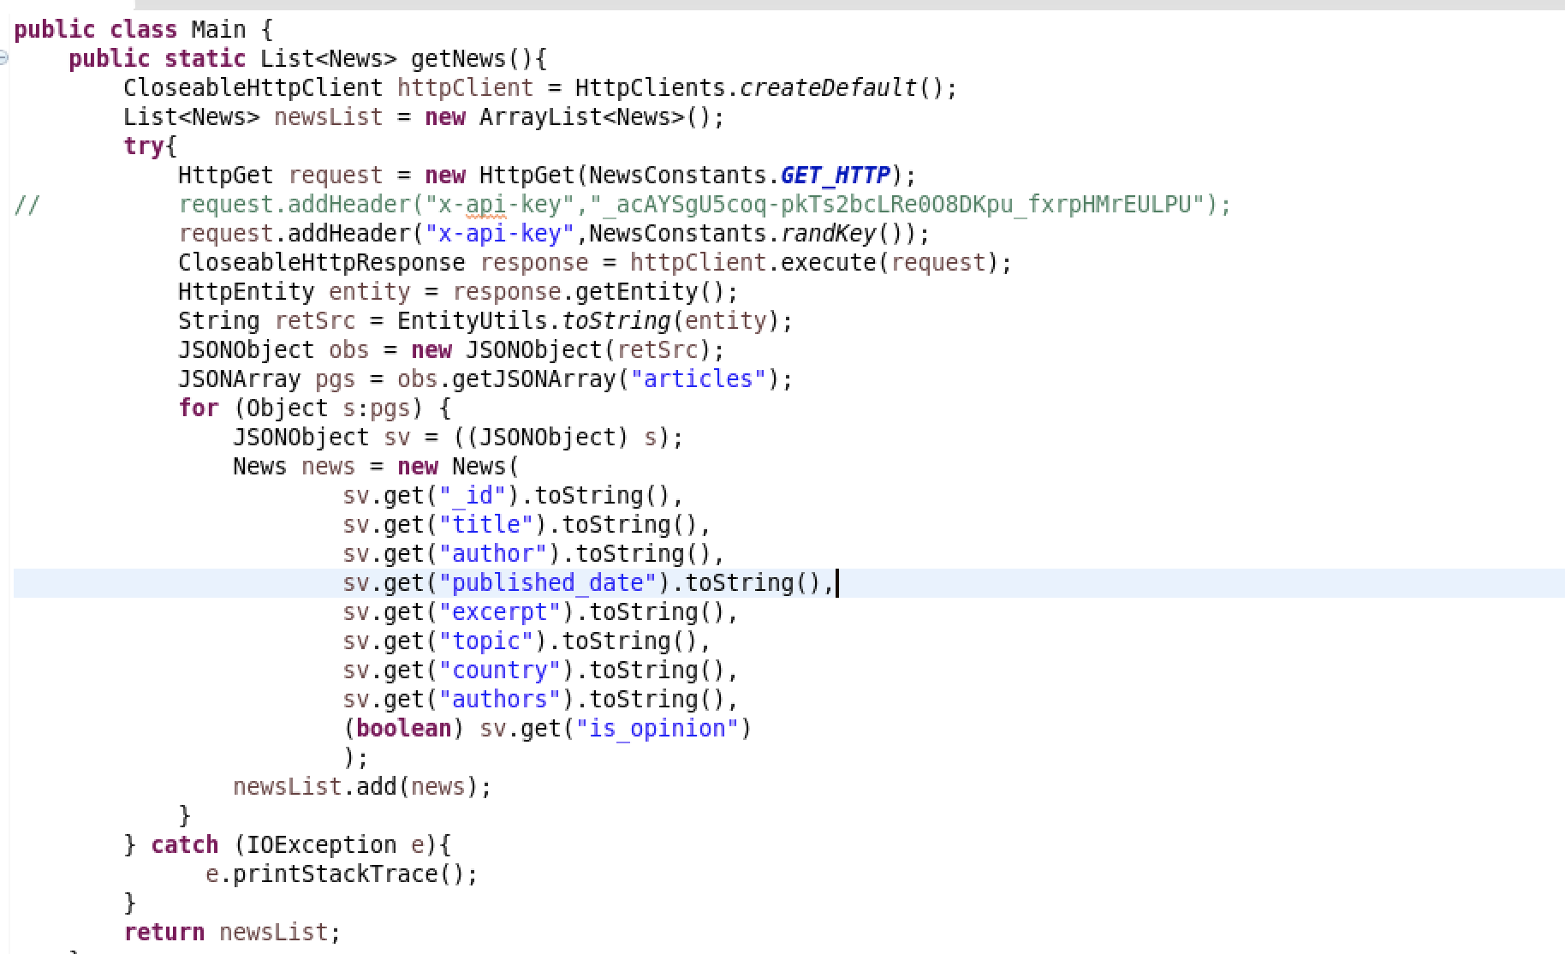

Slide 11
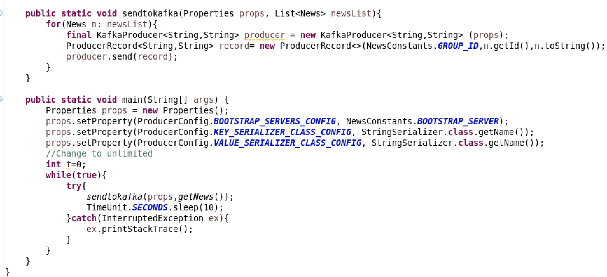

Slide 12
Spark Streaming

Slide 13

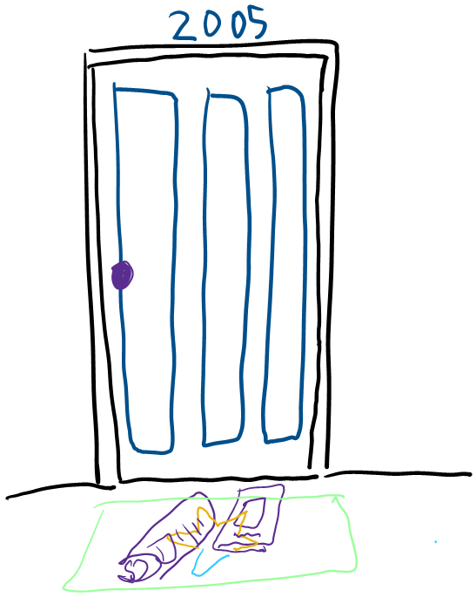


PROCESS

Slide 14
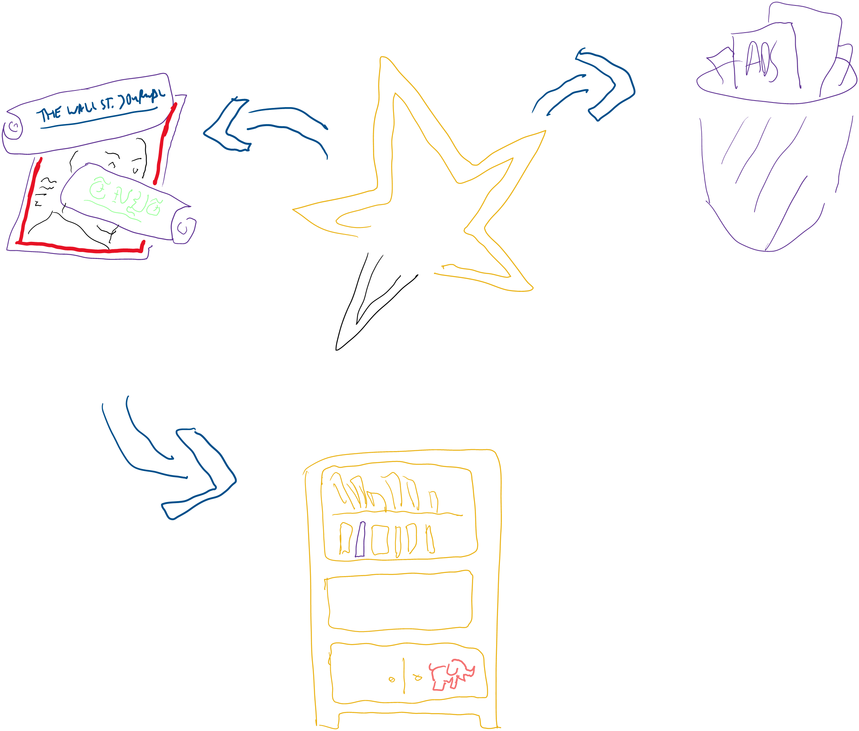
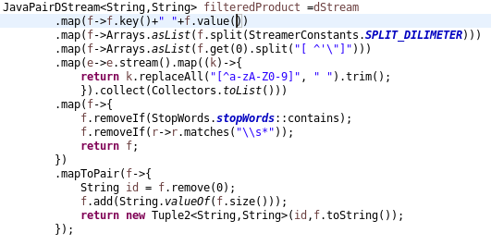

Slide 15
Spark SQL / Hive

Slide 16
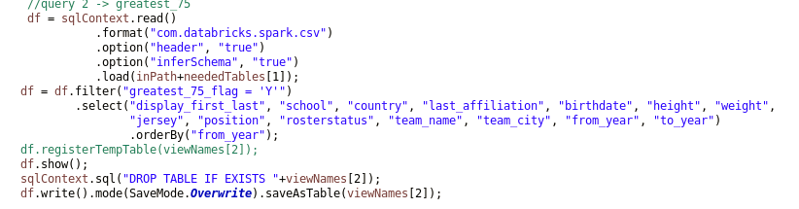
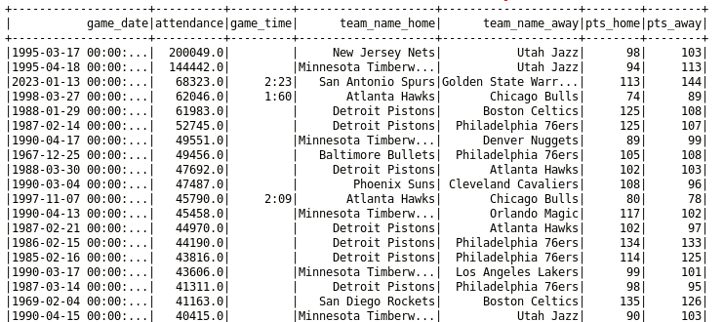
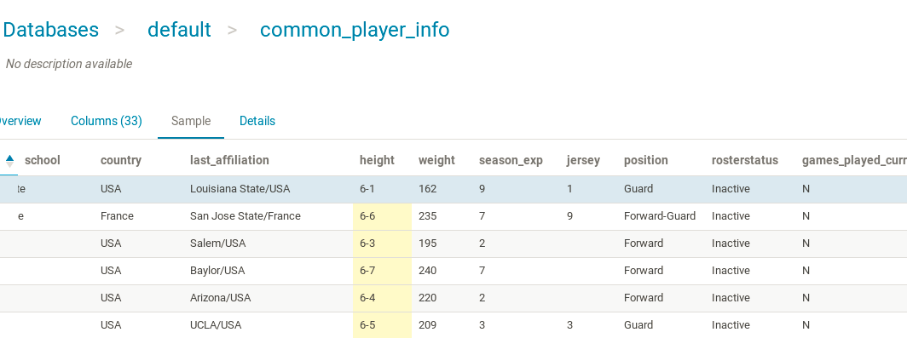
Spark sql and hive
Load csvs into java as DataFrames
Save to Hive
Perform Queries

Slide 17
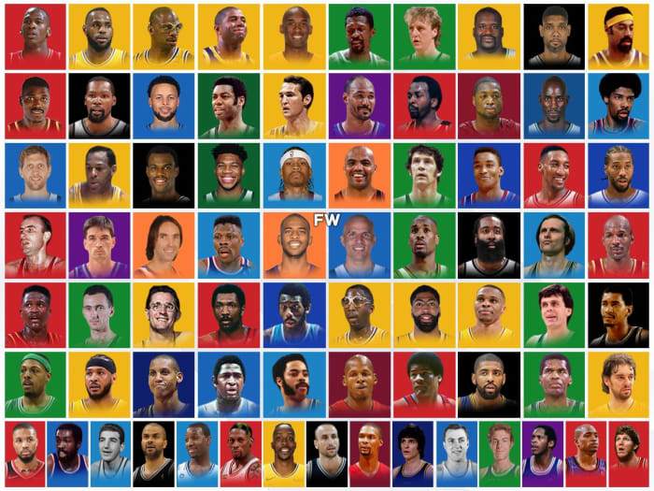
NBA Greatest 75
LA_LAKERS.mov

Slide 18
Visualization
Let's go to Tableau

Slide 19
THANK YOU
We have an infinite number of reasons to be happy, and a serious responsibility not be serious.
-- Maharishi Mahesh Yogi

