Slide 1
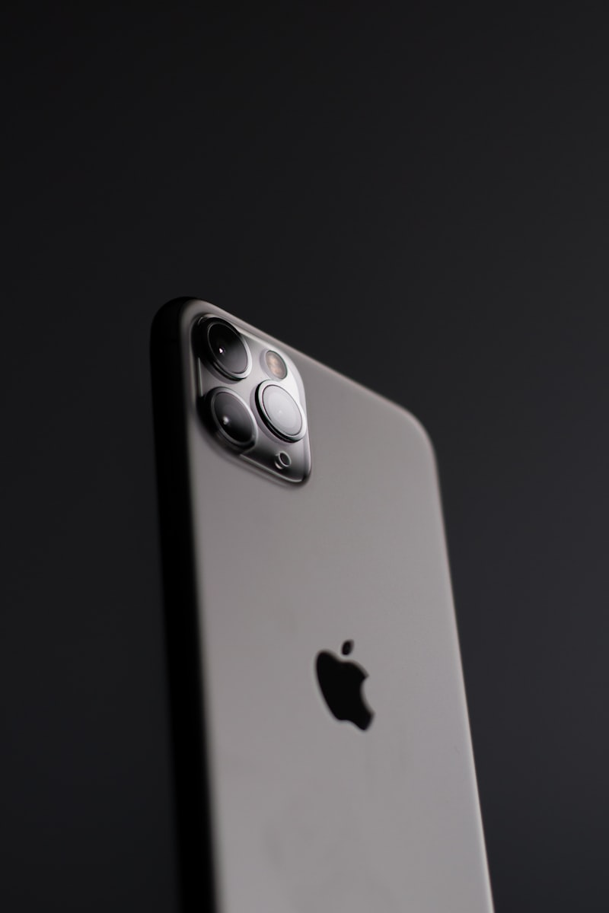
Meet the New
iPhone 16 Pro
Redefining Innovation, Again
• Sleek titanium design
• Groundbreaking A18 Pro chip
• Ultra-low-power AI processing
• Next-level iOS experience

Slide 2




What Makes It Stand Out
A18 Pro Chip
ProMotion XDR
48MP Camera
AI-Enhanced Siri
Blazing-fast performance & efficiency
Smooth, vibrant visuals
Professional-grade photography
Smarter, natural interactions

Slide 3
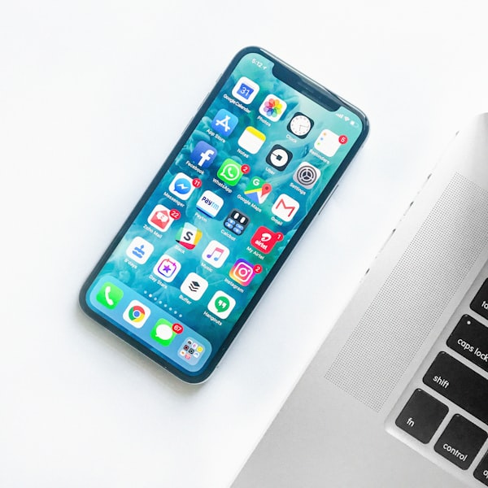
Designed Around You
✓ Seamless Apple ecosystem integration
✓ Always-on AI-powered assistance
✓ Enhanced privacy & security
✓ iOS 18 with improved widgets
Experience seamless integration across all your Apple devices

Slide 4
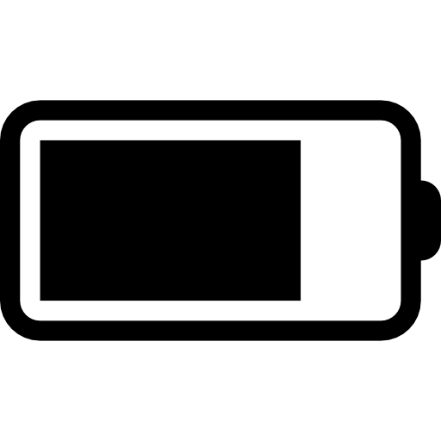


Why Choose iPhone 16 Pro
Longest Battery Life
Premium Titanium
Apple Services
Ever on iPhone
Aerospace-grade durability
iCloud+, TV+, Fitness+

Slide 5

Experience the Future Today
Pre-order starts Sept 10, 2025
Available in 5 stunning finishes
Starting at $999
Pre-order Now

