Slide 1

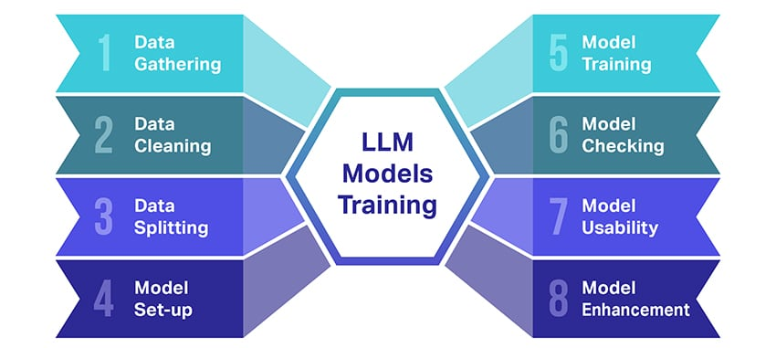
What is LLM?
Large Language Models

Slide 2
Definition
Large Language Models (LLMs) are advanced AI systems trained on vast amounts of text data to understand and generate human-like language.
Process and understand natural language
Generate coherent and contextual responses
Perform various language-related tasks
Learn patterns from massive text datasets

Slide 3
Key Capabilities
Text Generation
Language Translation
Question Answering
Code Generation
Content Summarization
Creative Writing
LLMs can perform multiple language tasks with remarkable accuracy and human-like understanding

Slide 4
Popular LLM Examples
GPT-4
(OpenAI)
Claude
(Anthropic)
Gemini
(Google)
LLaMA
(Meta)
Mistral
(Mistral AI)
PaLM
(Google)

Slide 5
How LLMs Work
Training Data
(Billions of texts)
Neural Network
(Transformer)
Trained Model
(LLM)
User Input
(Prompt)
Inference
(Processing)
Generated
Response

Slide 6
The Future of LLMs
🚀 More powerful and efficient models
🌐 Better multilingual capabilities
🔧 Specialized domain-specific LLMs
🤖 Integration with robotics and IoT
💡 Enhanced reasoning and problem-solving
🎯 Personalized AI assistants

