Slide 1
MVP2MVP Day (GitHub + Azure DevOps)
Reports for Azure DevOps on PowerBI using AzDevOps CLI and REST API
Creating reports not covered by Analytics Views and OData
Vinicius Moura
vinijmoura@hotmail.com
bit.ly/azuredevopssprints

Slide 2
Problem 1: Audit all repositories and respective Branch Policies
01
Apply same policies in 300 repositories
02
Different assigned polices on repositories
03
Protect main branch
04
Apply code review

Slide 3
Solution 1: Use AzDevOps CLI
01
02
03
04
List All projects
az devops
project list
List all repos
az repos list
List repo policies
az repos policy list
Generate json
Consume json on PowerBI

Slide 4




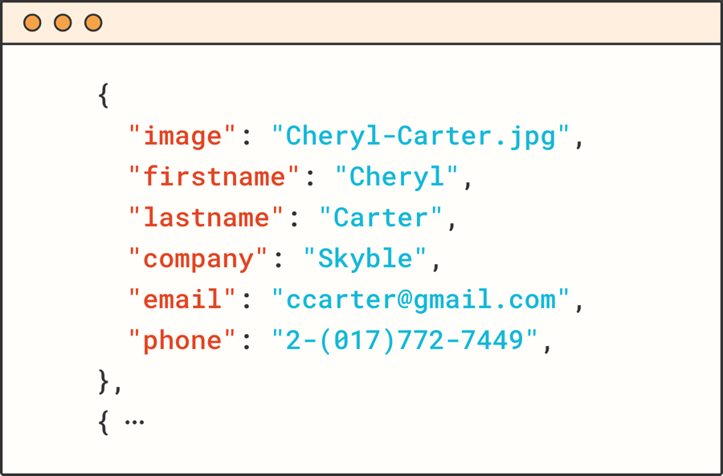
Flow 1: Create JSON using Azure Pipelines
Pipeline
trigger
PowerShell
AzDevOps CLI
JSON file
Upload Blob Storage
PowerBI connect Blob Storage

Slide 5
Problem 2: Check if a person is on more than 1 team
01
Identify personal capacity
02
In different projects
03
In different teams
04
Capacity
Teams Days Off
Individual Days Off

Slide 6
Solution 2: Use Azure DevOps REST API
List All projects
_apis/projects
List all teams
_apis/projects/$($project.id)/teams
List all sprints
$($project.id)/$($team.id)/_apis/work/teamsettings/iterations
Get team settings
$($project.id)/$($team.id)/_apis/work/teamsettings
Get teams days off
$($project.id)/$($team.id)/_apis/work/teamsettings/iterations/$($sprintteam.id)/teamdaysoff
Get capacities
$($project.id)/$($team.id)/_apis/work/teamsettings/iterations/$($sprintteam.id)/capacities
Generate json
Consume json on PowerBI

Slide 7
Flow 2: Create JSON using Azure Pipelines
Pipeline
trigger
PowerShell
Azure DevOps Rest API
JSON file
Upload Blob Storage
PowerBI connect Blob Storage

Slide 8
More examples: Reports and Scripts
X
Script: List Process Templates, Work Item Types and Fields
Process
X
Report: List Process Templates and respective Team Projects
Azure Repos
X
Script: Create Repository and Branch Policies
Configurations
X
Script: Insert new user, set access level and copy existing permissions of an active user
Azure DevOps
X
Report: List all users and respective permissions
Work Items
X
Script: Create multiple iterations at once
X
Report: Work Items by Tags
X
Report: Work Item Visualize
Pipelines
X
Report: List Pools, Agents, and Capabilties
https://github.com/vinijmoura/Azure-DevOps
https://vinijmoura.medium.com

