Slide 1
Linux Kernel
Julian Kuhn, Friederike Kunze,
Oliver Röhrdanz

Slide 2
Linux Kernel
Projektbeginn: April 1991
über 14.000 Autoren aus über 1.200 Firmen
Einsatz in IOT, Android, Server, …
20.618.159 Lines of Code in 51.570 Dateien
Aktuelle Version: 4.3

Slide 3
Requirements Engineering
Geschichtliche / Zeitliche Entwicklung des Linux Kernel
Anforderungsermittlung damals bis heute - wachsende Anfoderungen mit neuen technologien (PC, Tablet, Smartphone)
Betrachtung der steigenden Anforderungen
Umfang der unterschiedlichen Nutzung (Server, PC, Tablet, Smartphone)
Betrachten der Requirements von Linux Kernel aus sicht der verschiedenen Hersteller
Android (Samsung, HTC, etc.)
Betrachten der Nutzung von Linux Kernel
In der Wirtschaft
In privaten Haushälten
Zusammenfassung RE Linux Kernel
Anforderungserhebung
Analyse
Spezifikation
Verifikation & Validation
Management
Notes:
Optional: Zukunftsaussicht
Anforderungen: Connected Car, Smart Home, Internet of Things, etc..

Slide 4
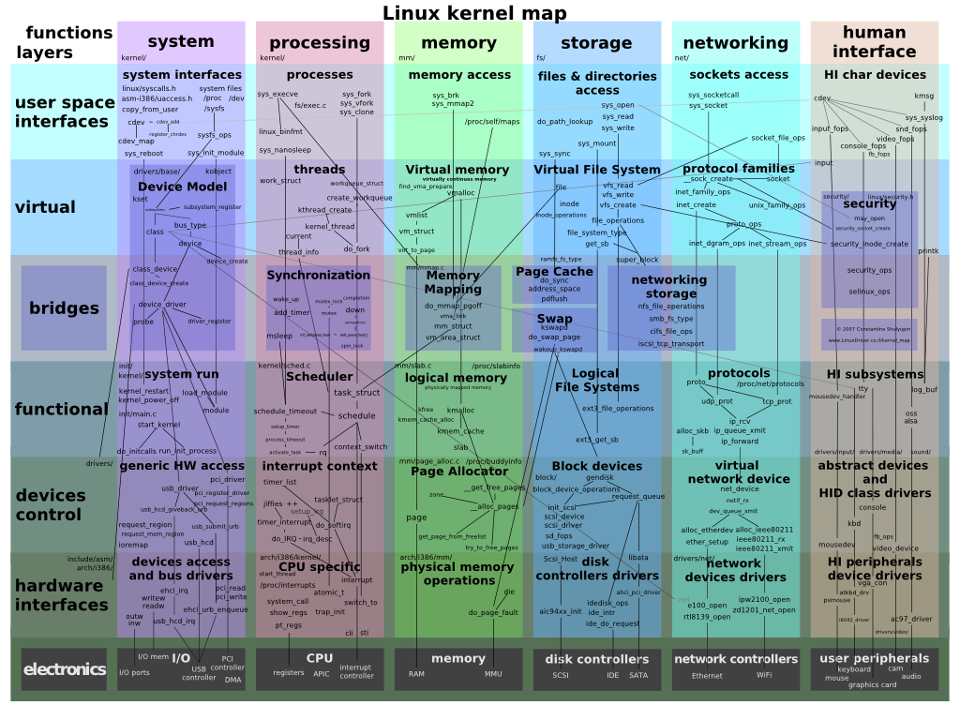
Architecture - Overview

Slide 5
Architecture
Monolithic kernel
Layered
Modular
Highly configurable
Notes:
Monolithic kernel
Layered
Modular
Highly configurable -> größen der Linux images variieren von 1 mb bis ein paar GB

Slide 6
Architecture – Monolithic and modular?
Monolothic means, …
one static image with all selected device drivers, filesystems, etc..
Everything runs in kernel space
Everything is available at startup
Adding features into kernel space possible through Modules

Slide 7
Modules
Kernel feature inclusion:
statically integrate into kernel image
Compile as module
Modules
can be integrated into the system during runtime into kernel space
Used as „Containers“ for device drivers, file systems, system calls, …

Slide 8
Linux as a product line
Pre-configuration through feature modeling language kconfig
Describes dependencies between modules
Helper Tools: menuconfig where users can select/deselect features in a pre-compilation step
Selections are reflected as compiler directives (#define) and are integrated into the compilation process

Slide 9
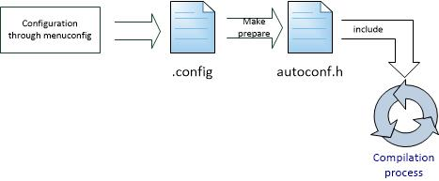
Linux as a product line

Slide 10
Linux as a product line
menuconfig SAMPLES
bool "Sample kernel code"
help
You can build and test sample kernel code here.
if SAMPLES
config SAMPLE_TRACE_EVENTS
tristate "Build trace_events examples
-- loadable modules only"
depends on EVENT_TRACING && m
help
This build trace event example modules.

