Slide 1
Linux Kernel
Julian Kuhn, Oliver Röhrdanz
Friederike Kunze, Vincenzo Baldini

Slide 2
Requirements Engineering
RE by external parties
Notes:
Optional: Zukunftsaussicht
Anforderungen: Connected Car, Smart Home, Internet of Things, etc..

Slide 3
Requirements Engineering – Community RE
No explicit RE
No plans for future releases & rejection of fixed interfaces
RE as a mix of community needs and quality control
community provides input and implementations (unstructured)
maintainers perform strict Quality Control
Quality Control as a workflow
very strict and hierarchical workflow
every step includes Quality Control
actual Quality Control is assured by taking personal responsibility
TODO: Implications and historical development
Notes:
Optional: Zukunftsaussicht
Anforderungen: Connected Car, Smart Home, Internet of Things, etc..

Slide 4
Architecture
Description of the high-level architecture
Linux as a product line
How it is done
Pros & Cons of the used approach (TBD)
Focus on LKMs(Loadable Kernel Modules)
Load/Unload Mechanism
Architectural design for module abstraction (TBD)
Analysis of a specific module: Linux Livepatching
General functionality
Code-Analysis with tools
Analysis of another module/kernel functionality (TBD)
Notes:
Umsetzung von Anforderungen
Construction
Implementation
Architektur Prinzipien
Design Dokument
erkennbare Patterns?
Schichtentrennung
Analyse des Sourcecodes
statisch
dynamisch
Sicherheit
Validation
Testing?

Slide 5
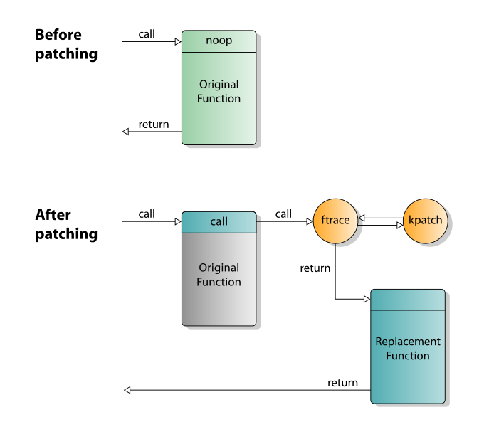
Architecture
Linux Livepatching
Besteht aus 2 Teilen
Kernel Modul führt Live Patching aus
Userspace bereiten hot patch kernel Module vor
Funktionen können ersetzt werden
Änderungen an Kernel Datenstrukturen nicht möglich
Notes:
Kurze Beschreibung von Live Patching (kpatch)

