Slide 1
Linux Kernel
Julian Kuhn, Friederike Kunze,
Oliver Röhrdanz

Slide 2
Linux Kernel
Projektbeginn: April 1991
über 14.000 Autoren aus über 1.200 Firmen
Einsatz in IOT, Android, Server, …
20.618.159 Lines of Code in 51.570 Dateien
Aktuelle Version: 4.3
Linux Kernel - Requirements und Architektur
<number>

Slide 3
Requirements Engineering
Requirements Engineering
Historically very informal
Vast majority of developers are paid for their work
Processes and goals of employers are not transparent to outsiders
Results seem to be satisfactory
Contribution Process
Strictly regulated
Process phases focussed on avoiding regression errors
Both automated and manual testing on many different platforms
Emphasis on personal responsibility and repeated code review
Tools
Bug Tracker: Bugzilla
Version control: git (obviously)
Communication, contributions, bug reports: mailing list
Linux Kernel - Requirements und Architektur
<number>
Notes:
Optional: Zukunftsaussicht
Anforderungen: Connected Car, Smart Home, Internet of Things, etc..
Build 2013
© 2013 Microsoft Corporation. All rights reserved. Microsoft, Windows, and other product names are or may be registered trademarks and/or trademarks in the U.S. and/or other countries.
The information herein is for informational purposes only and represents the current view of Microsoft Corporation as of the date of this presentation. Because Microsoft must respond to changing market conditions, it should not be interpreted to be a commitment on the part of Microsoft, and Microsoft cannot guarantee the accuracy of any information provided after the date of this presentation. MICROSOFT MAKES NO WARRANTIES, EXPRESS, IMPLIED OR STATUTORY, AS TO THE INFORMATION IN THIS PRESENTATION.
30/01/16
<number>

Slide 4
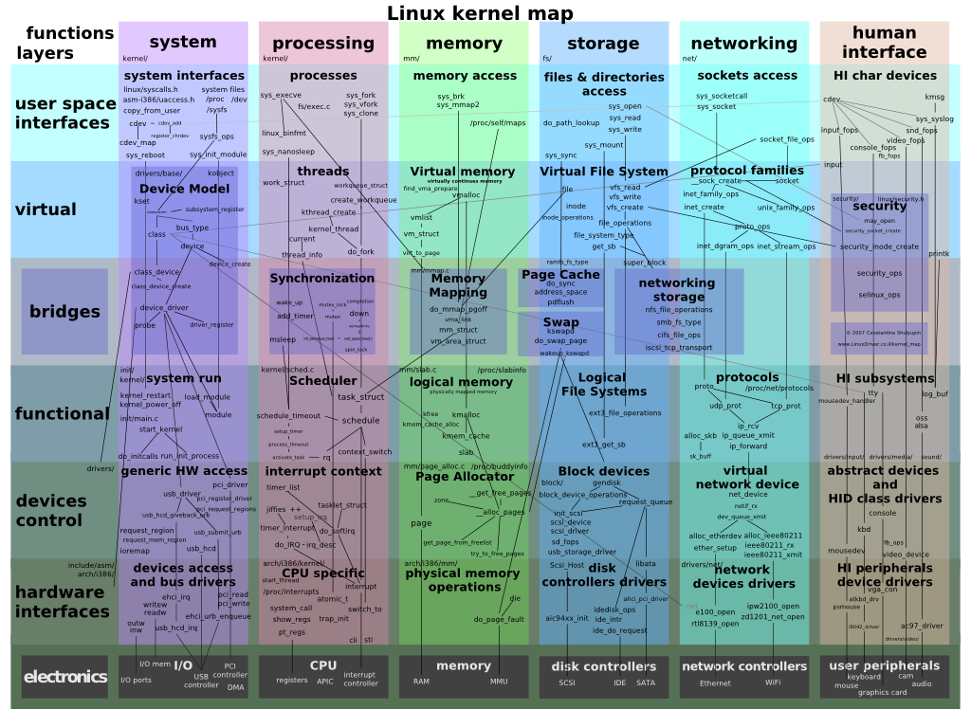
Architecture - Overview
Linux Kernel - Requirements und Architektur
<number>
Notes:
Build 2013
© 2013 Microsoft Corporation. All rights reserved. Microsoft, Windows, and other product names are or may be registered trademarks and/or trademarks in the U.S. and/or other countries.
The information herein is for informational purposes only and represents the current view of Microsoft Corporation as of the date of this presentation. Because Microsoft must respond to changing market conditions, it should not be interpreted to be a commitment on the part of Microsoft, and Microsoft cannot guarantee the accuracy of any information provided after the date of this presentation. MICROSOFT MAKES NO WARRANTIES, EXPRESS, IMPLIED OR STATUTORY, AS TO THE INFORMATION IN THIS PRESENTATION.
30/01/16
<number>

Slide 5
Architecture
Monolithic kernel
Layered
Modular
Highly configurable
Linux Kernel - Requirements und Architektur
<number>
Notes:
Monolithic kernel
Layered
Modular
Highly configurable -> größen der Linux images variieren von 1 mb bis ein paar GB
Build 2013
© 2013 Microsoft Corporation. All rights reserved. Microsoft, Windows, and other product names are or may be registered trademarks and/or trademarks in the U.S. and/or other countries.
The information herein is for informational purposes only and represents the current view of Microsoft Corporation as of the date of this presentation. Because Microsoft must respond to changing market conditions, it should not be interpreted to be a commitment on the part of Microsoft, and Microsoft cannot guarantee the accuracy of any information provided after the date of this presentation. MICROSOFT MAKES NO WARRANTIES, EXPRESS, IMPLIED OR STATUTORY, AS TO THE INFORMATION IN THIS PRESENTATION.
30/01/16
<number>

Slide 6
Architecture – Monolithic and modular?
Monolothic means, …
one static image with all selected device drivers, filesystems, etc..
Everything runs in kernel space
Everything is available at startup
Adding features into kernel space possible through Modules
Linux Kernel - Requirements und Architektur
<number>
Notes:
Build 2013
© 2013 Microsoft Corporation. All rights reserved. Microsoft, Windows, and other product names are or may be registered trademarks and/or trademarks in the U.S. and/or other countries.
The information herein is for informational purposes only and represents the current view of Microsoft Corporation as of the date of this presentation. Because Microsoft must respond to changing market conditions, it should not be interpreted to be a commitment on the part of Microsoft, and Microsoft cannot guarantee the accuracy of any information provided after the date of this presentation. MICROSOFT MAKES NO WARRANTIES, EXPRESS, IMPLIED OR STATUTORY, AS TO THE INFORMATION IN THIS PRESENTATION.
30/01/16
<number>

Slide 7
Modules
Kernel feature inclusion:
statically integrate into kernel image
Compile as module
Modules
can be integrated into the system during runtime into kernel space
Used as „Containers“ for device drivers, file systems, system calls, …
Linux Kernel - Requirements und Architektur
<number>

Slide 8
Linux as a product line
Pre-configuration through feature modeling language kconfig
Describes dependencies between modules
Helper Tools: menuconfig where users can select/deselect features in a pre-compilation step
Selections are reflected as compiler directives (#define) and are integrated into the compilation process
Linux Kernel - Requirements und Architektur
<number>
Notes:
Build 2013
© 2013 Microsoft Corporation. All rights reserved. Microsoft, Windows, and other product names are or may be registered trademarks and/or trademarks in the U.S. and/or other countries.
The information herein is for informational purposes only and represents the current view of Microsoft Corporation as of the date of this presentation. Because Microsoft must respond to changing market conditions, it should not be interpreted to be a commitment on the part of Microsoft, and Microsoft cannot guarantee the accuracy of any information provided after the date of this presentation. MICROSOFT MAKES NO WARRANTIES, EXPRESS, IMPLIED OR STATUTORY, AS TO THE INFORMATION IN THIS PRESENTATION.
30/01/16
<number>

Slide 9
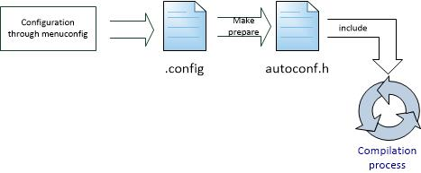
Linux as a product line
Linux Kernel - Requirements und Architektur
<number>
Notes:
Build 2013
© 2013 Microsoft Corporation. All rights reserved. Microsoft, Windows, and other product names are or may be registered trademarks and/or trademarks in the U.S. and/or other countries.
The information herein is for informational purposes only and represents the current view of Microsoft Corporation as of the date of this presentation. Because Microsoft must respond to changing market conditions, it should not be interpreted to be a commitment on the part of Microsoft, and Microsoft cannot guarantee the accuracy of any information provided after the date of this presentation. MICROSOFT MAKES NO WARRANTIES, EXPRESS, IMPLIED OR STATUTORY, AS TO THE INFORMATION IN THIS PRESENTATION.
30/01/16
<number>

Slide 10
Linux as a product line
menuconfig SAMPLES
bool "Sample kernel code"
help
You can build and test sample kernel code here.
if SAMPLES
config SAMPLE_TRACE_EVENTS
tristate "Build trace_events examples
-- loadable modules only"
depends on EVENT_TRACING && m
help
This build trace event example modules.
Linux Kernel - Requirements und Architektur
<number>
Notes:
Build 2013
© 2013 Microsoft Corporation. All rights reserved. Microsoft, Windows, and other product names are or may be registered trademarks and/or trademarks in the U.S. and/or other countries.
The information herein is for informational purposes only and represents the current view of Microsoft Corporation as of the date of this presentation. Because Microsoft must respond to changing market conditions, it should not be interpreted to be a commitment on the part of Microsoft, and Microsoft cannot guarantee the accuracy of any information provided after the date of this presentation. MICROSOFT MAKES NO WARRANTIES, EXPRESS, IMPLIED OR STATUTORY, AS TO THE INFORMATION IN THIS PRESENTATION.
30/01/16
<number>

