Slide 1

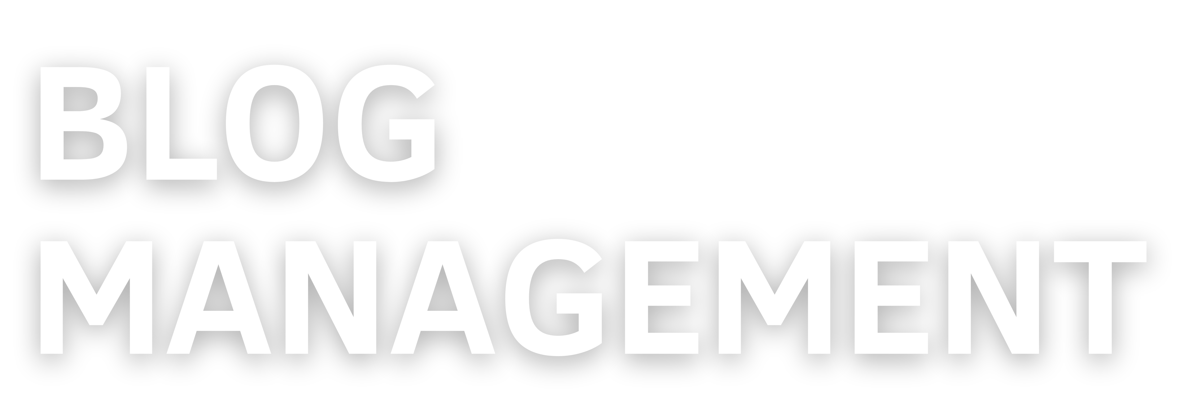
REVOLUTIONIZE YOUR WRITING EXPERIENCE WITH OUR FEATURE- PACKED BLOG APP. YOUR IDEAS, YOUR WORDS, YOUR APP!

Slide 2
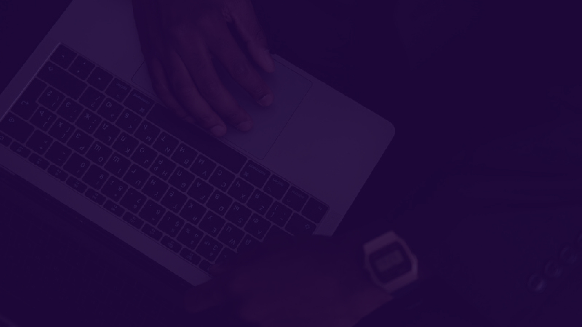

NAME : RIYA
ROLL NO : 2110991186
GROUP : G19
SUBMITTED TO : ASHWANI SIR

Slide 3



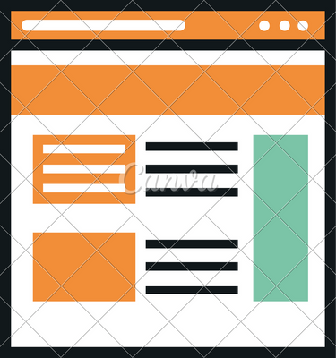
Idea Of Project
Create a feature-rich blogging app with user authentication, providing a secure login page.
Users can seamlessly manage their blog
content through an intuitive dashboard, allowing for easy addition, update, and deletion of posts, fostering a dynamic and personalized blogging experience.
CRAFT, SHARE, AND MANAGE YOUR STORIES SEAMLESSLY WITH OUR INTUITIVE BLOGGING APP AND RESPONSIVE DASHBOARD

Slide 4


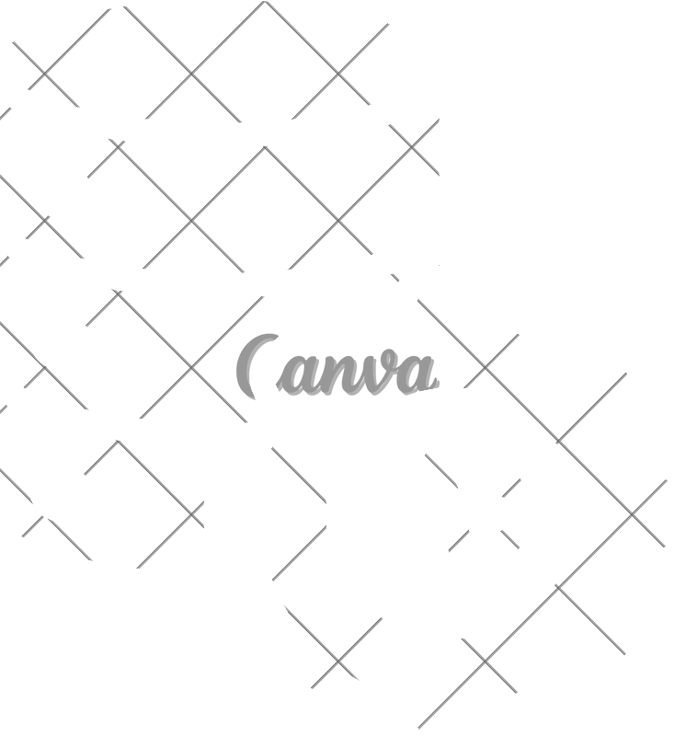
Frontend:
Build a responsive UI with HTML and Bootstrap.
Database:
Use MongoDB for storing user and blog post data
Server:
Develop an Express.js server using EJS for templating.
Create routes for user authentication, post CRUD, and dashboard.
Implement middleware for authentication and session management.

Slide 5
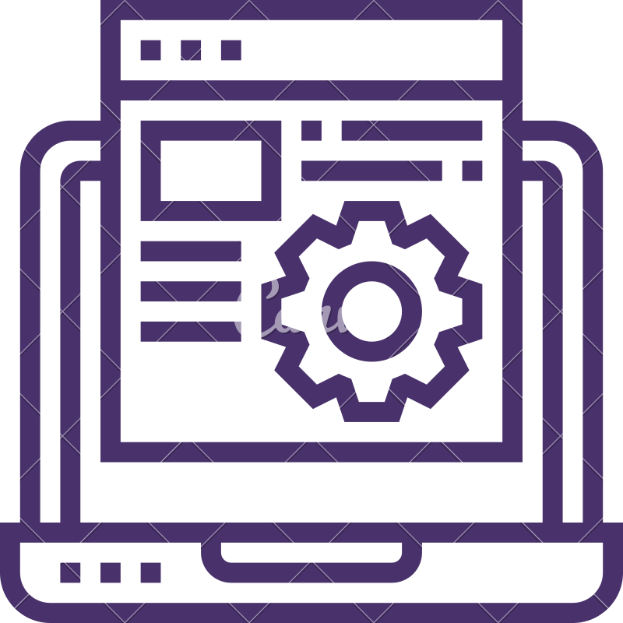

MODELS AND SCHEMA
BlogSetting Model: Manages blog configuration settings.
Includes fields for title, logo, and description.
Post Model: Represents an individual blog post. Stores title and content information.
User Model: Handles user data and authentication.
Includes fields for name, email, password, admin status, and token.

Slide 6


LIBRARIES
HTML BOOTSTRAP
MONGOOSE NODEMAILER RANDOM STRING EXPRESS SESSION MULTER
BCRYPT BODY PARSER
FRONTEND
MONGO DB EXPRESS JS
DATABASE AND SERVER

Slide 7
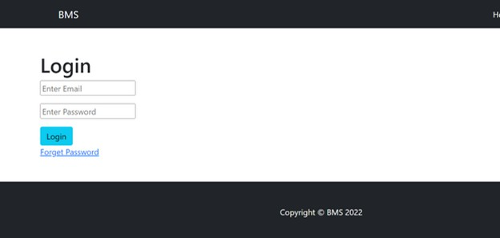
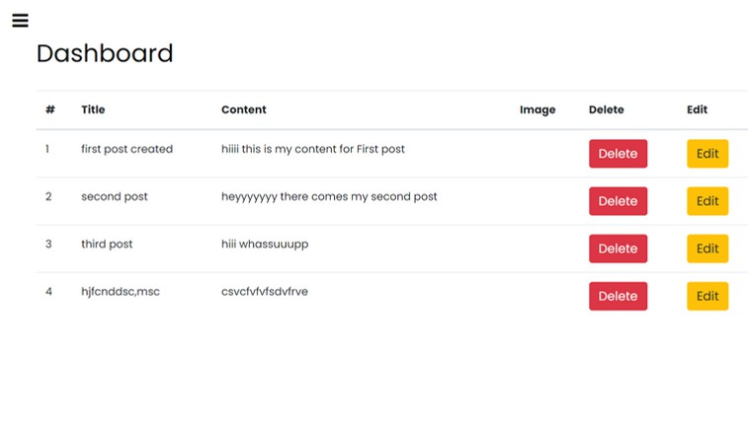
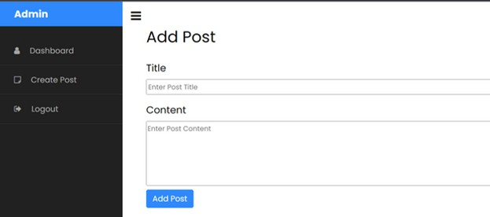
PROJECT OVERVIEW

Slide 8

MIDDLEWARES
Authentication Middleware:
isLogin: Ensures the user is logged in as an admin and redirects to the login page if not logged in as an admin.
isLogout: Redirects to the dashboard if the user is already logged in as an admin and continues to the next middleware if logged out.
Blog Middleware:
isBlog: Checks if the blog is set up.
Redirects to the blog setup page if the blog is not set up and the current URL is not the setup page.
Continues to the next middleware if the blog is set up or the current URL is
the setup page.

Slide 9
Admin Controller:
Manages blog setup, dashboard, and blog post operations.
Handles addition, deletion, editing, and updating of blog posts.
Blog Controller:
Renders the main blog page.
Loads a specific blog post.
User Controller: Handles user login, profile rendering, and logout.
Manages password recovery process.

Slide 10
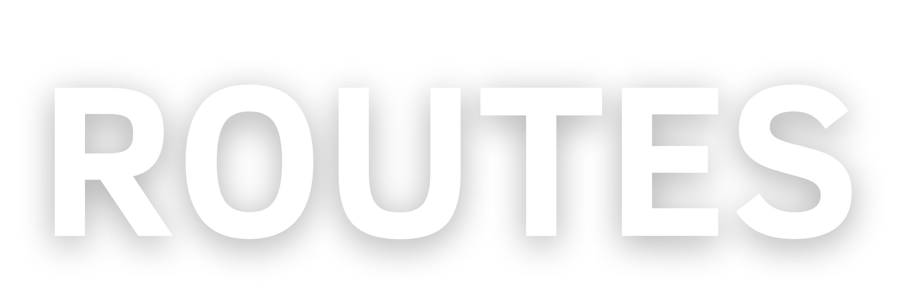
Admin Route:
Routes for blog setup, dashboard, and blog post operations.
Endpoints for adding, deleting, editing, and updating blog posts.
User Route:
Routes for user login, profile rendering, and logout.
Endpoint for managing the password recovery process.
Blog Route:
Endpoint for rendering the main blog page.
Endpoint for loading a specific blog post.

Slide 11
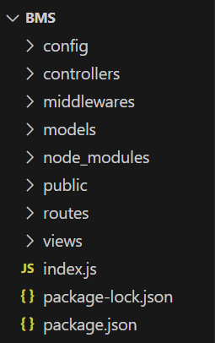
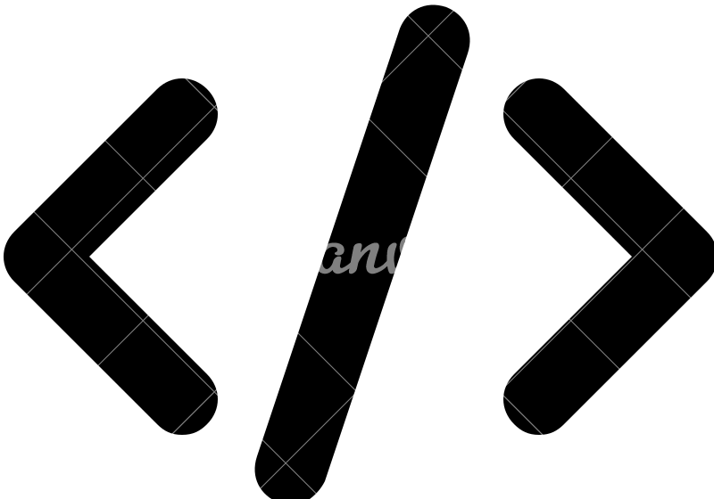
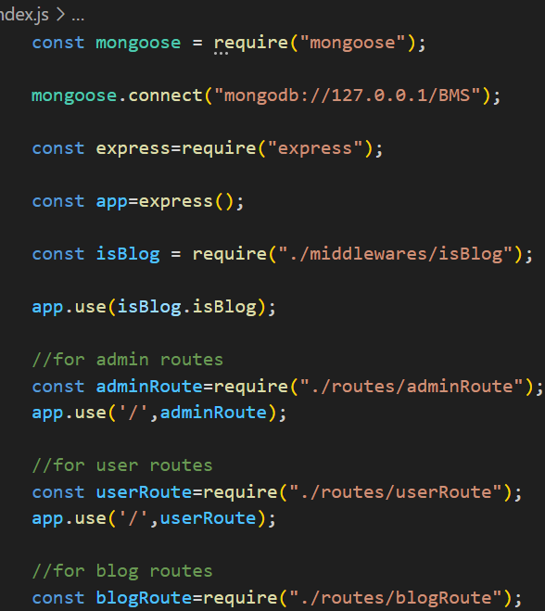
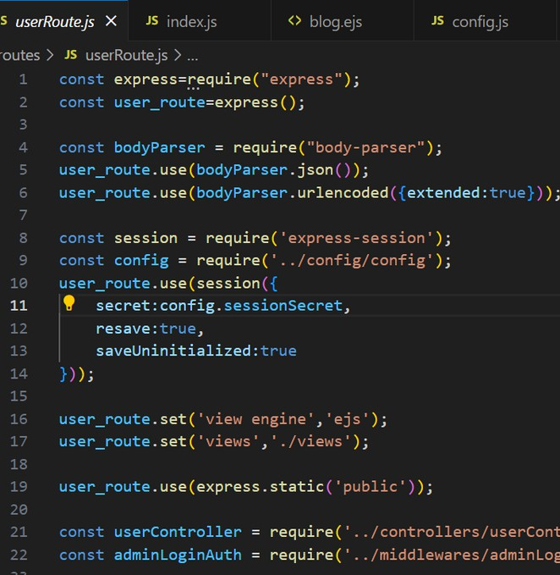
CODE OVERVIEW

Slide 12








THANK YOU

