Slide 1
CALCULATOR NAME : RIYA ROLL NO. : 2110991186
GROUP : G19 SUBMITTED TO : PRITPAL MAM

Slide 2
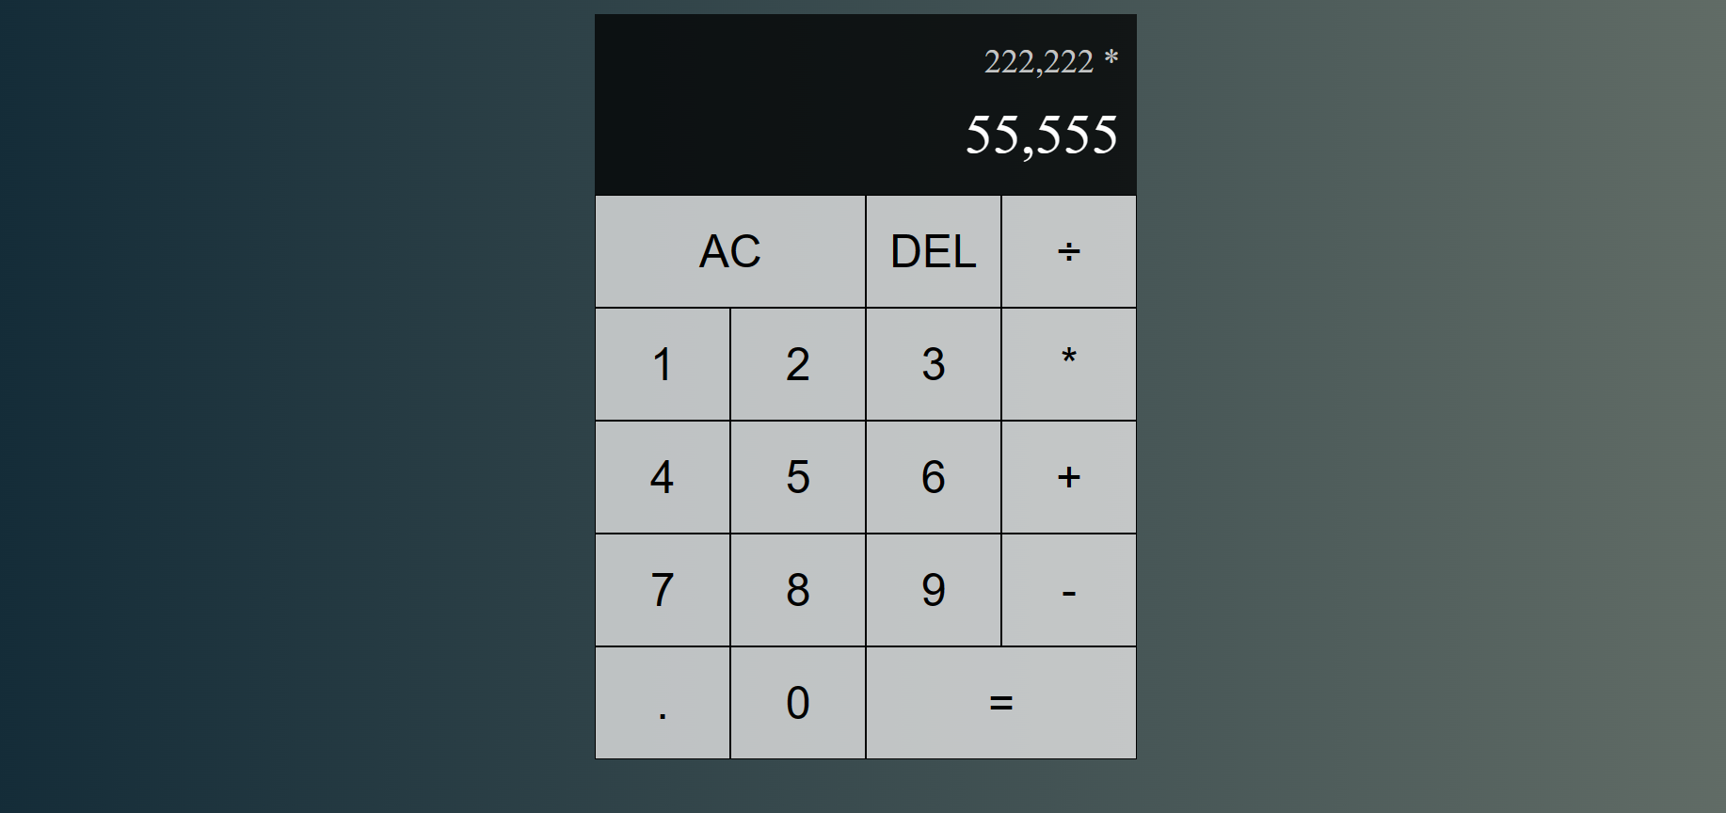
The JavaScript React calculator project implements a modern and user-friendly calculator application. It leverages React for the user interface, providing a dynamic and responsive design. Users can perform basic arithmetic operations, utilize advanced scientific functions, and customize the calculator's appearance. The two-line display layout shows the previous operand and operation at the top, with the current operand displayed below, ensuring clear and organized calculation tracking. This calculator employs JavaScript for logic, CSS for styling, and `Intl.NumberFormat` for numeric value formatting, offering a comprehensive and aesthetically pleasing calculator experience.

Slide 3
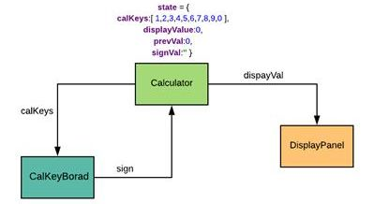
FLOW CHART

Slide 4
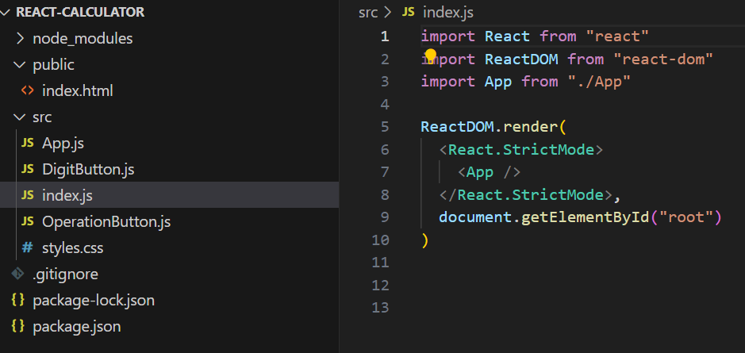
INDEX.JS
This code serves as the starting point for a React application. It imports necessary React and ReactDOM libraries. The `ReactDOM.render()` function renders the main `App` component within a DOM element identified as "root." React's `<React.StrictMode>` wrapper is used to detect and highlight potential development issues. In summary, this code initializes the application by rendering the root component, creating the user interface, and connecting it to the HTML element with the ID "root," effectively launching the React application.

Slide 5
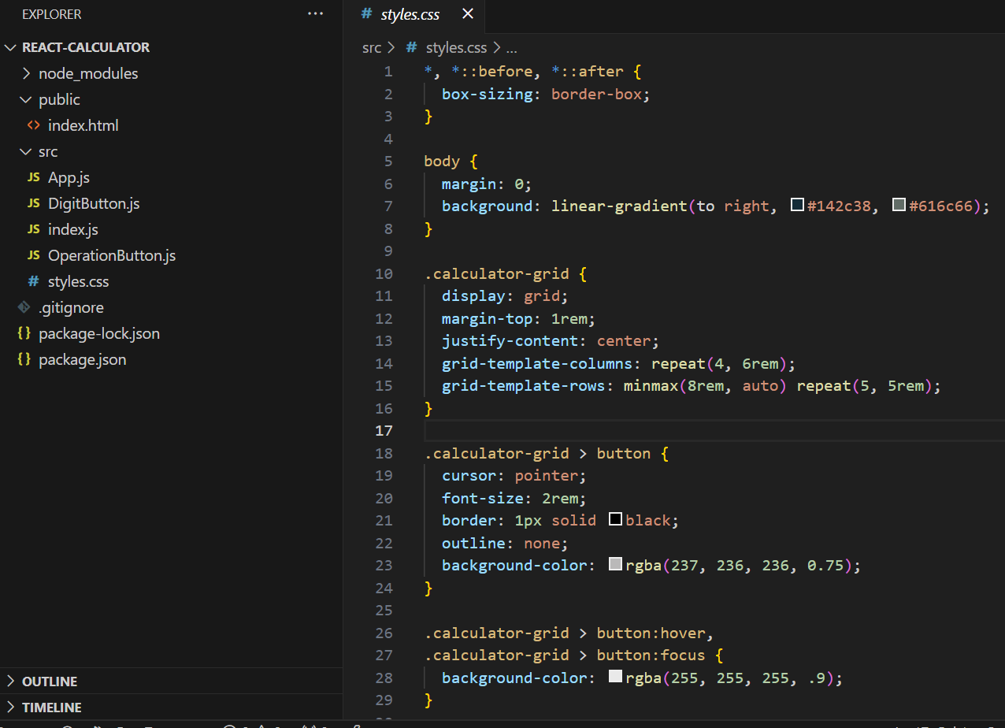
STYLES.CSS
This CSS code provides essential styling for a React-based calculator interface. It employs the `box-sizing` property to ensure predictable sizing of elements. The `<body>` rule resets margins and introduces an appealing linear gradient background. The `.calculator-grid` class defines a centered grid layout for the calculator, offering a responsive and organized structure. Button elements within this grid receive cursor and font-size adjustments and gain a subtle border and a removal of the default focus outline. Furthermore, when buttons are hovered or focused, their background slightly brightens to enhance user interaction. These styles contribute to a visually pleasing and user-friendly calculator interface.

Slide 6
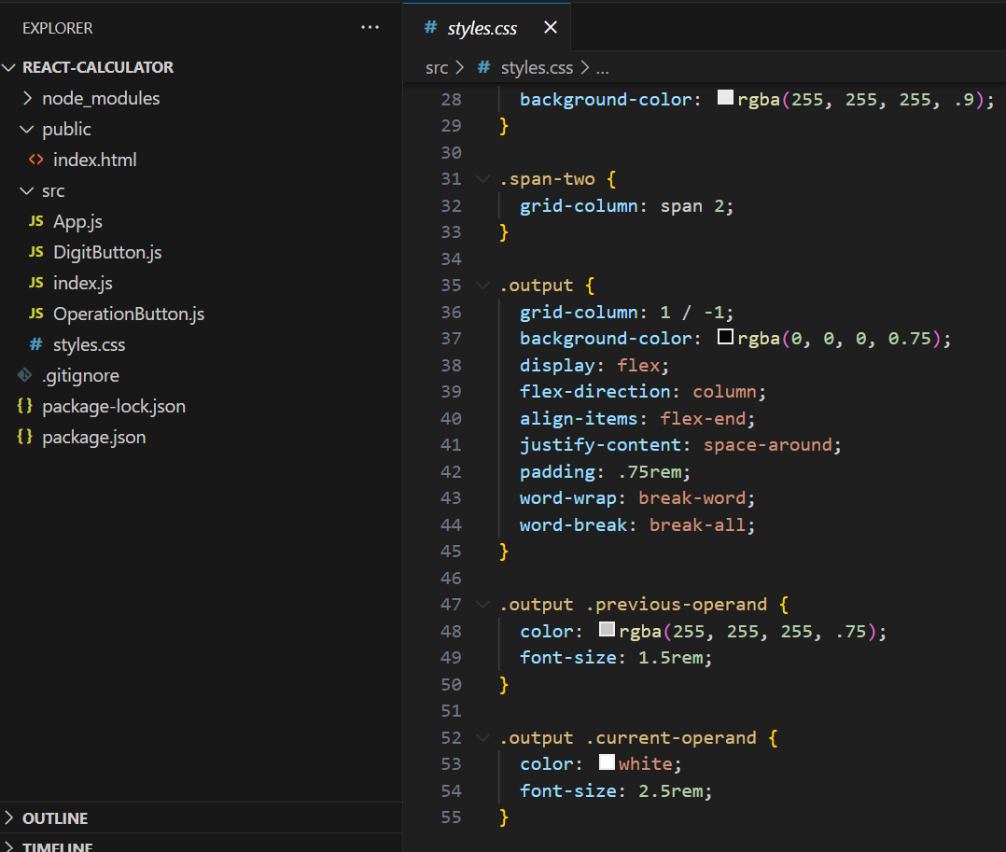
The CSS code provided offers targeted styling for the calculator's user interface. The ".span-two" class ensures elements span two grid columns. The ".output" class defines the appearance of the output display, featuring a semi-transparent dark background, vertical alignment, and word wrapping. Within the output, ".previous-operand" is styled with a slightly muted color and a 1.5rem font size, while ".current-operand" appears in white with a larger 2.5rem font size. These styles collectively enhance the user experience by presenting calculations clearly and attractively, with elements like the output display and column-spanning items well-designed for effective interaction.

Slide 7
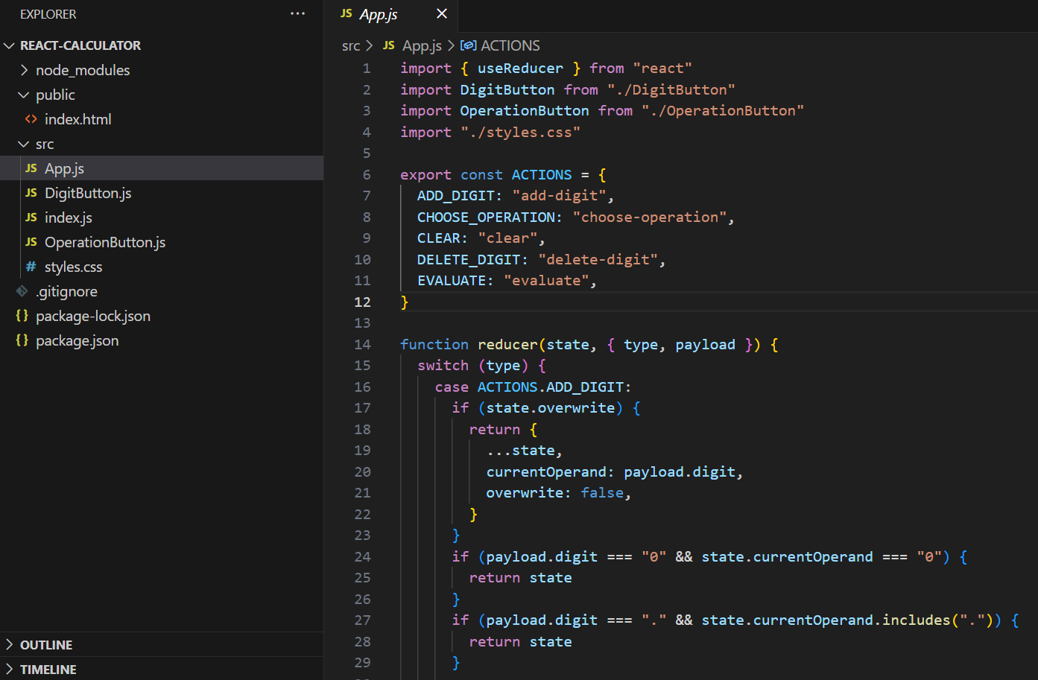
APP.JS
This code employs the `useReducer` hook in a React calculator to manage its state. It defines actions within the `ACTIONS` object, such as adding digits and choosing operations. The `reducer` function processes these actions by examining the current state, enabling users to interact with the calculator. For instance, it manages cases like overwriting the current operand, handling repeated zeroes, and ensuring only one decimal point. This code establishes the foundation for user input, state management, and accurate mathematical computations within the calculator.

Slide 8
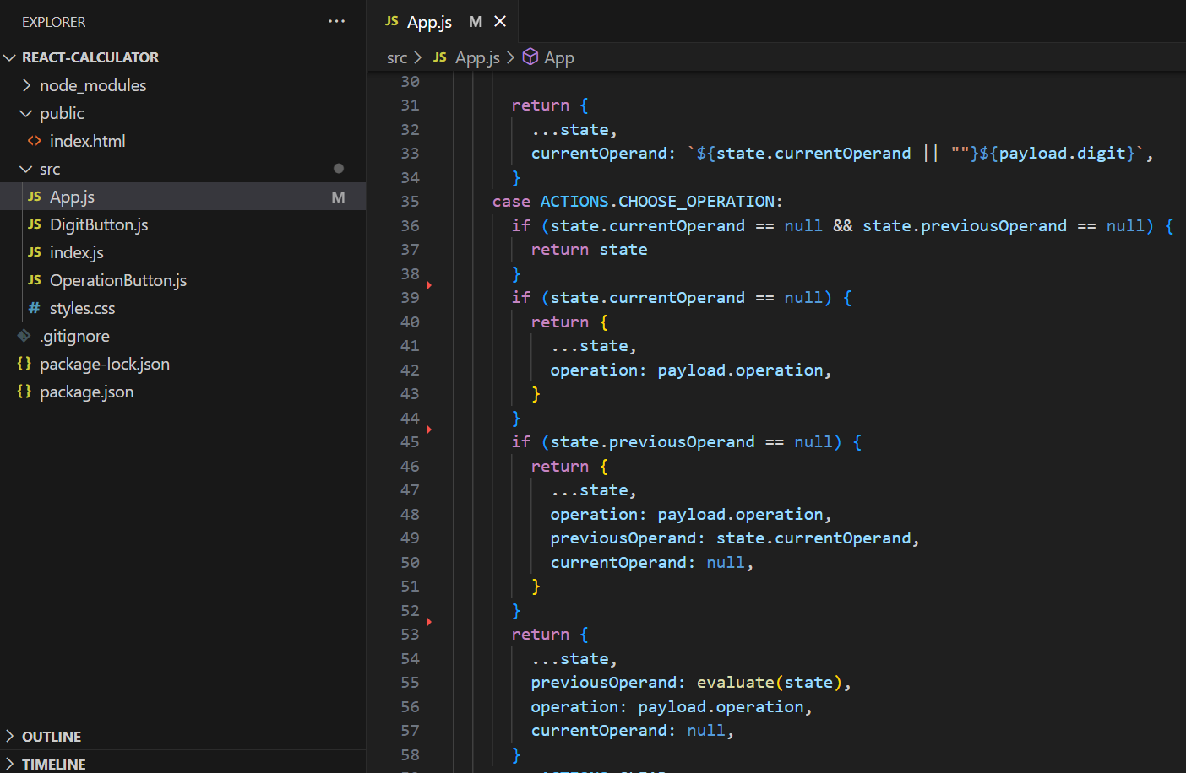
In the code, when the "ADD_DIGIT" action is triggered, it checks if the calculator is in "overwrite" mode; if so, it sets the current operand to the new digit. If the current operand is empty or zero, it preserves the digit. When "CHOOSE_OPERATION" is invoked, it handles different scenarios. If neither the current nor previous operands are set, it keeps the state unchanged. If only the current operand is empty, it sets the chosen operation. When both operands exist, it evaluates the expression, updates the previous operand, and sets the new operation while resetting the current operand for the next calculation.

Slide 9
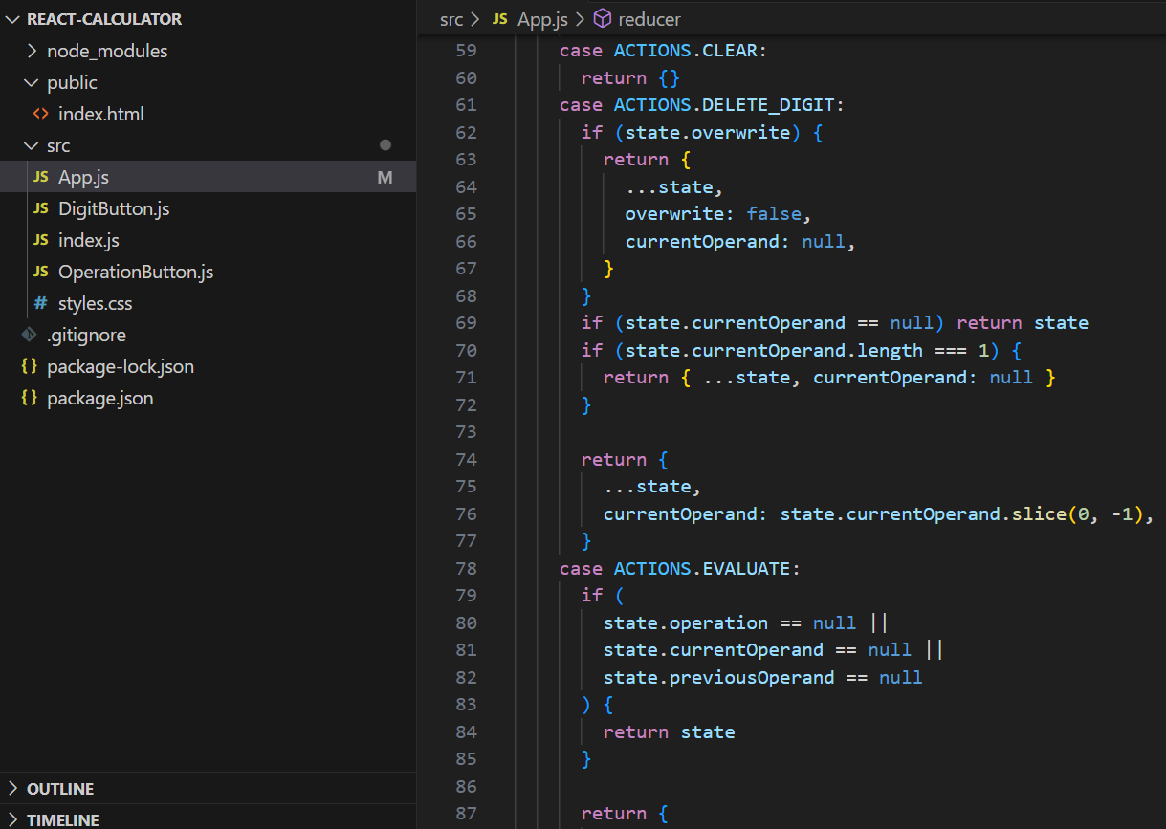
The code handles additional actions in the calculator. When the "CLEAR" action is invoked, it resets the calculator's state to an empty object. For "DELETE_DIGIT," it checks if the calculator is in overwrite mode; if so, it clears the current operand. If the current operand is null or contains only one character, it resets the current operand. When "EVALUATE" is triggered, it ensures that all the necessary components for a valid calculation, including an operation, current operand, and previous operand, are in place. If not, it keeps the state unchanged, ensuring accurate calculations.

Slide 10
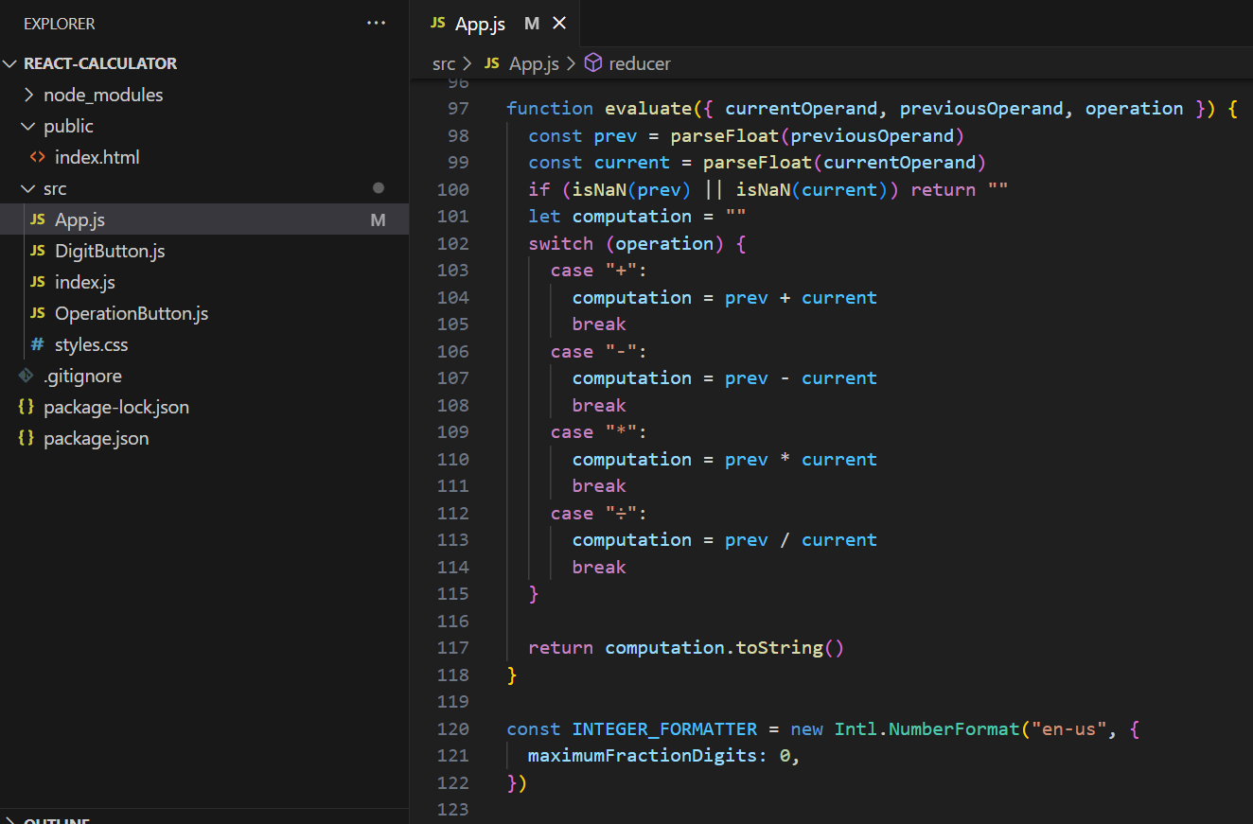
This code segment defines the `evaluate` function responsible for performing mathematical calculations. It takes the current and previous operands, along with the operation, and converts them to floating-point numbers. It ensures the validity of the numeric values to avoid errors. Using a `switch` statement, it executes the corresponding arithmetic operation based on the chosen operator (+, -, *, ÷). The result is then converted to a string. Additionally, it initializes an `INTEGER_FORMATTER` to format numbers, specifying a maximum of zero decimal places for integer-like presentation. This function and formatter contribute to the calculator's precise mathematical calculations and proper number formatting.

Slide 11
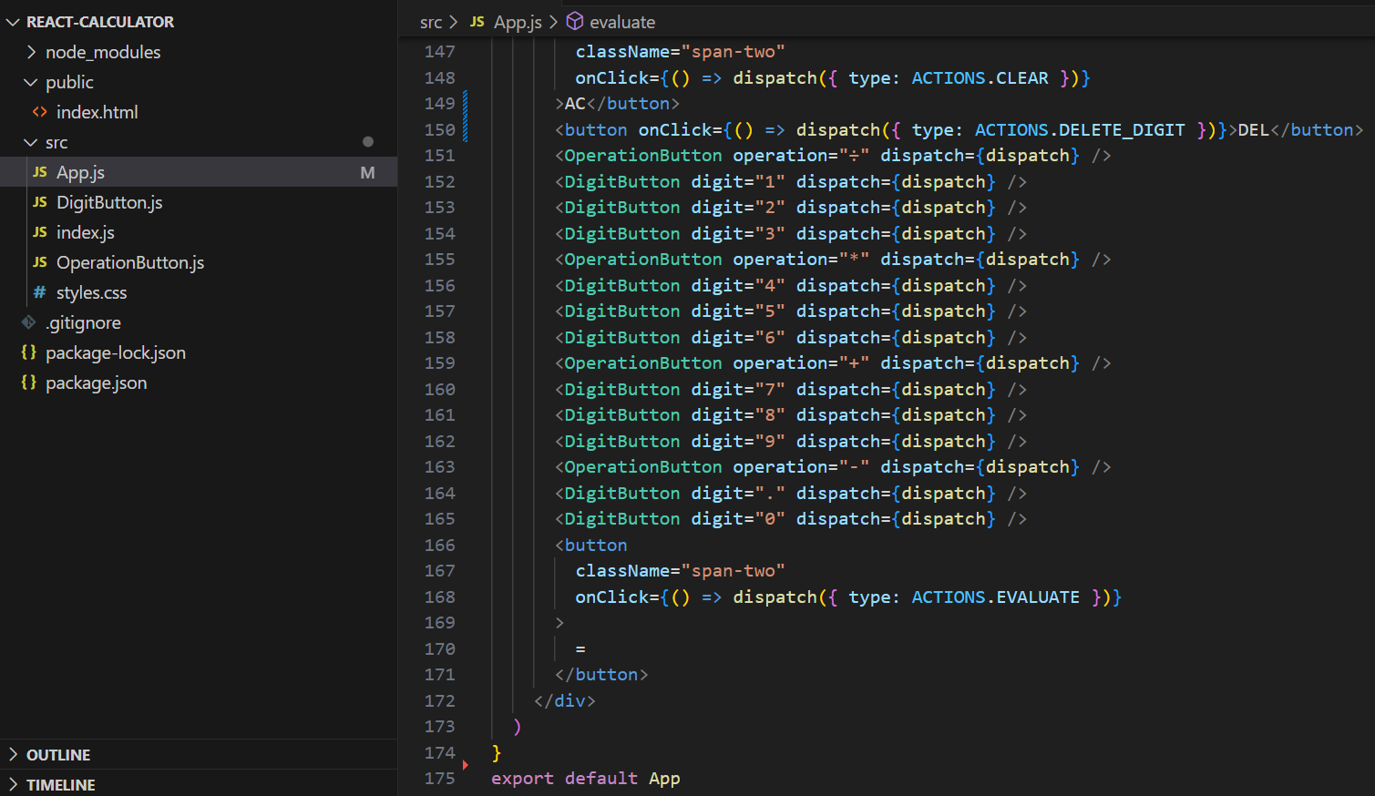
The provided JSX code segment represents the layout and functionality of a calculator in a React application. It consists of various buttons for numeric digits (0-9), mathematical operations (+, -, *, ÷), and special functions like "AC" (clear) and "DEL" (delete). These buttons trigger actions through the `dispatch` function based on user interactions, following the `ACTIONS` defined earlier. The "span-two" class extends the width of specific buttons to span two grid columns for a clear visual distinction. When the user clicks the "=" button, it triggers the "EVALUATE" action, calculating and displaying the result. Overall, this JSX code creates a user-friendly and functional calculator interface for performing arithmetic calculations.

Slide 12
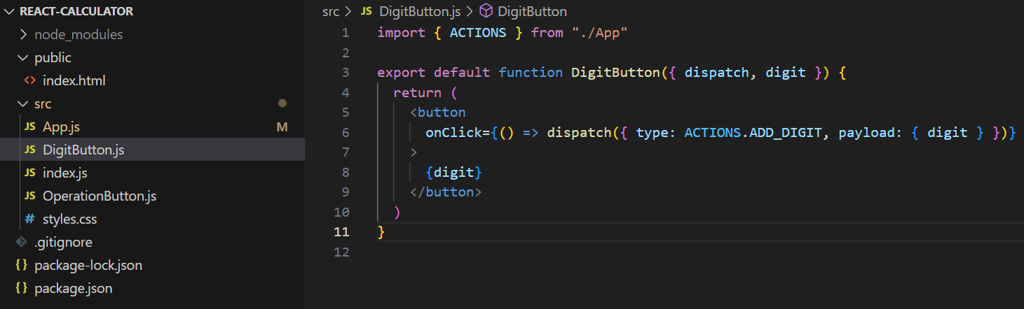
DIGITBUTTON.JS
This React component, `DigitButton`, is a button element that displays a given digit. When clicked, it dispatches an action, `ACTIONS.ADD_DIGIT`, to a Redux store using the provided `dispatch` function. The action includes the digit as its payload. This code assumes that the Redux store and action types are correctly set up elsewhere in the application, and the button's purpose is to add the digit to the store's state when clicked.

Slide 13
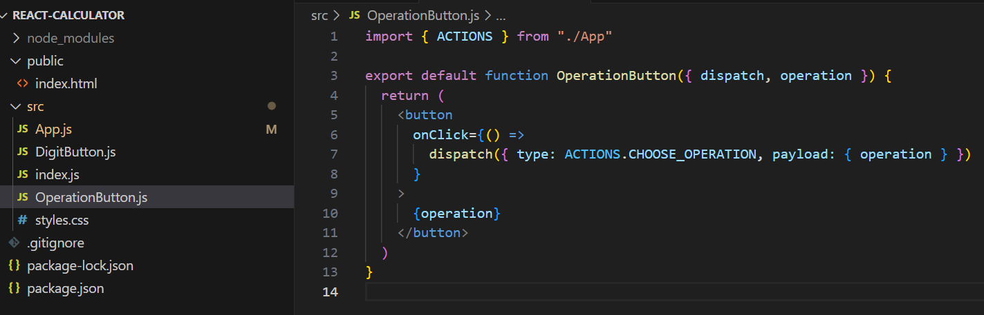
OPERATIONBUTTON.JS
This React component, `OperationButton`, represents a button displaying an operation symbol, such as addition or subtraction. When clicked, it dispatches an action with the type `ACTIONS.CHOOSE_OPERATION` and includes the selected operation as payload to a Redux store. It assumes that Redux actions and the store are correctly set up in the application, and this button's purpose is to inform the store of the chosen operation when clicked.

Slide 14
THANK
YOU

