Slide 1
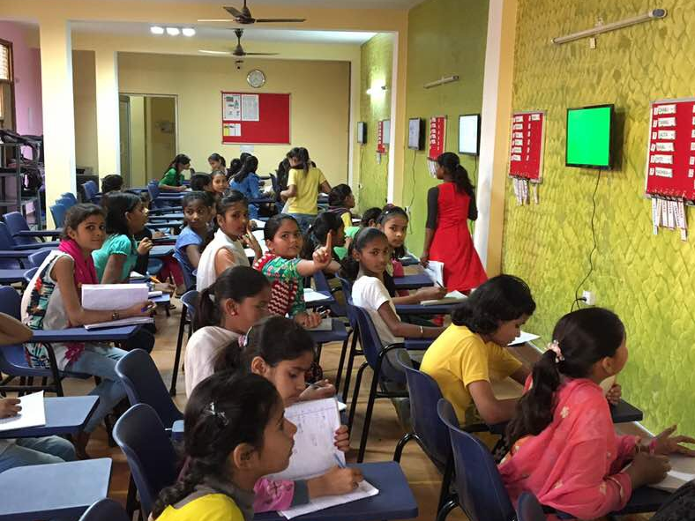
Kant Learning
Promoting
a high engagement
based
education methodology
Press space bar to move to next slide

Slide 2
Who are we?
Kant Learning is an organization dedicated to promoting an engagement based, innovative learning technology
The process is called ‘Kant Process’
The process has been developed by Hridayesh Kant, a Boston based retired software professional with bachelor and Master’s degrees from IIT Roorkee
Press space bar to move to next slide

Slide 3
Kant Cycle of Learning
Practice
Competence
Interest
Learning can be broken in three stage cycle as depicted
  Practice leads to competence
  Competence leads to interest
  Interest leads to practice
However, to enter this cycle, it is difficult to start with competence or interest stage. It is much simpler to start at practice stage which can be enforced by various means.
Kant process exploits ‘practice’ as a way to enter this learning cycle by putting students in a regular video game style practice environment.
Press space bar to move to next slide

Slide 4
Major components of education delivery
Facilities - Infrastructure, staff etc.
Contents - Books, worksheets, online and computer based systems
Engagement - Tests, quizzes, exams and assignments
Kant process addresses the engagement part of the above.
A good book, unopened, is as good as a paperweight.
It has been observed that a majority of students focus on studies only at exam time. Kant process exploits this tendency of students by creating a continuous evaluation environment.
Press space bar to move to next slide

Slide 5
Inspired by video games
Have you ever watched children playing video games?
  There are no text books for video games
  There are no coaching centers for how to play
  Every child is able to learn, how to play, without assistance
Children love and play video games because the scoring system and audio/video effects create an ‘instant gratification’ system, which propels children to continue playing.
Kant Process utilizes instant gratification as an engagement booster.
Press space bar to move to next slide

Slide 6
How it works?
A set of single-answer quizzes and answers are delivered by TV scripts
Students are seated in front of TVs in ordered fashion. Seating order is reflected on a leader board next to TVs
There are multiple TVs with scripts of increasing levels of difficulty
Students check answers of each other as directed by TV scripts
Winners are moved up on leader boards and their seats are also exchanged
As students reach the top of the leader board, they are moved to next TV with higher level of difficulty.
Press space bar to move to next slide

Slide 7
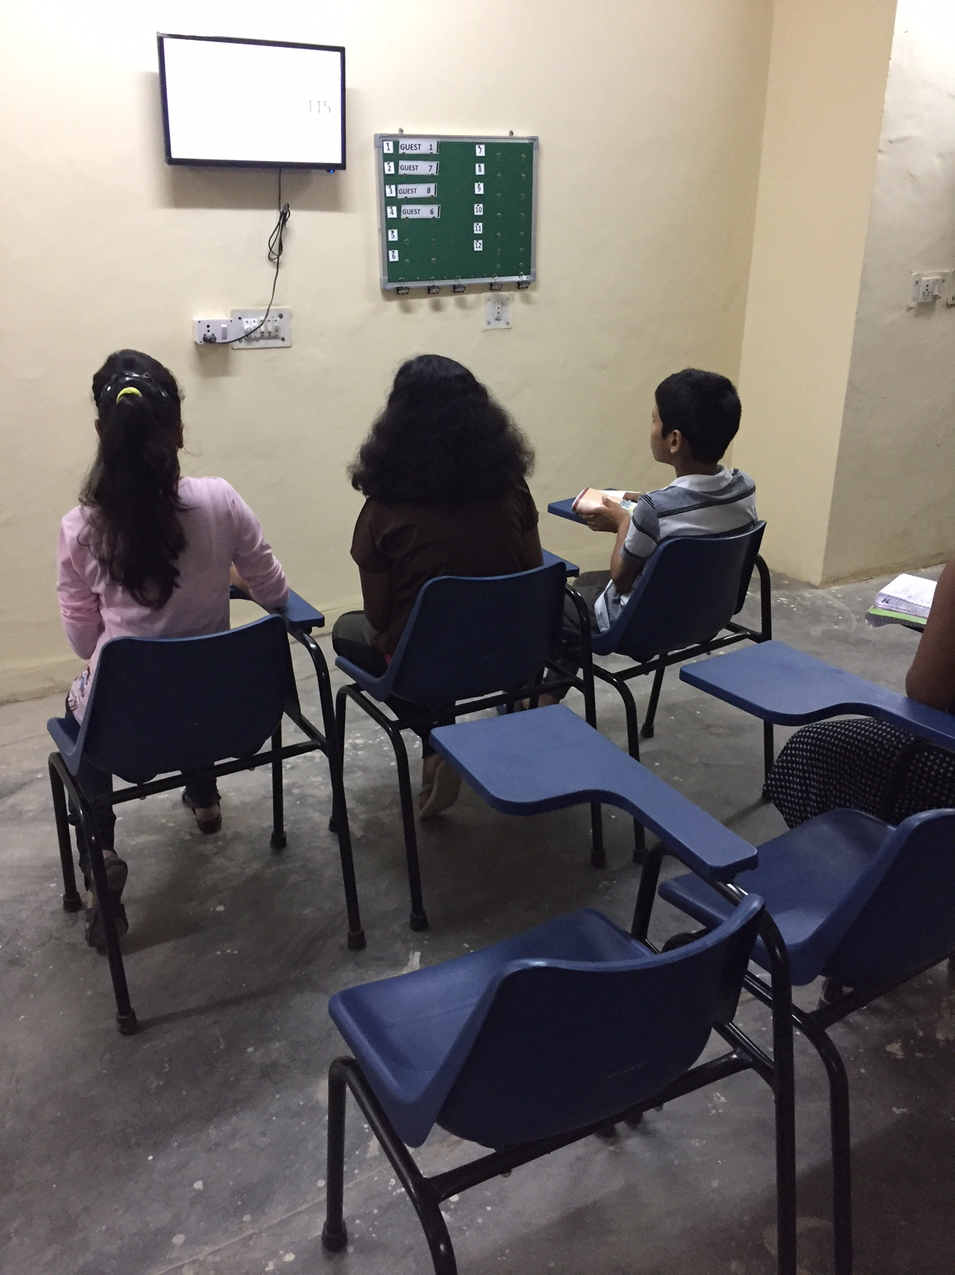
How it works?
Students are seated in front of TV, in ordered fashion.
Press space bar to move to next slide

Slide 8
How it works?
Seating order is reflected on a leader board next to TV
Press space bar to move to next slide

Slide 9
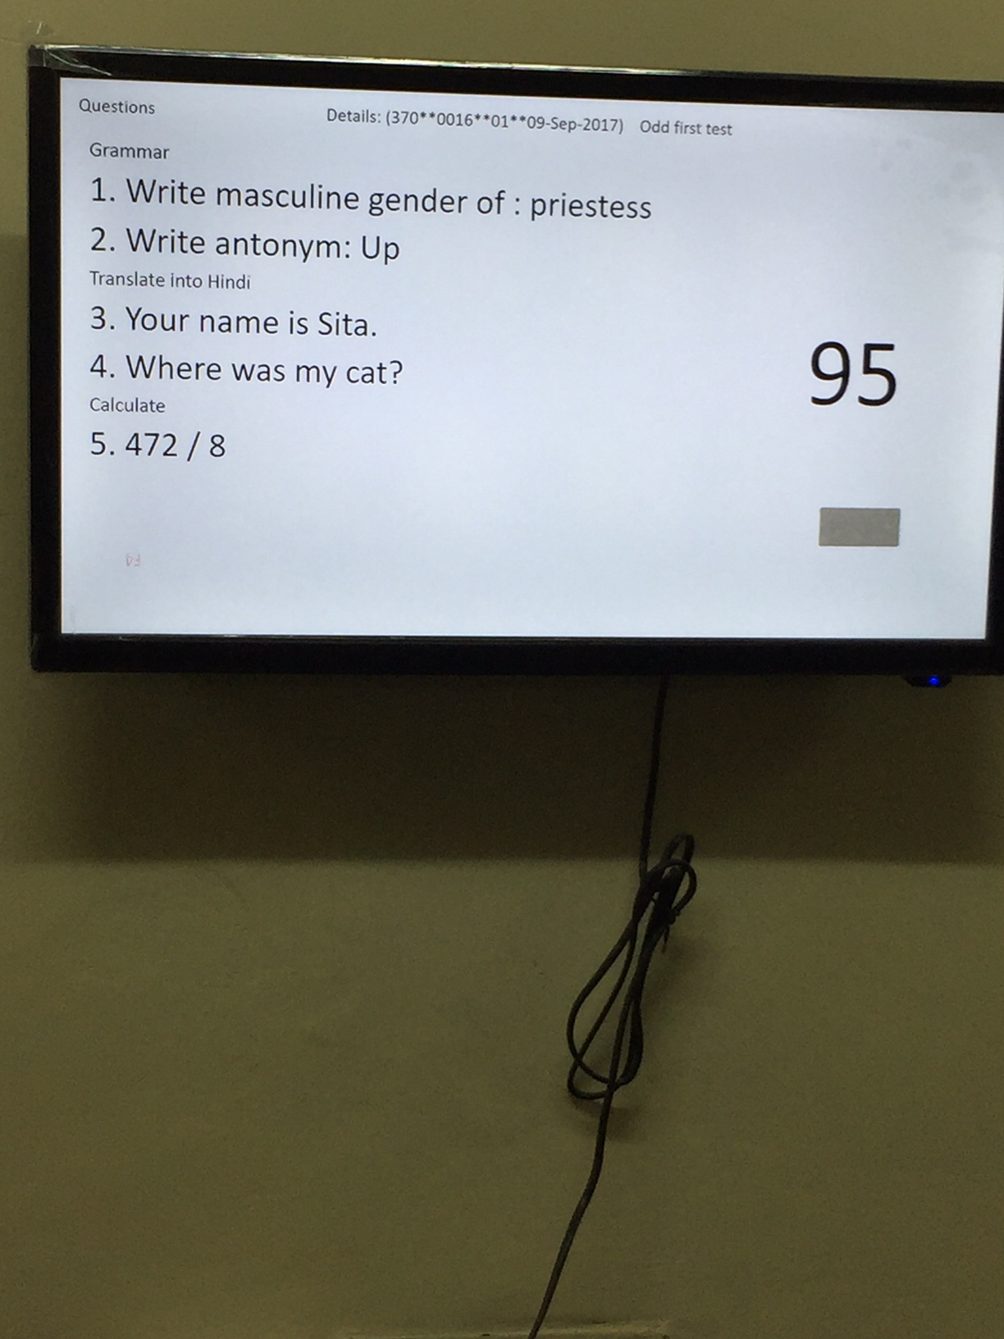
How it works?
A set of questions is presented on TV for fixed amount of time
Press space bar to move to next slide

Slide 10
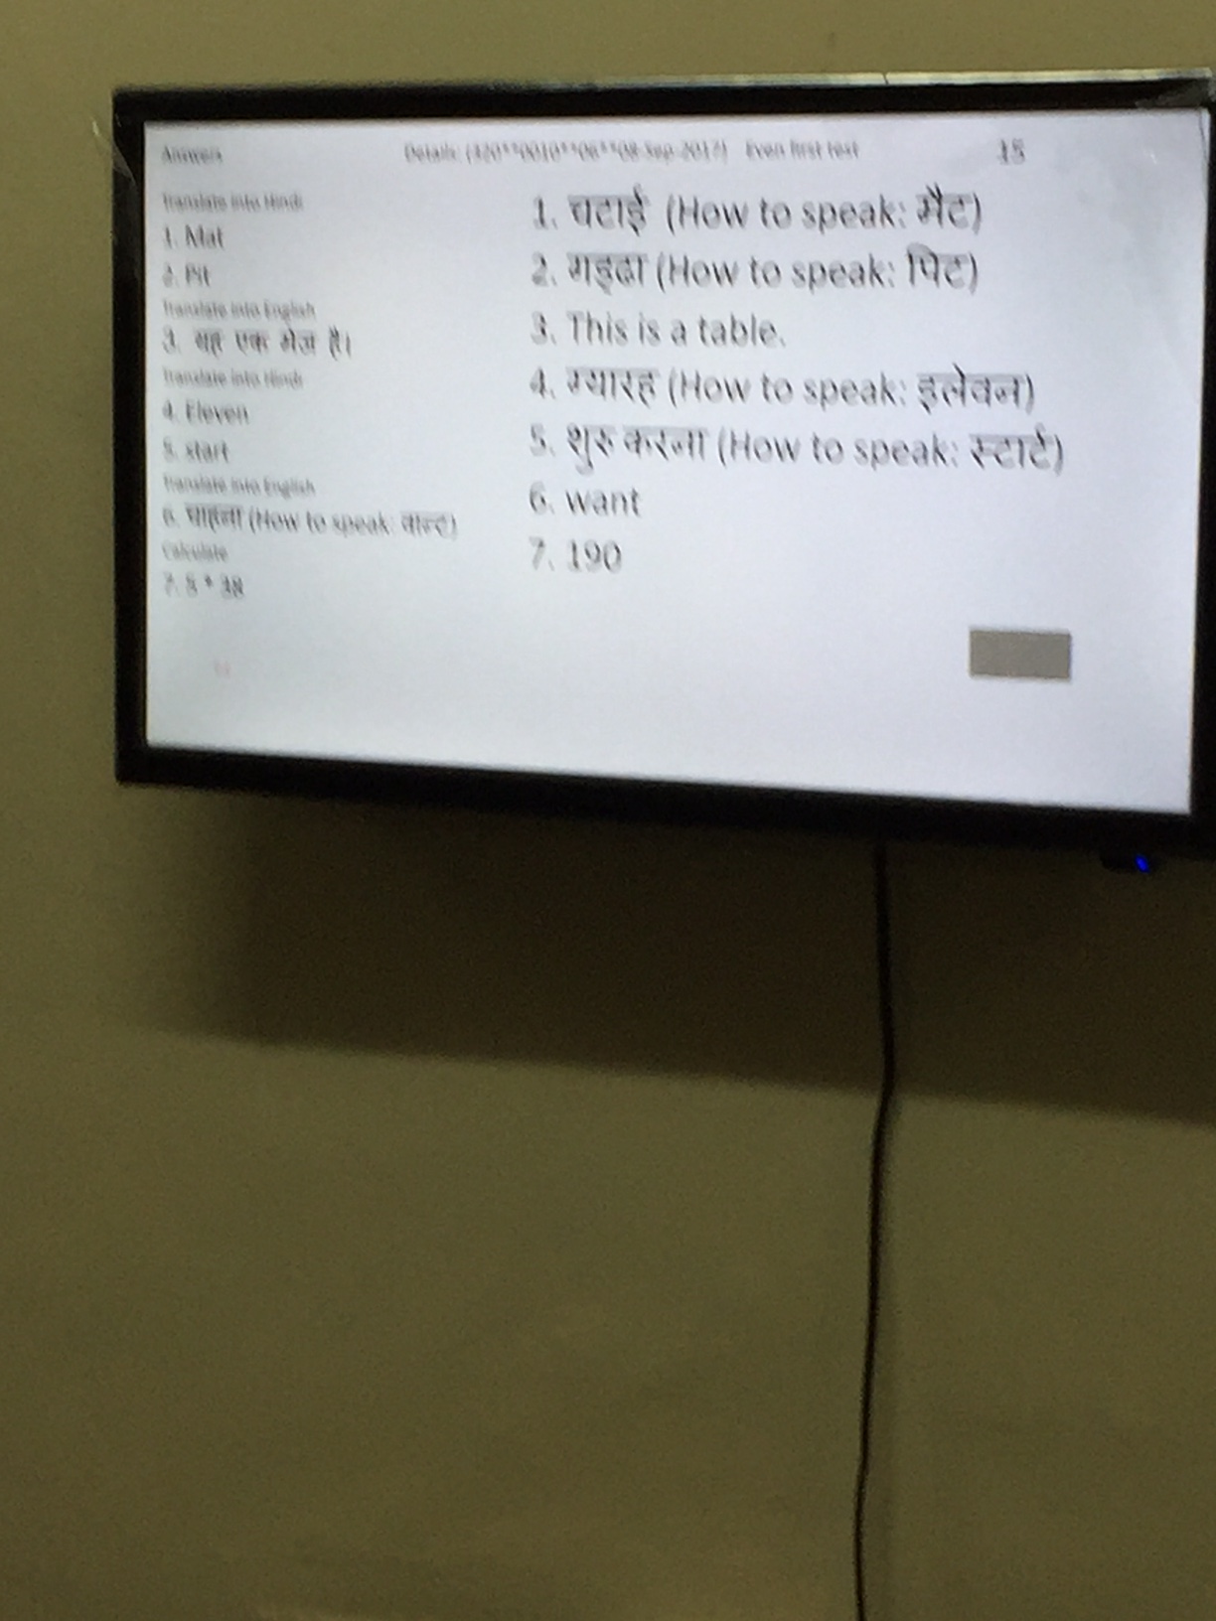
How it works?
After a set time students exchange copies and answers are revealed
Press space bar to move to next slide

Slide 11
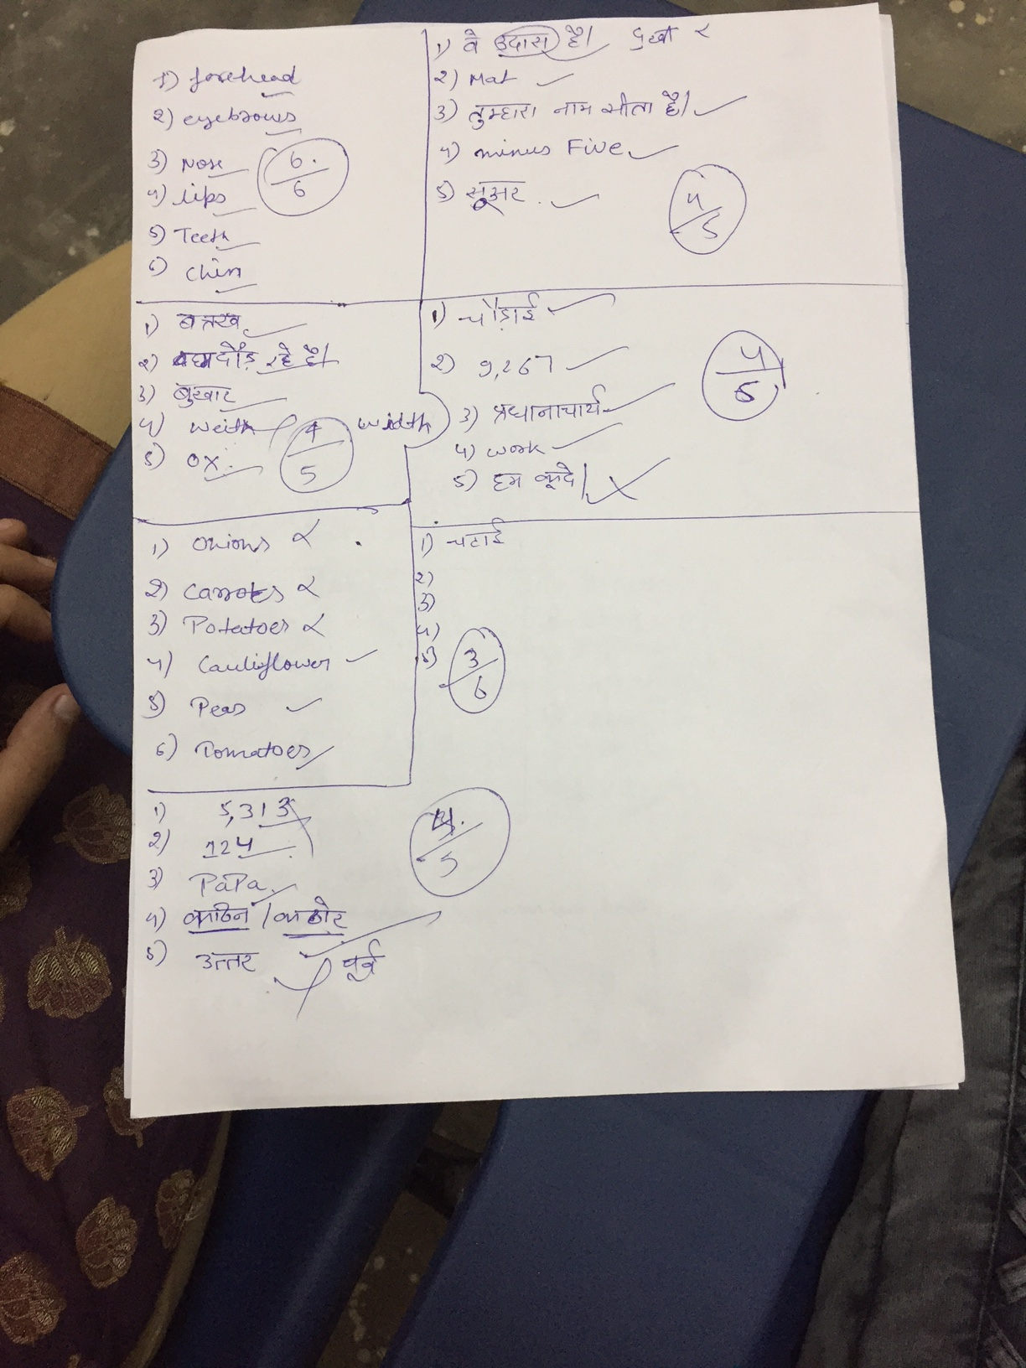
How it works?
Students check answers of each other as directed by TV script
Press space bar to move to next slide

Slide 12
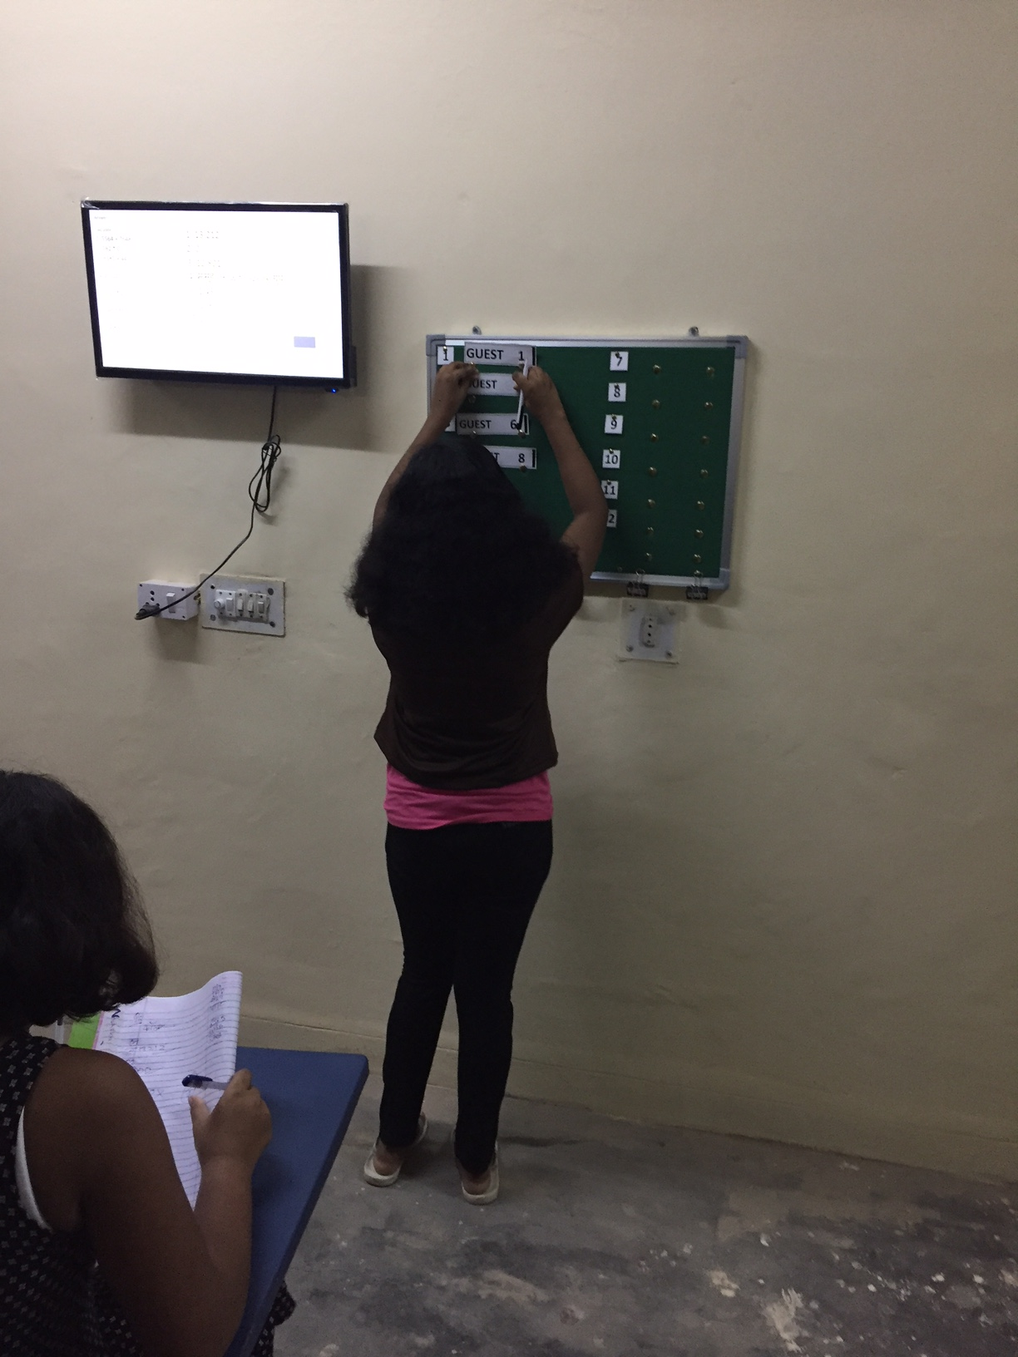
How it works?
Winners are moved up on leader boards and their seats are also exchanged
Press space bar to move to next slide

Slide 13
Conclusion
Kant process creates an immersive learning environment by employing continuous evaluation as a reinforcement tool.
It utilizes the energy of students for all routine tasks thus freeing up teachers to focus on monitoring the student performance.
This is a learning platform. It can work with any level of education by creating appropriate data sets.
Press space bar to move to next slide

