Slide 1

Department of Computer Science and Engineering
CROP/PLANT DISEASE DETECTION USING CNN
School of Engineering and Technology
Submitted By:
RIYA SINHA
(170385)
Consent code: MJPR21_CSE-F12-003
Mentor:
Dr. ANAND SHARMA

Slide 2
Plan of Presentation
Problem statement
Objective
Problem description
Technology used
Techniques and methodology
Project workflow
How this system helps?
Genesis
Project Timeline

Slide 3
PROBLEM STATEMENT:
The primary occupation in India is agriculture. India ranks second in the agricultural output worldwide. Here in India, farmers cultivate a great diversity of crops. Various factors such as climatic conditions, soil conditions, various disease, etc. affect the production of the crops. The existing method for plants disease detection is simply naked eye observation which requires more man labor, properly equipped laboratories, expensive devices ,etc. And improper disease detection may led to inexperienced pesticide usage that can cause development of long term resistance of the pathogens, reducing the ability of the crop to fight back.

Slide 4
OBJECTIVE:
The main objective is to identify the plant diseases using image processing. It identify the disease. It also identifies the insects and pests responsible for epidemic. Apart from these parallel objectives, this drone is very time saving. The budget of the model is quite high for low scale farming purposes but will be value for money in large scale farming. It completes each of the process sequentially and hence achieving each of the output.
Thus the main objectives are:
1) To design such system that can detect crop disease and pest accurately and then proper remedies can be taken after the proper research.

Slide 5
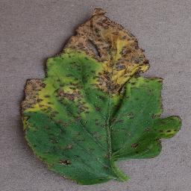
This is how my system will look
Disease detection
OUTPUT
Bacterial spot
Input image
Tomato Plant

Slide 6
TECHNOLOGY USED:
HARDWARE SPECIFICATION :
Processor – Intel Core i5-7200U CPU @ 2.50GHz 2.71GHz
OS – Microsoft Windows 10 x
RAM – 16 GB
Graphics – 4 GB NVIDIA GeForce 940MX x
LIBRARIES USED :
OpenCV
Matplotlib
NUMPY
Pickle
Keras
Scikit-Learn
SOFTWARE SPECIFICATION :
Jupyter notebook
Python 3.8.6

Slide 7
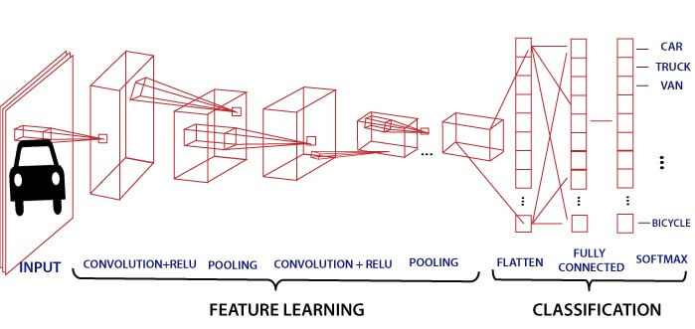
TECHNIQUES AND METHODOLOGY
Preprocessing the data
Training the model using CNN
CNN (convolutional neural network)

Slide 8
Understanding the Problem.
Study of Research papers, and requirement analysis
Training of model
& Exploratory Data analysis
Data collection and preprocessing
Week 1
Validating Data and documentation
Week 2
Week 3-4
PROJECT TIMELINE
Week 5-6
Week 7-8

Slide 9
Project Workflow
Healthy
Input test image
Preprocessing
Convert to an Array for comparison
Yes
Defect
CNN based classification
Segregated Database
Preprocessing
Training model using CNN
No
Display disease

Slide 10
Steps involved:
Splitting the data into testing and training
Model creation
Training my network
Plotting training and val curve
Model accuracy
Save model using pickle
Predicting result

Slide 11
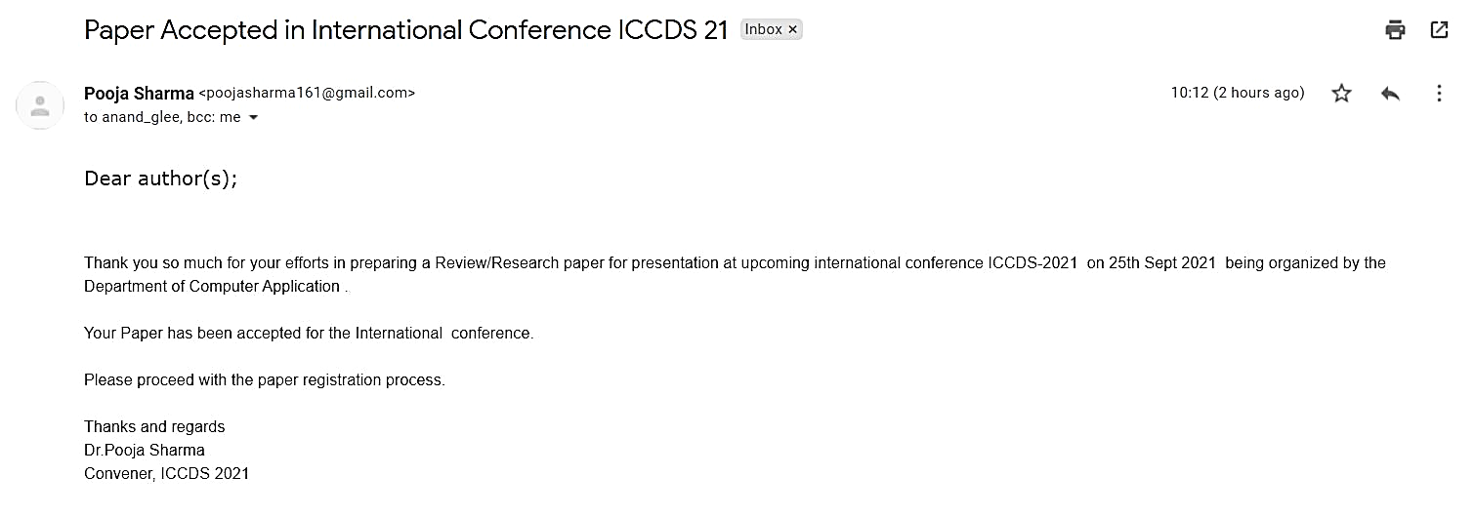
Paper acceptance mail

Slide 12
THANK YOU

