Slide 1
Corporate green bonds
ECO723 Group 19
members-
Riya Sharma
Abhishekh Yadav
Able topno

Slide 2
introduction
Corporate green bonds are a new financial instrument used to fund climate-friendly projects (e.g., renewable energy, green buildings).
Their use has rapidly increased in recent years—referred to as the "green bond boom"—from $5B in 2013 to $95.7B in 2018.
Green bonds come with constraints and added costs, including:
Funds must be used only for green projects.
Certification by third parties is often required, involving administrative and compliance costs.
The paper explores three potential rationales for issuing green bonds:
Signaling: To credibly show environmental commitment.
Greenwashing: To create a false image of environmental responsibility.
Cost of capital: To access potentially cheaper financing from impact-focused investors.
Investors respond positively to green bond announcements—especially for first-time issuers and certified bonds.
Firms issuing green bonds improve environmental performance (e.g., higher ESG ratings, reduced CO₂ emissions).
These bonds attract more long-term and green investors, reflecting increased investor confidence.

Slide 3
Conceptual framework
Three Main Rationale:
Signaling Commitment
Green bonds are costly (certification, constraints), making them a credible signal of environmental intent.
Leads to positive stock market reactions, better environmental performance, and more long-term/green investors.
Greenwashing
Issued to appear sustainable without real action.
Companies may use selective disclosure, dubious eco-labels, mislead-ing visual imagery (e.g., the display of biodiversity symbols on the product), and misleading narratives.
The green bond market is governed by private certification standards, which lack the enforcement power of public regulations.
Cost of Capital
Investors accept lower returns to support climate action, thus green bonds could offer cheaper financing for firms.
This leads to a positive stock market reaction, as shareholders gain from reduced financing costs.

Slide 4
Corporate green bonds
Definition and Market Expansion
Dedicated Use of Funds: Green bonds are financial instruments whose proceeds are exclusively allocated to environmental and climate-friendly projects such as renewable energy, energy efficiency, and sustainable infrastructure.
Rapid Market Growth: Since their emergence in 2013, corporate green bond issuance has grown dramatically—from $5 billion in 2013 to $95.7 billion in 2018—totaling $301.2 billion across 1189 bonds.
Industry and Geographic Concentration: Green bonds are more common in industries with environmental exposure (e.g., utilities, energy, transportation) and are primarily issued by firms in China, the US, France, Germany, and the Netherlands.
Motivations for Issuance
Signaling Commitment to Sustainability - Certification (e.g., Climate Bonds Initiative) is costly and common: 65.6% of bonds are certified. Certification includes pre- and post-issuance audits and carries reputational risk in case of non-compliance (e.g., Repsol case).

Slide 5
Corporate green bonds
Greenwashing Concerns: While some argue that green bonds could be used for superficial branding, the study finds that green bond issuers demonstrate actual environmental improvements post-issuance, contradicting this concern.
No Cost Advantage: Contrary to the hypothesis that green bonds lower financing costs, the study finds no significant difference in yields between green and conventional bonds, rejecting the cost-of-capital argument.
Market and Investor Reactions
Positive Stock Market Response: Event study analysis reveals that green bond announcements lead to a statistically significant average CAR of 0.49%, indicating investor optimism.
Impact of Certification and First-Time Issuance: Market reactions are stronger for certified green bonds (+0.71%) and for first-time issuers (+0.80%), supporting the signaling theory.
Attracting Long-Term Investors: Firms issuing green bonds experience a shift in ownership structure, gaining more attention from long-term and environmentally focused investors, enhancing alignment with sustainability goals.

Slide 6
Firm-level data
Data Sources and Variables
Financial and Market Data: Compustat provides accounting data such as asset size, leverage, and profitability, while stock returns are used to analyze market reactions.
ESG and Industry Metrics: ESG ratings are obtained from ASSET4, covering environment, social, and governance dimensions. Industry-level environmental materiality is measured using SASB scores.
Ownership Structure: Data from Thomson Reuters tracks institutional investor behavior, enabling analysis of shifts in ownership post green bond issuance.
Issuer Characteristics and Matching Design
Profile of Green Bond Issuers: Compared to other bond issuers, green bond firms are larger and exhibit higher environmental, social, and governance scores even before issuance.
Environmentally Sensitive Industries: Green bond issuance is more frequent in industries where environmental issues are financially material, as indicated by higher SASB scores.

Slide 7
Firm-level data
Matching Approach for Counterfactuals: Each green bond issuer is matched to a similar non-green bond issuer from the same country, industry, and year using a nearest-neighbor method, ensuring valid comparisons of post-issuance outcomes.
Post-Issuance Firm-Level Outcomes
Improved Environmental Performance: Firms show increases in ASSET4 environmental ratings and decreases in CO₂ emissions per dollar of assets, reflecting genuine improvement.
Investor Base Realignment: There is a measurable rise in ownership by long-term investors and members of green investor networks like Ceres, following green bond issuance.
Support for Signaling Argument: These post-issuance changes are consistent with the idea that green bonds signal serious environmental commitment rather than symbolic action.

Slide 8
Stock market reaction to the issuance of corporate green bonds
Green Bonds, Investor Attention and Stock Market Reaction: Evidence from ASEAN Countries - Andini Nurul Aini, Citra Sukmadilaga, Erlane K. Ghani
The market reaction to green bond issuance: Evidence from China - Jiazhen Wang, Xin Chen, Xiaoxia Li, Jing Yu, Rui Zhong

Slide 9
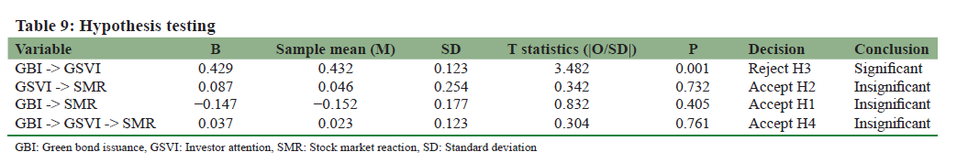

Stock market reaction to the issuance of corporate green bonds
Green Bond Issuance and Investor Attention
Issuing green bonds significantly increases investor attention. This is because green bonds signal a company’s commitment to sustainability, attracting investors who prioritize environmental issues.
Investor Attention and Stock Market Reaction
Despite the rise in investor attention, this does not significantly impact stock market reactions. This finding contrasts with some prior studies, which suggest that greater investor attention usually influences stock prices through sentiment and expectation changes.
Green Bond Issuance and Stock Market Reaction
The issuance of green bonds has a negative but statistically insignificant effect on stock market reactions. This means that, in this study, green bond announcements do not lead to meaningful changes in stock prices.

Slide 10
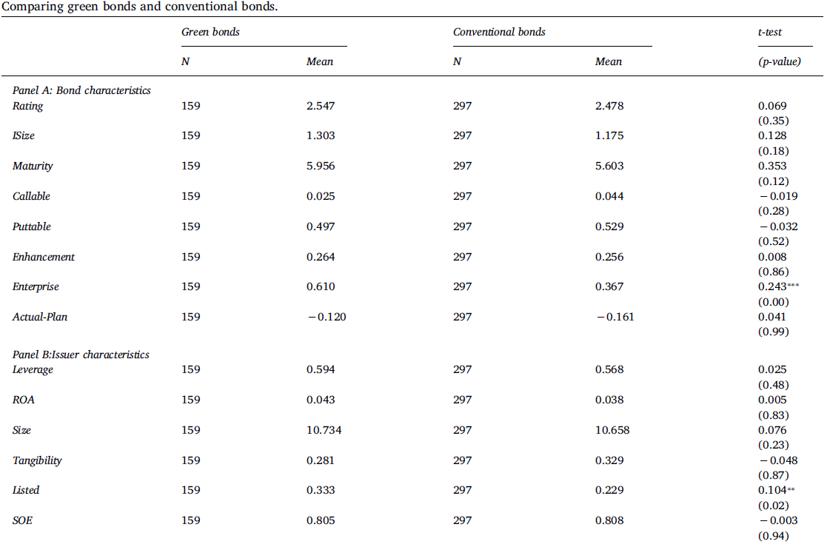
Stock market reaction to the issuance of corporate green bonds
Green Bond Pricing Premium: Corporate green bonds in China are issued at a pricing premium compared to conventional bonds. On average, green bonds have a yield spread 34 basis points lower than comparable conventional bonds, resulting in significant annual savings for issuers.
Factors Influencing the Premium:
The premium is stronger for issuers and underwriters with high corporate social responsibility (CSR) ratings.
Companies with less ownership concentration and those held by long-term institutional investors see a greater premium.
Investor demand for green bonds is higher, as measured by the difference between actual and planned issue amounts.
Stock Market Reaction: Announcements of green bond issuances lead to positive abnormal stock returns, supporting the view that green financing enhances long-term firm value and is favored by shareholders.

Slide 11
corporate green bonds in india
Role of Private Sector in Driving the Green Bond Market in India - Janardhana Anjanappa
Green Bonds : An Instrument for Financing a sustainable Future - Dr. S.K. Gupta

Slide 12
corporate green bonds in india
1. The Private Sector’s Role in India’s Green Bond Market
The private sector is crucial for expanding the green bond market in India, yet its participation remains limited compared to the public sector.
Private sector involvement brings capital, innovation, and leadership, supporting India’s climate goals and sustainable development targets.
2. Drivers for Private Sector Participation
Guidelines from SEBI and policy commitments under the Paris Agreement provide a supportive framework.
Corporate Social Responsibility (CSR): Growing pressure from investors and consumers for sustainable practices encourages green bond issuance.
Profitability and Market Access: Green bonds can offer stable returns and access to international capital, with the “greenium” effect lowering borrowing costs.
Green bonds help manage regulatory, environmental, and reputational risks.
Third-party verification and transparency increase trust and attract sustainability-focused investors.

Slide 13
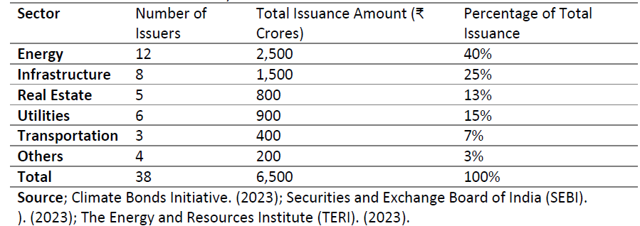
corporate green bonds in india
3. Innovations and Product Development
The private sector has introduced innovative instruments such as blue bonds, digital green bonds, green masala bonds, and sustainability-linked bonds.
These innovations aim to broaden market participation and address sector-specific sustainability challenges.
4. Impact and Market Growth
Private sector participation has steadily increased, contributing to both issuance and investment in green bonds, though public sector entities still lead.
Enhanced private sector engagement is essential for scaling the market, improving liquidity, and achieving India’s sustainability targets.

Slide 14
corporate green bonds in india
5. Barriers and Challenges
High Transaction Costs: Certification, reporting, and issuance costs are significant, especially for SMEs.
Regulatory Complexity and Uncertainty: Diverse and sometimes unclear regulations deter broader participation.
Absence of Tax Incentives: Lack of fiscal benefits reduces the appeal of green bonds for private issuers.
Greenwashing Concerns: Fear of being accused of overstating environmental benefits discourages some companies.
Limited Awareness and Expertise: Many private firms lack knowledge about green bonds and their benefits.
Market Liquidity Issues: Lower liquidity in the green bond market makes it less attractive to some investors.

Slide 15
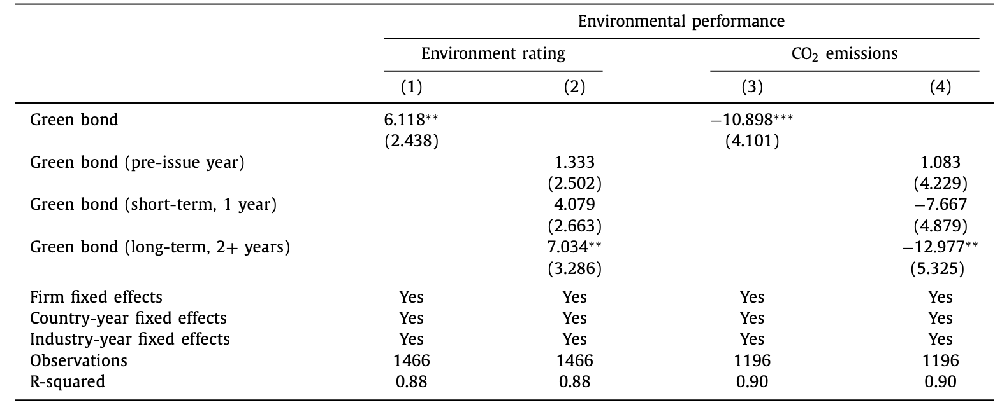
corporate green bonds and firm-level outcomes
Do Green Bonds Drive Real Change?
Study tracks firms before & after green bond issuance.
Matched with similar firms that issued regular bonds.
Focused on changes in environmental performance and investor ownership.
Main question: Is this real impact or greenwashing?

Slide 16
corporate green bonds and firm-level outcomes
Environmental Scores Improve, Emissions Drop!
Environmental scores rise ~7 points (~9%).
CO₂ emissions fall by ~13 tons per $1M in assets.
Changes appear long-term, not just short-term.
Evidence not consistent with greenwashing.

Slide 17
corporate green bonds and firm-level outcomes
Ownership Shifts Toward Long-Term & ESG Investors
Ownership by green investors increases ~2.9%.
Long-term institutional investors ↑ ~2%.
Overall institutional ownership doesn’t change.
Suggests targeted market trust in green issuers.

Slide 18
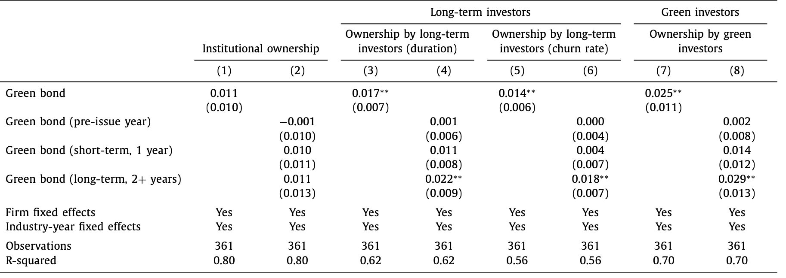

Slide 19
corporate green bonds and firm-level outcomes
Only Certified Bonds Show Clear Impact
Certified bonds drive stronger ESG gains and CO₂ cuts.
Non-certified bonds show weak or no effects.
Certification is costly and verifiable — makes the signal credible.
Consistent with signaling theory.

Slide 20
corporate green bonds and firm-level outcomes
Why It Works: A Signaling View
Green bonds restrict capital use → costly action.
Certification increases the credibility of that signal.
Market (investors) reacts to signal.
Firms follow through with real behavior change.
Classic costly signaling framework in action.

Slide 21
is there a premium for corporate green bonds?
Understanding the "Greenium" Concept
The "greenium" refers to the yield difference between green bonds and conventional bonds with similar characteristics
A negative premium means green bonds have lower yields (borrowers pay less interest)
This premium represents a potential financial incentive for issuers to finance environmentally friendly projects

Slide 22
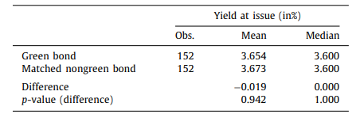
is there a premium for corporate green bonds?
Methodology to check for existence of premium:
Compared 152 green bonds to quasi-identical brown bonds from the same issuer
Matched by credit rating, maturity, coupon, and issuance size.
Results:
Mean yield difference: -0.019% (statistically insignificant, p = 0.942).
Median yield difference: 0% (p = 1.0)
This study shows investors don’t pay more for the green ones—their yields are nearly identical.

Slide 23
is there a premium for corporate green bonds?
Why Investors Don’t Pay Extra for Green Bonds
Industry Practice:
Surveys show investors refuse to accept lower returns for green bonds
Green projects are profitable enough to compete on financial terms.
Market Stage:
Early market phase: Most green projects are "low-hanging fruit" (high profitability).
Future premium possible if profitable projects become scarce
Investors treat green bonds like regular bonds because the projects they fund (e.g., solar farms) are already profitable. There’s no need for a discount—these aren’t charity investments. Even without cheaper financing, green bonds help companies burnish their eco-friendly image, attract loyal investors, and boost stock prices. It’s a win-win for reputation and capital.

Slide 24
conclusion
Corporate green bonds are a newer type of sustainable finance tool
They have become more common over time
More prevalent in industries where environment is important (e.g., energy)
Especially popular in China, the US, and Europe
Stock market responds positively when companies announce green bond issuance
Stronger positive reaction for first-time issuers and bonds certified by independent third parties
When companies announce they're issuing green bonds, the stock market generally reacts positively - meaning investors see this as good news! This positive reaction is even stronger when it's the company's first time issuing green bonds or when independent organizations certify the bonds as truly "green." This suggests investors value genuine environmental commitments.

Slide 25
conclusion
What Happens After Companies Issue Green Bonds?
Companies improve their environmental ratings
Companies reduce their CO2 emissions
More long-term investors and environment-focused investors buy their stock
Green bonds signal real commitment to environmental goals
Not just "greenwashing" - companies show actual improvements
No price difference between green bonds and regular bonds from same company
This study also calls for future research as corporate green bonds are a new financial instrument and the results are based on a relatively small number of observations. As more data become available, future research could provide larger-scale evidence and a more refined characterization of the long-term implications of corporate green bonds

Slide 26
Thank You

