Slide 1


Internship Project
Title: Optimizing Healthcare Workflows
Presented by:
R2142220153 – Riya Gupta
R2142210183 – Aryan Singh Paayal
R2142220895 – Daya Singh
Mentored by:
Dr. Anish Kumar Vishwakarma

Slide 2
CONTENTS
Abstract
Introduction
Problem Statement
Motivation
Objectives
Process Flow / System Architecture
Literature Review
Methodology
SWOT Analysis
Area of Application
PERT Chart
Requirement Analysis
Working Modules
Input, Output & Results
Inference from Literature
Conclusion & Future Scope
References

Slide 3
ABSTRACT
Efficient management of hospital resources is critical to delivering quality healthcare services. One of the major challenges faced by healthcare facilities is the unpredictable number of patient visits, which often leads to overcrowding, long wait times, and resource shortages. This project focuses on developing a Patient Inflow Prediction System that uses historical hospital data and external factors (such as time, weather, and public holidays) to accurately forecast the number of patients expected in a given time period.
By applying machine learning techniques such as time series forecasting and regression models, the system can predict patient arrivals on a daily or hourly basis. These predictions can help hospital administrators make informed decisions about staff scheduling, bed availability, and resource allocation, ultimately improving the overall efficiency of hospital workflows and enhancing patient care.

Slide 4
INTRODUCTION
Hospitals and healthcare centers often face challenges in managing patient flow, especially during peak hours, seasonal illness outbreaks, or emergencies. Sudden increases in patient numbers can overwhelm staff, delay treatments, and reduce the quality of care. On the other hand, underutilization of resources during quiet periods leads to inefficiencies and increased operational costs.
To address this issue, predicting how many patients are likely to visit the hospital in advance can play a crucial role in improving planning and resource management. Patient inflow prediction uses data-driven methods to forecast the number of patients expected to arrive during specific time periods. These forecasts can help hospitals prepare ahead by adjusting staff schedules, ensuring adequate bed availability, and improving service delivery.
This project aims to develop a predictive model using machine learning techniques that analyze historical patient data and other influencing factors (such as time, day, weather, and holidays) to provide accurate and actionable forecasts. By doing so, healthcare facilities can respond more effectively to patient demand and enhance the overall efficiency of their workflows.

Slide 5
PROBLEM STATEMENT
Hospitals often struggle with sudden increases or decreases in the number of patients visiting on a given day. This unpredictability can lead to long wait times, staff shortages, overcrowded emergency rooms, or underutilized resources. Without knowing how many patients to expect, it becomes difficult for hospital administrators to plan effectively.
This project aims to solve this problem by building a Patient Inflow Prediction System that uses historical data to forecast the number of patient visits. With accurate predictions, hospitals can improve scheduling, manage resources efficiently, and provide better care to patients.

Slide 6
MOTIVATION
Improve Hospital Efficiency: Help hospitals manage staff, beds, and equipment more effectively by anticipating patient load in advance.
Reduce Patient Wait Times: Predicting inflow allows hospitals to reduce waiting periods and offer faster care.
Enable Data-Driven Decision Making: Supports administrators with actionable insights for daily and long-term planning.
Handle Seasonal and Emergency Surges: Prepare better for predictable spikes such as flu season, heatwaves, public events, or pandemics.
Prevent Staff Overload and Burnout: Helps in better shift planning to ensure staff are neither overworked nor underutilized.
Reduce Costs Due to Inefficiency: Avoids unnecessary expenses from overstaffing or last-minute adjustments.
Apply AI/ML to Real-World Healthcare Problems: Demonstrates the value of machine learning in solving practical challenges with social impact.
Scalable to Various Healthcare Setups: Can be adapted for large hospitals, clinics, or even emergency departments.

Slide 7
OBJECTIVES
Predict the number of patients who will visit the hospital during a specific time (hour, day, or week).
Help hospital staff plan ahead by providing accurate forecasts of patient visits.
Improve resource management, such as bed availability, doctor and nurse schedules, and medical equipment use.
Reduce patient wait times by ensuring the hospital is prepared for busy periods.
Avoid overcrowding and understaffing in emergency departments and other hospital units.
Use historical and external data (like time, weather, holidays) to build a reliable prediction model.
Support hospital administrators in making data-driven decisions for better healthcare delivery.

Slide 8
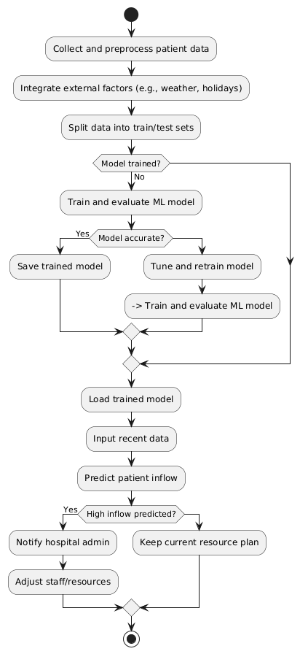
PROCESS FLOW
Collect Data-Gather patient visit records and external factors (e.g., weather, holidays).
Preprocess Data-Clean and prepare the data for modeling.
Feature Engineering- Create relevant time-based and categorical features.
Train-test split: divide data for training and evaluation.
Model Training- Apply machine learning models (e.g., ARIMA, LSTM, XGBoost).
Evaluate & Tune: Assess performance and optimize the model.
Make Predictions- Forecast future patient inflow using recent data.
Support Decisions- Notify hospital staff and recommend resource adjustments if needed.
Visualize Results-Show predictions and trends on dashboards or charts.

Slide 9
METHODOLOGY
Problem Definition
Identify the need to predict patient inflow to optimize hospital resource allocation and reduce wait times.
Data Collection
Collect historical patient visit records from hospital databases.
Gather external factors such as weather data, public holidays, local events, and seasonal trends.
Data Preprocessing
Handle missing or inconsistent values.
Normalize numerical features and encode categorical variables.
Perform exploratory data analysis to understand patterns and trends.
Feature Engineering
Create relevant features such as day of the week, month, holiday flags, temperature categories, etc.
Aggregate data to desired time units (e.g., daily, hourly).
Train-Test Split
Split the data into training and test sets (commonly 70/30 or 80/20 split).
Optionally use time series cross-validation if temporal ordering is critical.

Slide 10
METHODOLOGY
6.Model Selection & Training
Choose appropriate models such as:
Time Series Models: ARIMA, SARIMA, Prophet
Machine Learning Models: Random Forest, XGBoost, LSTM
Train models on historical data to learn inflow patterns.
7.Model Evaluation
Evaluate model performance using metrics such as MAE, RMSE, MAPE, or R².
Compare models and select the best-performing one.
8.Prediction & Forecasting
Use the trained model to predict patient inflow for future time periods.
Generate forecasts daily, weekly, or per department, as needed.
9.Decision Support
Use predictions to support hospital decisions on staffing, bed management, and emergency preparedness.
Provide alerts for anticipated surges in patient volume.
10.Visualization & Reporting
Present predictions, trends, and performance metrics through charts and dashboards.
Enable stakeholders to interpret and act on forecasted data easily.

Slide 11
AREA OF APPLICATION
Emergency Department Management
Forecasting patient volume helps reduce overcrowding and improve triage and response times.
Staff Scheduling and Workforce Planning
Predicting peak hours/days allows hospitals to allocate nurses, doctors, and support staff more efficiently.
Bed and Resource Allocation
Ensures optimal use of hospital beds, ICU units, ventilators, and other critical resources.
Outpatient Department (OPD) Optimization
Helps in scheduling appointments and managing walk-in patients without overwhelming the system.
Pandemic and Seasonal Illness Preparedness
Supports proactive resource planning during flu seasons or public health emergencies like COVID-19.
Healthcare Supply Chain Management
Predictive insights guide timely procurement of medical supplies and pharmaceuticals.
Hospital Revenue and Cost Management
Improved planning reduces under/over-utilization, leading to cost savings and better financial performance.

Slide 12
Datasets Used in Healthcare Flow Optimization
1: patients_df :- Contains patient details such as patient_id, age, gender, admission_time, and discharge_time .
Used to track patient flow and hospital occupancy patterns.
2: departments_df :- Metadata of hospital departments including department_id, name, and capacity.
Helps analyze load distribution across units.
3: movements_df :- Logs patient movements with from_department, to_department, start_time, and end_time.
Used to identify transition delays and optimize flow paths.
4: treatments_df :- Treatment records with fields like treatment_type, duration, and department info.
Used to analyze treatment effectiveness and resource usage.
5: staff_df :- Includes staff_id, role, department_id, and shift_hours.
Supports staff allocation and planning.

Slide 13
Pre Processings
1. Feature Engineering
Extracted Visit Hour, Visit Month from Visit Date (ER dataset)
Created Weekend flag based on Day of Week
Calculated:
Beds per Specialist = Beds / Specialist Availability
Patients per Nurse = Nurse-to-Patient Ratio
Overtime Ratio = Overtime Hours / Shift Duration (Staff dataset)
Satisfaction Change = Current - Previous Satisfaction Score
Binned Years of Experience into Experience Level
2. Data Cleaning
Dropped non-informative ID columns (e.g., Visit ID, Staff ID, etc.)
Handled missing values:
Numerical: Filled with mean
Categorical: Filled with the most frequent

Slide 14
Pre Processings
3. Data Transformation
Scaled numerical features using StandardScaler
Applied One-Hot Encoding to categorical features (drop first to avoid dummy trap)
Binned Years of Experience into Experience Level
4. Output
Saved cleaned and transformed datasets as:
Preprocessed_ER_WaitTime_Data.csv
Preprocessed_Staff_Scheduling_Data.csv

Slide 15
Thank You

