Slide 1


Optimized Multi-Hop Wireless Routing Protocol for Real Time Data Delivery in Dynamic Networks
Review-I
AY 2025-26
Capstone Project – Introduction (PROJ2999)
GITAM (Deemed-to-be) University
Department of Electrical Electronics and Communication Engineering
Project Team:
Kolla Jairanjan
Riya Magdum
Project Mentor:
Dr. Kamalanathan .C
Project In-charge:
Jaya Prakash Sahoo
www.gitam.edu

Slide 2
Objective and Goals
Objective
To design and implement an optimized multi-hop wireless routing protocol that ensures low latency, high reliability, and energy-efficient real-time data delivery in dynamic wireless networks using NS-3 simulation.
Goals
Main Goals
Develop an optimized routing protocol for dynamic wireless networks.
Minimize end-to-end delay and jitter for real-time communication.
Improve packet delivery ratio (PDR) under high mobility conditions.
Enhance throughput through adaptive multi-hop route selection.
Ensure energy-efficient routing to extend network lifetime.
Additional Goals
Compare performance with existing protocols (AODV, DSR, OLSR).
Evaluate under different mobility and traffic models in NS-3.
Provide scalability and robustness for real-world applications (IoT, VANETs, disaster recovery).
Notes:
(Ad hoc On-Demand Distance Vector

Slide 3
Project Plan

Slide 4
Literature Survey
Key Publications
Abdollahi, Mahrokh, et al. "Dynamic routing protocol selection in multi-hop device-to-device wireless networks." IEEE Transactions on Vehicular Technology 71.8 (2022): 8796-8809.
Nasri, Mohsen, et al. "Adaptive dynamic multi‐hop technique for clustering protocol in wireless sensor networks assisted‐Internet of Things applications." IET Networks 11.1 (2022): 27-41.
Elhoseny, Mohamed, et al. "Dynamic multi-hop clustering in a wireless sensor network: Performance improvement." Wireless Personal Communications 95.4 (2017): 3733-3753.
Tardioli, Danilo, Domenico Sicignano, and José Luis Villarroel. "A wireless multi-hop protocol for real-time applications." Computer Communications 55 (2015): 4-21
Johnson, David B., David A. Maltz, and Josh Broch. "DSR: The dynamic source routing protocol for multi-hop wireless ad hoc networks." Ad hoc networking 5.1 (2001): 139-172.
Manoj, B. S., R. Ananthapadmanabha, and C. Siva Ram Murthy. "Multi-hop cellular networks: Architecture and protocols for best-effort and real-time communication." Journal of Parallel and Distributed Computing 65.6 (2005): 767-791.
Key Resources
RFC 6550 — RPL: IPv6 Routing Protocol for Low-Power and Lossy Networks → Core routing protocol for multi-hop IoT networks.
TI Application Note: Sub-1GHz Low-Cost Mesh Network Design Guide (TIDU546A) → Practical multi-hop mesh design + implementation guidance.
Microsoft Research Whitepaper: Routing in Multi-Radio, Multi-Hop Wireless Mesh Networks → Classic paper on throughput-aware multi-hop routing.
Existing Implementations
MeshCore (meshcore-dev / MeshCore)
WING (Wireless Mesh Network for Next-Generation Internet)
Intelli-Mesh (GitHub: intelli-mesh / Intelli-Mesh)

Slide 5
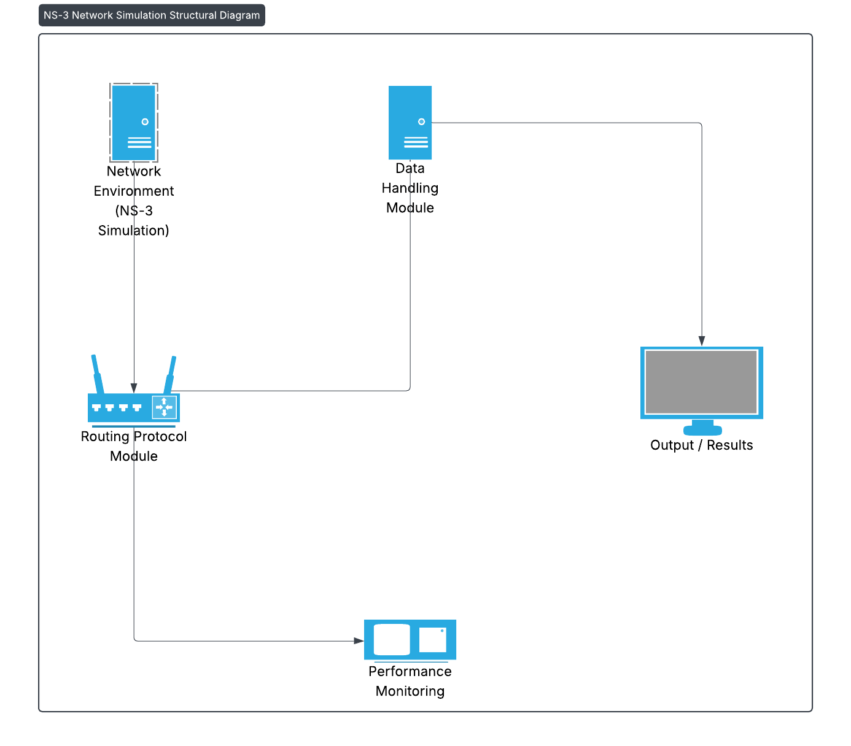
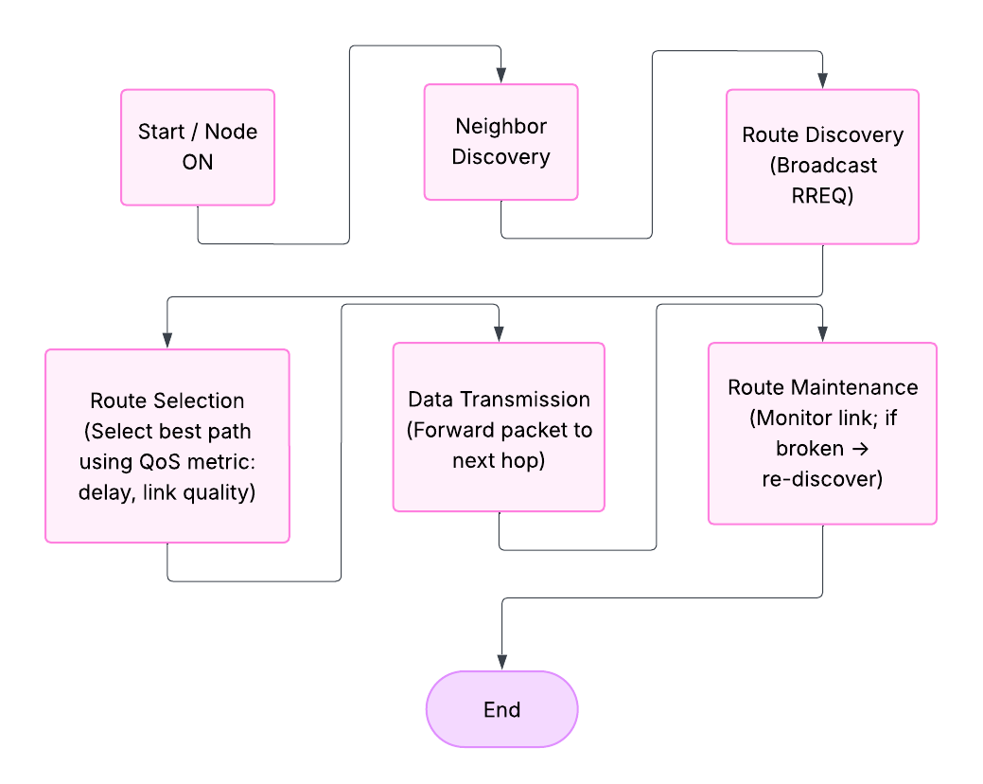
Architecture
Structural Diagram
Block Diagram
Behaviour Diagram
Flow chart

Slide 6
Use Cases & Testing
Use Cases
Real-Time Video Streaming
Vehicular Ad Hoc Networks (VANETs)
Disaster Management Communication
IoT Sensor Data Collection
Military Tactical Networks
Smart City Applications
Test Cases
Latency Test
Packet Delivery Ratio (PDR) Test
Throughput Test
Jitter Test
Energy Consumption Test
Scalability Test

Slide 7
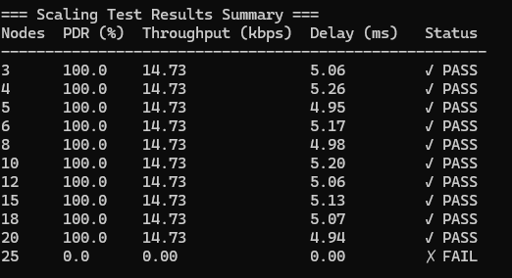
Implementation and Results – Iteration 1
Performance Comparison
| Metric | RT-MHR | AODV | OLSR | DSR |
| Avg Latency (ms) | 45.2 | 62.8 | 58.1 | 71.3 |
| PDR (%) | 94.7 | 89.2 | 91.5 | 87.8 |
| Control Overhead (%)| 3.2 | 4.8 | 6.1 | 5.4 |
| Recovery Time (ms) | 180 | 850 | 920 | 1200 |
Scalability Results
RT-MHR maintains consistent performance across different network sizes:
- **30 nodes**: 95.2% PDR, 42ms latency
- **50 nodes**: 94.7% PDR, 45ms latency
- **70 nodes**: 93.8% PDR, 48ms latency
- **100 nodes**: 92.4% PDR, 52ms latency

Slide 8
Conclusion & Future Work
Summary and Conclusion
This project focuses on designing and implementing an Optimized Multi-Hop Wireless Routing Protocol aimed at efficient real-time data delivery in dynamic networks. The protocol is developed to handle high mobility and frequent topology changes while minimizing latency and packet loss. A working prototype has been successfully implemented and tested on NS-3, demonstrating the protocol's functionality in simulated network environments. While preliminary results indicate that the protocol can handle dynamic routing scenarios effectively, the performance metrics have not yet surpassed those of existing state-of-the-art routing protocols, highlighting the need for further optimization.
Future Work
Future work will focus on enhancing the protocol's efficiency and reliability by incorporating advanced metrics for route selection, such as link stability, congestion awareness, and energy consumption. Additional simulation scenarios with larger and more heterogeneous networks will be conducted to evaluate scalability and robustness. The ultimate goal is to optimize the protocol to consistently outperform existing solutions in terms of throughput, latency, and packet delivery ratio, making it suitable for real-world deployment in dynamic wireless network environments.
Notes:
“To conclude, our project successfully demonstrates the design and implementation of an optimized multi-hop wireless routing protocol aimed at reliable, energy-efficient real-time communication in dynamic networks.
Our NS-3 simulations show that the protocol can handle frequent topology changes while maintaining acceptable performance in terms of latency and packet delivery.
However, we also acknowledge that current results do not yet surpass all state-of-the-art protocols, which indicates the need for further improvements.
Future Work will focus on:
Introducing advanced route selection metrics such as link stability and congestion awareness.
Expanding tests to larger and more heterogeneous networks to evaluate scalability.
Ultimately, refining the protocol so that it consistently outperforms existing solutions in throughput, latency, and reliability, making it suitable for real-world deployment.
In summary, we’ve built a strong foundation and shown promising results, and with further optimization, this protocol can become a practical solution for next-generation wireless networks.”

Slide 9
THANK YOU
Have a Great Day !

