Slide 1

JAL
Offline-first IoT for unsafe water, leaks and abnormal consumption
RAKSHAK
Riya Arora | Sabarigirish Manikandan | Breeti Bandyopadhyay
CSD457 Internet of Things | Research-Based Project
Notes:
Introduce the group. JalRakshak means 'water protector'. One line: an IoT network that detects unsafe water, pipeline leakage and abnormal consumption in real time, and keeps working when the internet connection is unreliable. This is a proposal: the design and evaluation plan are for discussion and approval before we build.

Slide 2

Water networks lose large volumes to leaks, contamination often goes unnoticed until people are affected, and abnormal consumption (continuous night flow, sudden spikes, meter faults) is rarely flagged in time. Most IoT solutions send raw sensor data to the cloud and make every decision there.
THE PROBLEM
When the internet link drops, which is common at rural, underground and remote sites, these systems stop deciding and cannot close a valve when it matters most. JalRakshak aims to detect unsafe water, leaks and abnormal consumption on the node itself, and to keep working offline.
Notes:
Three problems in one network: unsafe water (judged from pH, TDS, turbidity, temperature), leakage (a physical fault, seen as pressure drops and flow imbalance), and abnormal consumption (a node using water differently from its normal pattern, for any reason). They overlap only partly: a leak after a customer meter shows up as abnormal consumption, a leak in the mains does not. Key point: cloud-based systems depend on the link. If the link drops, detection and valve control stop. Our aim is to keep detection and control on the node.

Slide 3

EXISTING WORK
[1] Sharma et al., Sci. Rep., 2026
We use: 8-bit neural network on ESP32 that classifies water quality on the device
Limit: self-made dataset; offline use not tested
[2] Alghamdi et al., Sensors, 2022
We use: pressure-drop leak rule and smart valve closure over LoRaWAN
Limit: simulation only; measures the network, not detection accuracy
[3] Babazadeh, ISA Trans., 2019
We use: anomaly detection on the node; only anomalies sent over LoRa
Limit: examples are pressure events; read at abstract level
[4] Mariadhason et al., Sensors, 2026
We use: timestamped store-and-forward to SD card, duty cycling
Limit: water quality only; no outage-length tests
[5] Pagano et al., arXiv, 2024
We use: EPANET and NS-3 co-simulation of a water network
Limit: no network outages simulated
[6] Ali et al., Internet of Things, 2022
We use: mass balance (supply vs branch flows) for leaks, plus quality sensing
Limit: detection runs in the cloud; only buffers data offline
Notes:
From each paper we take only its detection or analysis method. [1] Sharma, Mishra, Yadav, Gami, Madhan. 'An Intelligent, low-cost water quality monitoring system with on-device machine learning and cloud integration.' Scientific Reports 16, 11106 (2026). Tiny quantized network: 14.5 KB flash, under 2 KB RAM, 99.28% on their own 6,000-point dataset. [2] Alghamdi, Khairullah, Al mojamed. 'LoRaWAN Performance Analysis for a Water Monitoring and Leakage Detection System in a Housing Complex.' Sensors 22(19), 7188 (2022). Leak when pressure falls below a threshold; valve closes. Simulated in FLoRa/OMNeT++, 72 to 1,800 nodes. [3] Babazadeh. 'Edge analytics for anomaly detection in water networks by an Arduino101-LoRa based WSN.' ISA Transactions 92, 273-285 (2019). Anomaly flagged when the compression rate of sensor data changes. We read the abstract and preview only. [4] Mariadhason, Joseph, Srinivasan, Francis. 'An Energy-Efficient Hybrid LoRa-Wi-Fi Architecture for Real-Time Water Quality Monitoring and Machine Learning-Based Trend Forecasting.' Sensors 26(15), 4916 (2026). [5] Pagano, Garlisi, Giuliano, Cattai, Cuomo. 'SWI-FEED: Smart Water IoT Framework for Evaluation of Energy and Data in Massive Scenarios.' arXiv 2404.07692 (2024). [6] Ali, Abdelmoez, Heshmat, Ibrahim. 'A solution for water management and leakage detection problems using IoTs based approach.' Internet of Things 18, 100504 (2022). Leak when supply flow minus branch flows exceeds 10% of supply; synchronised sampling every 3 s; data goes to Firebase.

Slide 4

  Each task has been done on the edge, but separately: water quality [1], leakage [2], anomaly detection [3].
  The one integrated system we found [6] still runs its detection in the cloud.
  In the papers we reviewed, none measures how detection, alert delivery and energy degrade as outages get longer, against a cloud baseline.
RESEARCH
GAP
Notes:
Be careful with the wording: this comes from a limited search. The gap is not 'edge computing for water' and not 'combining three tasks' on its own. Point 1: each task already has edge work, but separately. Point 2: Ali et al. do all three in one system, but detection happens in the cloud; nodes only store data locally when there is no internet. Point 3 is our gap: in the papers we reviewed, nobody tests how the system behaves as outages get longer. Say 'to the best of our search', never 'no one has done this'.

Slide 5
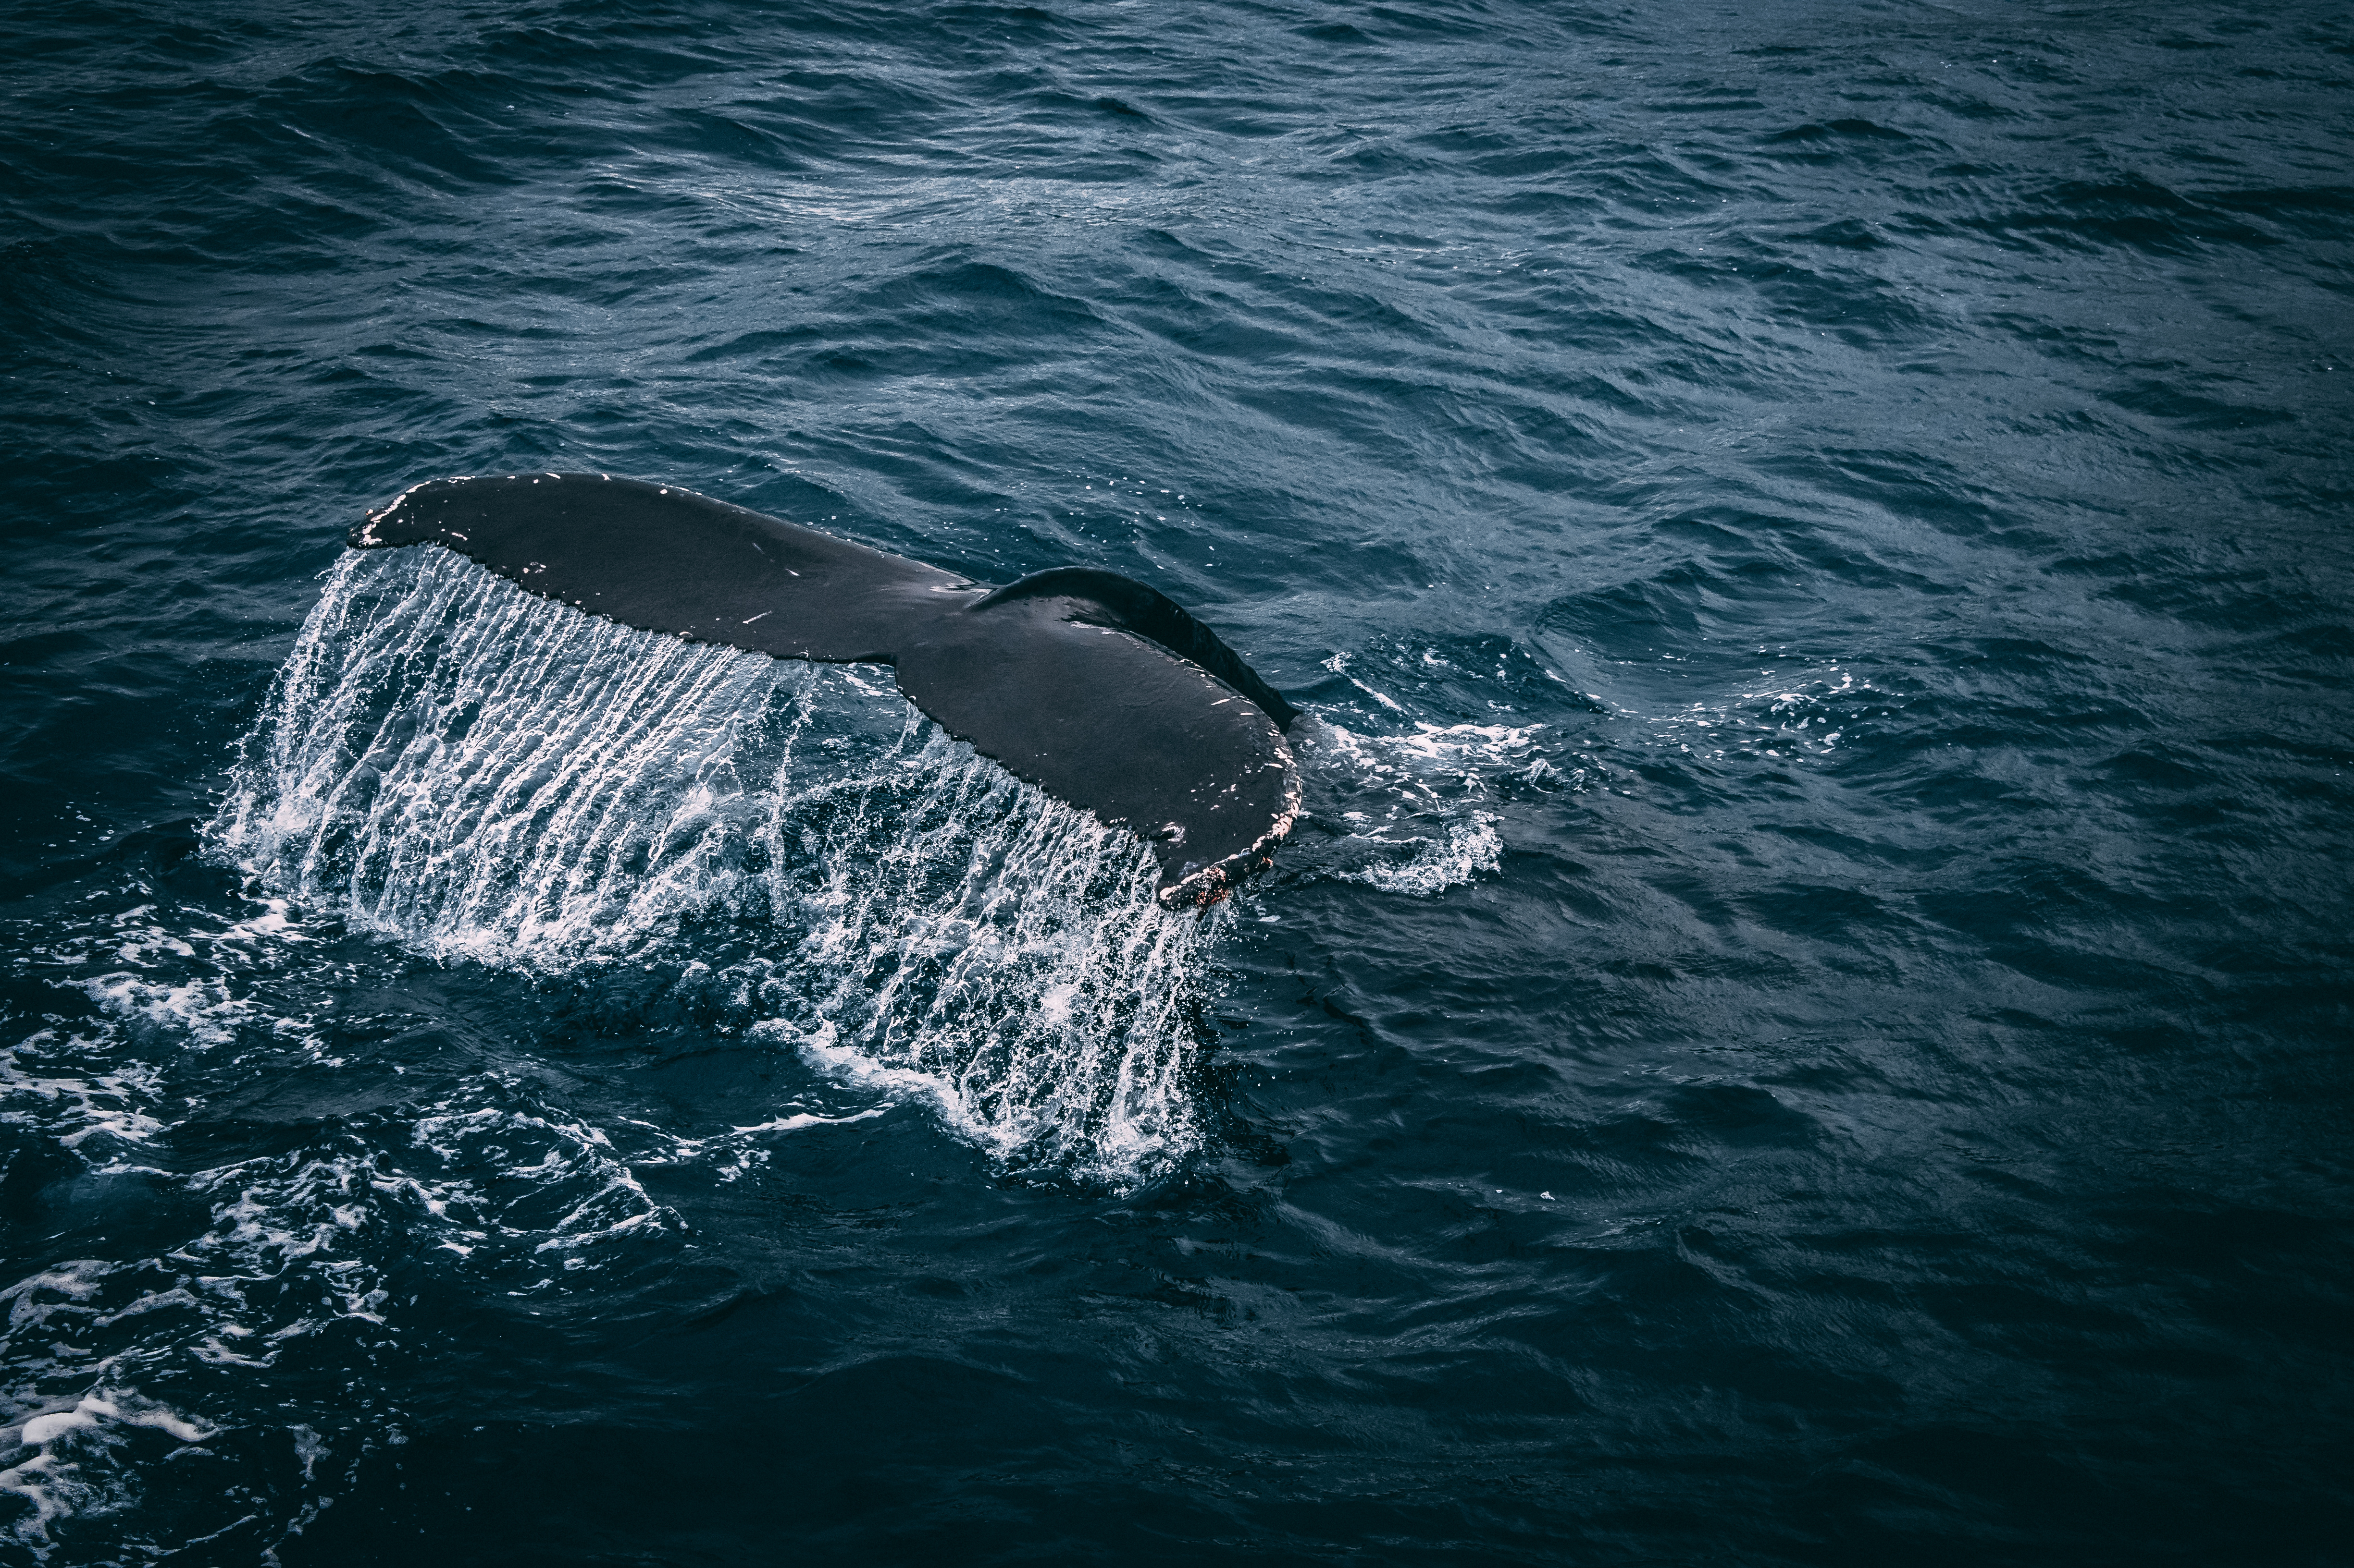
RESEARCH QUESTION
How does an offline-first edge node that detects unsafe water, leakage and abnormal consumption compare with a cloud-dependent design in detection accuracy, alert delivery, latency and energy use, as network availability decreases?
Hypothesis (draft): the edge design keeps detection latency and alert delivery within set bounds at outage lengths where the cloud baseline fails.
Notes:
This is a draft for faculty approval. The question compares two designs, not just 'does it work'. The hypothesis is falsifiable: if the edge node also fails at the same outage lengths, or its accuracy drops too far, the hypothesis is wrong. The exact bounds (for example maximum acceptable detection delay) will be fixed once the evaluation plan is approved.

Slide 6
On each node (ESP32), every decision is made locally:
1. Water quality: quantized neural network on pH, TDS, turbidity and temperature [1]
2. Leakage: pressure-drop rule [2] and supply vs branch flow balance [6]
3. Action: valve closes when the pressure difference is significant [2]
4. Abnormal consumption: lightweight check against the node's normal pattern; only anomalies sent over LoRa [3]
5. Outages: timestamped store-and-forward on SD card, alerts sent first [4]
At the gateway (our proposed rule): if every node sees a pressure drop at the same time, it is treated as a supply event, not a leak, so valves are not closed everywhere.
Evaluation: EPANET + WNTR for hydraulics and NS-3 for the LoRa network, as in [5], with network outages added by us. Hardware prototype if time allows.
PROPOSED APPROACH
Notes:
Everything here is PROPOSED, pending approval. We combine known methods in order to test something new. Walk through the node: sense, decide quality, decide leak, act on the valve, flag abnormal use, survive outages by storing and forwarding. The gateway rule is our own idea: a real leak shows up at one or a few nodes, but when the main source weakens, pressure drops everywhere at once. Without this check, every valve would close. It still has to be validated in simulation. Evaluation uses the EPANET plus NS-3 co-simulation idea from SWI-FEED; that paper does not simulate outages, so we add them.

Slide 7

Platform and Tools
ESP32 with PlatformIO or Arduino IDE
TensorFlow Lite Micro
EPANET + WNTR (Python)
NS-3 LoRaWAN or FLoRa
Python for analysis
Wokwi if no hardware
Notes:
Simulation first, hardware prototype as a stretch goal. ESP32 is the node microcontroller. TensorFlow Lite Micro runs the small quality classifier. EPANET simulates water flow and pressure in pipes; WNTR is its Python wrapper, used to create leaks and supply drops. NS-3 (or FLoRa on OMNeT++) simulates the LoRa radio network, where we cut the link for different lengths of time. Python for analysis. Wokwi is an online ESP32 simulator if we have no board. On memory: the quality model in [1] needs about 14.5 KB flash and under 2 KB RAM, and the leak and consumption rules are lightweight, so all three should fit on one ESP32.

Slide 8

BASELINES AND METRICS
01. BASELINES
02. METRICS
  Cloud-only pipeline like Ali et al. [6]: all data sent to the cloud, detection done there
  Single-task edge detectors run separately [1], [2], [3]
  Precision, recall and F1 for each task
  Detection latency; alert delivery vs outage length
  Data loss; false valve closures during supply drops
  Energy per node, battery life, flash and RAM use
Notes:
Baseline A is the cloud-dependent design, modelled on Ali et al.: nodes send readings, detection happens remotely. Baseline B is each task done on its own edge device. Metrics answer the research question: accuracy (precision, recall, F1 per task), how fast we detect, how many alerts get through as outages get longer, how much data is lost, how often valves close wrongly during a supply drop, and the cost on the node (energy, battery life, memory). Data will be simulated: EPANET leaks and supply drops, injected consumption anomalies, and public water quality data. We will state clearly that it is synthetic.

Slide 9
EXPECTED CONTRIBUTION
  An offline-first node design that covers all three detection tasks on one low-cost microcontroller
  A measured comparison of how it degrades under outages of increasing length, against a cloud baseline
  A cross-node rule that separates supply events from leaks, so valves do not close falsely
Notes:
Novelty in the course's own terms: a new combination of techniques, aimed at an IoT constraint that is not well addressed (unreliable connectivity), plus one small new method (the supply-event rule). Lead with the constraint, not the combination. Contribution 2 is the main research result: none of the papers we reviewed measures behaviour as outages get longer. Contribution 3 is our own idea and still has to be validated. Why it matters: a cloud-only system cannot close a valve during an outage, which is exactly when a leak does the most damage.

Slide 10
THANK
YOU
Questions?
Notes:
Likely questions. (1) How is this different from Ali et al.? They detect in the cloud; we detect on the node and measure behaviour under outages. (2) Where does the data come from? Simulated leaks and supply drops in EPANET, injected consumption anomalies, public water quality data; it is synthetic and we say so. (3) Leak vs abnormal consumption vs supply drop? Leaks show as pressure or flow imbalance at network points; abnormal consumption shows at the meter against its normal pattern; a supply drop hits every node at once. (4) Why not just use the cloud? Latency, bandwidth, single point of failure, and outages at rural or underground sites. (5) Will it fit on one microcontroller? The quality model is tiny and the other rules are simple; heavier leak models such as a 255 KB RAM TinyML network would not fit, so we avoid them.

