Slide 1
BTech A.Y. 2022-2023 Development of customer intelligence platform using SAS Viya for the BFSI sector
Presented by :
Rishabh Tulshyan (B074)
Vedant Misra (B091)
Riya Adsul (B100)
Under the guidance of: Prof. Vijayetha Thoday

Slide 2
Roadmap
Introduction
Problem definition
Proposed System/ Algorithms /Architecture
Design Diagrams
Implementation
References

Slide 3
Introduction
The purpose of the project is to develop complete integrated ecosystem for an organization (primary focus on Insurance and banking sector) to leverage data analytics at various processes of different departments like Providing a view of revenue and expenses distributed by various lines of business, forecast based on historical data, insights on Sales achievement & factors affecting sales, Lead Scoring, Lead Generation, Customer Segmentation & Customer Interaction, view of different business of the organization, lost opportunities & insights to new opportunities.
Problem Statement
To leverage the power of data analytics & data science on various aspects of business to improve the Customer Experience, Lead Generation,Organization Revenue,Internal Processes Areas currently focusing on : Insurance ( Customer Churn, Pre sales Risk factor research and optimizing premium, Fraud Rate Prediction, Insurance Claims and customer complaints analysis )

Slide 4
Roadmap
Phase I
Phase II
Phase III
Phase IV
Identify Business Use Cases
Analytics dashboard &
Predictive Models
React Web/Mobile Application
Deployment
Exploring Business Use cases
Explored various Insurance business use cases like claims analysis,customer complaints analysis, customer churn, risk factor prediction and fraudulent claims identification.
Reports and Dashboards
An overview dashboard page consisting of important statistics was created for top management/CXOs using a life insurance dataset
ML pipelines built on the same
SAS SDK and API (MAS, CAS)
Enable businesses embed analytics into their day-to-day process on easily accessible internal web apps and mobile apps
Make better decisions and improve customer satisfactions.
Finalization and Rollout
Creating an integrated ecosystem for an organization and deploy the project. Make further improvements like increasing security etc. if required.
Analytics and ML Pipelines to improve business decisions
Computer Engineering Dept. MPSTME, Mumbai Campus

Slide 5

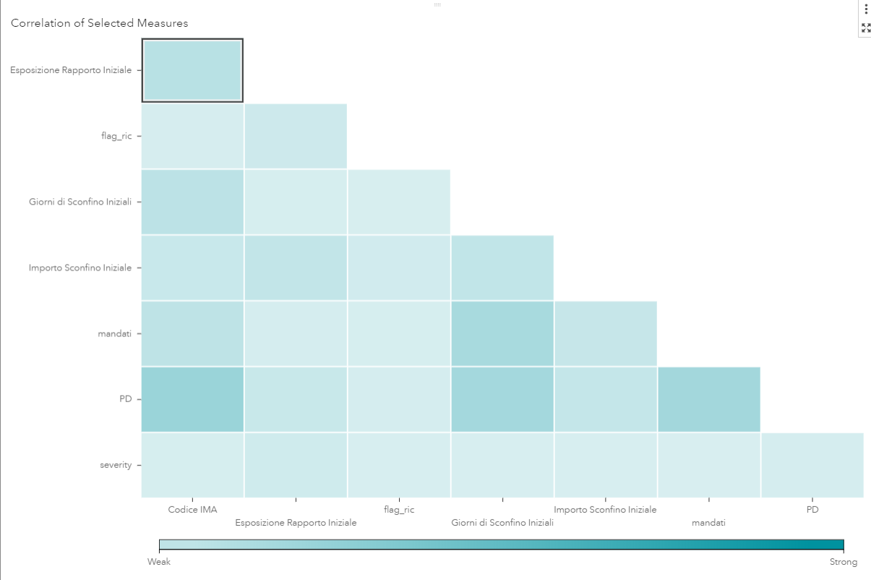
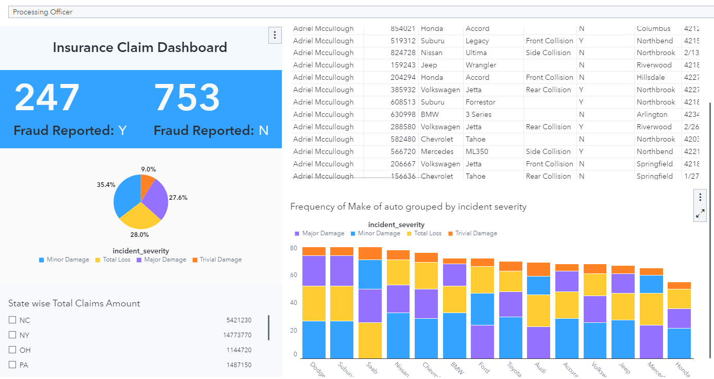

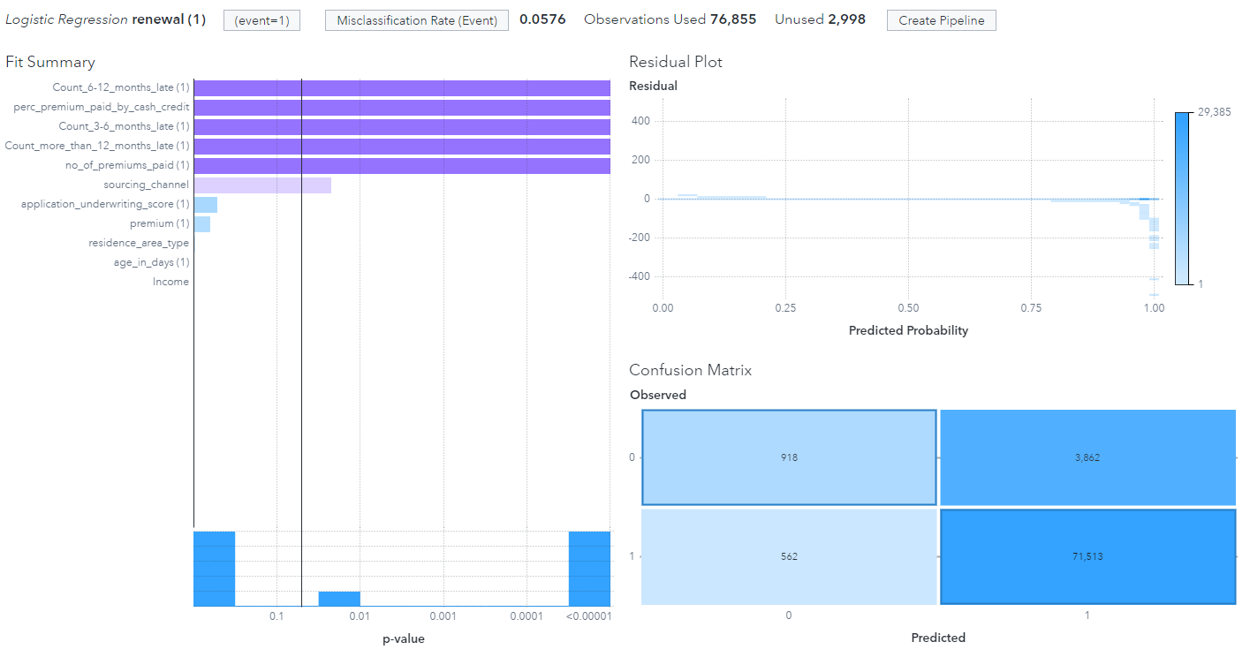
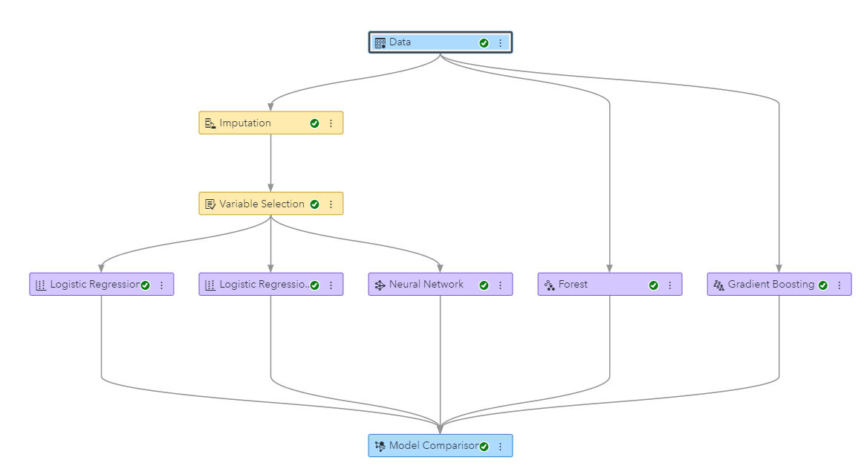
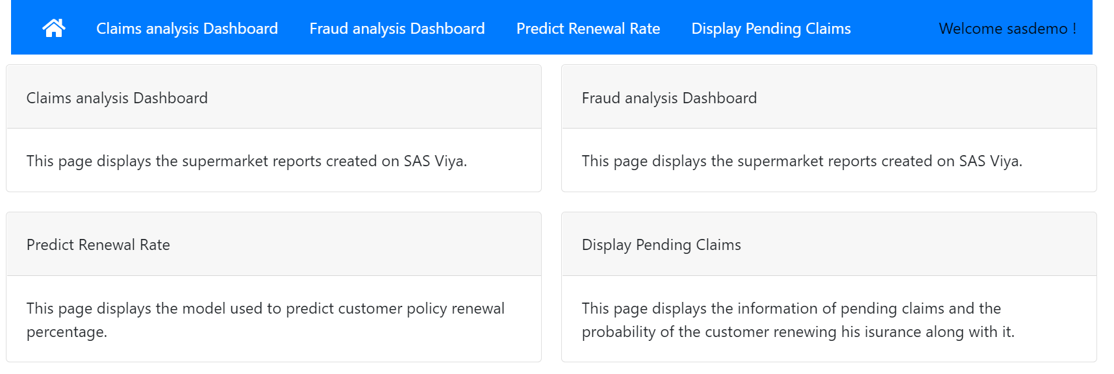
INPUT
ELABORATION
OUTPUT
Creating final dashboard and integrating with webapp
Life Insurance
Dataset
DATA PREPARATION
Perimeter identification
DASHBOARD AND WEB APP WITH USER AUTHENTICATION
Risk factor and Premium optimization
Handling missing values, Cleaning data,
Data analysis, visualization.
Building ML pipelines and scoring the models
Choosing Appropriate Dataset
MACHINE LEARNING ALGORITHMS
Preprocessing
Insurance
Renewal and
Fraud pred

Slide 6
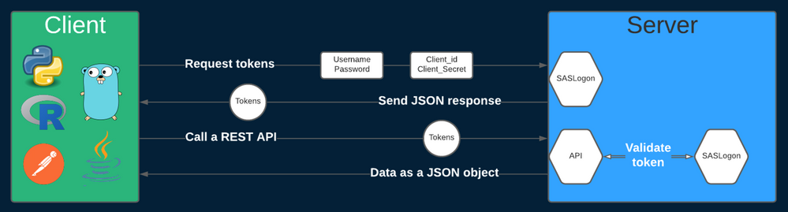
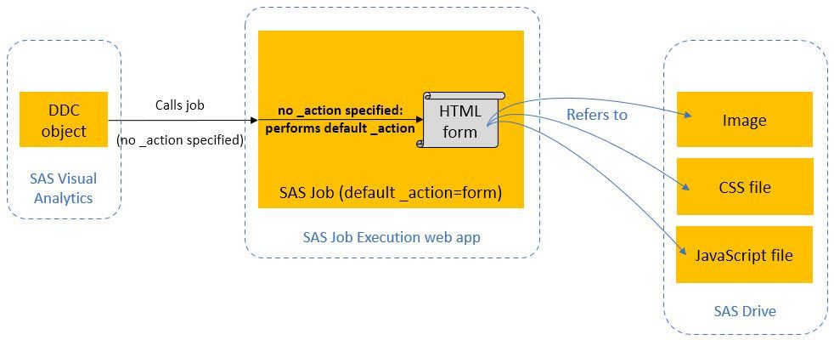
Architecture Diagram

Slide 7
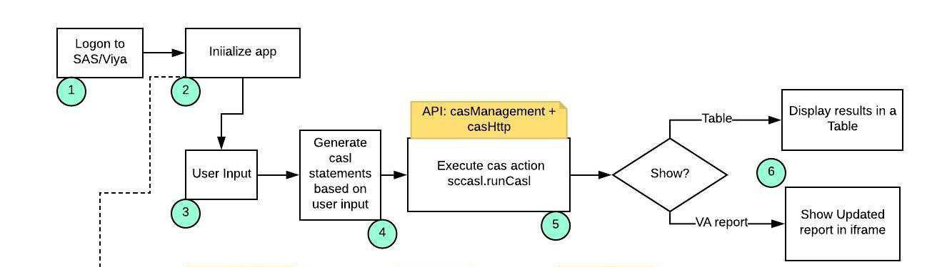
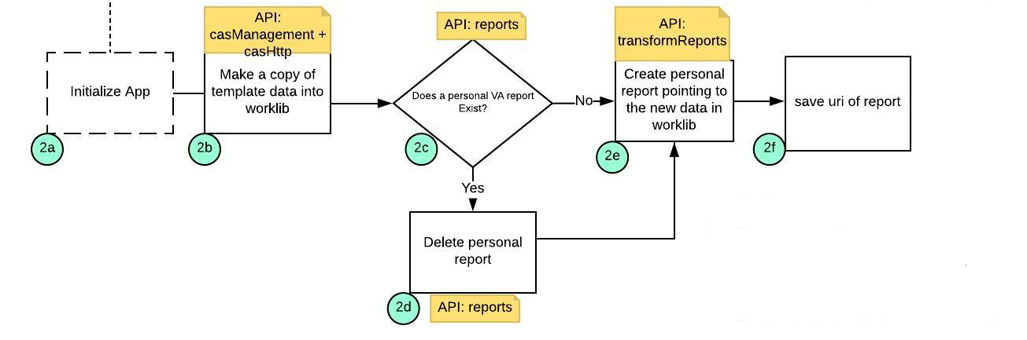
Architecture Diagram

Slide 8
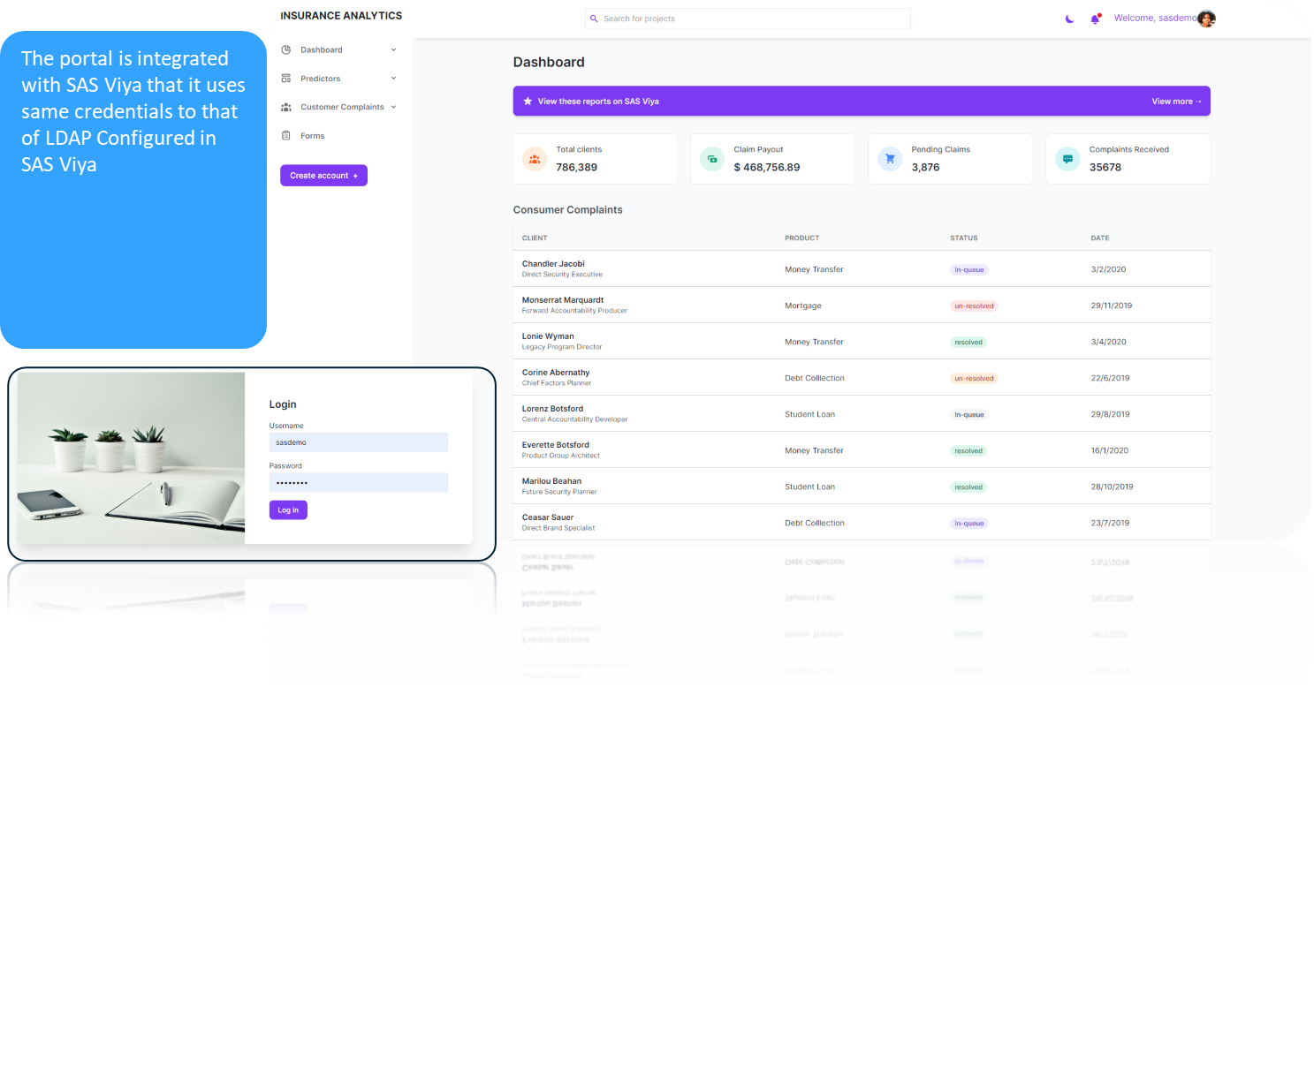
Integration in Web Application (ReactJS) & Data Driven Content

Slide 9
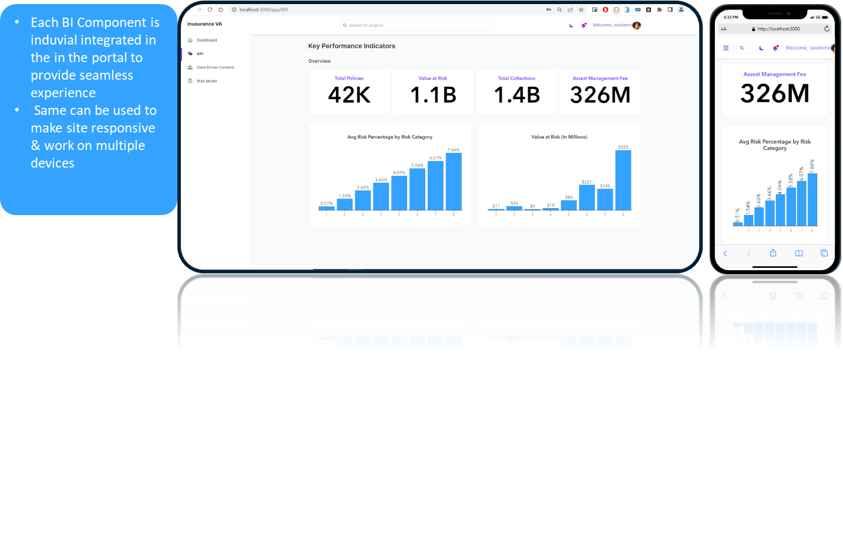
Integration in Web Application (ReactJS) & Data Driven Content

Slide 10
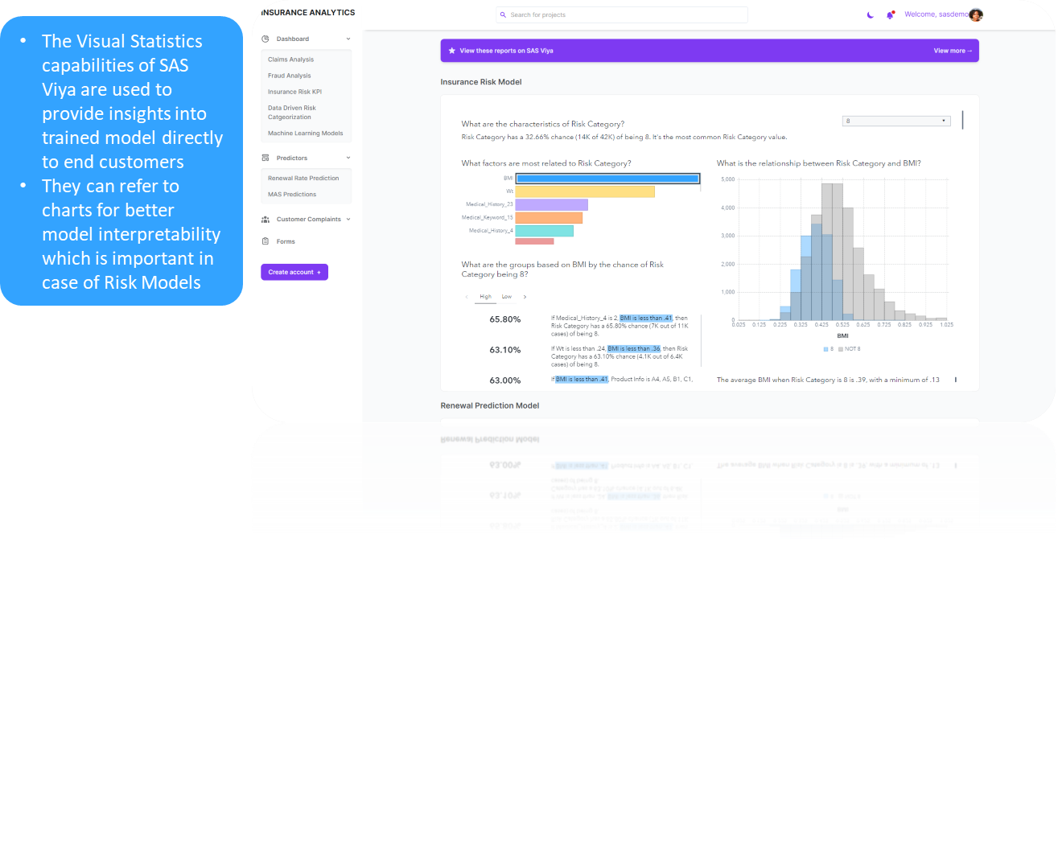
Risk Factor Prediction Model

Slide 11
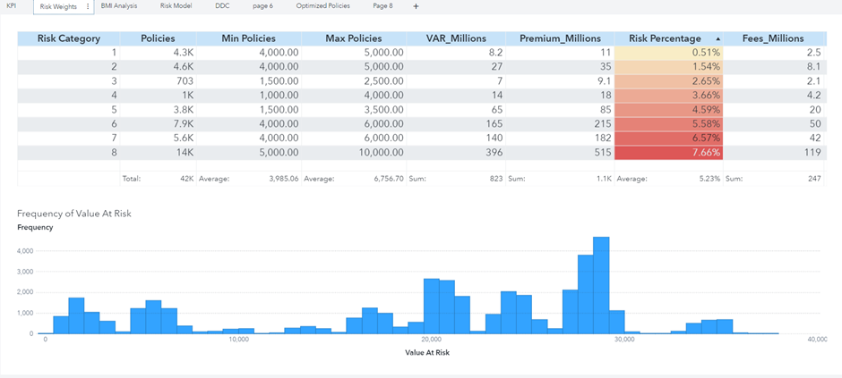
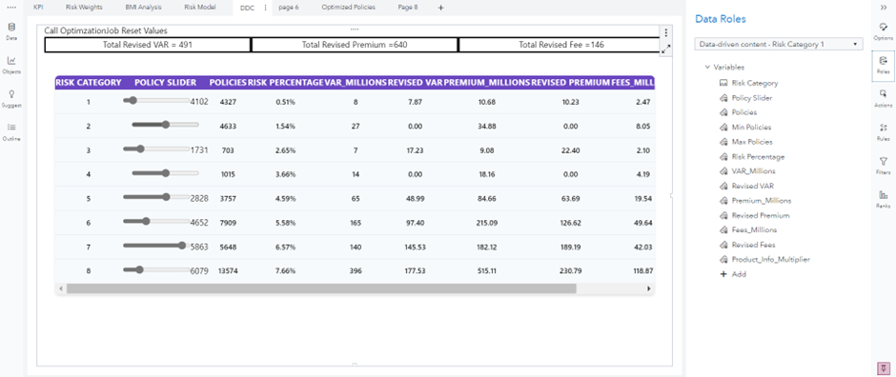
Data Driven Content

Slide 12
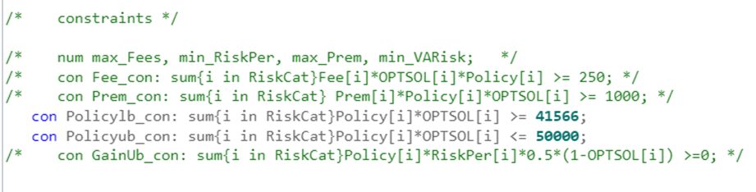
SAS Jobs and Optimization
We also had to recommend the optimal number of policies the company should have to maximise its gains while reducing its value at risk. We used the SAS PROCOPT model which used a linear solver to get the answer. We provided different constraints to our model like minimum number and maximum number of policies required in each risk category, or the sum of total value at risk should be below a certain number.

Slide 13
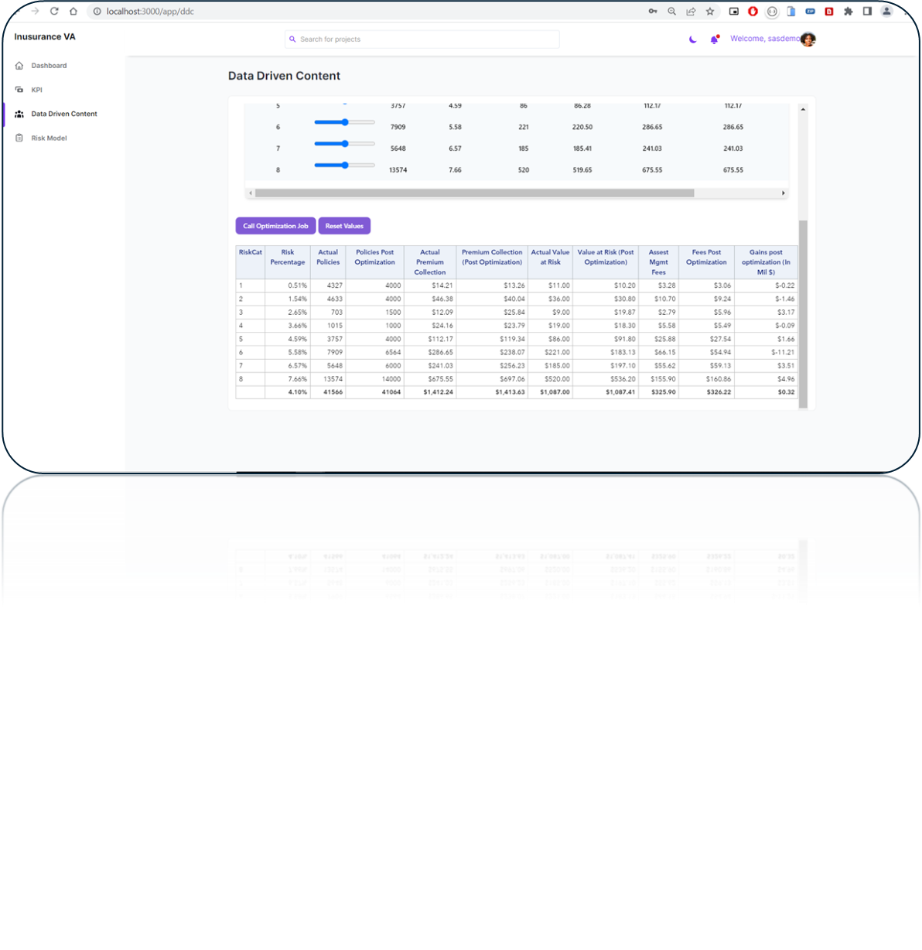
Optimization model output on same window for quick calculations and decisions
Real time scoring and gain calculation

Slide 14
Auto Insurance Analysis
In visualization phase, two auto insurance datasets consisting of 17000 rows were used.
One for forecasting renewal rates based on information from clients whose insurance had already expired. Chosen Model: The Gradient Boosting Model (97%) gave the highest accuracy and least misclassification rate for the prediction of fraud rate, so it was chosen as the final model.
The second dataset, which contained information on each policy officer's pending claims, was utilised to forecast the fraud rate. Chosen Model: The Logistic Regression Model (94%) gave the highest accuracy and least misclassification rate for the prediction of renewal rate, so it was chosen as the final model.

Slide 15
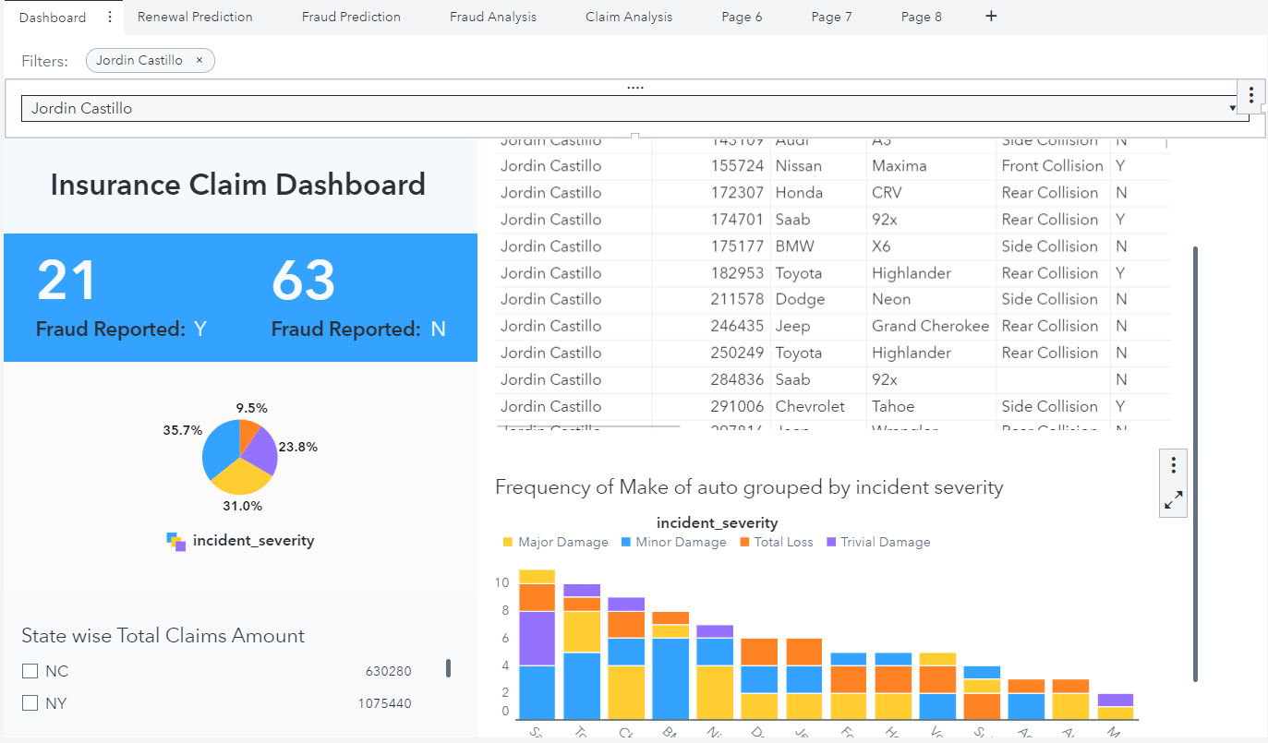
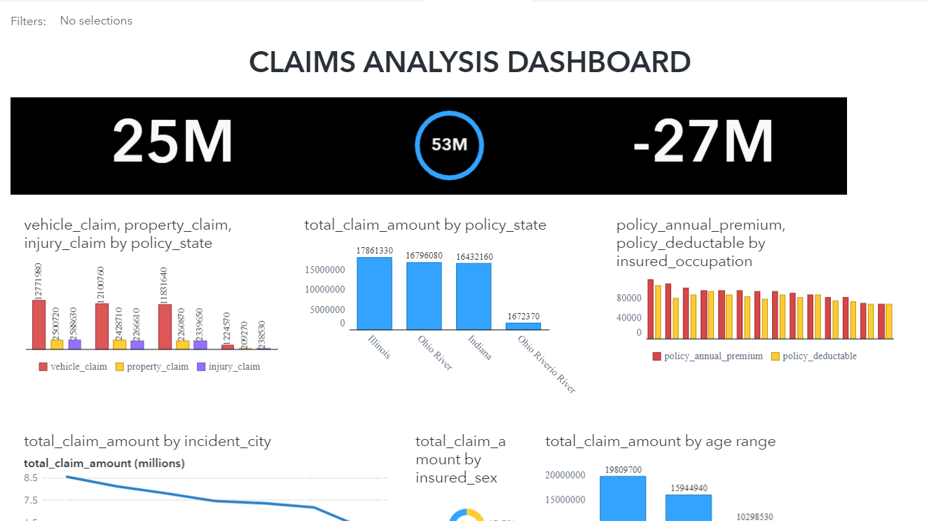

Slide 16
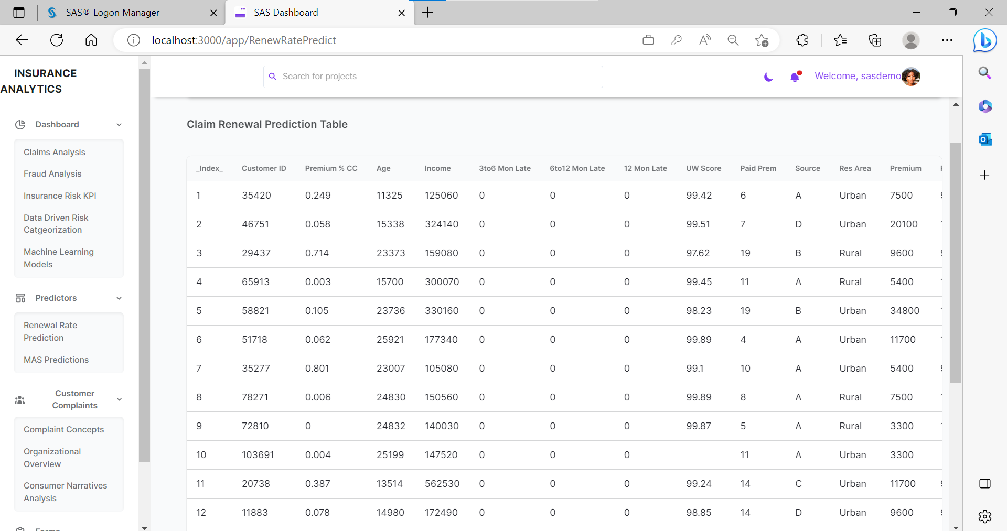

Slide 17
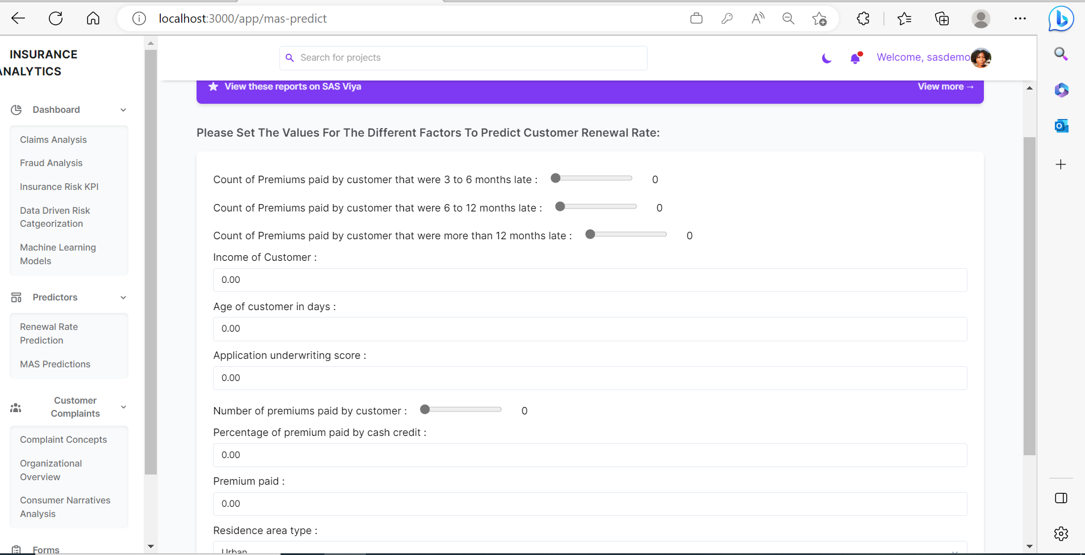

Slide 18
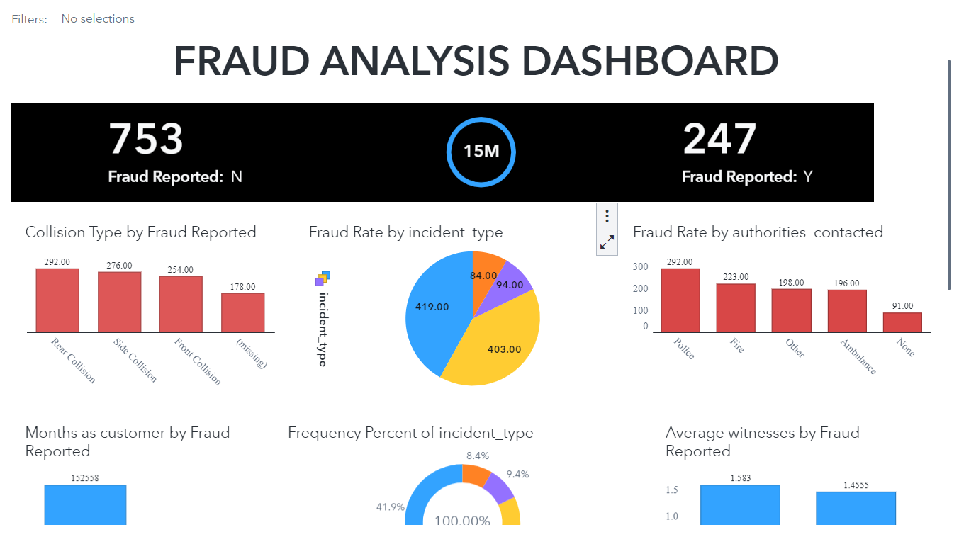
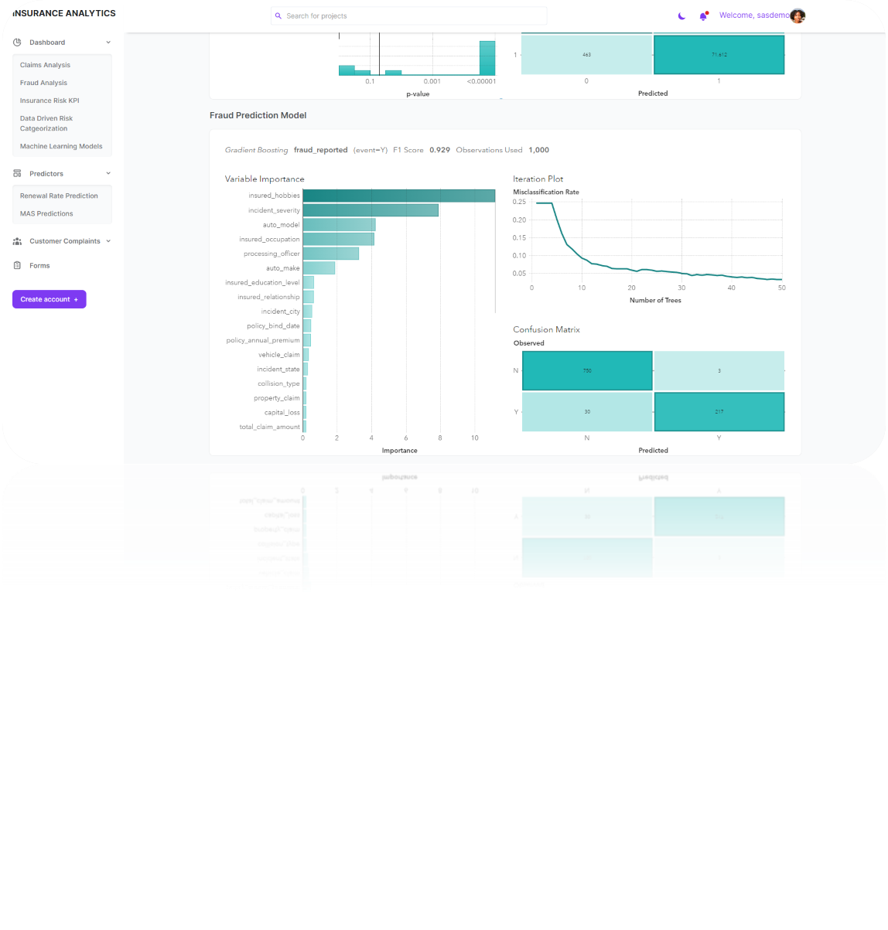
Gradient Boosting Model for Fraud Rate prediction

Slide 19
Customer Complaint Analysis
In this section we have analyzed the Consumer Complaint dataset (between the years 2018–2021) obtained from the Consumer Financial Protection Bureau website. I brought that data into SAS Data Studio in which we created an ID column with unique values and in SAS Model studio we began to run some visual text analytics
After creating all our concepts and categories, we ran the VTA pipeline to be able to download the score code for categories, concepts, and sentiment from VTA results. The score code was then entered into a code window in SAS Studio and then brought into Visual Analytics to allow exploration and visualization of the data.
The next step was to create visualizations to visualize the distribution patterns in the complaints and the information extracted from the complaint narratives which is shown in the images below

Slide 20
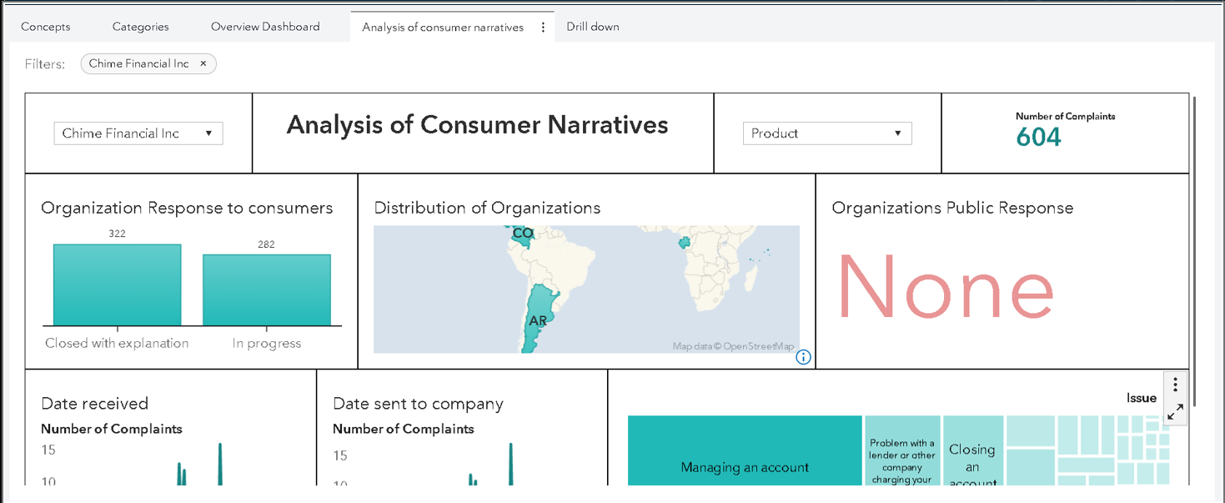
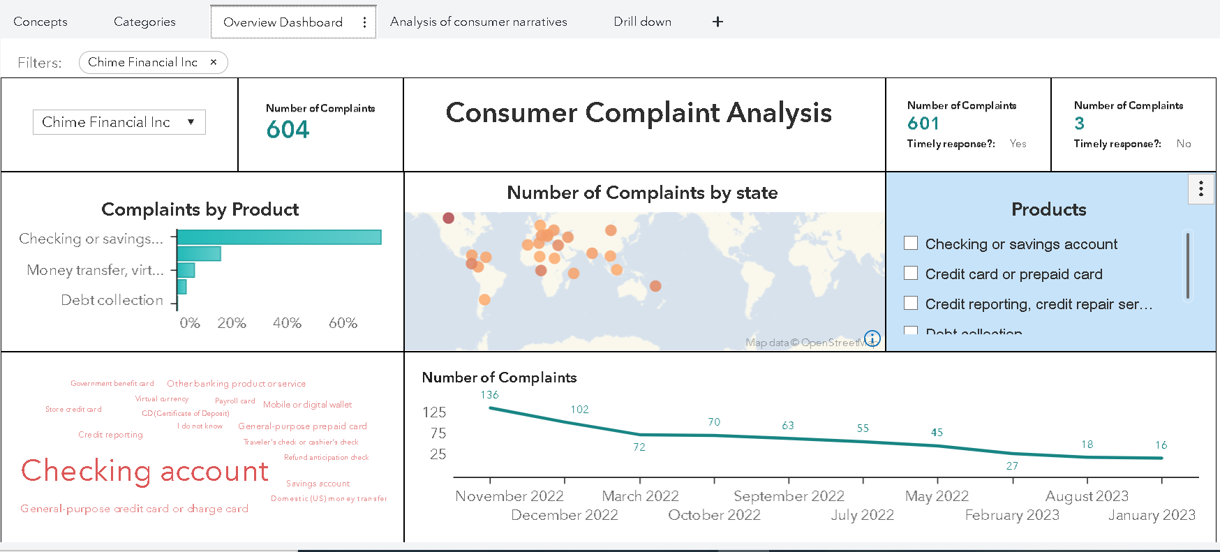
Consumer narrative Dashboard
Consumer Complaint Dashboard

Slide 21
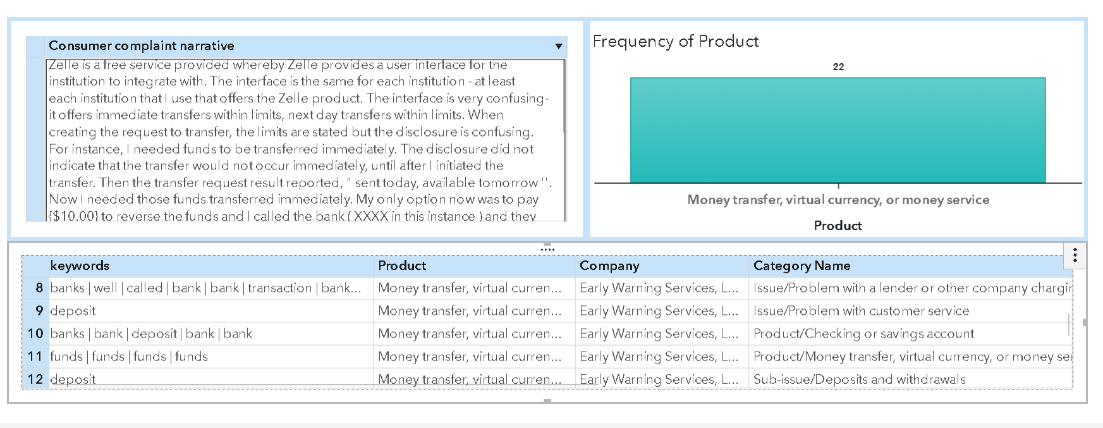
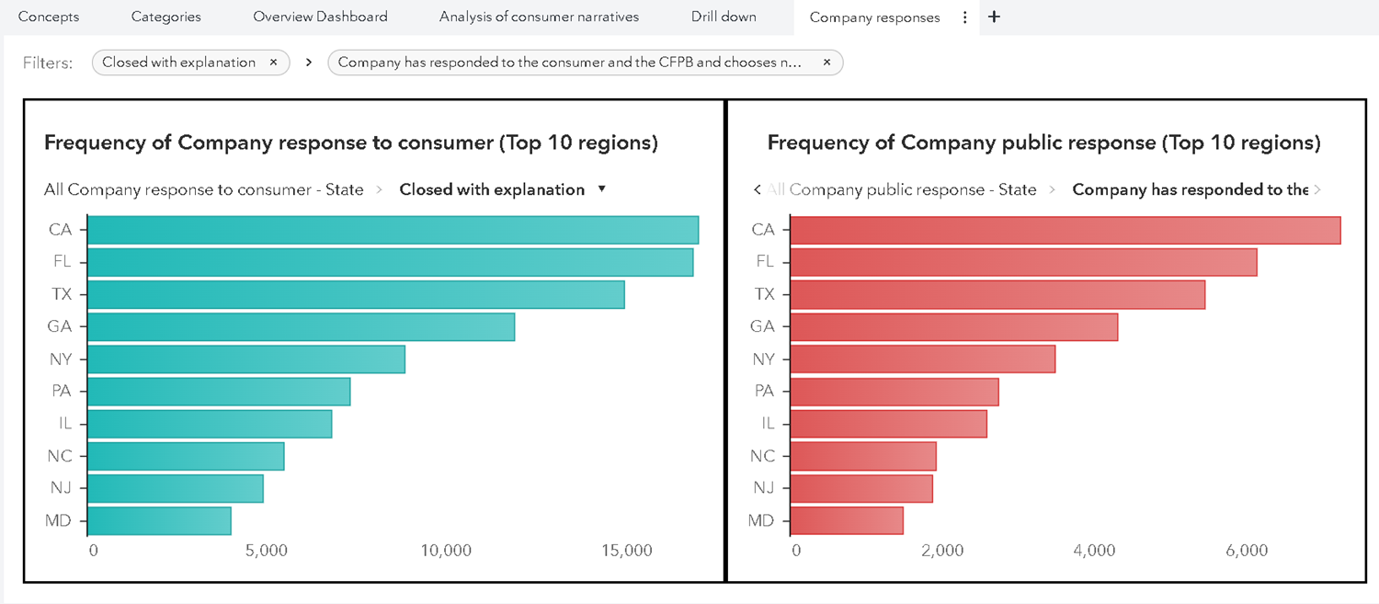
Information Extracted By using nlp
Company Response Dashboard

Slide 22
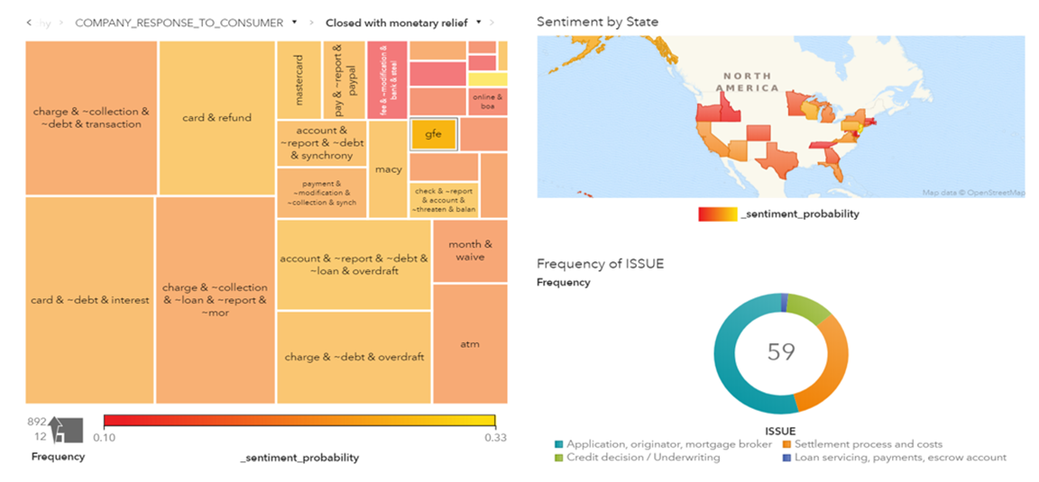
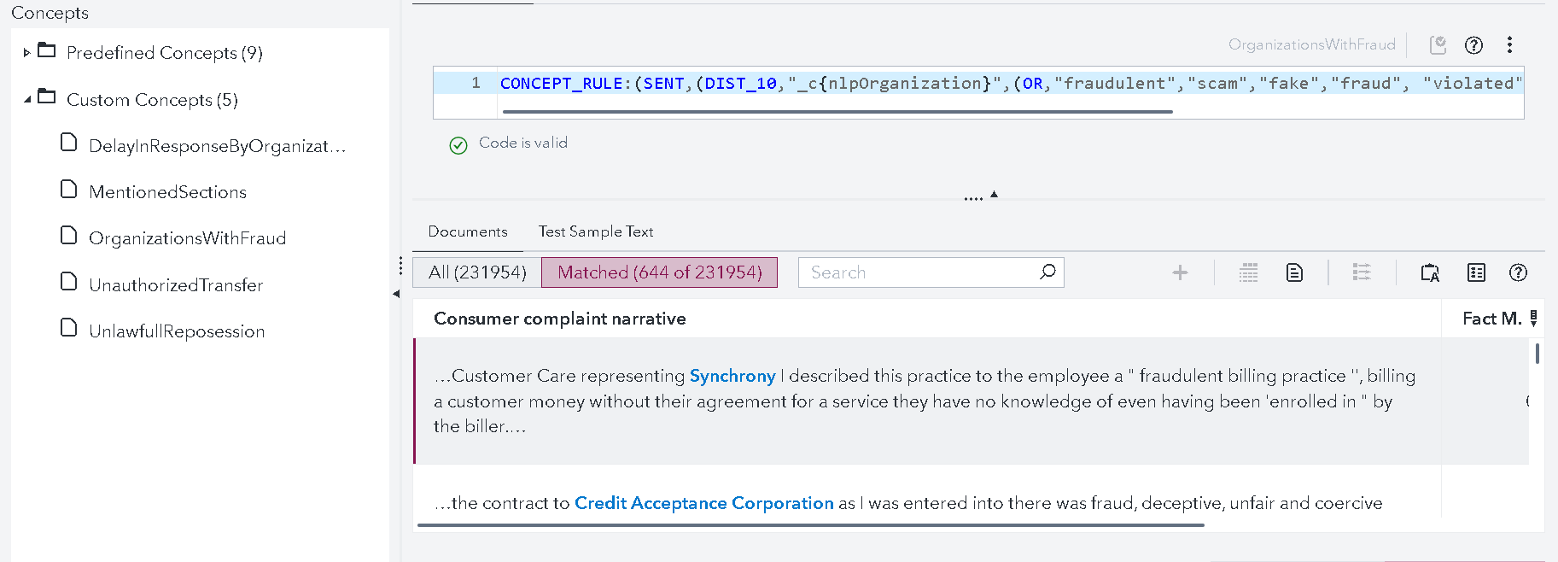
Distribution of Consumer Sentiment
Custom Concepts

Slide 23
Conclusion
Machine learning and Natural Language Processing (NLP) have become increasingly important tools for the insurance industry in predicting fraudulent claims, identifying potential customer churn, and extracting valuable insights from customer data. With the explosion of digital data, these advanced technologies enable insurers to analyze vast amounts of unstructured data, such as social media posts, emails, and customer service conversations, to detect patterns and anomalies that might indicate fraudulent activity or dissatisfaction among customers. By analyzing customer behavior and sentiment, insurers can proactively intervene to prevent customer churn and improve the overall customer experience.

Slide 24
References
[1] Yeo, A.C., Smith, K.A., Willis, R.J. and Brooks, M., 2001. Clustering technique for risk classification and prediction of claim costs in the automobile insurance industry. Intelligent Systems in Accounting, Finance & Management, 10(1), pp.39-50.
[2] Boodhun, N. and Jayabalan, M., 2018. Risk prediction in life insurance industry using supervised learning algorithms. Complex & Intelligent Systems, 4(2), pp.145-154.
[3] Wang, Y., Li, B., Li, G., Zhu, X. and Li, J., 2019. Risk factors identification and evolution analysis from textual risk disclosures for insurance industry. Procedia Computer Science, 162, pp.25-32.
[4] Poornima, A. and Priya, K.S., 2020, March. A comparative sentiment analysis of sentence embedding using machine learning techniques. In 2020 6th international conference on advanced computing and communication systems (ICACCS) (pp. 493-496). IEEE.
[5] Verma, A., Taneja, A. and Arora, A., 2017, August. Fraud detection and frequent pattern matching in insurance claims using data mining techniques. In 2017 tenth international conference on contemporary computing (IC3) (pp. 1-7). IEEE.
[6] Tao, H., Zhixin, L. and Xiaodong, S., 2012, October. Insurance fraud identification research based on fuzzy support vector machine with dual membership. In 2012 international conference on information management, innovation management and industrial engineering (Vol. 3, pp. 457-460). IEEE.

Slide 25
[7] Burri, R.D., Burri, R., Bojja, R.R. and Buruga, S., 2019. Insurance claim analysis using machine learning algorithms. International Journal of Innovative Technology and Exploring Engineering, 8(6S4), pp.577-82.
[8] Spiteri, M. and Azzopardi, G., 2018, September. Customer churn prediction for a motor insurance company. In 2018 Thirteenth International Conference on Digital Information Management (ICDIM) (pp. 173-178). IEEE.
[9] Jayadi, R., Kelvin, A., Rifyansyah, P., Mufarih, M. and Firmantyo, H.M., 2020, September. Predicting Customer Churn of Fire Insurance Policy: A Case Study in an Indonesian Insurance Company. In 2020 6th International Conference on Science and Technology (ICST) (Vol. 1, pp. 1-4). IEEE.
[10] He, Y., Xiong, Y. and Tsai, Y., 2020, April. Machine learning based approaches to predict customer churn for an insurance company. In 2020 Systems and Information Engineering Design Symposium (SIEDS) (pp. 1-6). IEEE.
[11] Soares, J.H.C., Barbosa, J.L.N., Lopes, L.A., Júnior, G.V.M., Rabêlo, R.D.A.L., Passos, E.B. and dos Santos Neto, P.D.A., 2019, June. How to Avoid Customer Churn in Health Insurance/Plans? A Machine Learn Approach. In 2019 IEEE 32nd International Symposium on Computer-Based Medical Systems (CBMS) (pp. 559-562). IEEE.

