Slide 1
FMCG Data Pipeline
Atlon × Sports Bar
Building a Scalable Medallion Architecture on Databricks
for Unified Supply Chain Analytics
Databricks
Delta Lake
PySpark
AWS S3
Star Schema
Post-Acquisition Data Integration Project
Presented by: Riya Dedhia

Slide 2
Agenda
01
Project Background & Business Context
02
Data Architecture – Medallion Layers
03
Star Schema & Data Model
04
Environment Setup
05
Dimension Processing Pipeline
06
Fact Orders – Full & Incremental Load
07
Orchestration, Analytics & Dashboard
FMCG Data Pipeline | Atlon × Sports Bar | Databricks Medallion Architecture

Slide 3
Project Background & Business Context
ATLON (Parent)
SPORTS BAR (Child – Acquired)
Industry: Sports Equipment (Cricket, Badminton, Volleyball) Systems: OLTP + OLAP (Databricks) Architecture: Mature Medallion (Bronze → Silver → Gold) Status: Fully operational BI dashboards Scale: 93,000+ fact rows, structured star schema
Industry: Energy Bars & Nutrition Data: Chaotic – spreadsheets, cloud drives, WhatsApp, ad-hoc APIs Issues: No standardization, duplicate IDs, negative prices, missing months Status: Excel dashboards from OLTP only Gap: No unified view with parent data
ACQUIRES
FMCG Data Pipeline | Atlon × Sports Bar | Databricks Medallion Architecture

Slide 4
Problem Statement & Success Criteria
The Challenge
Tony's Success Criteria
CEO needs a single dashboard showing aggregated revenue from BOTH Atlon & Sports Bar products
Top-5 products, combined revenue, supply chain forecasting — none of this is possible without a unified data layer
Sports Bar's chaotic data sources must be ingested, cleaned, and merged with Atlon's gold layer
✔ Reliable aggregated dashboard for both companies ✔ Low learning curve for new hires ✔ Scalable long-term solution (beyond 1-year ERP migration)
The Solution – Scalable Databricks Pipeline
Build a complete Bronze → Silver → Gold medallion pipeline for Sports Bar data using Databricks (free edition) and AWS S3. Process historical backfill (Jul–Nov) then switch to daily incremental loads
Merge Sports Bar's gold layer into Atlon's consolidated gold layer via Delta Lake upsets
Expose a single denormalized sales_view for BI dashboards and Genie AI assistants
FMCG Data Pipeline | Atlon × Sports Bar | Databricks Medallion Architecture

Slide 5
Medallion Architecture – Overview
BRONZE
SILVER
GOLD
Raw Landing
Cleansed & Enriched
BI-Ready
▸ Ingest CSV files from AWS S3
▸ Deduplicate records
▸ Select & rename columns to parent schema
▸ Infer schema automatically
▸ Trim whitespace, initcap fields
▸ Aggregations (monthly fact quantities)
▸ Add metadata: read_timestamp, file_name, file_size
▸ Regex corrections (e.g., 'proten' → 'protein')
▸ Derive revenue = price × quantity
→
→
▸ Append to Delta tables (audit trail)
▸ Standardize city names (e.g., 'Bangaluru' → 'Bangalore')
▸ Upsert/merge into Atlon consolidated gold
▸ Move processed files to /archive
▸ Handle nulls, invalid IDs, negative prices
▸ Power dashboards & Genie AI
FMCG Data Pipeline | Atlon × Sports Bar | Databricks Medallion Architecture

Slide 6
End-to-End Data Flow
Sports Bar
OLTP
AWS S3
Landing
BRONZE
Delta Tables
SILVER
Cleansed
SB GOLD
(Child)
→
→
→
→
→
↓ UPSERT / MERGE
BI Dashboard
+ Genie AI
ATLON GOLD (Consolidated)
←
Key Insight: Data chaos post-merger highlights why medallion architecture matters — it standardizes messy sources into reliable BI without disrupting legacy Atlon systems
FMCG Data Pipeline | Atlon × Sports Bar | Databricks Medallion Architecture

Slide 7
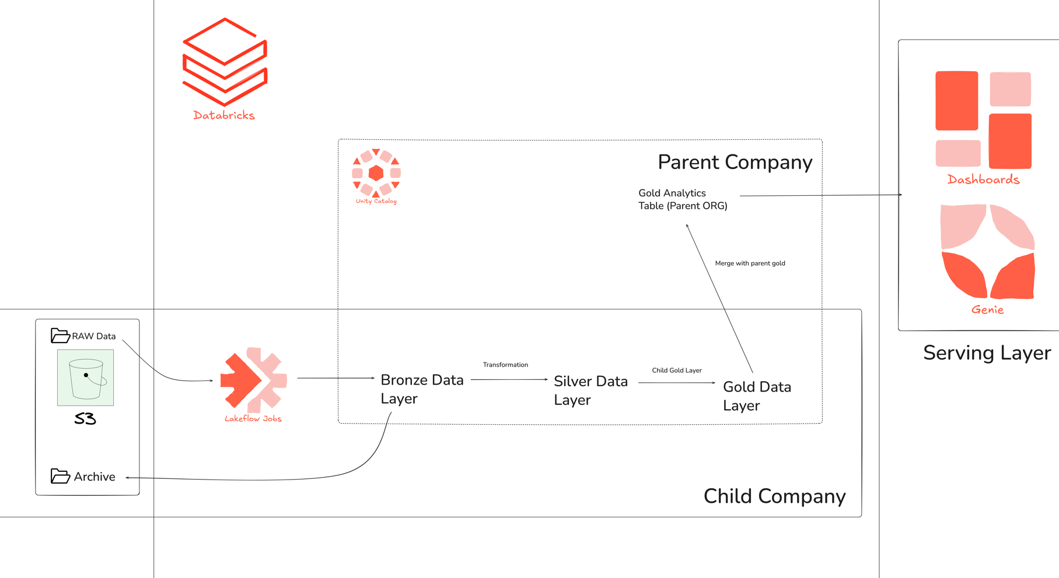

Slide 8
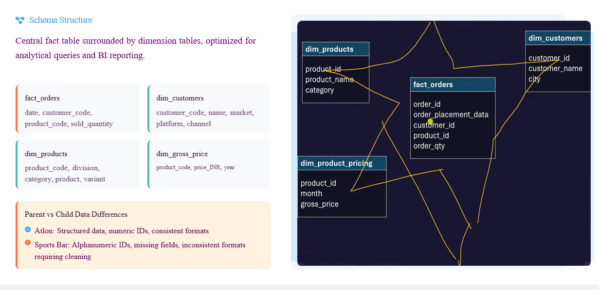
Data Model – Star Schema
FMCG Data Pipeline | Atlon × Sports Bar | Databricks Medallion Architecture

Slide 9
Dimension Processing Pipeline – Common Pattern
BRONZE
SILVER
CHILD GOLD
MERGE
PARENT
spark.read.csv() from S3
Infer schema
Add read_timestamp
saveAsTable (Delta, overwrite)
dropDuplicates()
f.trim() / f.initcap()
regexp_replace()
when/otherwise mapping
Joins for enrichment
saveAsTable (overwrite)
Select & rename cols
Match parent schema
saveAsTable FMCG.gold.sb_dim_*
DeltaTable.forPath()
.merge(child, 'key')
.whenMatchedUpdateAll()
.whenNotMatchedInsertAll()
.execute()
→
→
→
⚠ Key Rule: Dimensions must be processed BEFORE facts — facts join on product_code and customer_code keys generated in dim layers.
FMCG Data Pipeline | Atlon × Sports Bar | Databricks Medallion Architecture

Slide 10
Fact Orders – Full Load (Historical Backfill)
Bronze Layer
Silver Layer
▸ Read all S3 landing CSVs (51k rows, Jul–Nov)
▸ Filter null sold_quantity rows
▸ Add metadata columns
▸ Regex: clean non-numeric customer IDs → '9999'
▸ Append to Delta table
▸ Clean dates: regexp_replace weekday prefix
▸ Move processed files → /processed
▸ Dedupe on 5 key columns
▸ String-cast product_ID; join products for SHA code
Child Gold Layer
Merge Parent Layer
▸ Upsert if table exists
▸ Select required columns
▸ Merge sb_fact_orders → Atlon fact_orders
▸ trunc(date, 'MM') → month_start
▸ Keys: month_start + product_code + customer_code
▸ groupBy(month_start, product_code, customer_code)
▸ whenMatchedUpdateAll()
▸ sum(sold_quantity)
▸ whenNotMatchedInsertAll()
▸ Upsert to sb_fact_orders
▸ QC: count rows, min/max date (Jul 1 – Nov 30)
FMCG Data Pipeline | Atlon × Sports Bar | Databricks Medallion Architecture

Slide 11
Fact Orders – Incremental Load (Daily)
1
New file arrives
Why Staging?
e.g., Dec1.csv (350 rows) → S3 landing
✔ Transform only NEW data each day
2
Staging Bronze
Process ONLY new file → append staging_orders_bronze
✔ Historical gold stays untouched (green)
3
Move file
✔ Avoids re-processing 51k+ rows daily
dbutils.fs.mv(landing → processed)
✔ Scales as data volume grows
4
Staging Silver
✔ Dec 1-4 records aggregate → single Dec monthly row
Apply same transforms → append main silver + staging_silver_orders
✔ Drop staging tables post-merge (clean)
5
Child Gold
Staging silver → trunc month → append sb_fact_orders
6
Merge Parent
Select Dec records → group sum(qty) → upsert fact_orders; drop staging
Example: Dec 1 CSV (350 rows) → 217 post-clean → monthly agg → upsert single Dec row into parent gold
FMCG Data Pipeline | Atlon × Sports Bar | Databricks Medallion Architecture

Slide 12
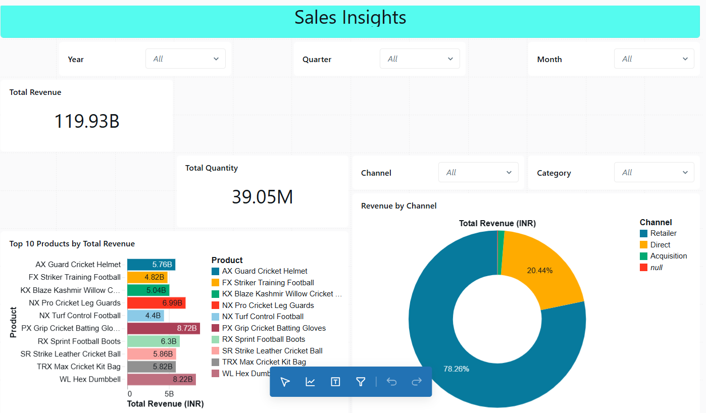
Analytics –Genie AI & BI Dashboard View
gold.sales_view
Genie AI Assistant
▸ Massive JOIN: fact_orders + all dims + dim_date
▸ Natural language → SQL + visualization
▸ Derived: total_INR = price_INR × sold_quantity
▸ "Revenue by quarter" → auto bar chart
▸ Single denormalized table for fast BI queries
▸ "Top 5 customers by quantity" → ranked table
▸ Duplicate-tolerant for analytics workloads
▸ Builds queries on sales_view automatically
▸ Powers all dashboard visualizations
▸ Verifies SQL; no manual query writing needed
Dashboard Visualizations – Atlon Sales Insights
KPI Counters
Bar Chart
Pie Chart
Trend Line
Scatter Plot
Sum revenue & total quantity sold
Top 10 products by revenue (₹B labels)
Revenue breakdown by channel
Monthly revenue & qty trends
Quantity vs Price relationship
FMCG Data Pipeline | Atlon × Sports Bar | Databricks Medallion Architecture

Slide 13
Why This Architecture Scales
Δ Delta Lake
⚡ Apache Spark
🔧 Widgets & Configs
ACID transactions, time travel, Change Data Feed (CDF) for audits. Never lose data integrity even at scale.
Distributed processing handles millions of rows. Same PySpark code runs on dev cluster or 100-node production.
Environment variables (dev/prod) via dbutils.widgets. Zero code changes to switch environments.
⬆ Upsert Pattern
📦 Staging Strategy
🔗 Modular Jobs
DeltaTable.merge() ensures idempotency. Re-run pipelines safely — no duplicates, no data loss.
Incremental loads transform only new data. Historical records untouched. Cost-efficient at scale.
Separate notebooks per dimension + fact. Independent testing, easy onboarding for new hires.
FMCG Data Pipeline | Atlon × Sports Bar | Databricks Medallion Architecture

Slide 14
Key Takeaways
01
Medallion architecture (Bronze→Silver→Gold) is the industry standard for taming chaotic post-merger data without disrupting legacy systems.
02
Star schema with SHA2 surrogate keys enables seamless parent-child merging even when source schemas differ significantly.
03
Staging-based incremental loads are cost-efficient — process only new data daily while historical gold remains untouched.
04
Delta Lake upserts ensure idempotency: pipelines can be re-run safely with no duplicates or data loss.
05
Databricks Workflows + Genie AI give both engineers and business analysts a unified platform from ingestion to insight.
Data Engineering = Ingredients | BI Dashboards = Recipes | Clean Gold Layer = The Foundation

Slide 15
THANK YOU

