Slide 1
Robotic Process Automation (RPA)
📘 Definition of RPA
Robotic Process Automation (RPA) is a technology that uses software robots (bots) to emulate human actions while interacting with digital systems to execute rule-based, repetitive business processes.
✅ Typical RPA Tasks:
Data entry & form filling
Invoice processing
Report generation
Email automation
ERP/CRM updates
👉 Bots operate on UI level just like a human — no deep system integration needed!

Slide 2
Need for RPA
• Reduces manual effort
• Improves accuracy
• Saves time and cost
• Works 24/7
• Enhances productivity
✨ Especially useful in banking, healthcare, telecom, education, and IT services.

Slide 3
❓ Why RPA is Needed (The Need for RPA)
🔹 Business Challenges:
High manual effort ⏳
Human errors ❌
Low scalability 📉
High operational cost 💰
Benefits:
Aspect | Impact
⚡ Speed | 5–10x faster execution
🎯 Accuracy | Near zero errors
📈 Scalability | Bots can run 24/7
💵 Cost Saving | Reduced manpower
🔄 Standardization | Consistent output

Slide 4
Traditional Automation
Script-based automation requiring coding skills and complex integration.
Example
Google Apps Script
Selenium
Bash (Shell Scripting)
Python Scripts
PowerShell
Cron Jobs
Jenkins
Ansible
Puppet
Chef
UFT (QTP)

Slide 5
RPA vs Traditional Automation
RPA: Easy, UI-based, quick deployment
Traditional: Complex, code-heavy, slow setup

Slide 6
⚙️ RPA vs Traditional Automation
Feature | RPA | Traditional Automation
🔧 Implementation | UI-based | Code-based
💻 Technical Skill | Low/No coding | High coding
⏱ Development Time | Days/Weeks | Months
🔄 System Integration | Not mandatory | Mandatory
📊 Flexibility | High | Low
💰 Cost | Lower | Higher

Slide 7
UiPath Platform Architecture
UiPath Studio – Design bots
UiPath Robots – Execute tasks
UiPath Orchestrator – Manage bots

Slide 8
🧩 1. UiPath Studio (Design Layer)
👉 Used to build automation workflows
🔹 Key Functions:
Drag-and-drop activities
Flowcharts, Sequences, State Machines
Debugging & testing
Recording user actions
🎯 Users:
Developers
Business Analysts

Slide 9
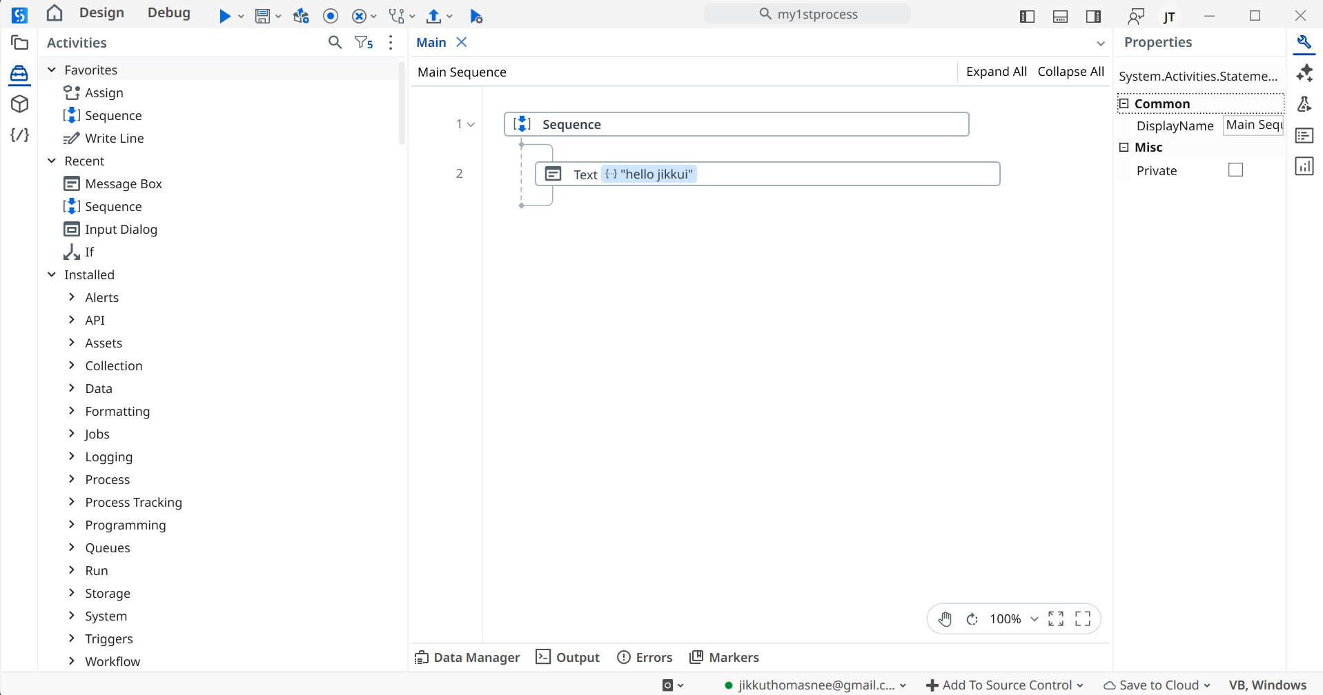
🧩 1. UiPath Studio (Design Layer)

Slide 10
🤖 2. UiPath Robot (Execution Layer)
👉 Executes the automation created in Studio
🔹 Types:
🧑‍💻 Attended Robot (triggered by human)
🌐 Unattended Robot (runs automatically)
🔹 Capabilities:
Click, type, read data
Interact with apps, browsers, Excel, SAP, etc.
The Robot is a background service that executes the code developed in UiPath Studio. The Assistant is a client of that robot, providing a graphical interface for users to start, stop, and manage automations.

Slide 11
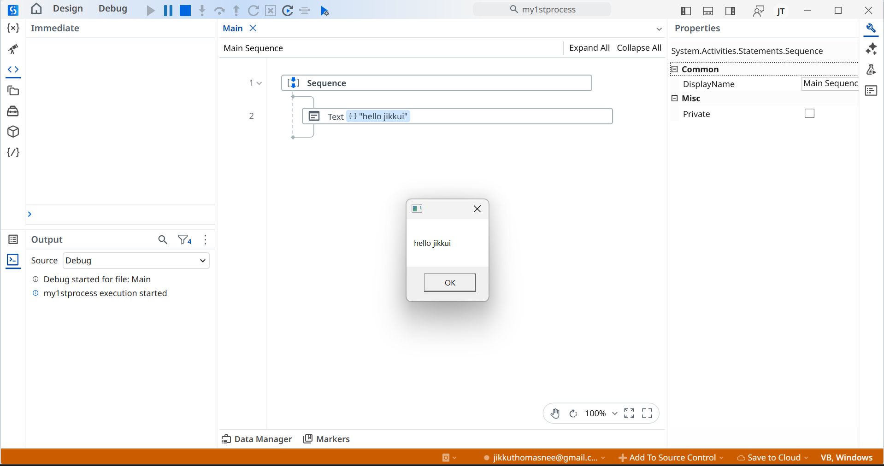
🤖 2. UiPath Robot (Execution Layer)

Slide 12
☁️ 3. UiPath Orchestrator (Control Layer)
👉 Centralized web platform to manage, monitor, and schedule bots
🔹 Core Features:
Bot deployment 🚀
Job scheduling ⏰
Queue management 📥
Logs & analytics 📊
Security & access control 🔐

Slide 13
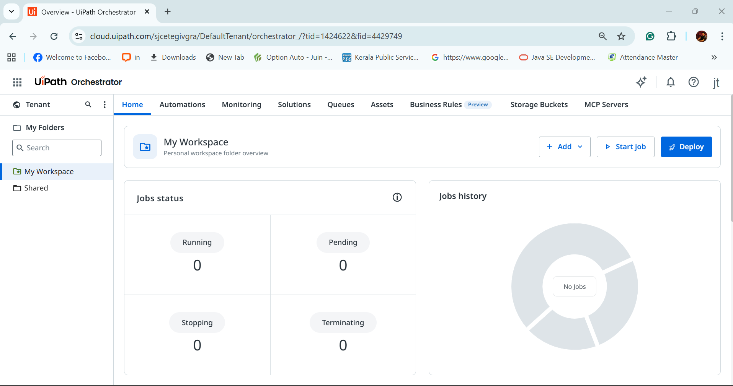
☁️ 3. UiPath Orchestrator (Control Layer)

Slide 14
UiPath Components Flow
UiPath Studio → UiPath Robot → UiPath Orchestrator
(Design) (Execute) (Manage)

Slide 15
🤖 Basics of UI Automation
UI Automation is the process of automating human-like interactions with software applications such as:
Web applications 🌐
Desktop software 🖥️
Legacy systems 📊
Most commonly implemented using tools like UiPath Studio.
🎯 What UI Automation Does
It simulates actions like:
✅ Clicking buttons ✅ Typing text ✅ Reading screen data ✅ Submitting forms
👉 Just like a human user — but faster and error-free.
⭐ Key Benefits
Works without APIs
Automates repetitive tasks
Reduces human error
Saves time and cost

Slide 16
UiPath Selectors
In UiPath, a selector is an XML fragment that uniquely identifies a UI element in an application (desktop, web, SAP, Citrix, etc.). It is the core mechanism behind reliable UI automation.
A selector is essentially a structured query over the UI Automation tree.

Slide 17
🧩 1. Basic Structure of a Selector A typical selector looks like:
<wnd app='notepad.exe' title='Untitled - Notepad'>
<ctrl name='Text Editor' role='editable text'/>
</wnd>
Key Concepts
<wnd> → Window node
<ctrl> → Child control
app → Process name
title → Window title
name → UI element label
role → Control type

Slide 18
A selector is an XML-based identifier used by UiPath to uniquely locate a UI element on the screen.
👉 Technically, it is a structured query over the UI Automation tree that tells UiPath:

Slide 19
Execution of attended automation workflows
What is Attended Automation?
Runs on the user’s machine
Requires an active login session
Triggered manually by the user
Designed to assist in real-time

Slide 20
🔄 Execution Flow (Step-by-Step)
1️⃣ Development
Workflow created in UiPath Studio
Published to Orchestrator or local machine
2️⃣ Deployment
Process made available to the user
Assigned via Orchestrator (optional)
3️⃣ Trigger Mechanism
Attended workflows can start via:
▶️ UiPath Assistant (manual click)
⌨️ Keyboard shortcut
🖱 Context menu trigger
📁 File-based trigger
🧩 Application event trigger
API call (advanced use case)

Slide 21
🔹 How It Is Executed
▶ Run from UiPath Studio (development/testing)
▶ Run from UiPath Assistant (production use)
⌨ Triggered via shortcut / event / user action

Slide 22
🔹 Execution Characteristics
Runs in foreground
Interacts directly with UI elements
Can request user input
Stops if user logs out

