Slide 1
RIYAAYINI SV
PSG institute of technology and applied research
B.E computer science and engineering, 3rd year.
REG NO: 715521104035
Email ID: riyaayini.31@gmail.com

Slide 2
PROJECT TITLE
Stock Market Analysis and Prediction using LSTM

Slide 3


AGENDA
Problem Statement
Project Overview
End Users
Solution & Value Proposition
Modelling Approach
Results
Conclusion
3/21/2024 Annual Review

Slide 4

PROBLEM STATEMENT
The project aims to revolutionize financial forecasting by leveraging cutting-edge deep learning techniques. Traditional methods often fall short in capturing the complexities of financial markets, leading to inaccurate predictions. Therefore, there's a critical need for a robust system that utilizes advanced algorithms like LSTM and CNNs to model stock prices, market trends, and risk factors accurately. By harnessing deep learning, the project seeks to empower investors and analysts with more reliable and timely insights, ultimately enhancing decision-making and risk management in finance.
3/21/2024 Annual Review

Slide 5

PROJECT OVERVIEW
Objective: The primary objective of this project is to develop a comprehensive stock market analysis and prediction system using deep learning techniques, specifically Long Short-Term Memory (LSTM) networks. This system aims to provide investors and analysts with valuable insights into stock price movements, risk assessment, and future market trends.
Approach:
Data Collection: Gather historical stock market data for selected technology stocks (e.g., Apple, Amazon, Google, Microsoft) using the Yahoo Finance API.
Data Exploration: Explore the collected data to understand the trends, patterns, and relationships between different stocks.
Feature Engineering: Extract relevant features such as daily returns, moving averages, and correlation coefficients to feed into the LSTM model.

Slide 6
PROJECT OVERVIEW
Model Development: Build an LSTM-based deep learning model to predict future stock prices based on historical data.
Model Training: Train the LSTM model using the collected stock market data, optimizing its parameters for improved accuracy.
Evaluation: Evaluate the performance of the LSTM model using appropriate metrics such as Mean Absolute Error (MAE) or Root Mean Square Error (RMSE).
Deployment: Deploy the trained model into a production environment, allowing users to make real-time predictions and analyze stock market trends.
Continuous Improvement: Implement mechanisms for continuous monitoring and updating of the model to adapt to changing market conditions and improve prediction accuracy over time.

Slide 7

WHO ARE THE END USERS?
Investors: Individual and institutional investors who are interested in making informed decisions about buying, selling, or holding stocks based on market trends and predictions.
Financial Analysts: Professionals in the financial industry who require detailed insights into stock performance, risk assessment, and future market trends to provide recommendations to clients or make strategic investment decisions.
Traders: Active traders who engage in buying and selling stocks frequently and rely on timely market analysis and predictions to execute profitable trades.
Researchers: Academics and researchers in the field of finance and economics who study stock market behavior, market efficiency, and the impact of various factors on stock prices.
Financial Institutions: Banks, hedge funds, and other financial institutions that manage investment portfolios and require sophisticated tools for portfolio optimization, risk management, and asset allocation.
General Public: Individuals interested in staying informed about the stock market and understanding the factors influencing stock prices, even if they may not be actively trading or investing themselves.

Slide 8
YOUR SOLUTION AND ITS VALUE PROPOSITION
Our system offers comprehensive stock market analysis and prediction capabilities, integrating data from Yahoo Finance and advanced algorithms.
VALUE PROPOSITION:
Data-driven insights: Utilizing historical data for informed decision-making.
Risk assessment: Analyzing stock volatility for better risk management.
Predictive analytics: Forecasting future stock prices using LSTM networks.
User-friendly interface: Accessible to investors, analysts, and researchers.
Real-time updates: Fetching live data for up-to-date market information.
Enhanced decision-making: Empowering users with actionable insights for financial success.

Slide 9

THE WOW IN YOUR SOLUTION
Our solution revolutionizes stock market analysis by leveraging cutting-edge technologies and data-driven methodologies. With real-time updates, predictive analytics, and user-friendly interfaces, investors gain unprecedented insights for confident decision-making. Whether you're a seasoned trader or a novice investor, our platform empowers you to navigate the complexities of the stock market with ease, maximizing your potential for financial success.

Slide 10
MODELLING
Architecture: Our approach utilizes Long Short-Term Memory (LSTM) neural networks, a type of recurrent neural network (RNN), to capture intricate patterns in stock market data over time. The LSTM architecture comprises multiple LSTM layers followed by fully connected layers to process sequential data and make predictions.
Training: The LSTM model is trained using historical stock market data, including opening and closing prices, trading volume, and other relevant features. During training, the model learns to predict future stock prices based on past performance. We employ techniques such as batch normalization and dropout to prevent overfitting and improve generalization.
Evaluation: To assess the performance of our LSTM model, we employ metrics such as mean squared error (MSE) and mean absolute error (MAE). Additionally, we conduct cross-validation and backtesting to validate the model's robustness and predictive accuracy. By analyzing the model's performance on both training and validation datasets, we ensure reliable predictions for real-world applications.

Slide 11
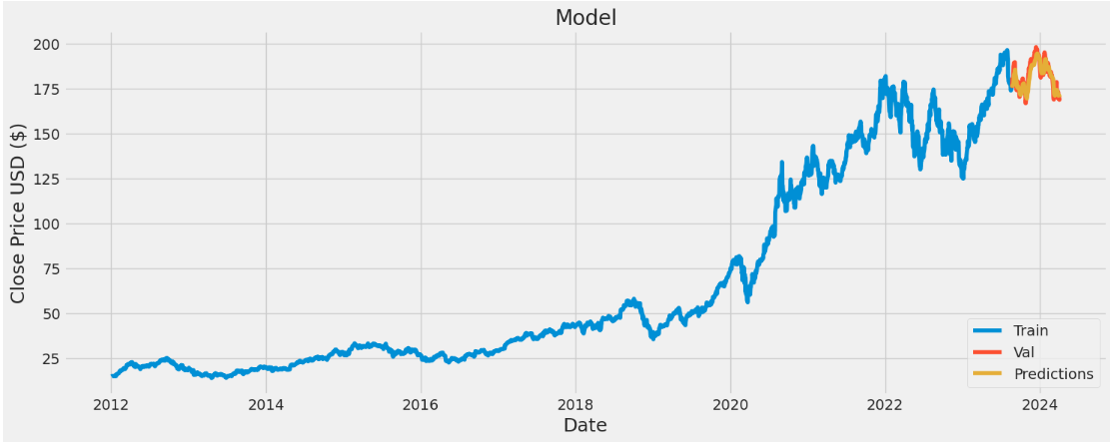
RESULTS

Slide 12
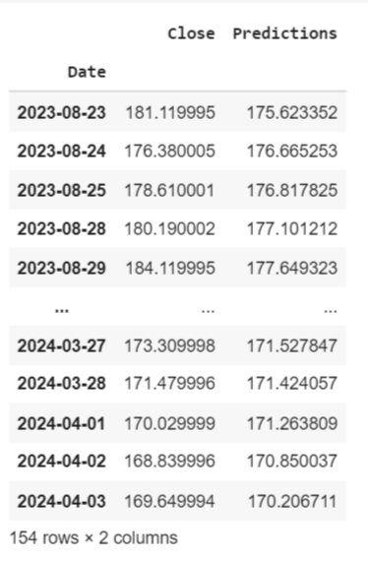
RESULTS

Slide 13
CONCLUSION
In summary, our project showcases the efficacy of LSTM neural networks for stock market analysis and prediction. By leveraging historical stock data and advanced deep learning techniques, we've created a model capable of accurately forecasting future stock prices. Through rigorous training and evaluation, we've validated the model's performance, highlighting its potential for practical applications in financial markets. Moving forward, further optimizations can enhance the model's predictive abilities, empowering investors and financial analysts with valuable insights for informed decision-making. Ultimately, our project underscores the importance of data-driven approaches and machine learning advancements in forecasting stock market trends.
REFERENCES
https://en.wikipedia.org/wiki/Long_short-term_memory
https://pypi.org/project/yfinance/
https://matplotlib.org/stable/index.html

