Slide 1
Name – Riya Kishor Bhanushali
College – Shah and anchor kutchhi engineering college
Subject – Data Science
Topic – Customer Segmentation

Slide 2
Problem Statement
Customer Segmentation is a popular application of unsupervised learning. Using
clustering, identify segments of customers to target the potential user base. They divide
customers into groups according to common characteristics like gender, age, interests,
and spending habits so they can market to each group effectively.
Use K-means clustering and also visualize the gender and age distributions. Then
analyze their annual incomes and spending scores.

Slide 3
What is customer segmentation?
Customer segmentation is the process of grouping customers together based on common characteristics.
Customer segmentation offers the technique to divide the customers into the groups so that they can be offered appropriate products and also the one can also identify the profitable group to target . The given dataset is totally business-to-consumer marketing , therefore the company segments according to the demographics that includes Age, Gender , Income ,etc. Customer segmentation helps to grow company in various aspects such as increased customer retention , price optimization , ability to expand , capitalized at right time and many more.
Here in these given scenario we are going segment the customers on the basis pf their annuals income and spending score .

Slide 4
Mall Customer Dataset
The given dataset consist of the basic information of the customers that visit the mall such as their age, gender , annual income and their spending score . The spending score is calculated from the amount of the money they have spend and given the score between 1 to 100 . The dataset consist of 200 rows and 5 columns . After analysing the dataset we came to the result that the annual income and the spending score are the main factors that can be used to segments the customers using the clustering K-Means algorithm.

Slide 5
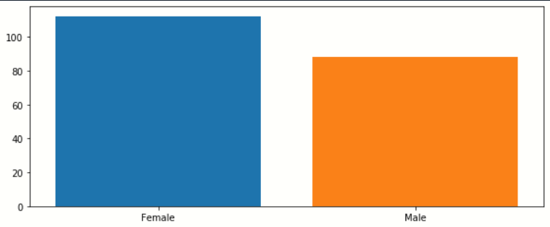
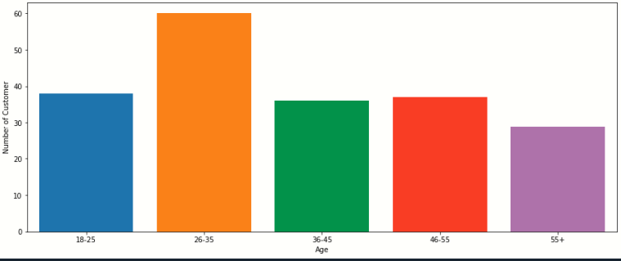
Data visualization
Data Visualization is the graphical representation of the provided data. By using charts, plots, graphs we can easily see the outliers and understand the patterns.
These is the bar plot of the gender . From these we can analyze
that the number of the female are more than male that visit to the
Mall.
These is the bar plot of the age . From these we can evaluate that the customers of the age group 26-35 visit most in the mall hence to maximize the profit we should target the customers from this age group.

Slide 6
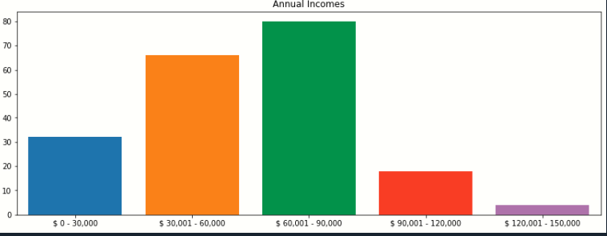
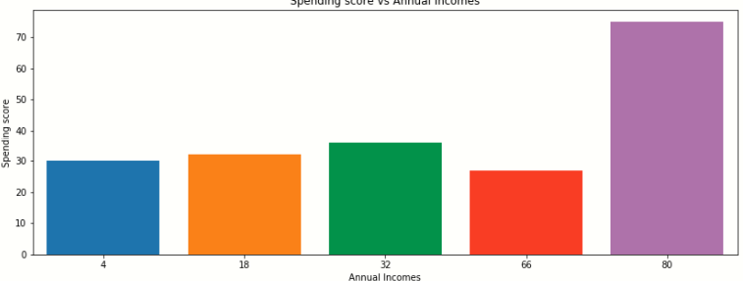
These is the plot of the annual income of the customers , from this we came to know that maximum customers have the income between 60,000 to 90,000$ .
It is the bar graph of the spending score vs annual income .
From these we conclude that the customer having the more income only has the more spending score . Hence , if we want to increase the sale at the mall we should mainly target this group of the people.

Slide 7
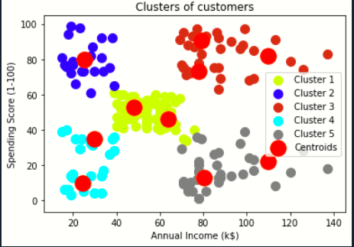
K-Means Clustering
Customer Segmentation is a popular application of unsupervised learning. Using K-means clustering we can identify the segments of customers based on their demographic, geographical, psychographics and behavioral data. K-means clustering can be used to compare customers annual income, spending income. There can be 5 clusters that can be drawn which are annual income high spending low ,vice versa and some which have annual and spending equal and some for annual and spending is high and for some annual and spending is low. Through which it will easier to target customers for their marketing business.

Slide 8
THANK YOU

