Slide 1

WebItAlL
By Riya Chhetri
Roll no. 7024

Slide 2

Name of the website Nav bar

Slide 3
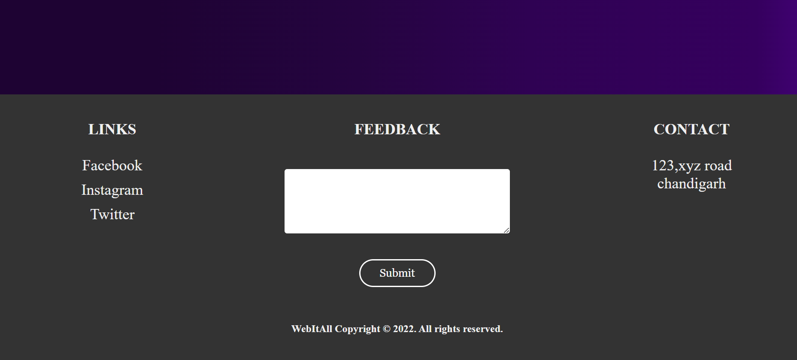
Footer which contains links, feedback area and contact

Slide 4
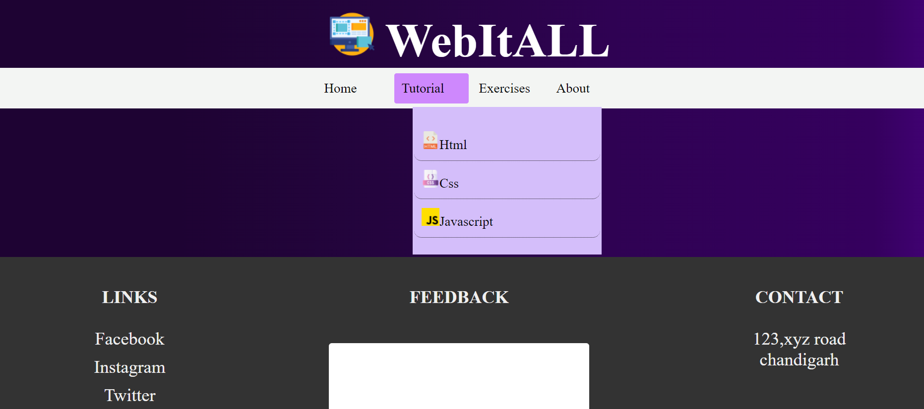
Drop down menu

Slide 5
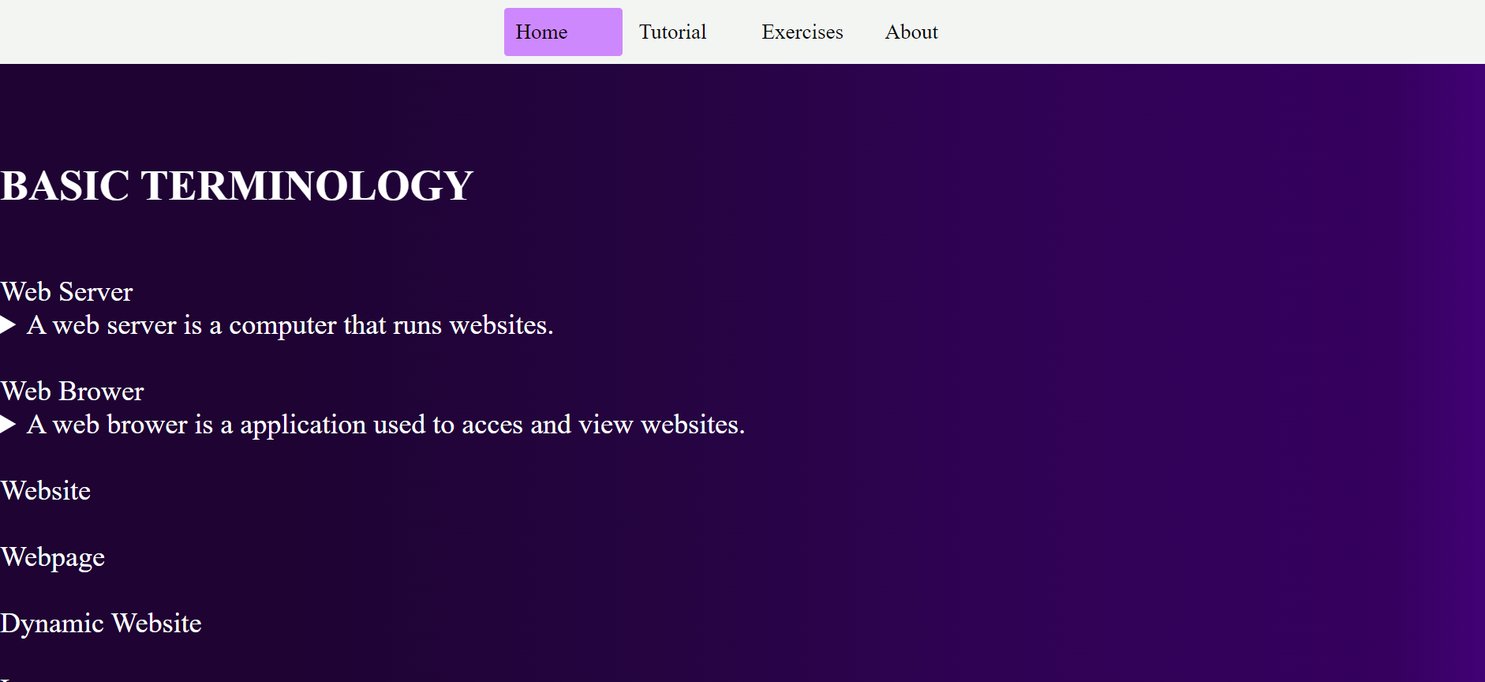
Next page after clicking html drop down menu

Slide 6
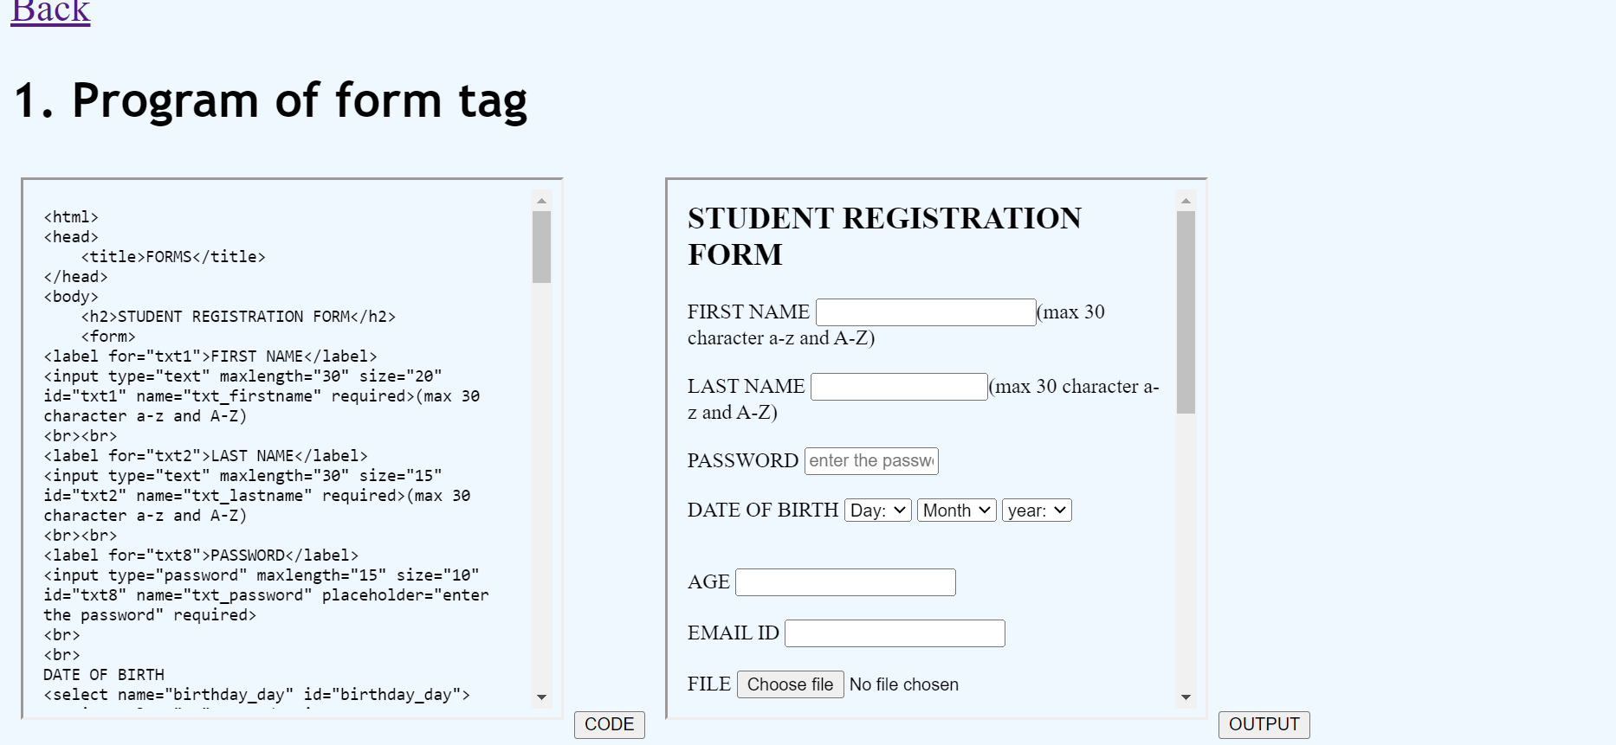
Next page after clicking exercise tab from nav bar

Slide 7

THANKS FOR WATCHING

