Slide 1
Telco Customer Churn Analysis
Analysis of Customer Behavior and Churn Patterns

Slide 2
Introduction and Objectives
The primary objective of this analysis is to identify key factors influencing customer churn in a telecom company, by analyzing demographic and behavioral patterns. The goal is to provide insights for targeted retention strategies.

Slide 3
Data Preparation and Cleaning
The dataset underwent preprocessing to handle missing values, impute key columns, and remove duplicates for accurate analysis.
Columns with missing values: 'Offer', 'Internet Type', 'Churn Category', and 'Churn Reason'. Duplicates removed to ensure data quality.

Slide 4
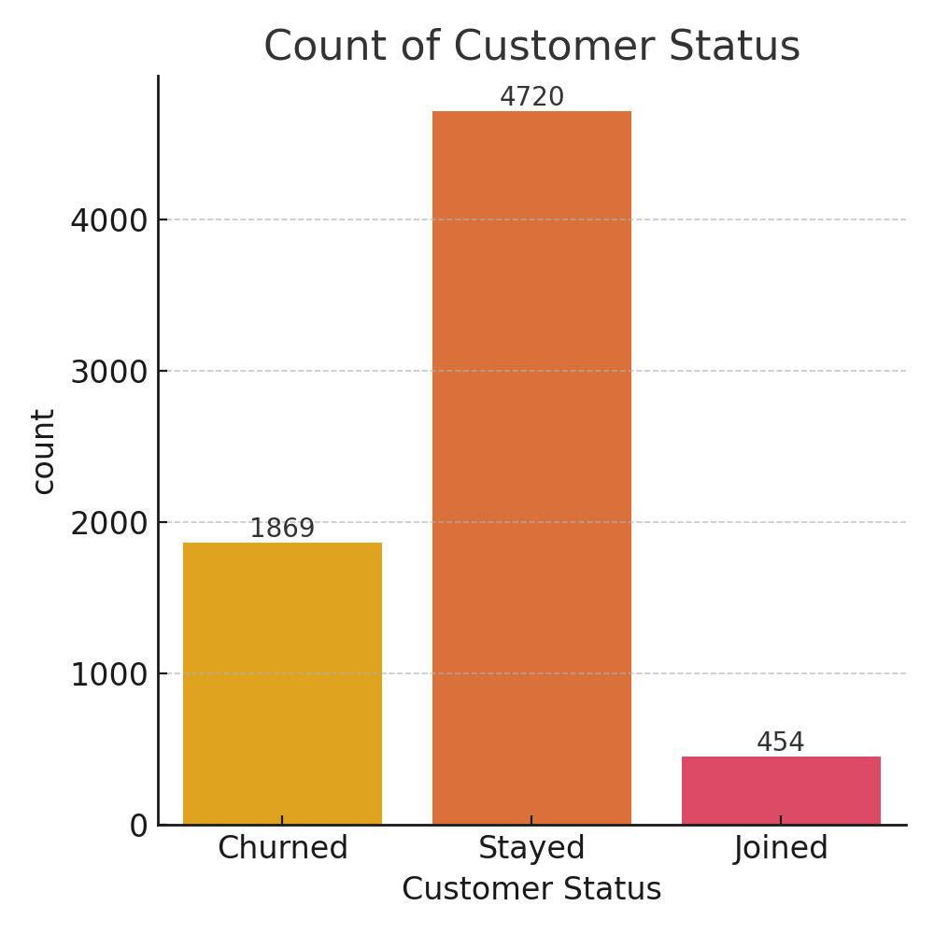
Customer Status Distribution
Majority of customers are active, with about 26.54% churned

Slide 5
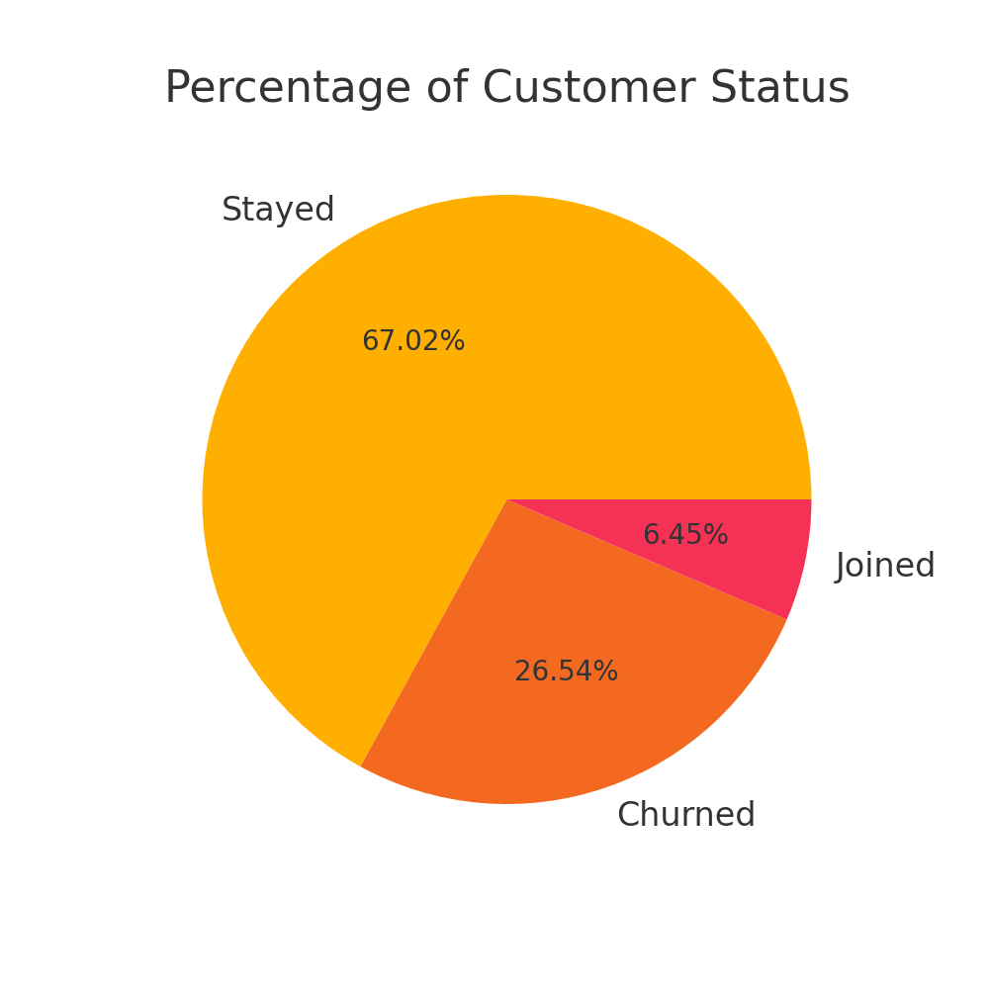
Customer Status Percentage
Active customers dominate, with churned customers representing about a quarter.

Slide 6
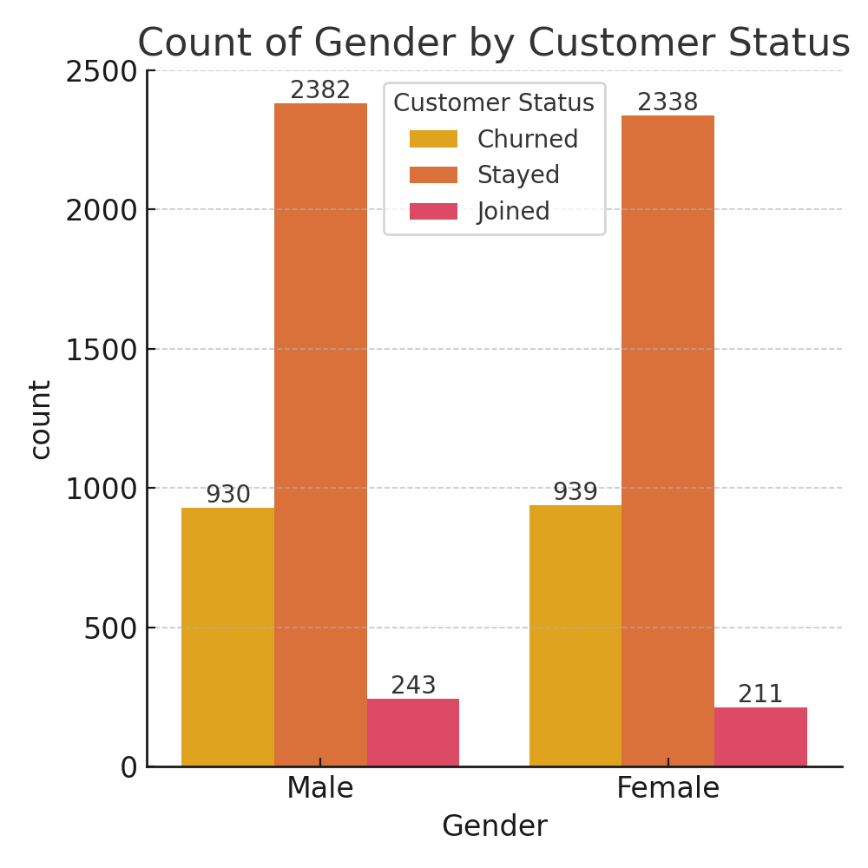
Gender and Churn
Churn rates are similar across male and female customers.

Slide 7
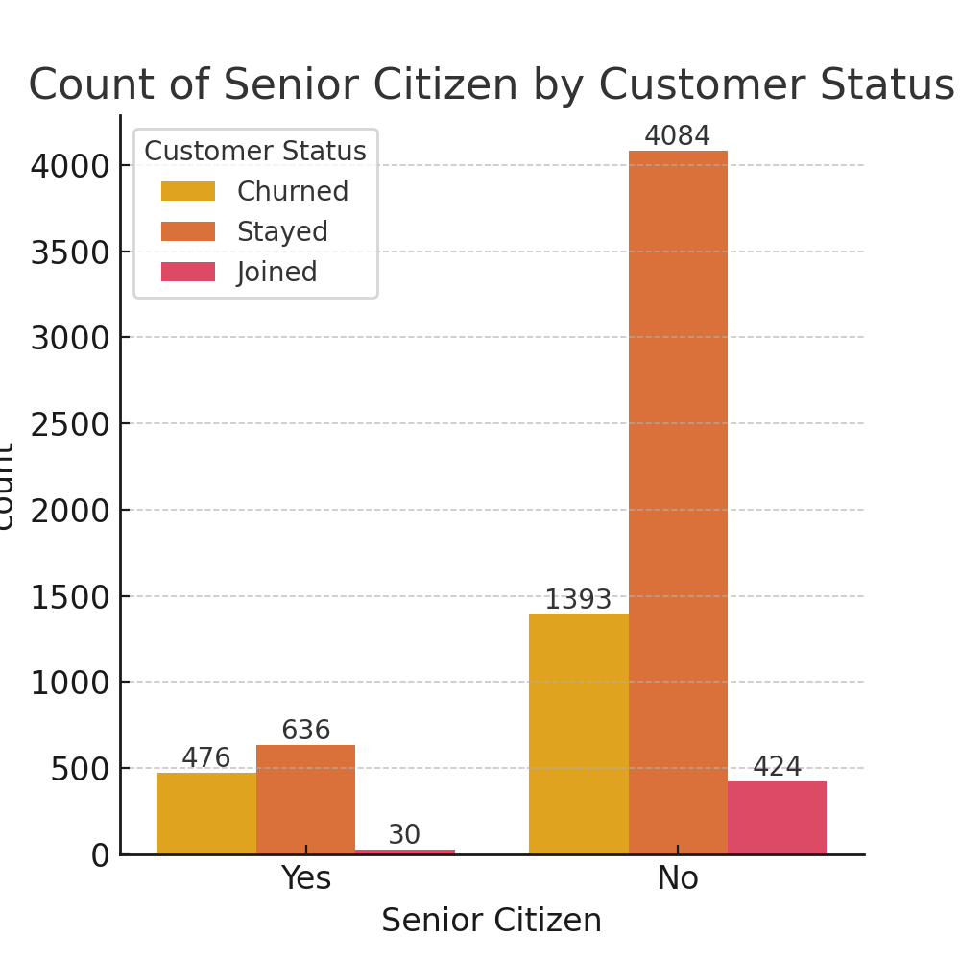
Senior Citizen and Churn
Senior citizens have a noticeably higher churn rate.

Slide 8
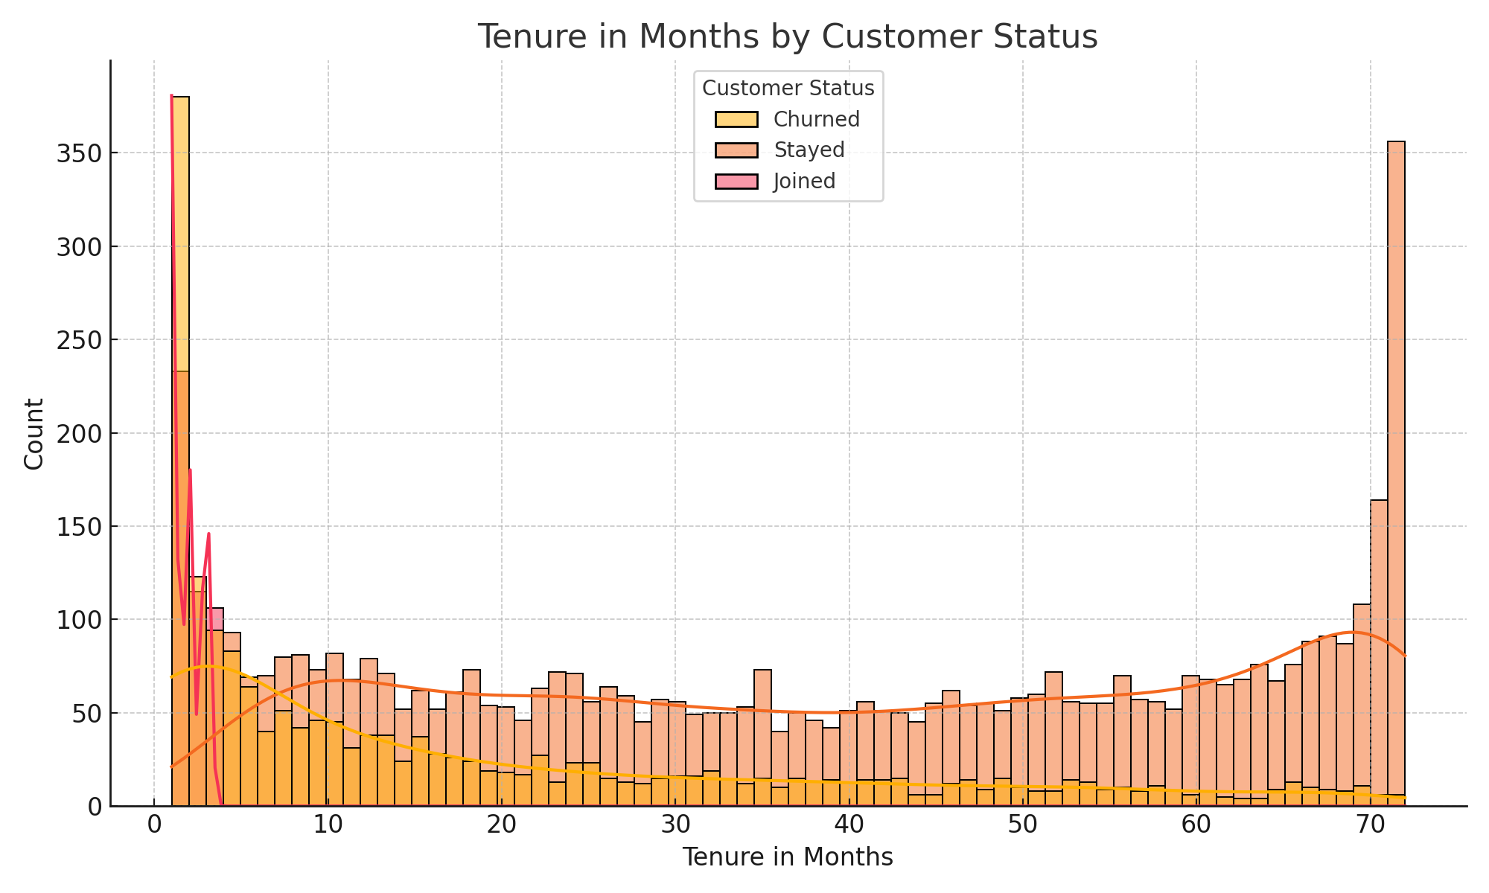
Tenure and Churn
Short-tenured customers churn more, while long-tenured customers tend to stay.

Slide 9
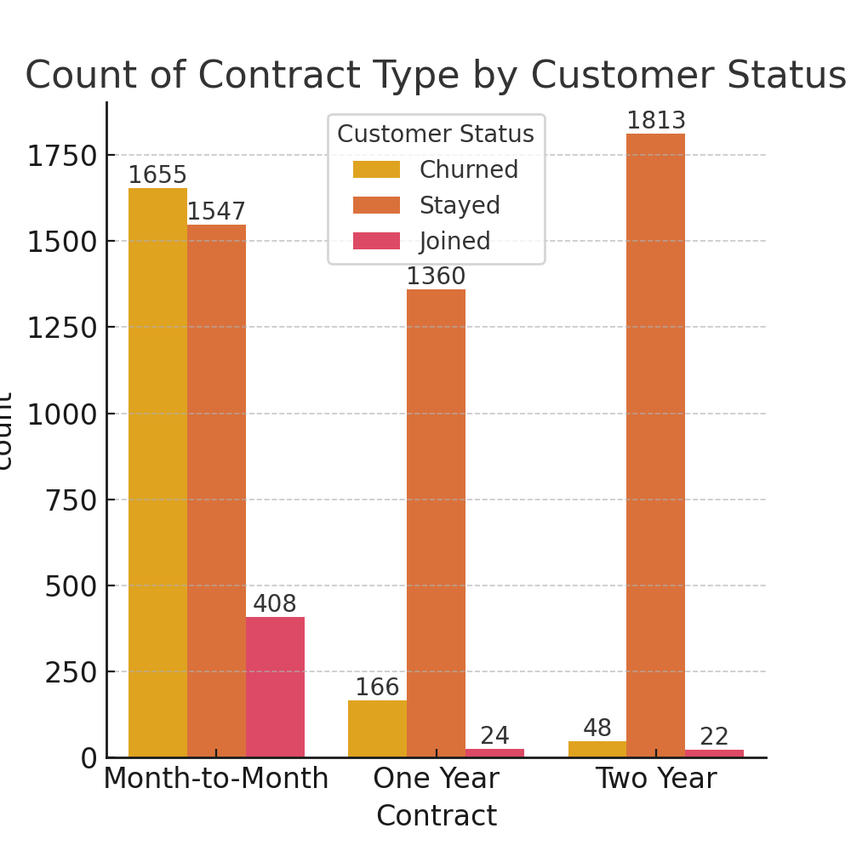
Contract Type and Churn
Month-to-month contracts have the highest churn rate; longer contracts reduce churn.

Slide 10
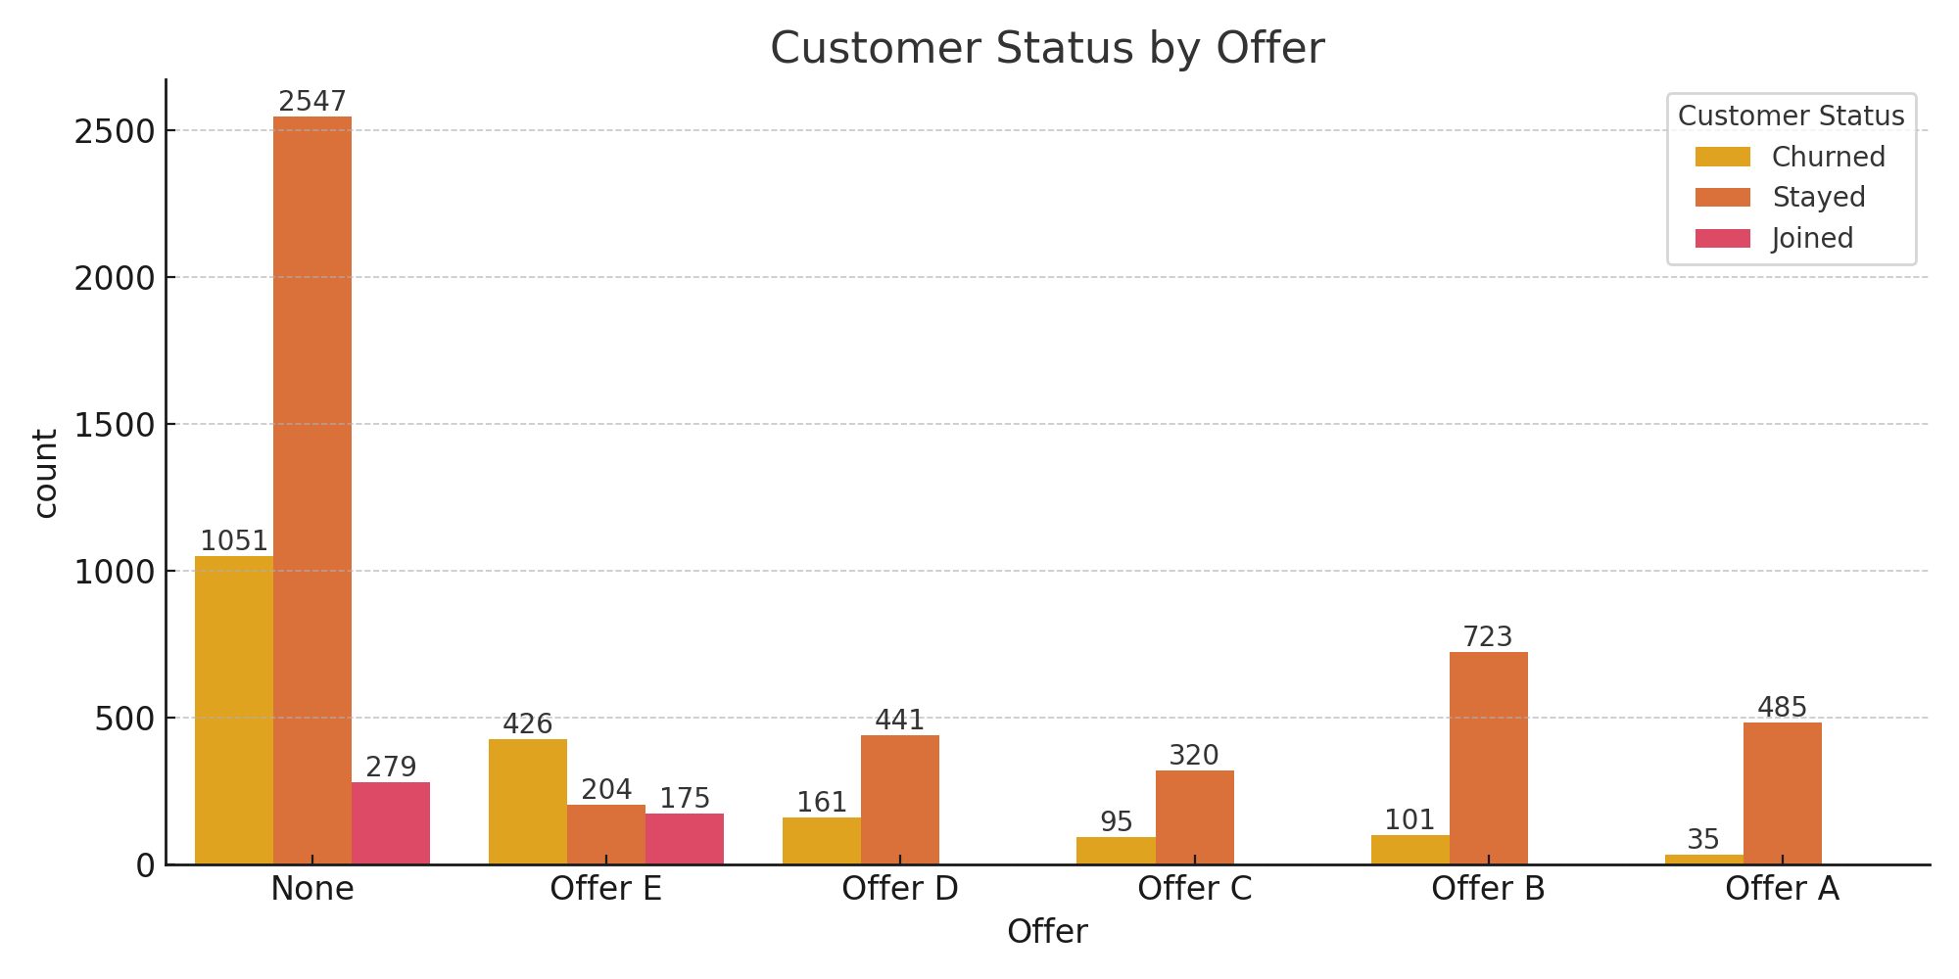
Offer and Churn
Customers on "Offer E" show a high churn rate compared to other offers.

Slide 11
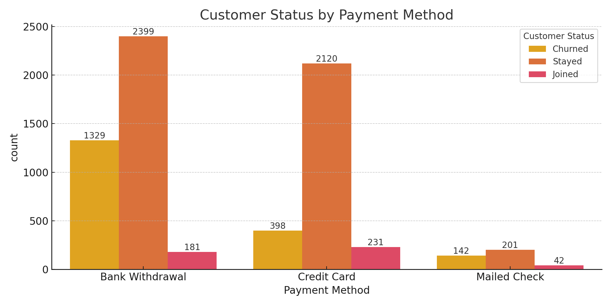
Payment Method and Churn
Customers paying via bank withdrawal have lower churn compared to other payment methods.

Slide 12
Key Insights and Recommendations
- Month-to-month contract customers exhibit higher churn rates; recommend focusing on promoting long-term contracts.
- Customers with short tenure are at high risk of churn; consider special offers to engage new customers.
- Add-on services like tech support and online security correlate with customer retention.
- Bank withdrawal payment method associates with lower churn rates; encourage this option.

Slide 13
Thank You
Thank you for reviewing the Telco Customer Churn Analysis presentation.

