Slide 1

Netflix 2023 Viewership Analysis
Netflix 2023 Viewership Analysis
Trends, Patterns, and Insights
Trends, Patterns, and Insights

Slide 2
Key Findings
Content Type Dominance:
Shows outperformed movies in viewership, highlighting Netflix's focus on serialized content for better audience engagement.
Language Preferences:
English-language content led viewership, followed by Korean, showcasing Netflix’s global appeal and diverse content strategy.
Monthly Viewership Trends:
Peaks in June and December align with holidays and vacations, driving higher engagement during these periods.
Seasonal Insights:
Fall recorded the highest viewership, while Winter, Spring, and Summer had relatively stable but lower hours.
Release Patterns by Weekday:
Fridays saw the most releases and highest viewership, indicating strategic scheduling to capture weekend audiences.
Holiday Impact:
Major holidays like New Year’s, Valentine’s, and Christmas boosted viewership through targeted, theme-based releases.

Slide 3
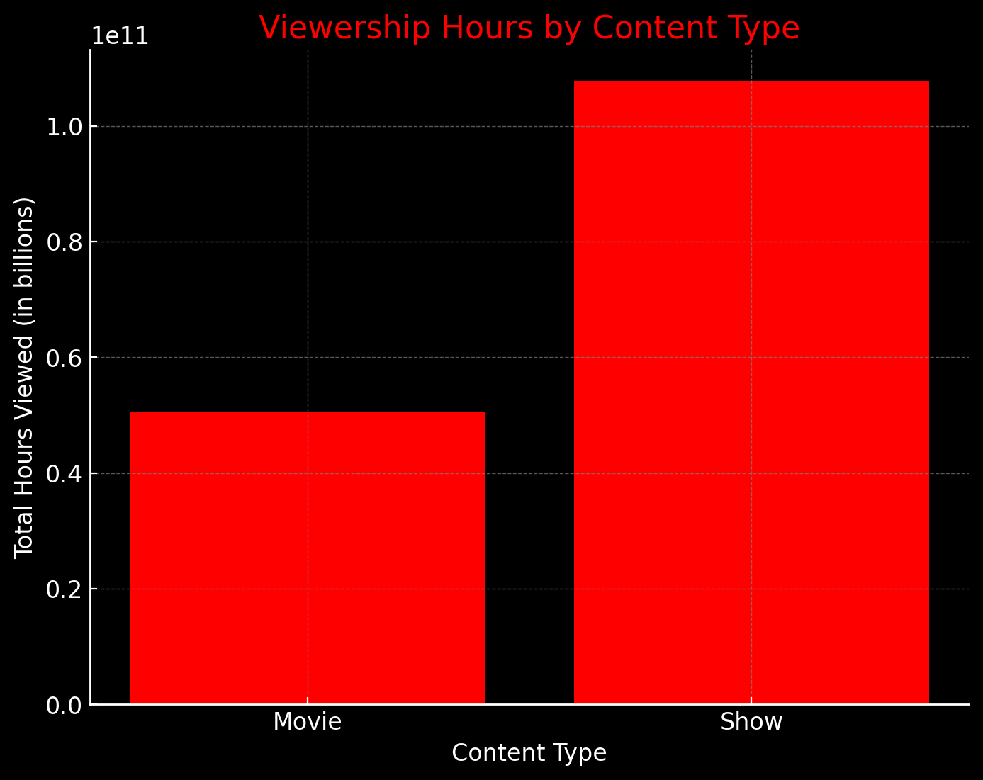
Total Viewership Hours by Content Type
Shows vs. Movies: Shows accounted for the majority of viewership hours, outperforming movies significantly. This suggests that audiences prefer long-form, episodic content that fosters binge-watching behavior and sustained engagement.
This suggests that Netflix’s content strategy leans heavily toward shows, as they tend to attract more watch hours overall.

Slide 4
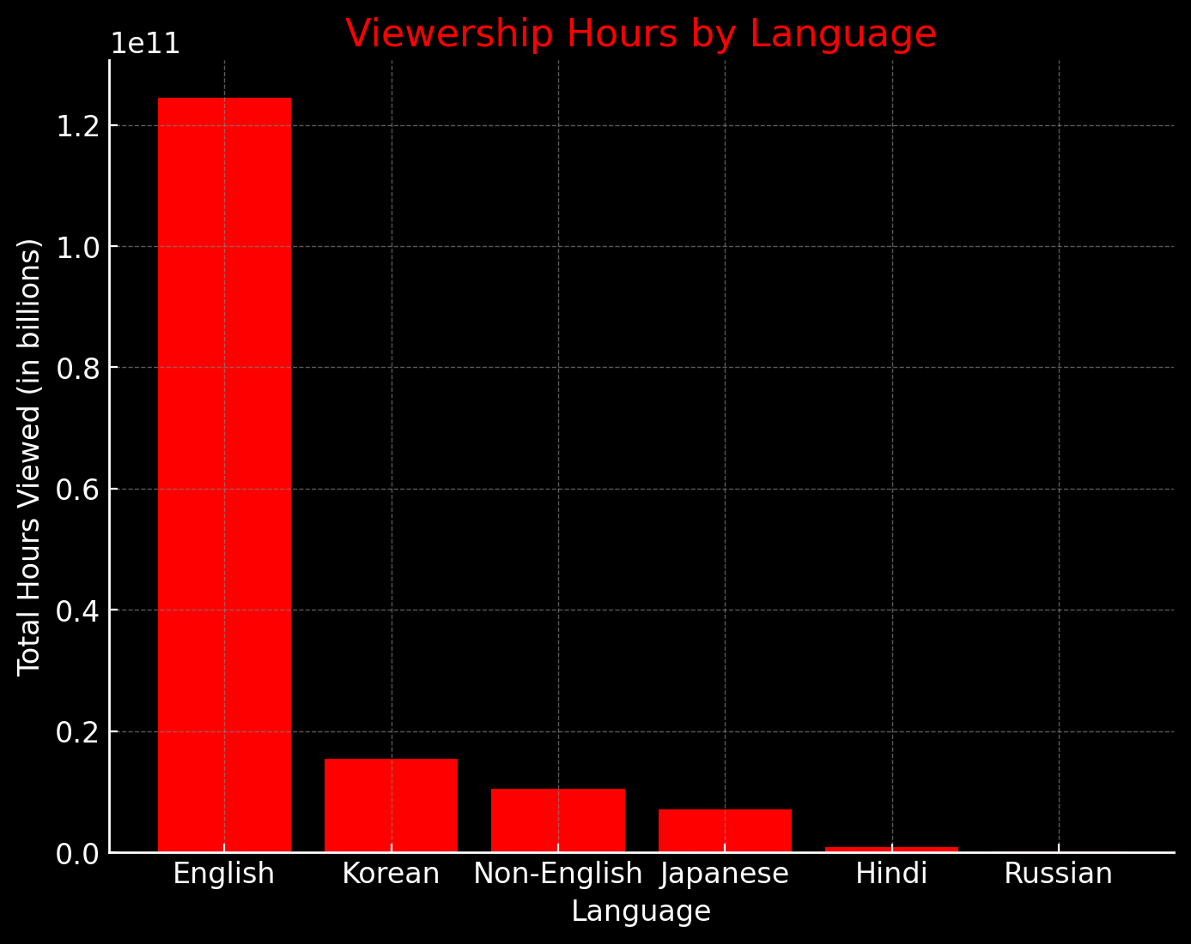
Total Viewership Hours by Language
Dominance of English Content: English-language content captured the largest share of viewership, reflecting Netflix’s strong foothold in English-speaking markets.
Growth of Korean Content: Korean shows and movies ranked second, indicating a growing international appeal of K-dramas and Korean films. This highlights Netflix’s success in diversifying its catalog and appealing to global audiences.
Opportunities for Non-English Content: While English and Korean content led, other languages also showed promising engagement, signaling an opportunity to expand regional content offerings to attract more diverse viewers.
Broaden investments in non-English content, especially Korean, Spanish, and Hindi, to attract and retain diverse audiences worldwide.

Slide 5
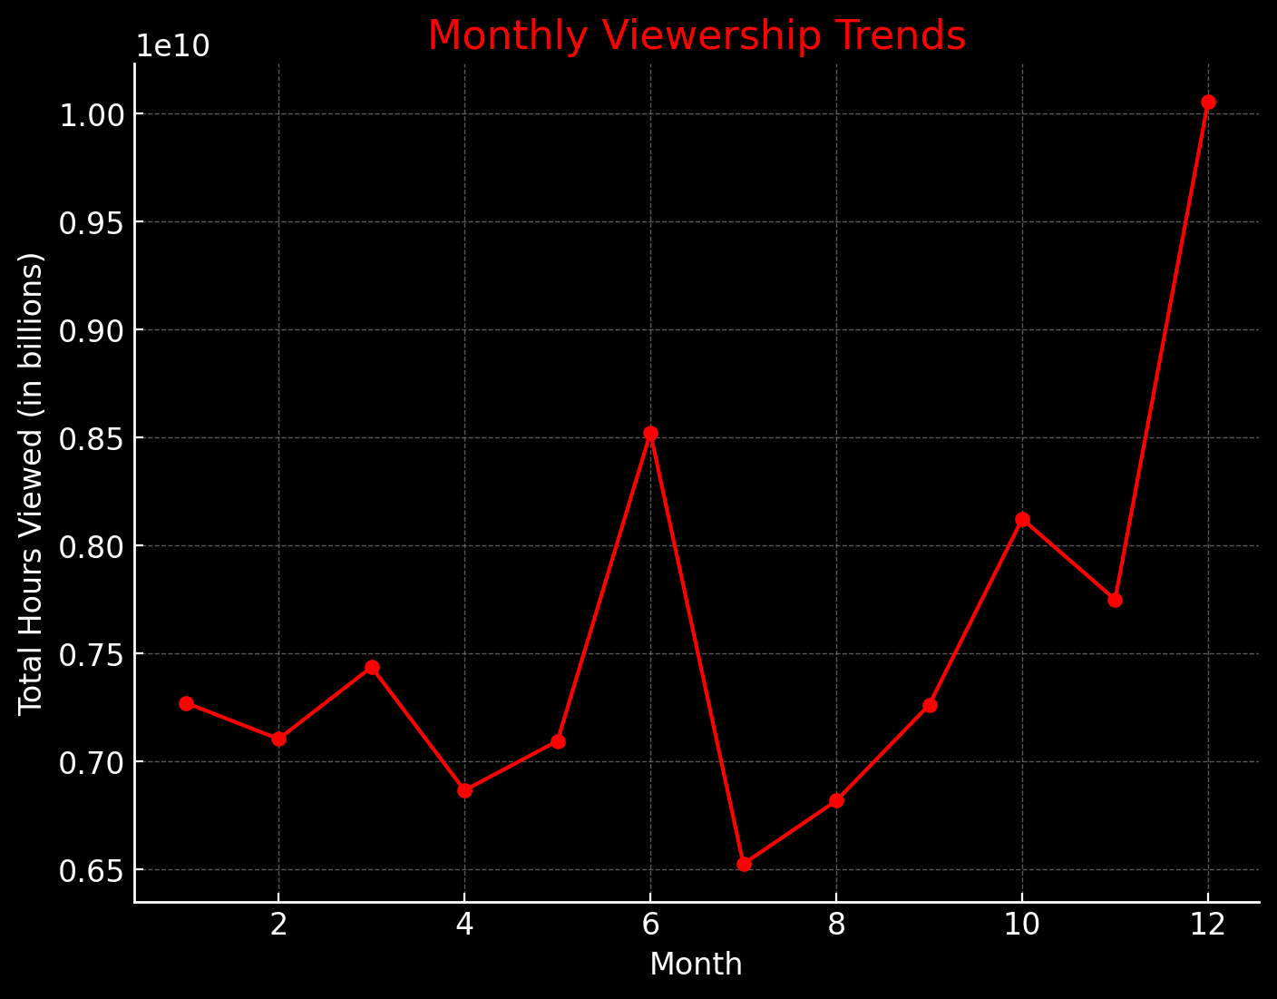
Total Viewership Hours by Release Month
Peak Months:
June and December experienced the highest viewership hours, suggesting a strong correlation with mid-year vacations and festive holidays at the end of the year.
These peaks may reflect Netflix’s strategy of releasing blockbuster titles during periods when audiences have more leisure time.
Content Launch Impact: Releases timed during these months showed a higher success rate, emphasizing the importance of aligning content launches with audience availability.
Netflix experiences spikes in audience engagement during these periods, possibly due to strategic content releases, seasonal trends, or holidays, while the middle months have a steady but lower viewership pattern.

Slide 6
Most successful content (both shows and movies)
The Night Agent: Season 1 (English, Show) with 812.1 million hours viewed.
Ginny & Georgia: Season 2 (English, Show) with 665.1 million hours viewed.
King the Land: Limited Series (Korean, Movie) with 630.2 million hours viewed.
The Glory: Season 1 (Korean, Show) with 622.8 million hours viewed.
ONE PIECE: Season 1 (English, Show) with 541.9 million hours viewed.
English-language shows dominate the top viewership spots. But, Korean content also has a notable presence in the top titles, which indicates its global popularity.

Slide 7
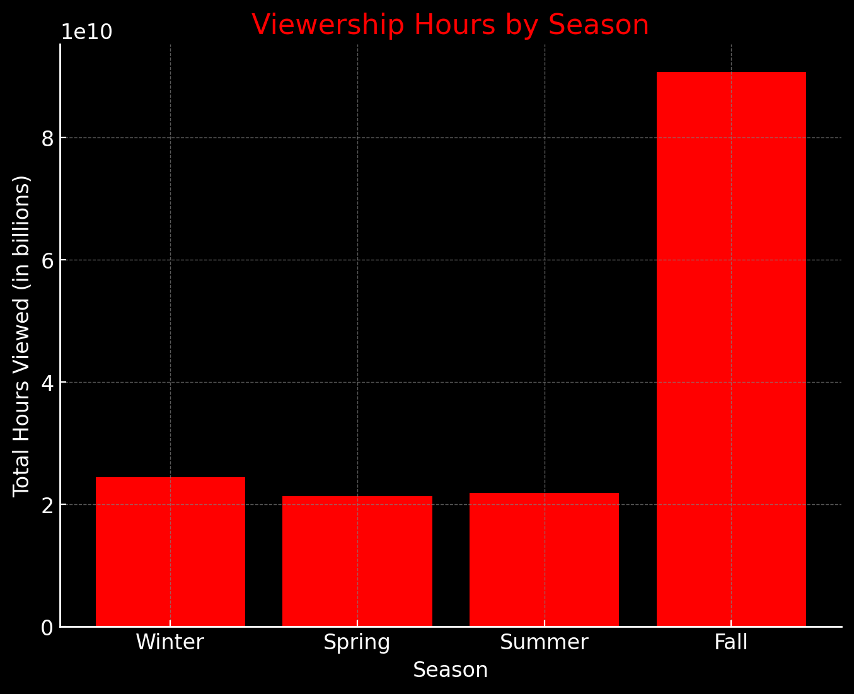
Total Viewership Hours by Release Season
Highest Seasonal Engagement in Fall: Viewership was highest during the Fall season, possibly due to a combination of new show releases, cooler weather driving indoor activities, and anticipation for holiday-related entertainment.
Stable Engagement in Other Seasons: Winter, Spring, and Summer maintained relatively stable engagement levels, suggesting a consistent baseline audience throughout the year.
Netflix experiences the highest audience engagement during the Fall.

Slide 8
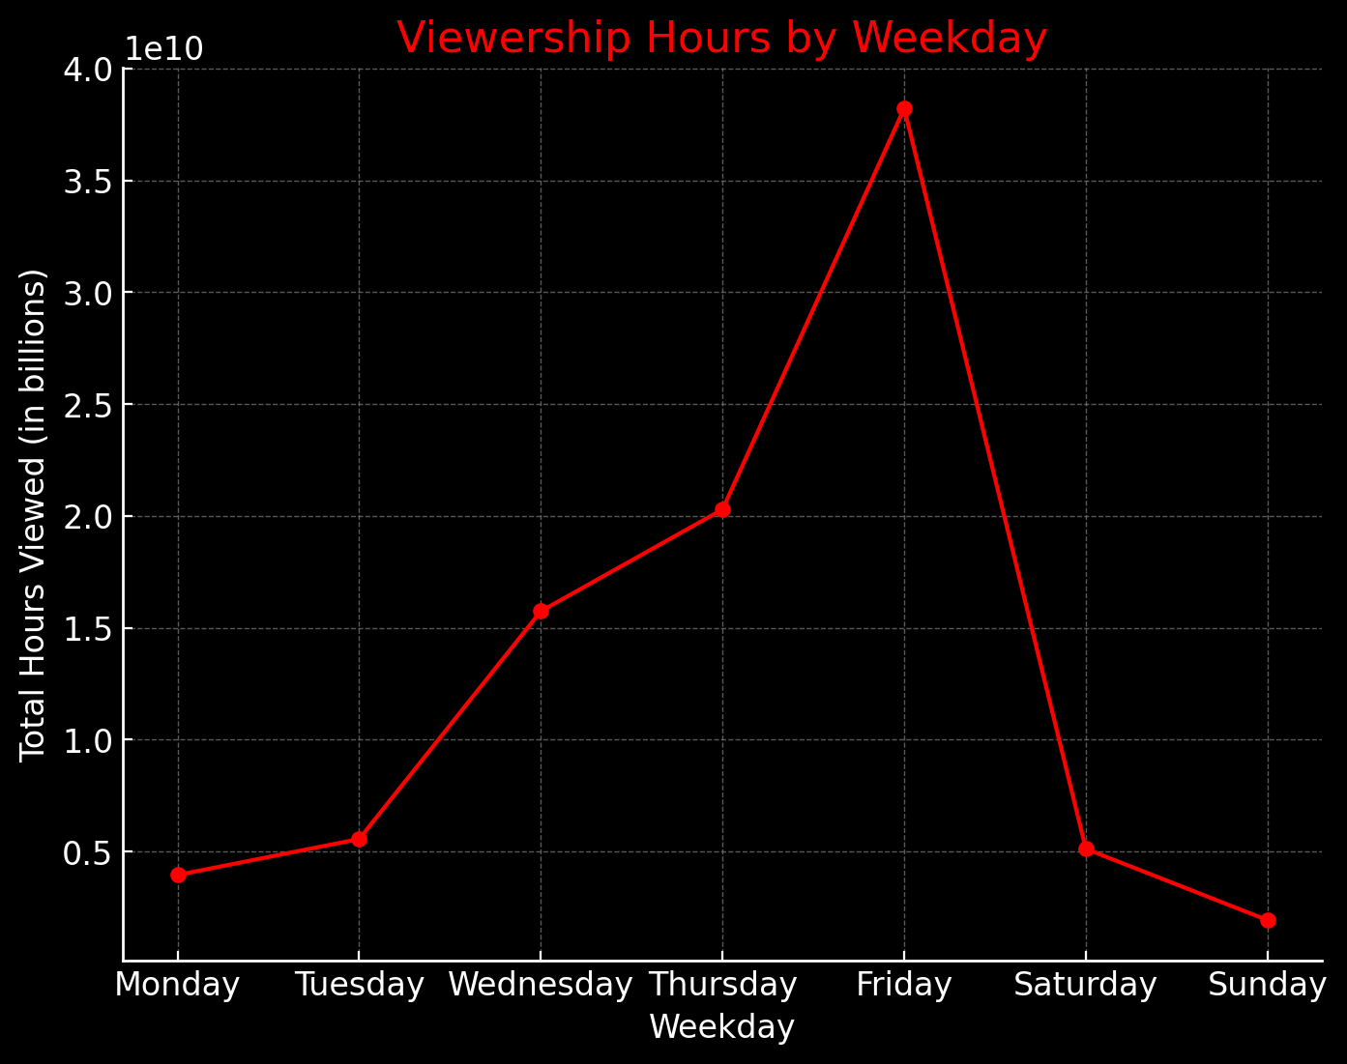
Weekly Release Patterns and Viewership Hours
Fridays Lead Content Releases and Viewership:
Fridays saw the most content releases and the highest viewership hours, suggesting Netflix strategically schedules releases closer to weekends to maximize audience reach.
Weekends generally sustained higher engagement, as viewers are more likely to binge-watch during leisure time.
Netflix strategically releases content toward the weekend to maximize audience engagement.

Slide 9
Recommendations
Expand Multilingual Content Offerings:
Broaden investments in non-English content, especially Korean, Spanish, and Hindi, to attract and retain diverse audiences worldwide.
Leverage Seasonal and Holiday Trends:
Continue to release flagship shows and blockbuster movies during high-viewership periods like holidays and year-end seasons to sustain engagement spikes.
Enhance Weekend Strategies:
Optimize content releases on Thursdays and Fridays to capture weekend binge-watching audiences.
Localized Marketing Campaigns:
Develop region-specific marketing strategies to promote content tailored to cultural preferences and seasonal viewing habits.
Invest in Analytics for Viewer Insights:
Use advanced data analytics to predict future trends and identify emerging genres and themes based on viewing behaviors.
Experiment with Limited Series and Miniseries:
Given the success of series like Kaleidoscope, focus on short, high-impact series that allow binge-watching while appealing to time-constrained viewers.

