Slide 1
Sales Analysis for 2019
Comprehensive Report with Key Insights and Visualizations

Slide 2
Introduction
This analysis investigates sales trends from 2019, covering:
- Monthly sales performance
- Best-performing cities
- Optimal advertising times
- Product insights and bundling opportunities
The goal is to enable data-driven decision-making for business growth.

Slide 3
Key Questions Addressed
1. What was the best month for sales?
2. Which city had the highest sales?
3. What time should advertisements be displayed?
4. Which products are most often sold together?
5. What product sold the most, and why?

Slide 4
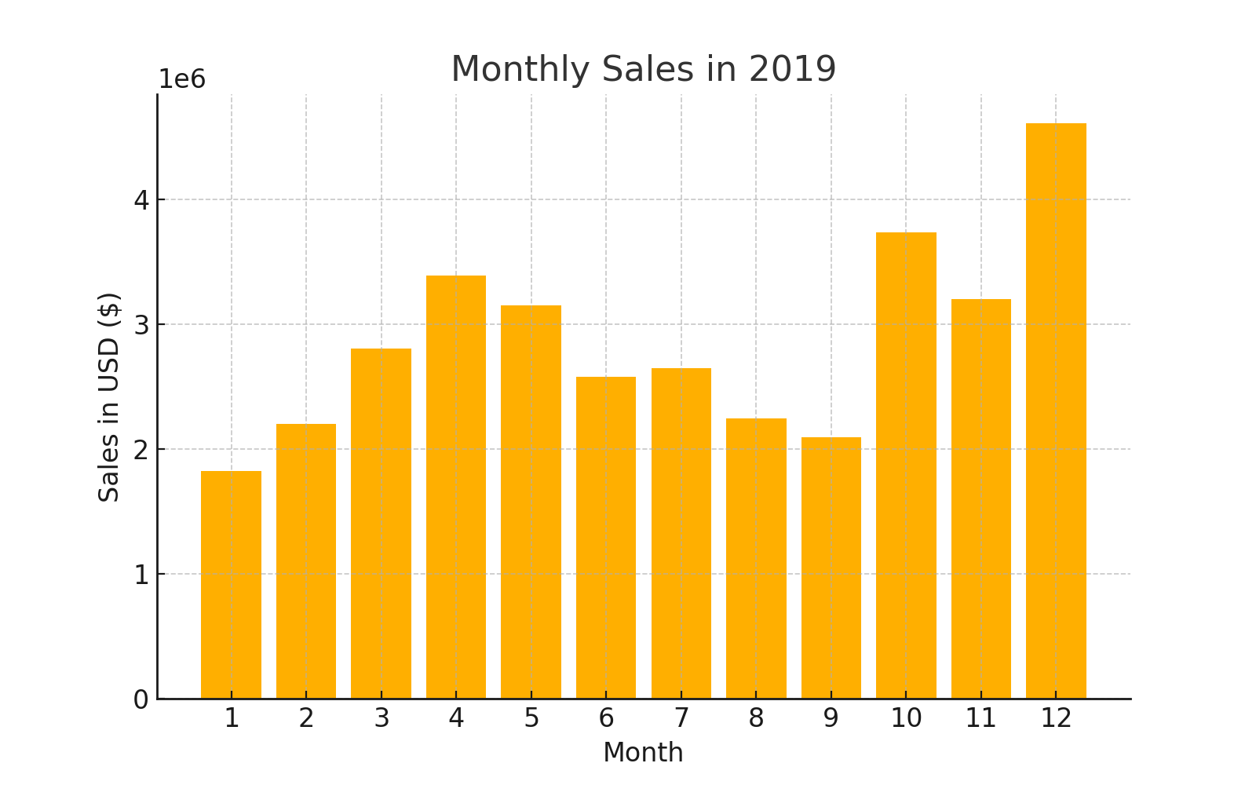
Best Month for Sales
December was the best month for sales, generating the highest revenue due to holiday shopping.

Slide 5
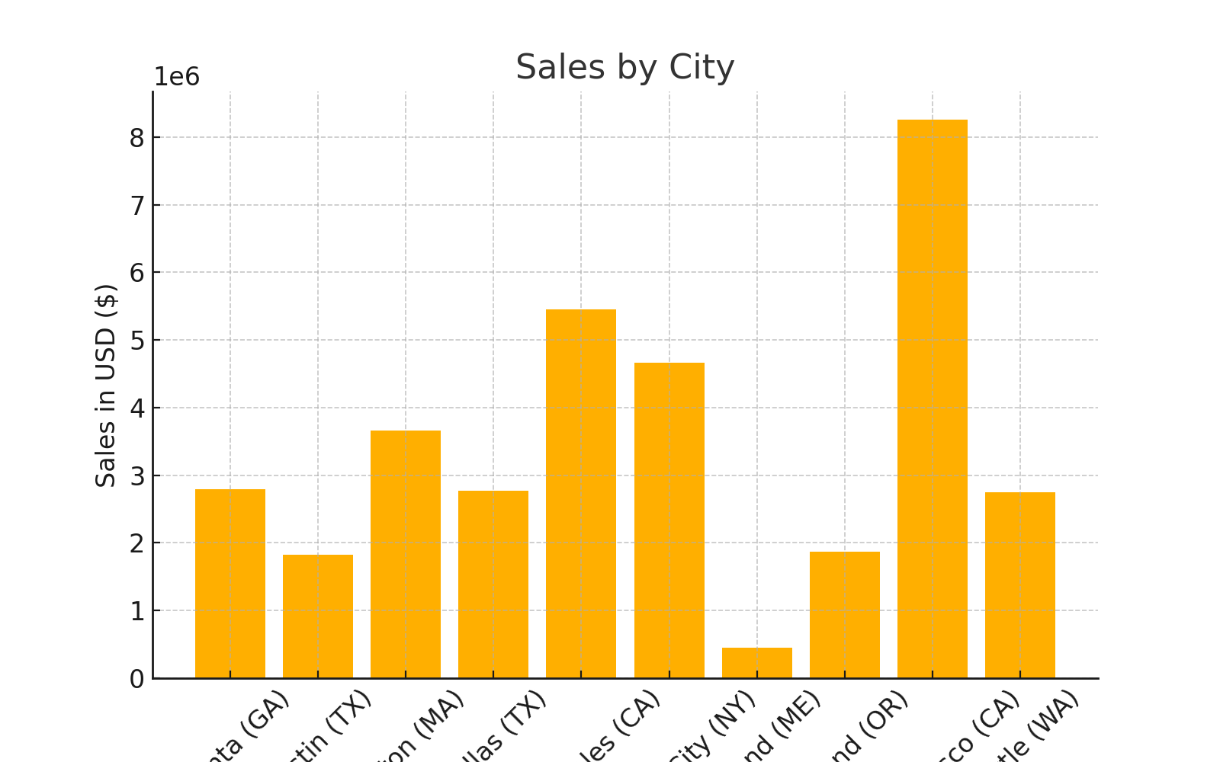
City with the Highest Sales
San Francisco (CA) had the highest sales, driven by high population and purchasing power.

Slide 6
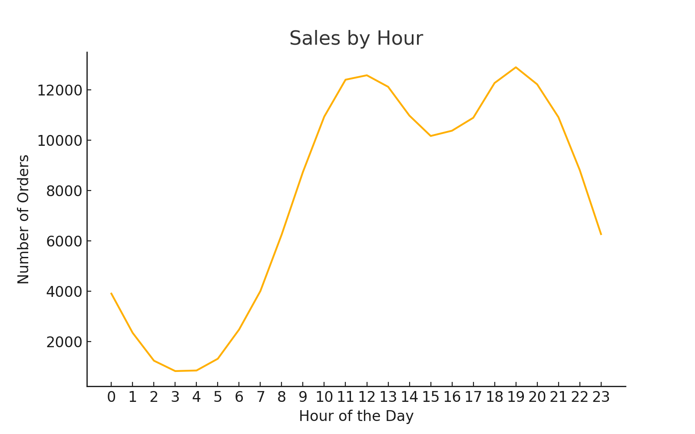
Optimal Advertising Times
Advertising at 11:00 AM and 7:00 PM maximizes sales due to peak customer activity.

Slide 7
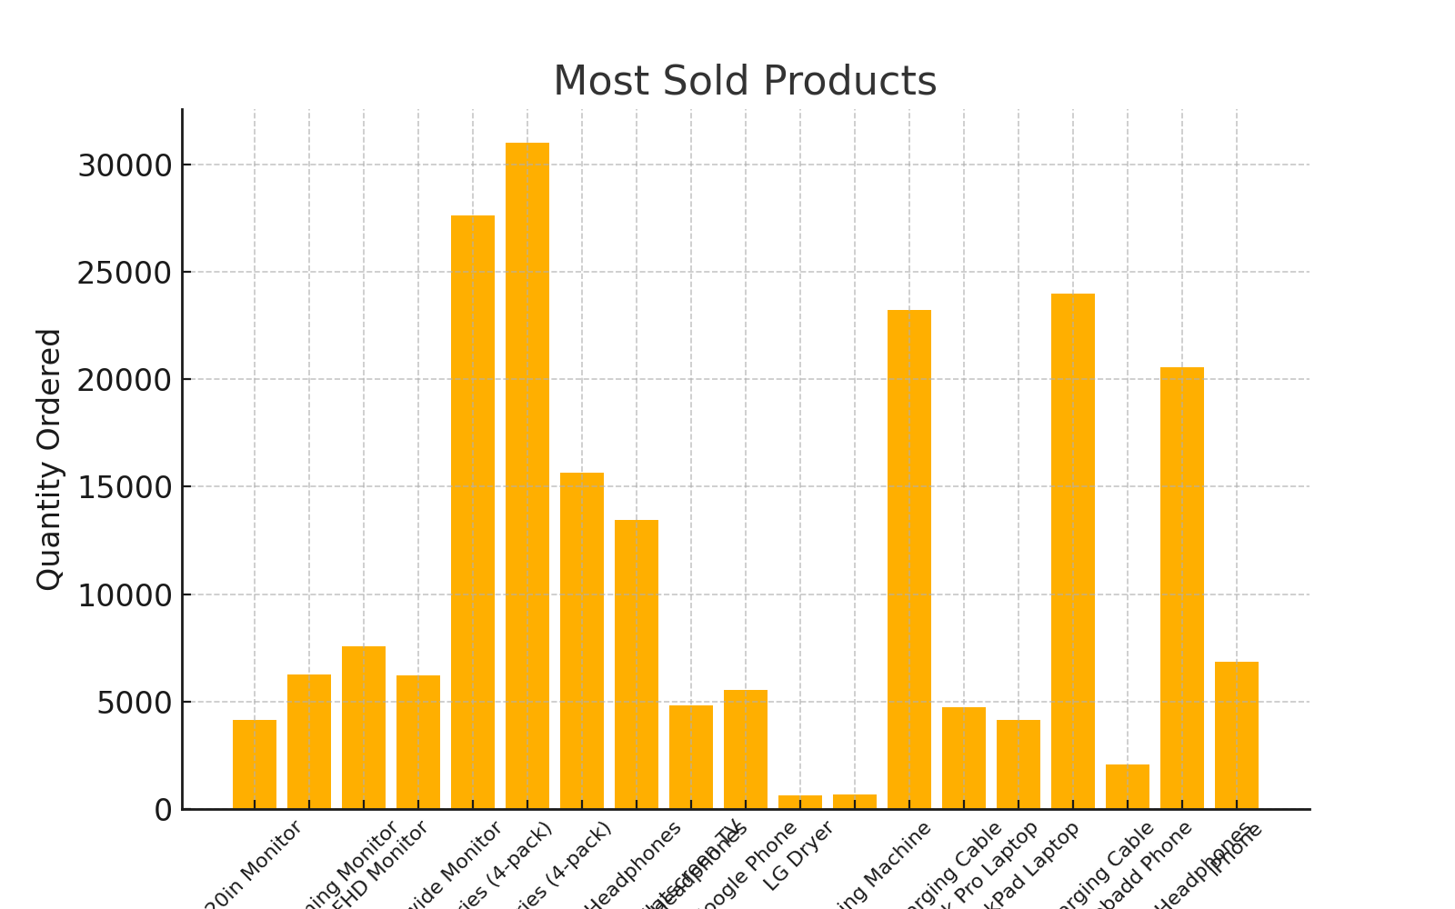
Most Sold Products
AAA Batteries (4-pack) sold the most units due to affordability and high utility.

Slide 8
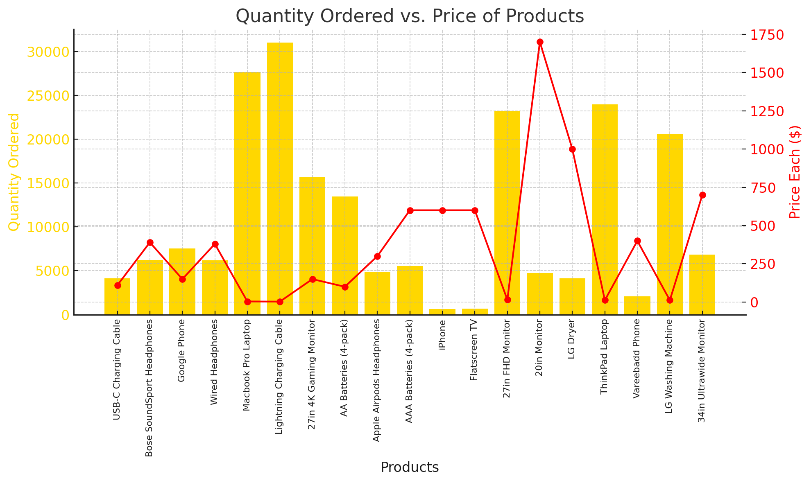
Product Performance: Quantity vs. Price
Higher quantities are sold for lower-priced products, highlighting affordability's impact on sales volume.

Slide 9
Conclusion
Business Impact
Strategic Planning:
Identify peak months and allocate resources accordingly to maximize revenue.
Advertising Strategy:
Schedule campaigns during high-traffic hours for better ROI.
Product Bundling:
Leverage insights on frequently purchased product combinations to create promotional bundles.
Stock Management:
Ensure sufficient inventory of high-demand products like AAA Batteries (4-pack).

