Slide 1
Steppable-Surface Segmentation in Simulated Staircase Point Clouds
A Comparison of RANSAC, PCA Normal Analysis, DBSCAN, and Height-Histogram Methods
Riyadh Lakadimu
Master Program in Electrical Engineering - Politeknik Elektronika Negeri Surabaya (PENS)
Course: Sensor and Signal Processing Systems (Final Project)

Slide 2
Background & Objectives
Introduction
• Stair-climbing/following robots and assistive devices need reliable 3D perception.
• Must separate steppable surfaces (tread) from vertical faces (riser) and noise.
– Mislabeling a riser as steppable -> foothold onto a vertical face -> fall hazard.
• Deep-learning methods need large labeled data and lack interpretability.
– No controlled benchmark with exact ground-truth labels for this sub-problem.
Objectives:
– Generate a labeled 4-step staircase point cloud from a mathematical model.
– Implement and compare four classical geometric methods.
– Quantitative evaluation + noise analysis + robot-safety discussion.

Slide 3
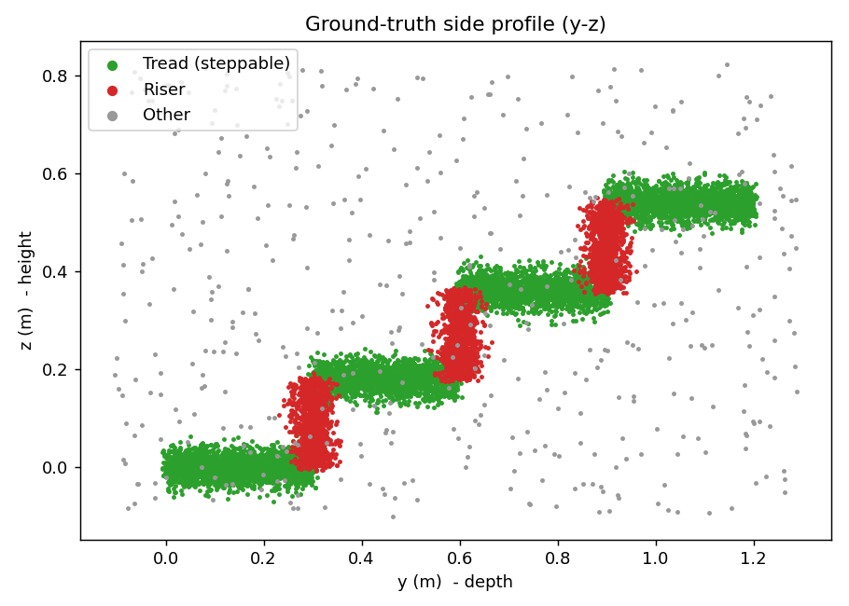
Point Cloud Data Generation
Mathematical 4-step model
• Parameters: width w=2.5 m, depth d=0.30 m, height h=0.18 m, N=4 steps.
Tread (i=0..3):
– x~U(0,w), y~U(i·d,(i+1)·d), z=i·h+εz, εz~N(0,0.02²)
Riser (i=1..3):
– x~U(0,w), y=i·d+εy, z~U((i-1)·h, i·h)
• + ~4% random outliers and LiDAR jitter N(0,0.005²).
Total 18,333 points (12,800 tread / 4,800 riser / 733 other).
Side profile (y-z): green=tread, red=riser, grey=other

Slide 4
Four Segmentation Methods
Three-class scheme: tread / riser / other
1. RANSAC Plane Fitting (orientation-gated)
– Horizontal phase -> tread, vertical phase -> riser; rejects the oblique 'ramp' plane.
2. PCA Normal Analysis
– Per-point normals via PCA over k-NN; classified by tilt |n·z|.
3. DBSCAN + Slope Analysis
– Orientation split -> spatial clustering -> per-cluster slope confirmation.
4. Height-Histogram Analysis (advanced)
– Peaks of the z-histogram = tread levels; bands between = riser.
Minimum 2 methods required -> 4 implemented for a thorough comparison.

Slide 5
Methodology & Algorithms
Core formulas
RANSAC: point-to-plane distance
– d(x)=|n·x+b|, inliers I={x: d(x)<τ}, τ=0.035 m
– Orientation gate: horizontal |n·z|≥0.93 (tread), vertical ≤0.25 (riser).
PCA Normal: local k-NN covariance (k=50)
– C_p=(1/k)Σ(x_j-x̄)(x_j-x̄)ᵀ, n_p=eigvec_min(C_p)
– Tread |n·z|≥0.80, riser ≤0.50 (looser: per-point normals are noisier).
DBSCAN: ε=0.08 m within each orientation group, then slope confirmation.
• Global stair 'ramp' plane: |n·z|=d/√(d²+h²)≈0.86 -> motivates the orientation gate.

Slide 6
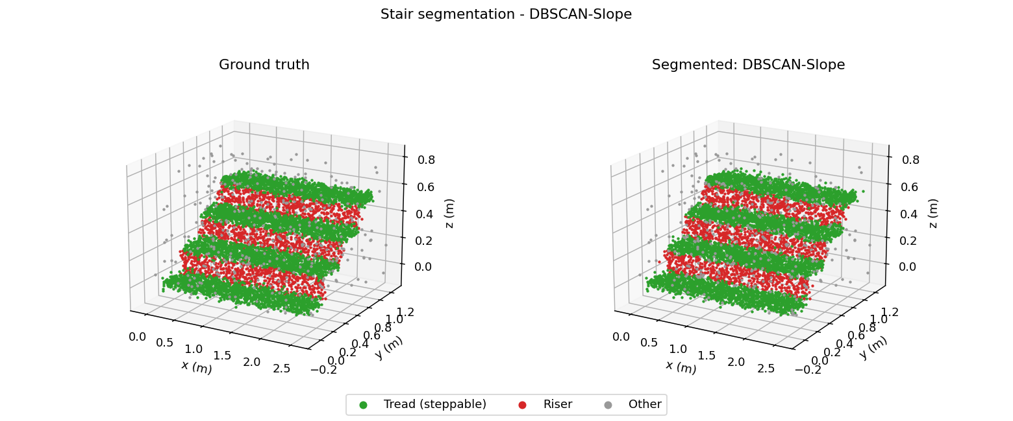
Experimental Results
Tread-class metrics (one-vs-rest)
Method | Acc | Prec | Rec | F1 | IoU
RANSAC | 0.681 | 0.714 | 0.904 | 0.798 | 0.664
PCA-Normals | 0.901 | 0.954 | 0.901 | 0.927 | 0.864
DBSCAN-Slope | 0.920 | 0.936 | 0.949 | 0.943 | 0.892
Height-Histogram | 0.827 | 0.809 | 0.984 | 0.888 | 0.799
DBSCAN 3D segmentation vs ground truth
DBSCAN-Slope is best: F1 0.943, IoU 0.892.
• PCA-Normals close behind: F1 0.927, highest precision 0.954.
• Height-Histogram: highest recall 0.984, lower precision.
• Plain RANSAC weakest: precision 0.714 (risers absorbed by tread planes).

Slide 7
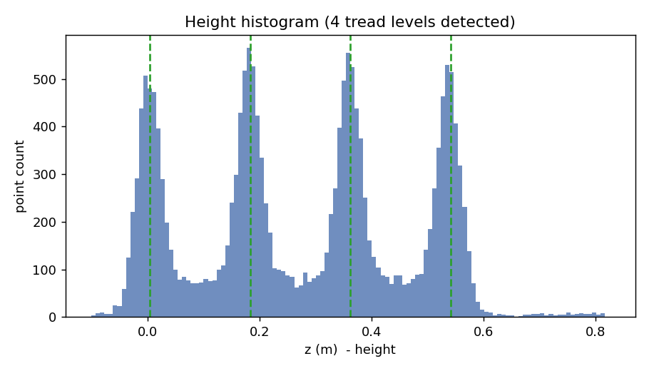
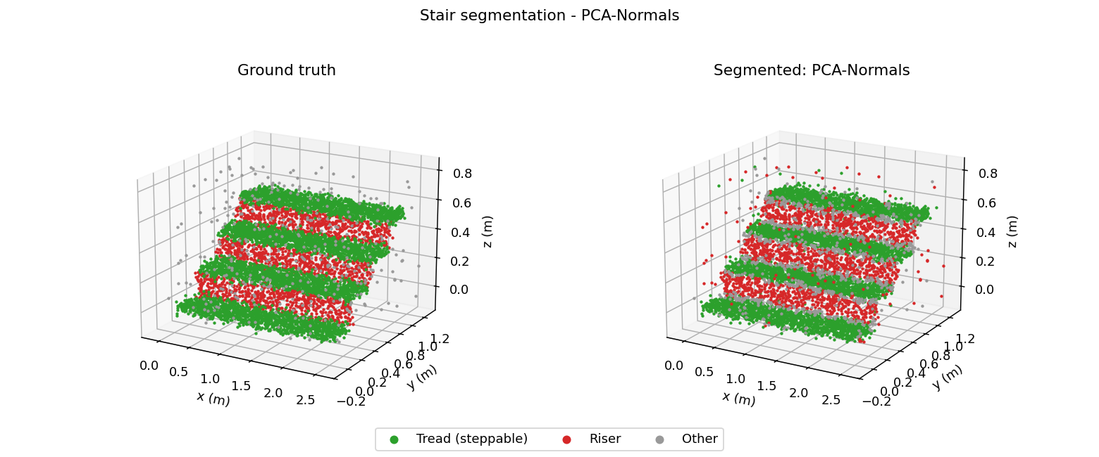
3D Visualization & Histogram
Experimental results
PCA-Normals 3D segmentation (left GT, right result)
• Each tread forms a sharp z-level; risers fill the bands between levels.
• Green=tread, red=riser, grey=other/outlier.
Height histogram: 4 tread levels detected (z≈0,0.18,0.36,0.54 m)

Slide 8
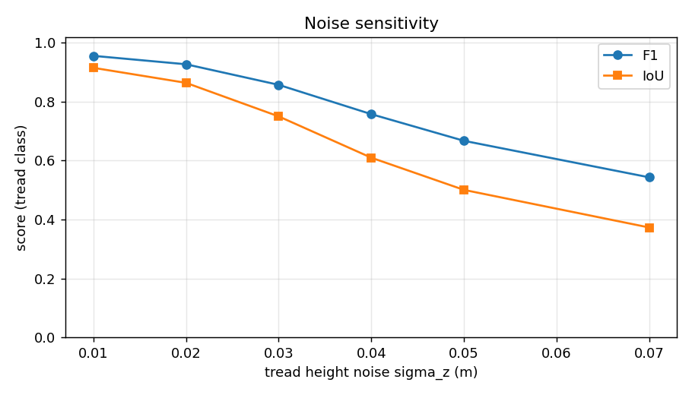
Noise Analysis & Robot Safety
Discussion
Effect of noise:
– F1 drops 0.956 -> 0.543 as σz 0.01 -> 0.07 m.
– Sharp fall as σz approaches ½ step height (0.09 m): normals become ambiguous.
Safety for stair-following robots:
– IoU≈0.89 is adequate for coarse foothold planning.
– Precision <1.0 -> some risers mislabeled steppable = hazard.
– Mitigation: ensemble voting, tread-edge erosion margin, temporal verification.
Tread F1/IoU vs σz (PCA-Normals)

Slide 9
Conclusion
Summary
• A fully labeled synthetic staircase benchmark + comparison of four classical methods.
DBSCAN + slope analysis is best (F1 0.943, IoU 0.892); plain RANSAC is weakest.
• Normal-based methods (PCA, DBSCAN) win: tread vs riser orientation is a strong cue.
• Segmentation degrades as noise approaches half the step height.
• Adequate for coarse foothold planning; needs safety margins before robot use.
• Future work: multi-method ensemble, real LiDAR validation, comparison vs deep learning.
Code + paper + repo: github.com/riyadh-gif/UAS-citraPraktikum-PakNando
Thank you.

