Slide 1






Bogura Polytechnic Institute
Course Code:- Electronics 68
Presentation On
IoT-Enabled Wireless Robotic Arm for Remote Manipulation
Supervised By
ZZZZZZZZ
ZZZZ
ZZZ
BPI
Department Chef Instructor
YYYYYYY
YYYYY
YYY
BPI

Slide 2

Presentation On
IoT-Enabled Wireless Robotic Arm for Remote Manipulation
Presented By
Name | Roll
ABID MOLLA | 615651
MAHMUDUL HASAN | 615654
MD. ABDULLAH ALL FARUK | 615664
KHADIZA AKTER | 615678
ROMAN HOSSAIN BIJOY | 615680
Name | Roll
MD. ROBIUL ISLAM | 615684
MST. MUBASHIRA ZAMAN DUTHI | 615689
MD. SAKIN HASAN | 615693
AHSAN HABIB | 644780
MD. RIYAD HASAN | 670678
Bogura Polytechnic Institute

Slide 3
Presentation Outline
Introduction
Objective
Methodology
Hardware Components
NodeMCU
ATMEGA 328p
Servo Motor
NRF24L01
Circuit Diagram
Application
Advantages
Features of the System
Limitation
Future Scopes
Conclusion
1
Bogura Polytechnic Institute

Slide 4
Introduction
Robotics is an important part of modern engineering and automation.
Robotic arms are widely used in industries, laboratories, and medical fields.
Wireless control increases flexibility and safety.
This project focuses on designing a low-cost wireless robotic arm.
The arm can pick, move, and place objects accurately.
2
Bogura Polytechnic Institute

Slide 5
Objectives
To design a wireless controlled robotic arm.
To achieve precise object manipulation.
To reduce human effort and risk.
To develop a low-cost and easy-to-use system.
To apply theoretical knowledge into practical implementation.
3
Bogura Polytechnic Institute

Slide 6
Methodology
Analyze project requirements and select components.
Design system architecture and block diagram.
Assemble robotic arm and connect hardware.
Develop control software using Arduino.
Configure wireless communication.
Integrate, test, and calibrate the system.
4
Bogura Polytechnic Institute

Slide 7
Hardware Component
Transmitter Section
NodeMCU ESP-32
NRF24L01
Potentiometer
Resistor
Capacitor
Mode Changing Switch
Buck Converter
Buzzer
Power Switch
Receiver Section
ATmega 328p
Servo Motor
Buck Converter
NRF24L01
Cristal Oscillator
Connecting Wires
Battery
Power Switch
5
Bogura Polytechnic Institute

Slide 8
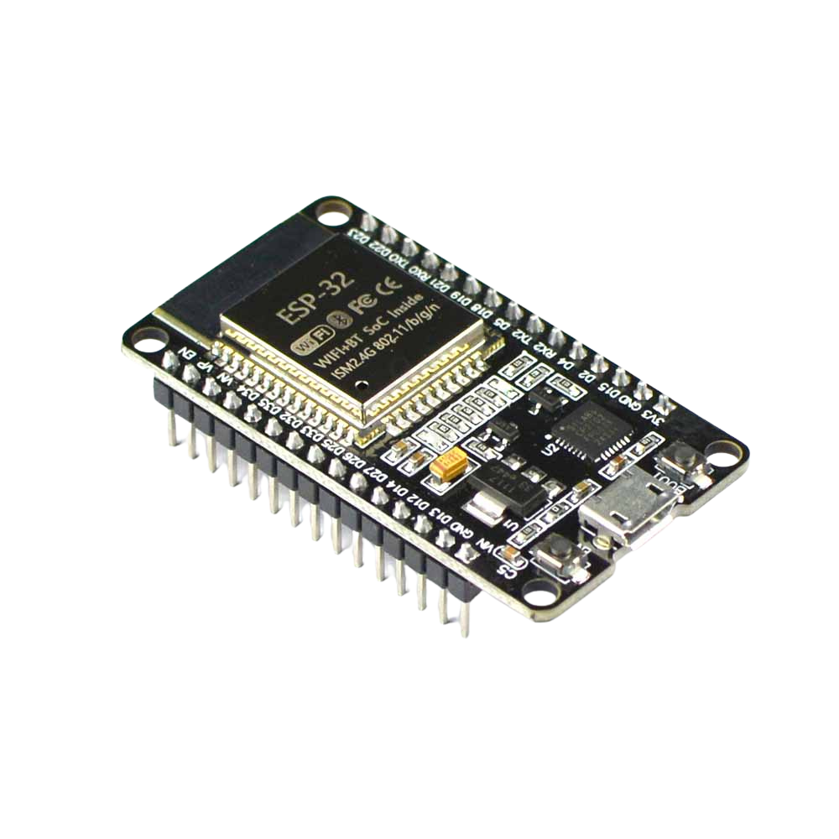
NodeMCU ESP-32
NodeMCU is a low-cost, open-source IoT platform based on the ESP8266 Wi-Fi module. It allows easy programming with Arduino IDE and supports wireless communication for smart applications.
Specification
Microcontroller : ESP-32 (32-bit, Dual-Core CPU)
Operating Voltage : 3.3V
Clock Speed : 240 MHz
Flash Memory : 4MB
Wi-Fi : 802.11 b/g/n with built-in TCP/IP stack
Bluetooth : V4.2 (Classic + BLE)
GPIO Pins : 34 digital I/O, 18 ADC (12bit)
6
Bogura Polytechnic Institute

Slide 9
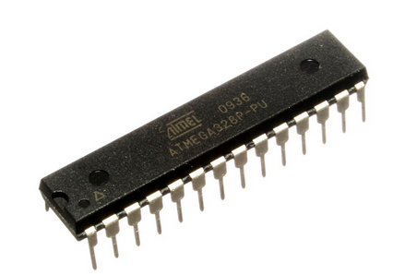
Atmega 328p
The ATmega328P is a low-power 8-bit microcontroller widely used in embedded and IoT applications. It efficiently controls sensors, actuators, and communication modules and is easy to program, making it suitable for real-time control systems.
Specification
Microcontroller : ATmega328P (8-bit AVR RISC)
Operating Voltage : 5V
Clock Frequency : 16 MHz
GPIO Pins : 20 programmable I/O pins
7
Bogura Polytechnic Institute

Slide 10
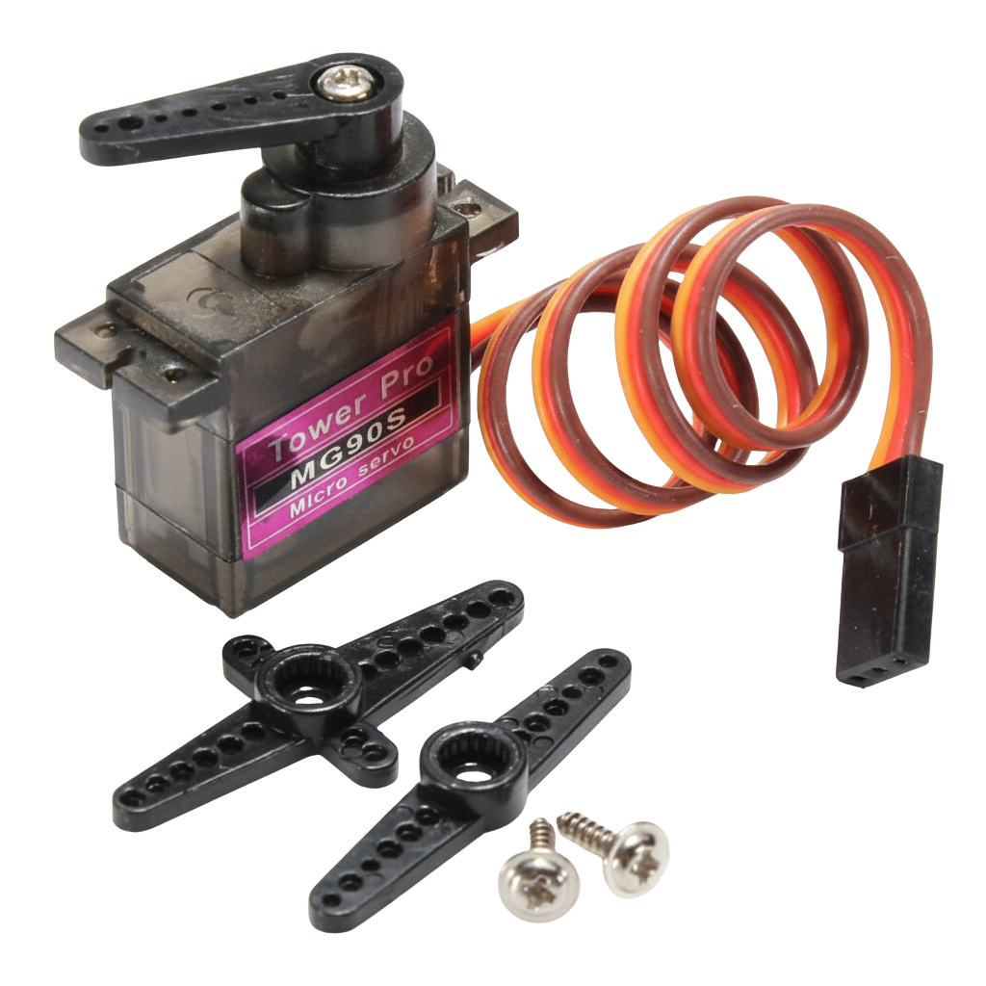
Servo Motor
A servo motor precisely controls angular position using control signals. It’s commonly used in solar trackers to adjust panel angles, offering smooth, accurate movement powered by DC voltage and controlled via pulse-width modulation for efficient and reliable operation.
Specification
Operating Voltage : +5V typically
Torque : 1.4kg/cm
Operating speed : 0.1s/60°
Gear Type : Metal
Rotation : 0°-180°
8
Bogura Polytechnic Institute

Slide 11
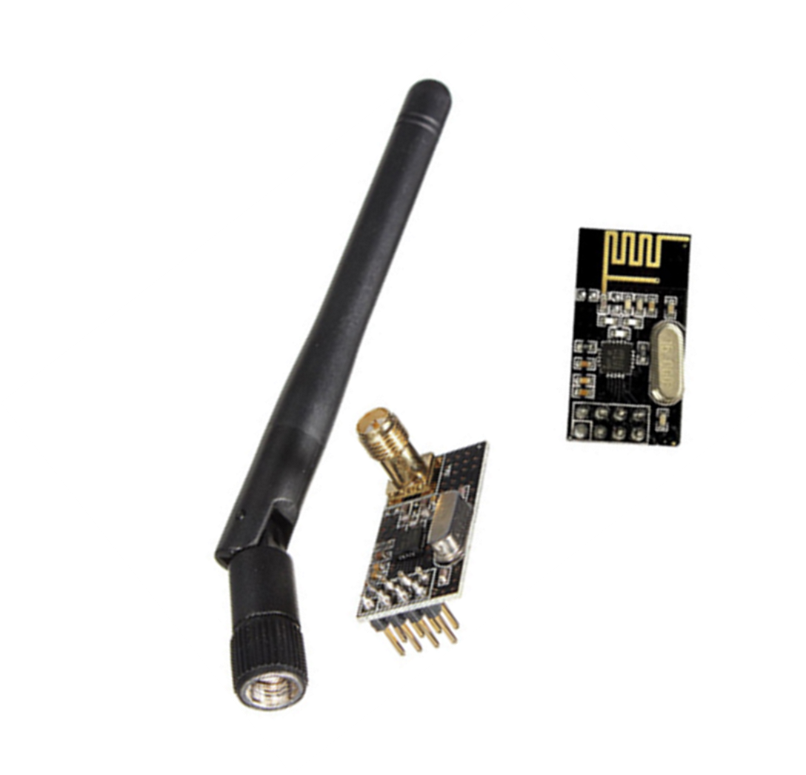
NRF 24L01
The NRF24L01 is a low-power 2.4 GHz wireless transceiver used for short-range communication, enabling fast, reliable data transfer between microcontrollers in IoT and robotic applications.
Specification
Module : NRF24L01
Operating Frequency : 2.4 GHz ISM band
Operating Voltage : 1.9–3.6 V
Data Rate : 250 kbps, 1 Mbps, 2 Mbps
Communication Interface : SPI
Range : Up to 100 m (line of sight)
9
Bogura Polytechnic Institute

Slide 12
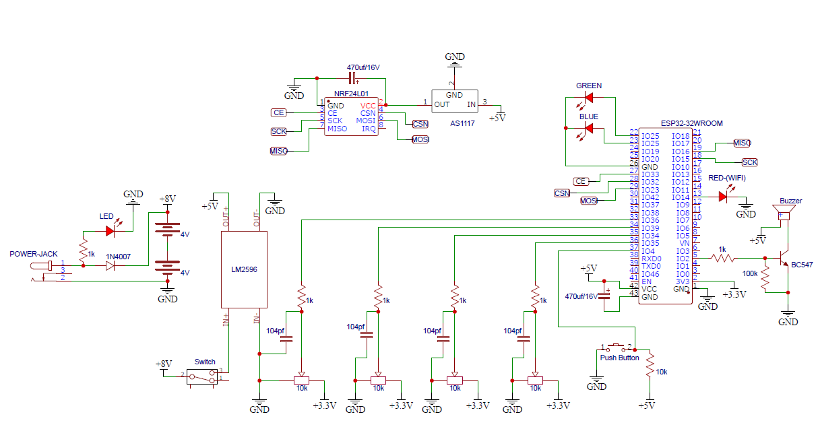
Circuit Diagram Transmission Section
10
Bogura Polytechnic Institute

Slide 13
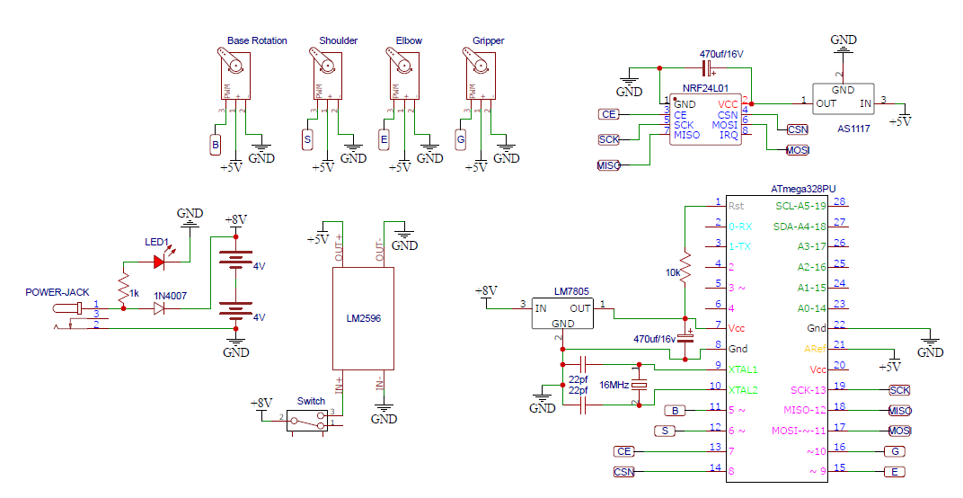
Circuit Diagram Receiver Section
11
Bogura Polytechnic Institute

Slide 14
Application
Industrial object handling.
Educational and training purposes.
Hazardous environment operations.
Medical assistance (basic level).
Research and development projects.
12
Bogura Polytechnic Institute

Slide 15
Advantage
Reduces human effort.
Improves safety.
Flexible movement.
Affordable design.
Simple construction and maintenance.
13
Bogura Polytechnic Institute

Slide 16
Features of the System
Wireless operation.
Easy to control.
Low power consumption.
Low cost.
Compact and portable design.
Accurate object manipulation.
14
Bogura Polytechnic Institute

Slide 17
Limitation
Limited load carrying capacity.
Short wireless range.
Not suitable for heavy industrial work.
Accuracy depends on servo quality.
15
Bogura Polytechnic Institute

Slide 18
Future Scope
Increase load capacity.
Add camera for visual monitoring.
Improve wireless range.
Use AI for automatic control.
16
Bogura Polytechnic Institute

Slide 19
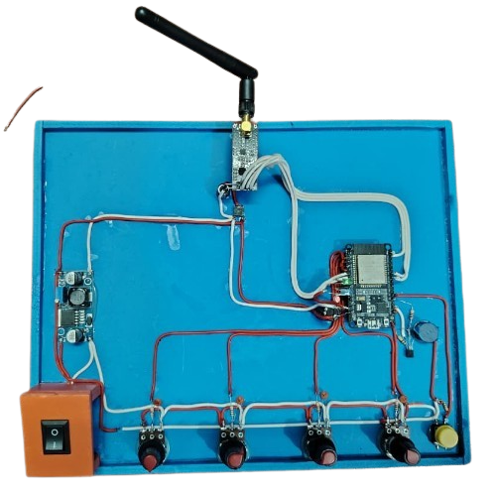
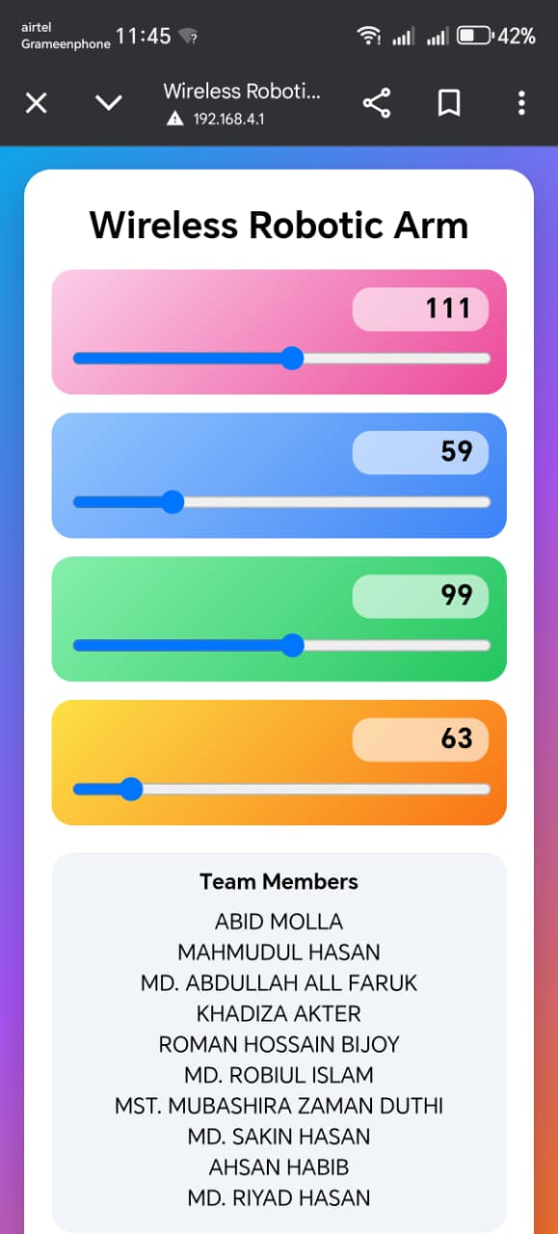
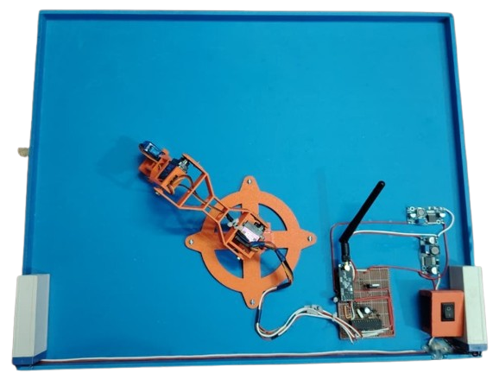
Complete Hardware Setup
Fig:2:Receiver Section
Fig:1:Transmission Section
Fig:3:Mobile Control
17
Bogura Polytechnic Institute

Slide 20
Conclusion
The project successfully demonstrates a wireless robotic arm. It performs precise object manipulation. Suitable for industrial and educational use. The system is cost-effective and reliable. This project enhances practical engineering skills
18
Bogura Polytechnic Institute

Slide 21
THANK YOU

