Slide 1







Fusion of Selection Parameters for Customer Behavior Prediction Based on Web Usage Mining (1570615223)
# 47329 Communication Systems, Computing & IT Applications, 3-4 April 2020
Snehal Kulkarni , Varsha Nagpurkar
Caroline Lopes,Avril Lopes
Riya Dodthi

Slide 2
Content
Introduction
Problem Statement
Proposed Solution
Literature
Work Flow of the system
Algorithm with Implementation details
Experimental Set Up
Data Set
Performance Evaluation Parameters
Validation with Test Cases
Results & Discussion
Conclusion
References

Slide 3
Introduction
With the expeditious growth of e-commerce or the web-based marketing system, the Internet has become the most important media for understanding consumers. Marketing managers seek to gain significant insights on consumers’ web navigation behavior allowing them to identify the most important visitors and hence derive customized marketing strategies. Hence such a methodology that allows the analysis of web data and deduction of insights would be invaluable.

Slide 4

Problem Definition
In a regular retail shop the behavior of customers may yield a lot to the shop assistant. However, when it comes to online shopping it is not possible to see and analyze customer behavior such as facial mimics, products they check or touch etc. In this case, clickstreams or the mouse movements of e-customers may provide some hints about their buying behavior. The model we present predicts whether customers will or will not buy their items added to shopping baskets on a digital marketplace.

Slide 5
Work Flow of the system
Fig 1. Block Diagram.
MSE/RMSE

Slide 6
Proposed Solution
Clickstream is a record of a user’s activity on the internet; these mouse clicks a user makes when he or she is surfing may tell us a lot about the behaviour of the user if it is analyzed in an appropriate way.
Before starting a web farming, web mining or clickstream analysis, analysts need to build a model with a proper data warehouse. The data warehouse will be in the heart of a web mining model.
We will be using artificial neural networks model.
Neural networks learn through input, a set of hidden layers and an output layer.

Slide 7
Literature
Markov model is assumed to be a probability model by which users’ browsing behaviors can be predicted at category level.[2]
Bayesian statistics can also be applied to present and infer users’ browsing behaviors at webpage level.[2]
For learning, decision tree and artificial neural network algorithms have been used. [1]
The algorithms used are C4.5 and SPRINT (Scalable Parallelizable Induction of Decision Trees). [1]
With high accuracy values Artificial Neural Network works well for predicting customer behavior. [1]

Slide 8
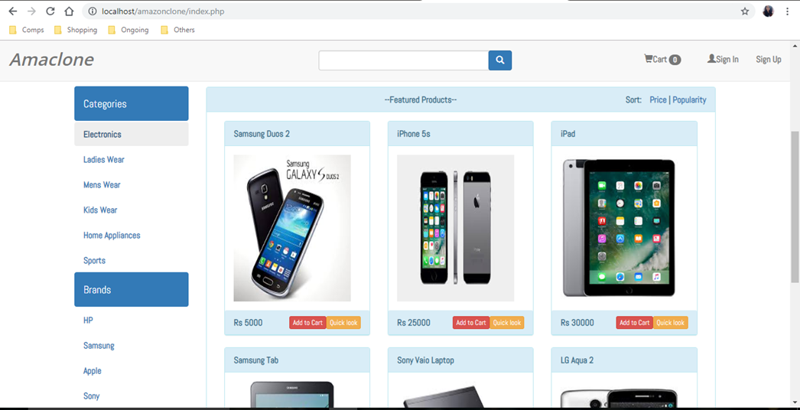
Implementation Steps
An ecommerce website was created to collect data.

Slide 9
Algorithm with Implementation Details
Implementation steps:
(Performed)
An ecommerce website was created to collect data.
Hosted the website using ngrok without port forwarding.
Created all the tables and codes needed to collect the datasets.
Shared the website link to collect clickstream data.
The collected data was pre-processed to fit the decided ranges.
The pre-processed data was normalized.

Slide 10
Algorithm with Implementation Details
Implementation steps:
Data validation will be performed on the dataset.
BPNN algorithm will be used to do prediction.
Validation will be done for the predicted result.
The result can be used for marketing strategies for the website.

Slide 11
Algorithm with Implementation Details
BPNN-
BPNN is a supervised algorithm in which error difference between the desired output and calculated output is back propagated.
The procedure is repeated during learning to minimize the error by adjusting the weights through the back propagation of error.

Slide 12
Algorithm with Implementation Details
Learning in BPNN is a two step process:
Step 1 (Forward Propagation): In this step, depending upon the inputs and current weights, outputs are calculated.
Step 2 (Backward Propagation of Error): During this step, error is calculated by difference between the targeted output and actual output of each output unit.
This error is back propagated to the previous layer that is hidden layer. Forward and backward steps are repeated until the error is minimized up to the expected level.

Slide 13
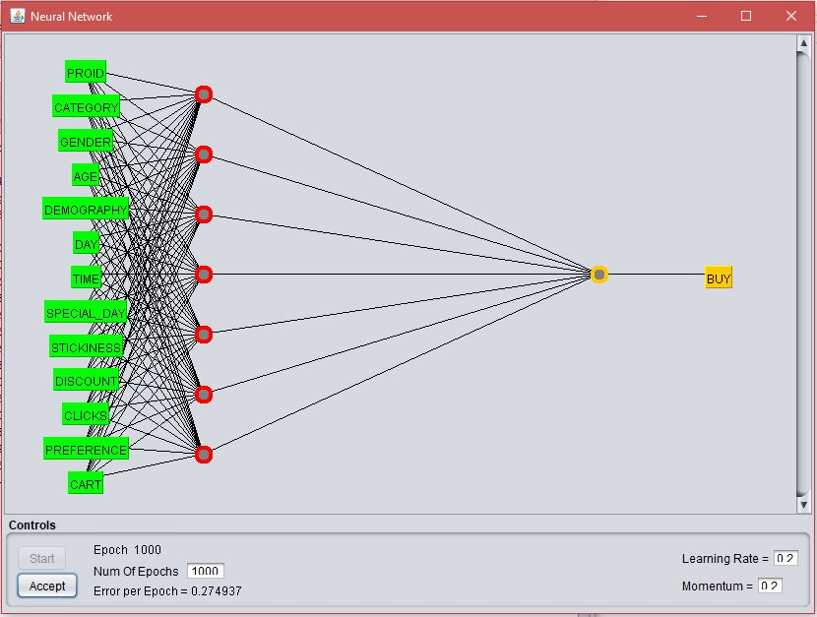
Algorithm with Implementation Details
Fig 1. BPNN Architecture.

Slide 14
Experimental Setup
Input Parameters (With Linguistic variables used )for prediction-
Amount of clicks :- <2 (0-Low), >=2&<6 (1-Average), >=6 (2-High)
Category :- Makeup(0), Clothing(1), Footwear(2)
Product preference :- High(0), Medium(1), Low(2)
Stickiness:- High(2) , Medium(1) , Low(0)
Discounted item :- Yes(1) , No(0)
Special day :- Yes(1) , No(0)

Slide 15
Experimental Setup
Parameters used for prediction-
Day of the week :- Week day(0), Week end(1)
Period of the day :- 12am-12pm(1-Morning), 12pm-4pm(2-Afternoon), 4pm-8pm(3-Evening), 8pm-12am(4-Night)
Cart :- Yes(1) , No(0)
Gender :- Male(0) , Female(1)
Age :- 14-18 (0), 19-35(1) , 35 and above(2)
Demography :- Urban(1), Rural(0)

Slide 16
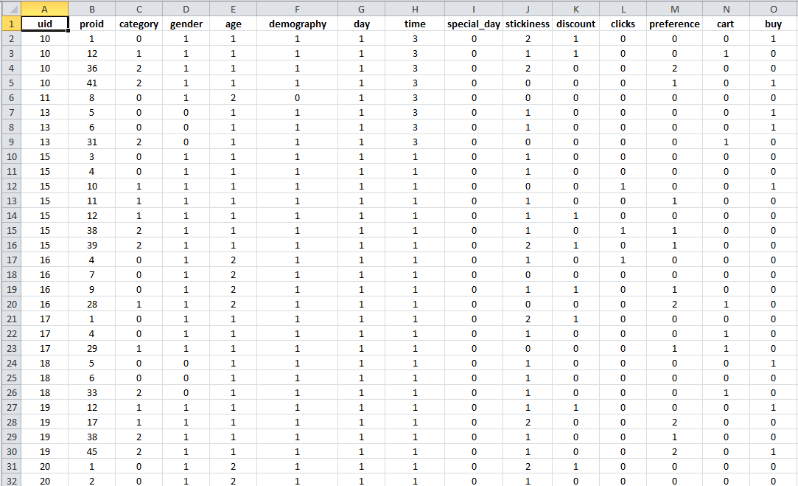
Experimental Setup
Fig 2. Sample of the collected data.

Slide 17
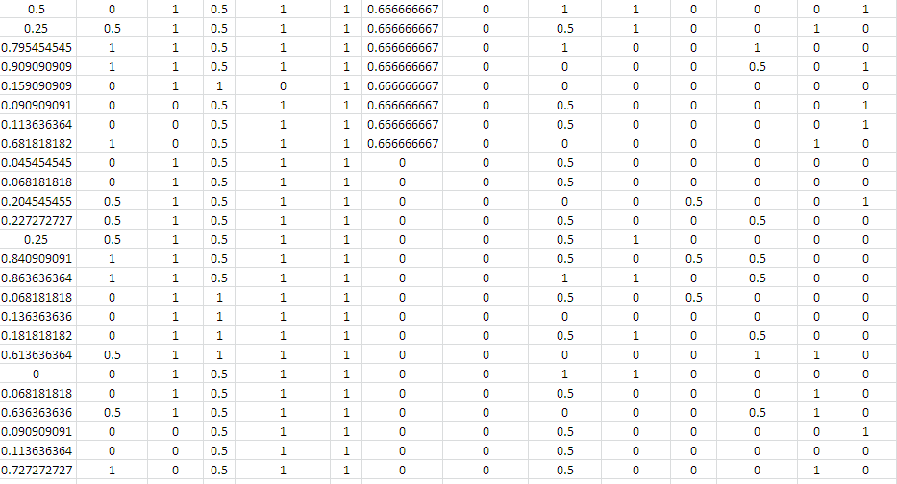
Experimental Setup
Fig 3. Sample of the normalized data.

Slide 18
Validation with Test Cases
Validation will be done using:-
ANOVA(Analysis Of Covariance)
K-Fold Cross Validation
Evaluation on Training, Testing and Checking Errors.
MSE (Mean Square Error, actual output vs. predicted output)

Slide 19
Results and Discussions
Analysis Of Covariance
Parameter | Result (Buy)
Day | 0.2498
Discount | 0.2488
Special Day | 0.2275
Time | 0.2127
Gender | 0.1875
Category | 0.1678
Demography | 0.1444
Stickiness | 0.1148
Prodid | 0.1051
Clicks | 0.1047
Preference | 0.0894
Age | 0.0623
Cart | 0.0148
The result is most affected by the Day parameter.
The result is least affected by the Cart parameter.
Fig 4. Dependency of the final result on each data parameter.
Notes:
Dependency of the final result(Buy) on each data parameter

Slide 20
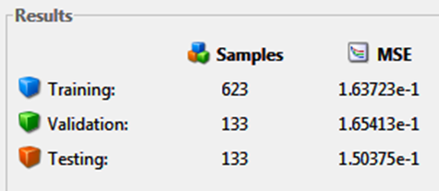
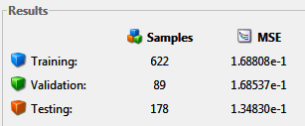
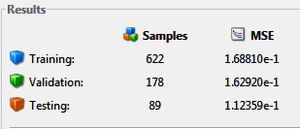
Results and Discussions
K-fold Cross Validation using nntool in Matlab
Training - 70%
Validation - 15%
Testing - 15%
Training - 70%
Validation - 10%
Testing - 20%
Training - 70%
Validation - 20%
Testing - 10%
Notes:
This combination gives the least MSE for Training

Slide 21
Results and Discussions
WEKA tool was used to do the classification.
The function Multilayer Perceptron in WEKA uses Back Propagation to classify instances.
70% of the data was used as training set.
30% of the data was used for testing on the trained model.
The prediction was obtained in the form of ‘Yes’/’No’ (whether the user will buy the product or not) .

Slide 22
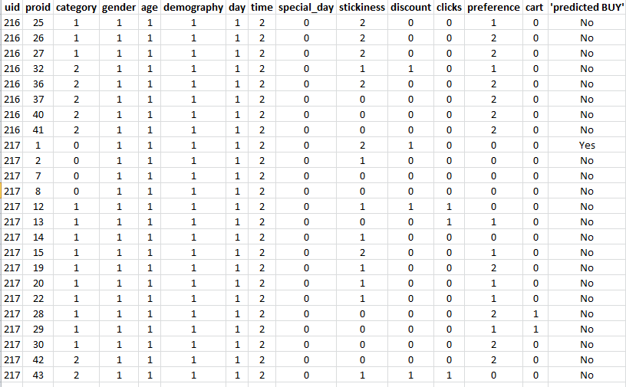
Results and Discussions
Prediction obtained using WEKA

Slide 23
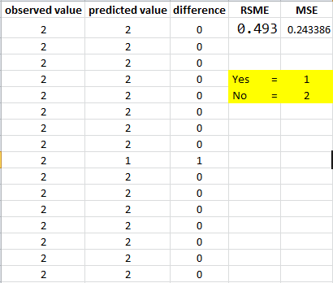
Results and Discussions
RMSE (Root Mean Square Error)

Slide 24
Conclusion
In this project, we will introduce an approach so as to predict customers’ shopping patterns from mouse movements and website logs in order to predict if a customer will buy the items he/she has added to his /her basket. Artificial Neural Networks model (BPNN) will be used to extract online customers’ behavior patterns. The prediction can be used for various marketing strategies in the website.
Based on these results ,if the customer is not buying any product even after putting it in cart ,we can attract customer by giving discounts and convert them in to punchers
.

Slide 25
References
[1] G. Sılahtaroğlu and H. Dönertaşli, "Analysis and prediction e-customers' behaviour by mining clickstream data," 2015 IEEE International Conference on Big Data (Big Data), Santa Clara, CA, 2015, pp. 1466-1472.
[2] S. Cheriyan and K. Chitra, "Web page prediction using Markov model and Bayesian statistics," 2017 Second International Conference on Electrical, Computer and Communication Technologies (ICECCT), Coimbatore, 2017, pp. 1-6.

