Slide 1
PROJECT PRESENTATION on C - GLOSSARY Language Used: C
Submitted To:
PROF. M. SYAMALA DEVI
Submitted By:
RIYA DUTTA (34174)
NAVNEET KAUR (34166)
[MCA (Morning) – I]

Slide 2
INTRODUCTION
A glossary also known as a vocabulary, is an alphabetical list of terms in a particular domain of knowledge with the definitions for those terms.
The domain of this glossary project is C programming language i.e. terms and keywords related to C programming language.
Also, the project is made using C programming language and data structures - arrays and queue.

Slide 3
ABSTRACT
The “C Glossary” is basically developed to solve programmer’s confusion and problem regarding terminologies used in “C”. Just few clicks and meaning is known.
It is a tool for referencing. Simply type the word and the basic meaning will be known to you.
If the word is typed wrong, the program will give suggestions for the correct related words.
The Glossary Project is user friendly so any person with basic knowledge can access it.

Slide 4

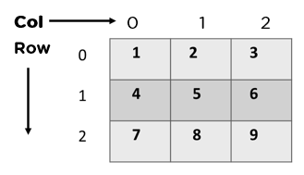
DATA STRUCTURES and CONCEPTS USED
Arrays- An array is a collection of similar data items stored at contiguous memory locations and elements can be accessed randomly using indices of an array. There are two types of arrays:
1-D Arrays :
2-D Arrays:

Slide 5
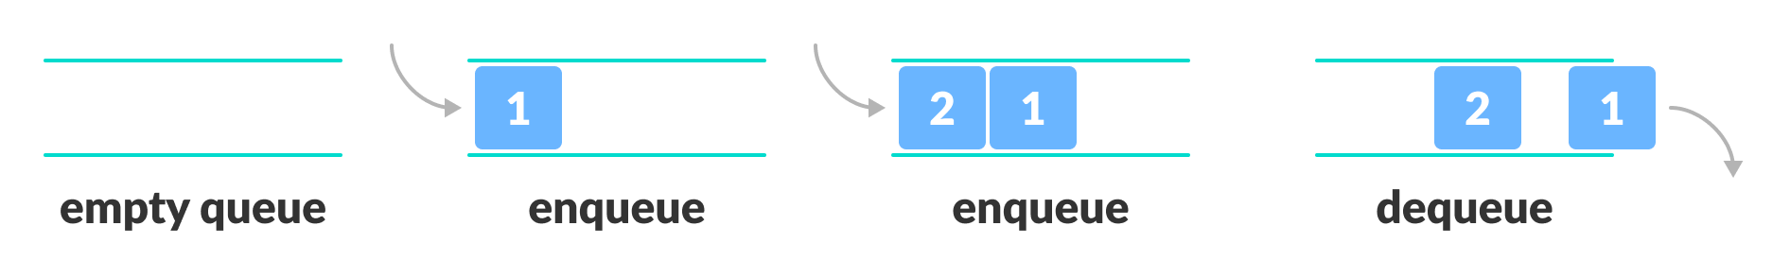
Queue- Queue is a linear data structure that follows a particular order in which the operations are performed for storing data. The order is First In First Out (FIFO). It is an ordered list in which insertions are done at one end which is known as the rear and deletions are done from the other end known as the front.

Slide 6
Structure – Structure is a user-defined data-type that enables us to store the collection of different data types. Each element of a structure is called a member. We are using a structure of array. A structure creates a data type that can be used to group items of possibly different types into a single type. Structure syntax: typedef struct dictionary { char word[30]; char mean[200]; }dict;

Slide 7
File Handling – File Handling is storing of data in a file using a program. The programs store results, and other data of the program to a file using file handling. Also, we can fetch data from a file to work with it in the program.

Slide 8
FUNCTIONS CREATED
search(char *) - to search word in the glossary.
add(char *) - to add word in the glossary.
display() - to display all the words present in the glossary.
update(char *) - to update meaning of any word in the glossary.
del(char *) - to delete word from the glossary.
search_letter(char ) - to display all words starting from a particular alphabet.
did_you_mean(char *) - to provide recommendations or related words to the user if wrong spelling of a word is entered.
recent_searches() - to display recently searched words.

Slide 9
MODULES
Print words starting from particular alphabet
Search Word
Display List
Delete Word
Add Word
Recently Searched Words
Update Word

Slide 10
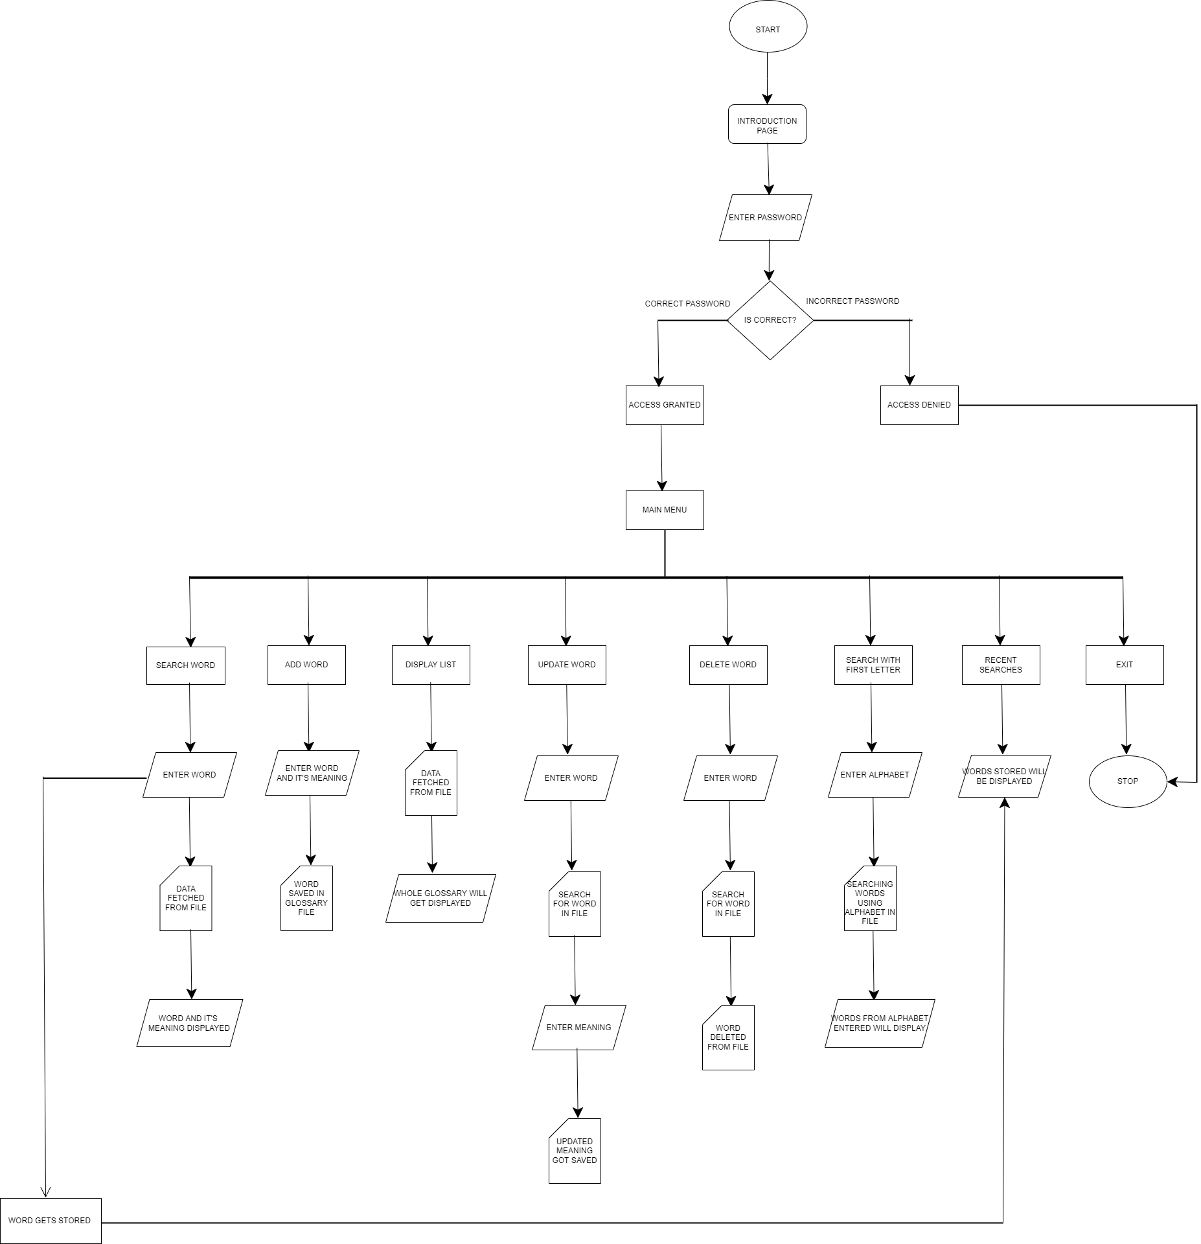
FLOWCHART

Slide 11
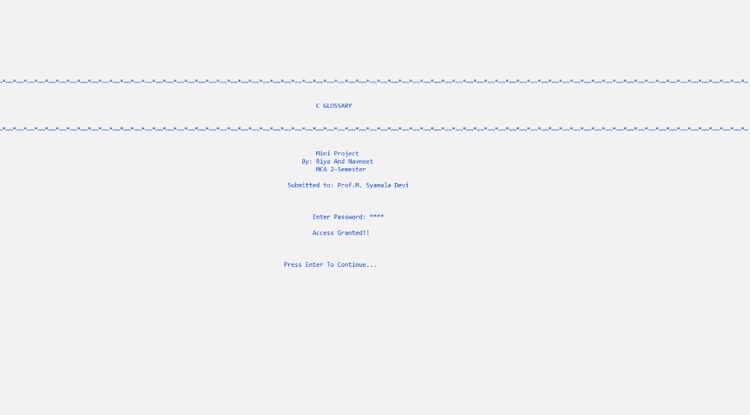

Slide 12
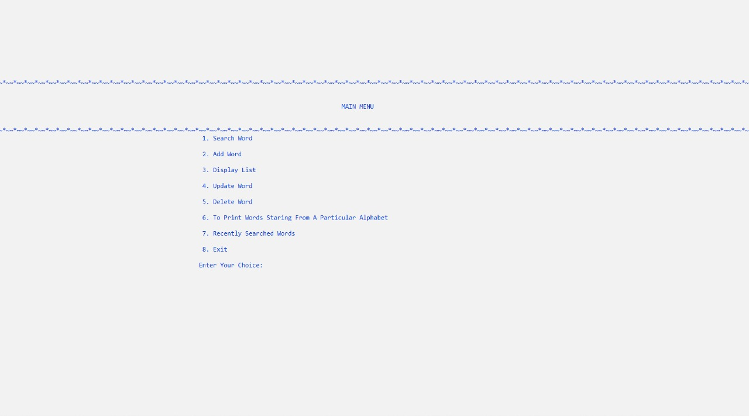

Slide 13
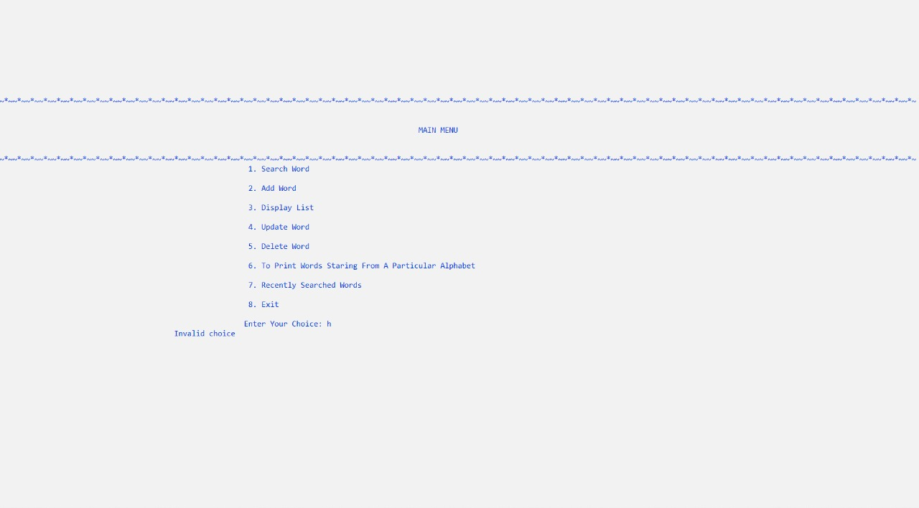

Slide 14
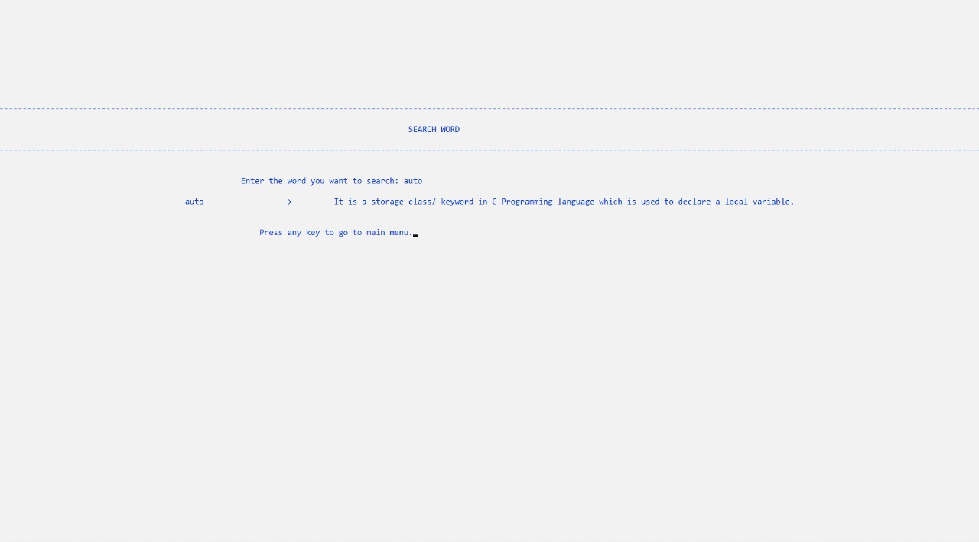
MODULE-1

Slide 15
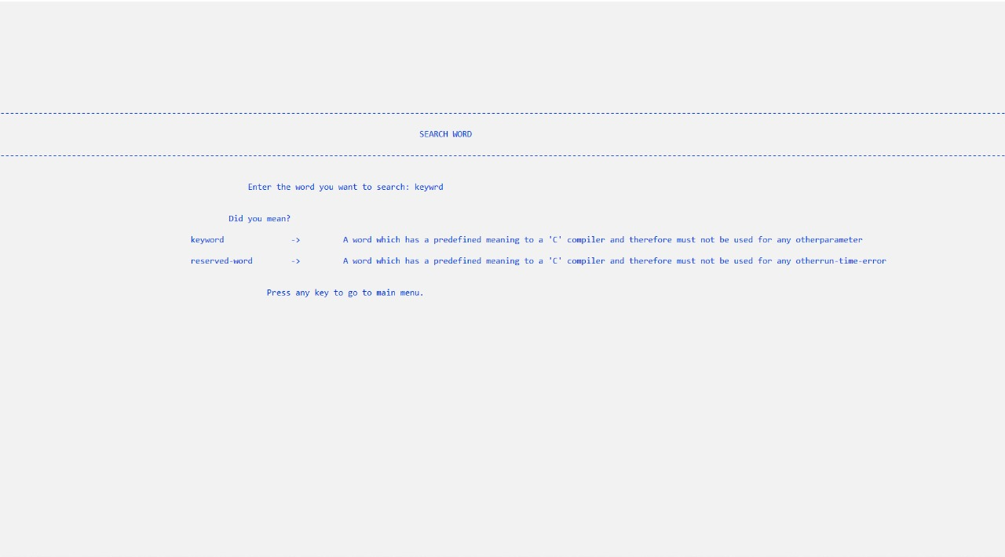

Slide 16
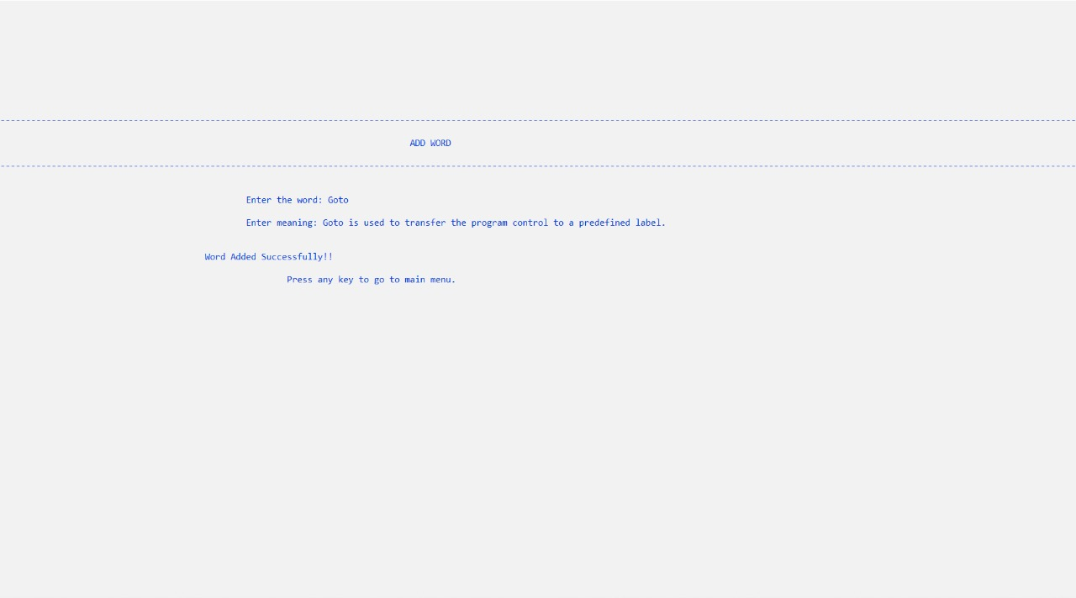
MODULE-2

Slide 17
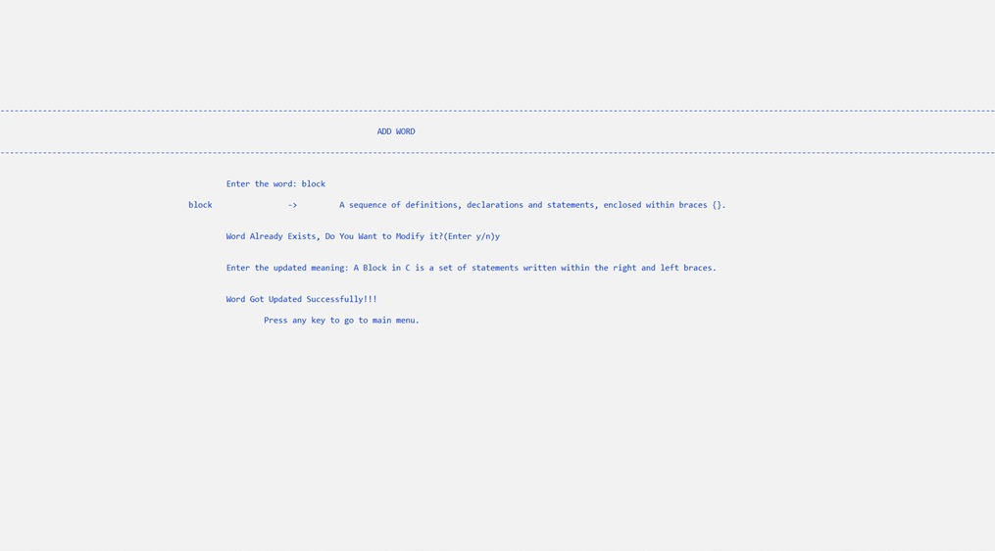

Slide 18
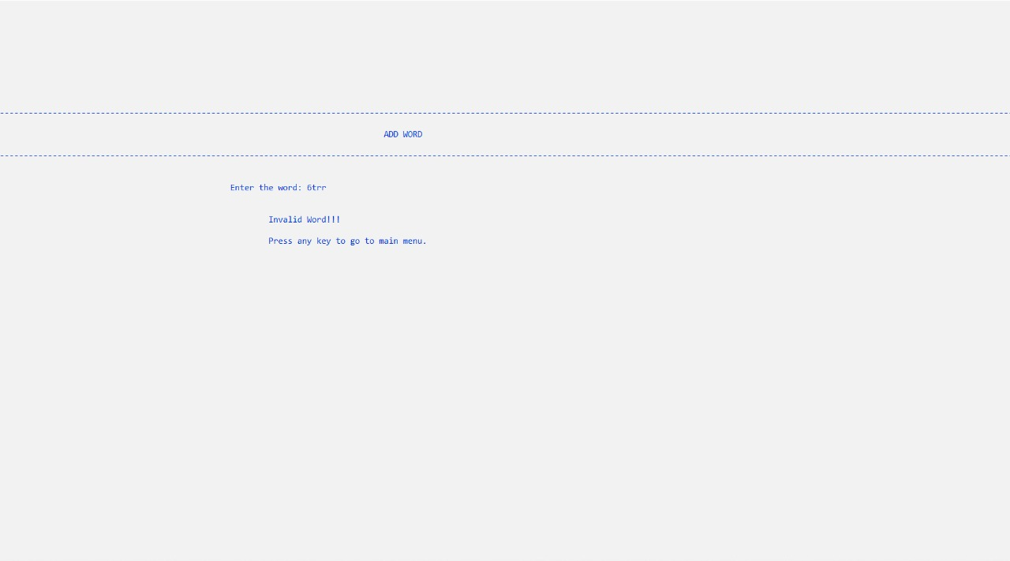

Slide 19
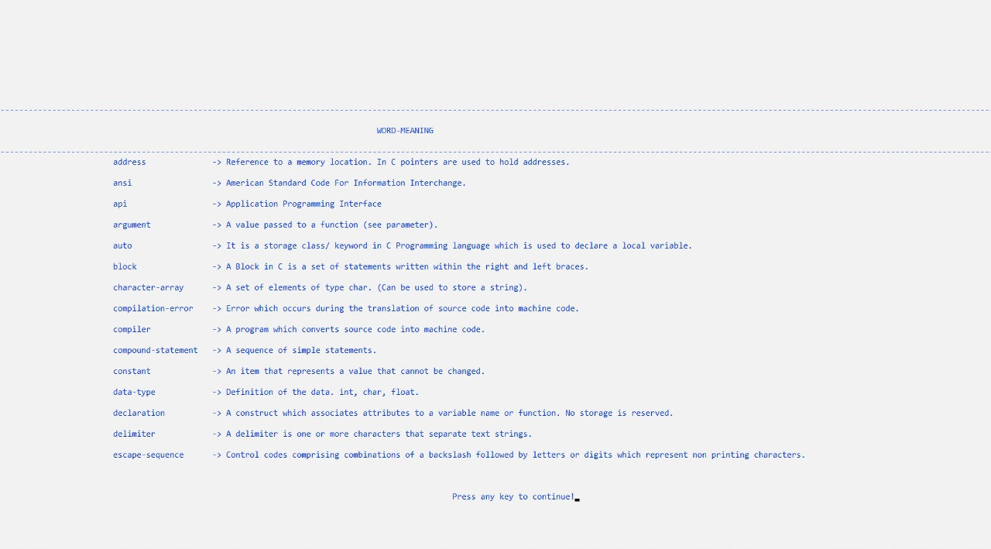
MODULE-3

Slide 20
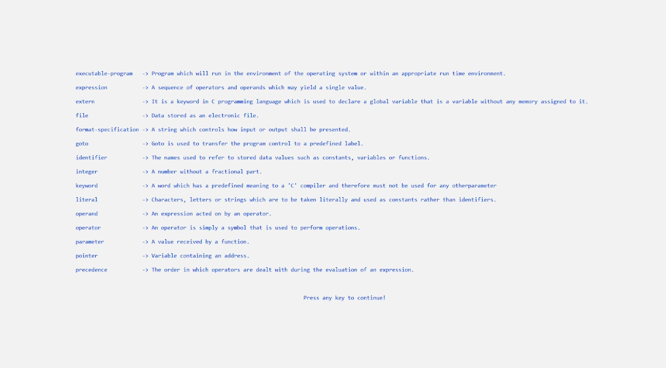

Slide 21
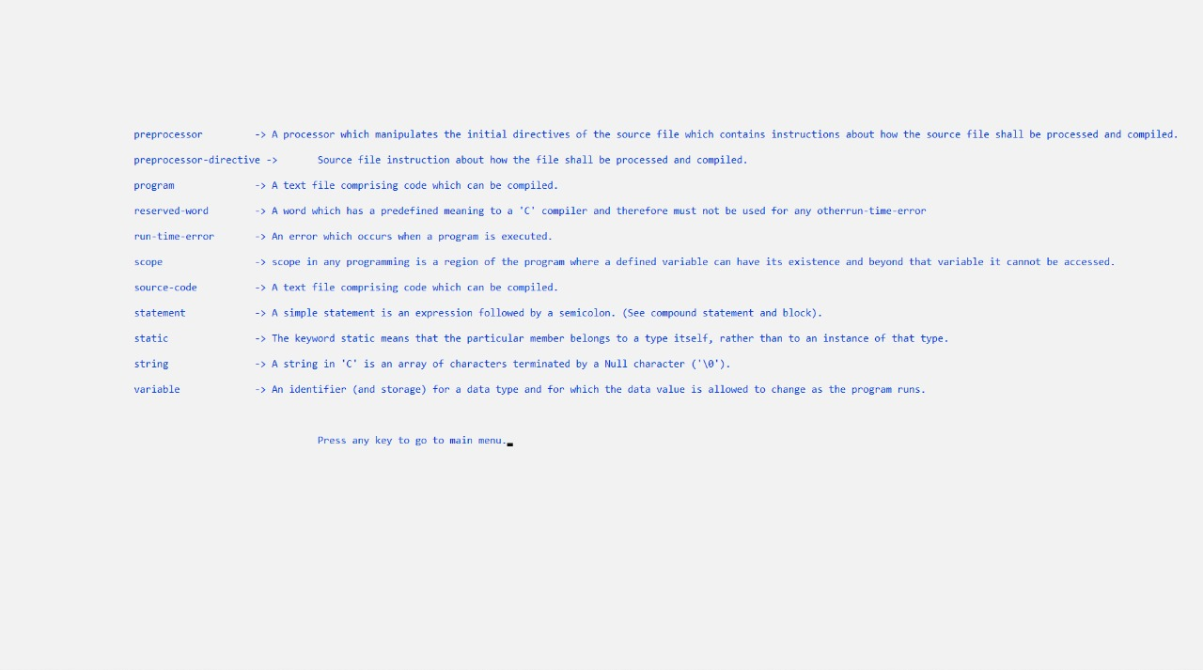

Slide 22
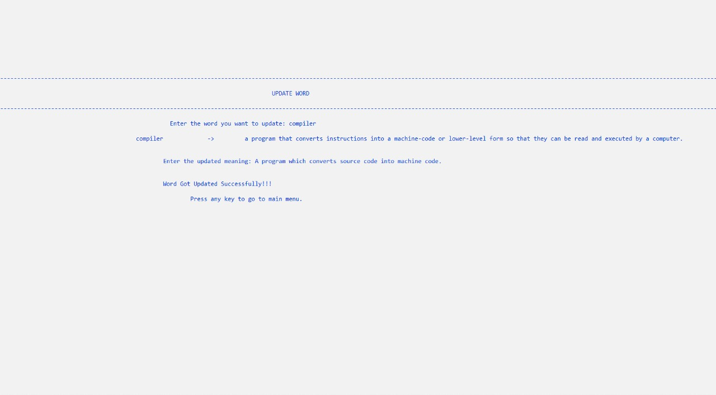
MODULE-4

Slide 23
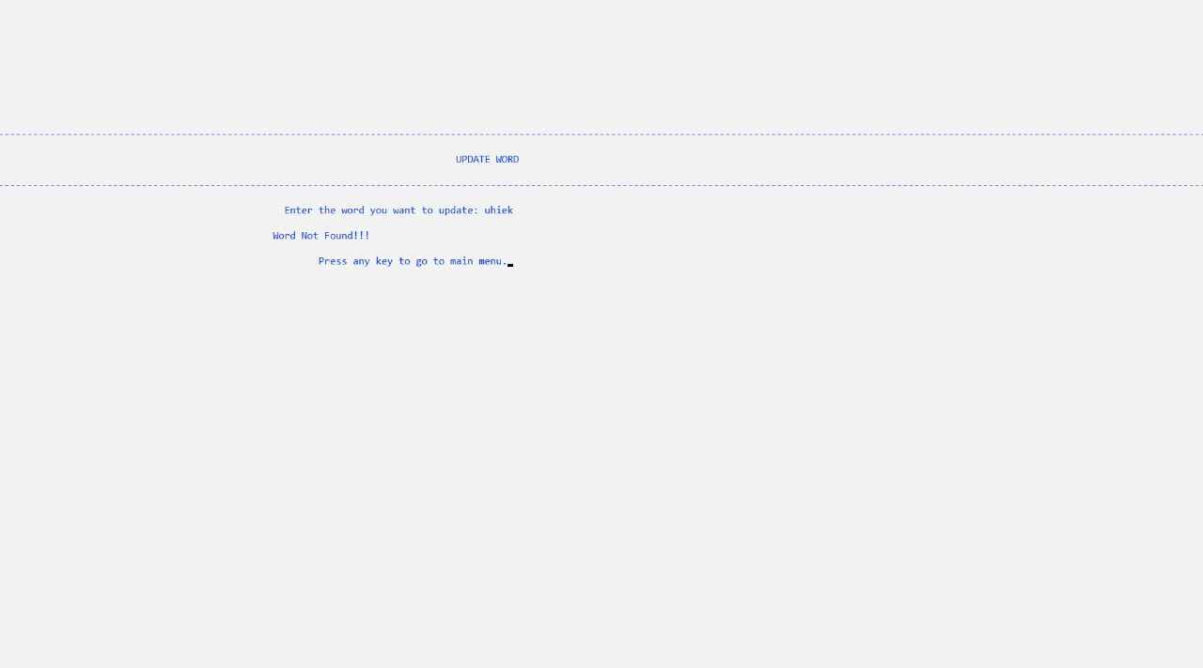

Slide 24
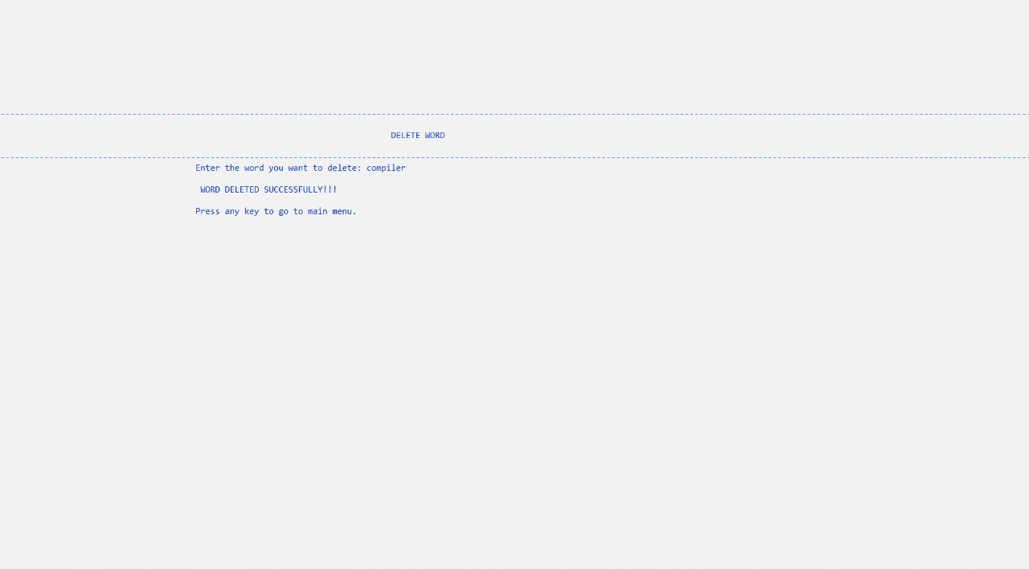
MODULE-5

Slide 25
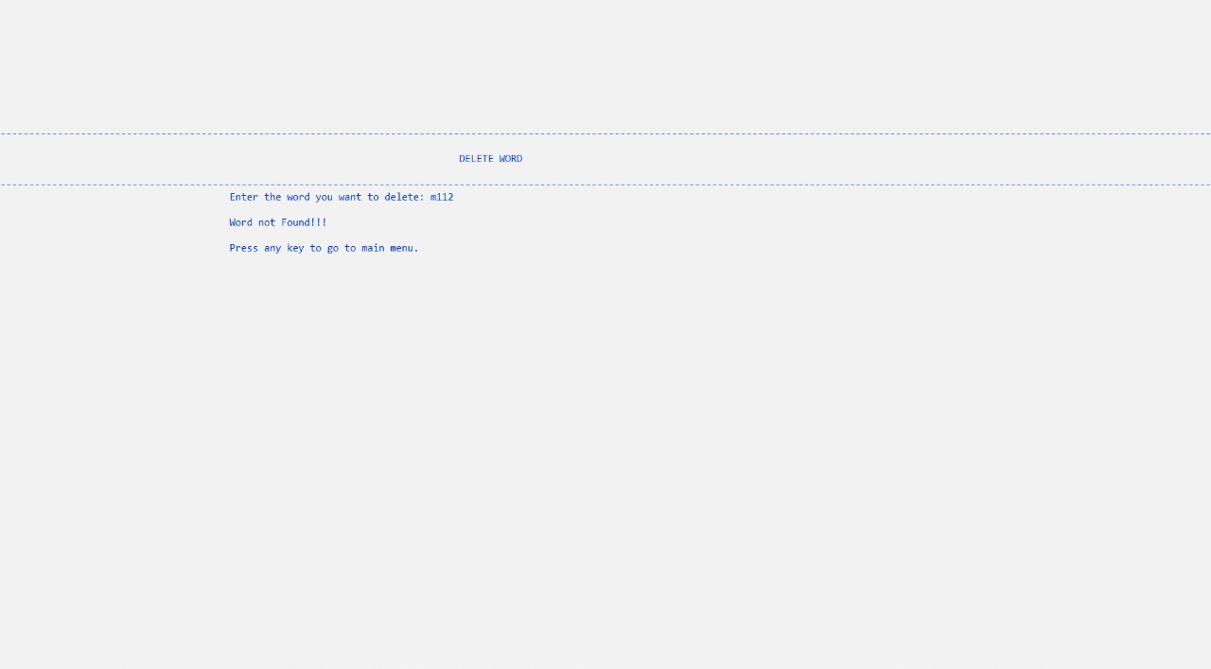

Slide 26
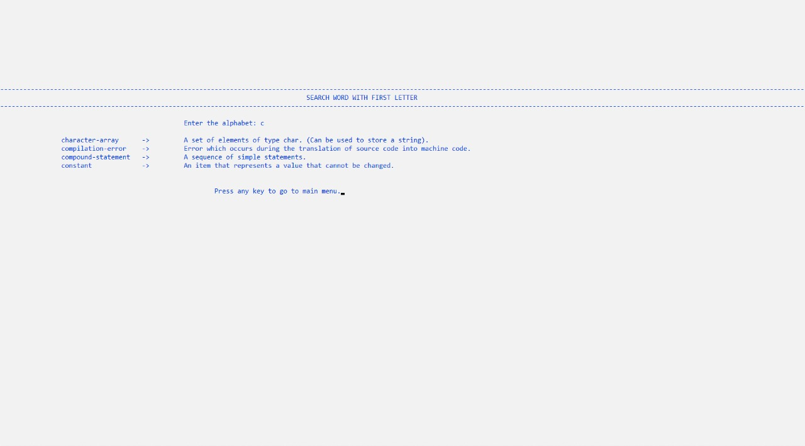
MODULE-6

Slide 27
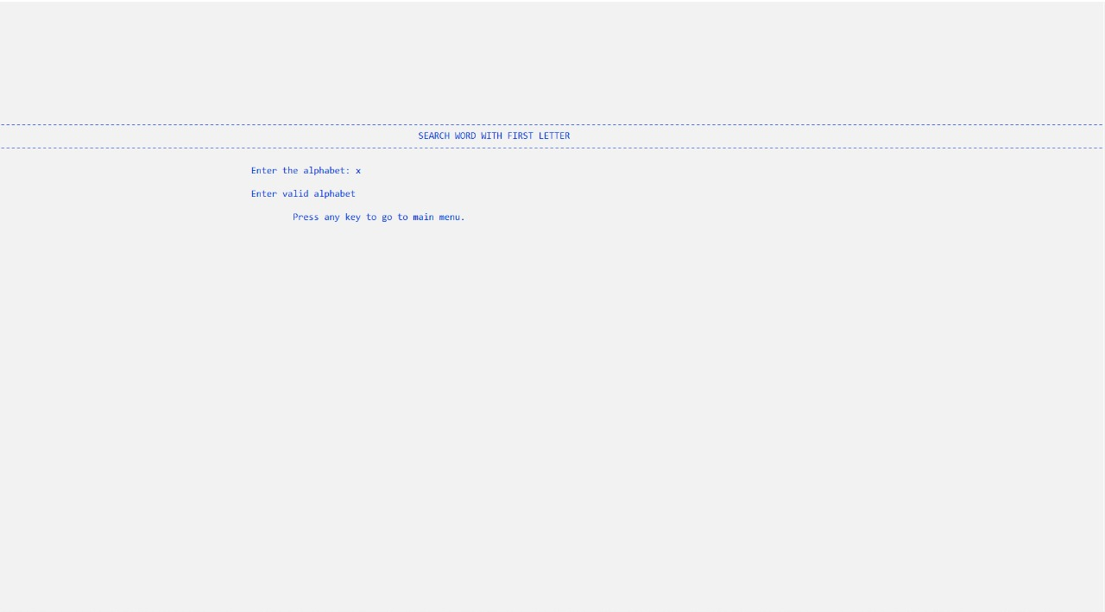

Slide 28
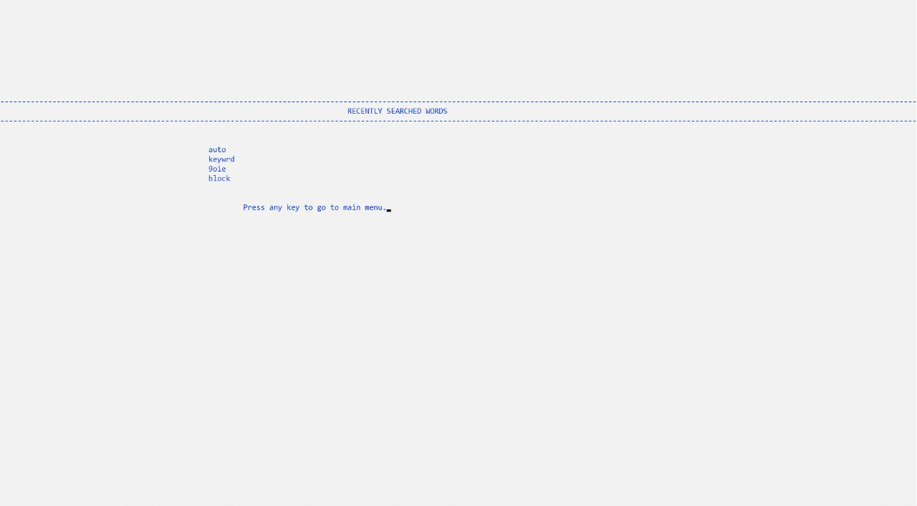
MODULE-7

Slide 29
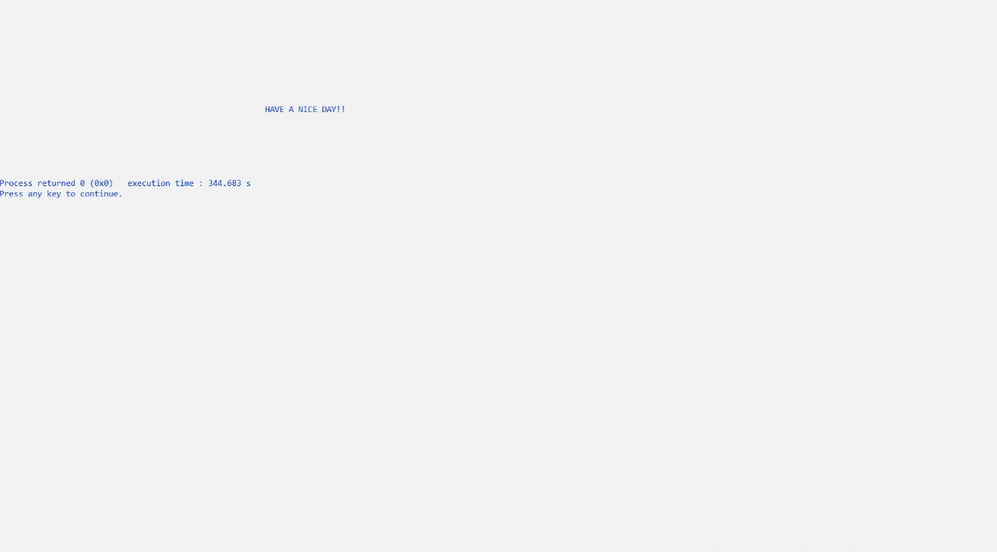

Slide 30
FUTURE SCOPE AND FURTHER ENHANCEMENT Definitively this project has been finished inside the stipulated time and the accompanying topics have illustrated: Program Strength The application is password protected, upon insertion of the password asterisks are shown in case a 3rd party might be looking at the screen. If there are huge numbers of Words, it is more quicker and simple to search word in just a few seconds. It is user friendly as it automatically suggests the similar words in case of misspelling. It also has a feature that keeps record of recently searched words. It helps searching much easier with the “search word with first letter” module, that prints all the words starting from a particular letter entered by the user. Program Enhancement The application has password upon start-up but it needs to have username as well for more security constrains. Only 1 administrator can have the access code but in future if it needs to have multiple administrators due to some reasons.

Slide 31
BIBLIOGRAPHY Let Us C by Yashwant Kanetkar Learn Programming in C by Anshuman Sharma Data Structures and Algorithms using C by R.S. Salaria https://www.tutorialspoint.com/data_structures_algorithms/dsa_queue.htm#:~:text=Queue%20is%20an%20abstract%20data,first%20will%20be%20accessed%20first

Slide 32
THANK YOU!!

